Slide 1


Slide 2




Unit
2
HEALTHY LIVING
LESSON 1: GETTING STARTED
Let’s go out!
Unit
HOBBIES

Slide 3

OBJECTIVES
By the end of the lesson, students will be able to:
Use the lexical items related to the topic Healthy living
Identify and talk about the daily activities and decide if they are good or bad for health

Slide 4
LESSON 1: GETTING STARTED
WARM-UP
Brainstorming
PRESENTATION
Vocabulary
Listen and read.
Task 1: Circle the correct answer.
Task 2: Write a word or phrase from the box under its picture.
Task 3: Complete each sentence with a word from the conversation.
PRACTICE
PRODUCTION
Task 4: Survey: Good or bad for health.
CONSOLIDATION
Wrap-up
Homework

Slide 5

LESSON 1: GETTING STARTED
WARM-UP
Brainstorming
Aims of the stage:
to create an active atmosphere in the class before the lesson
to introduce the topic

Slide 6

WARM-UP: BRAINSTORMING
HEALTH

Slide 7
How do you feel after watching the video?

Slide 8
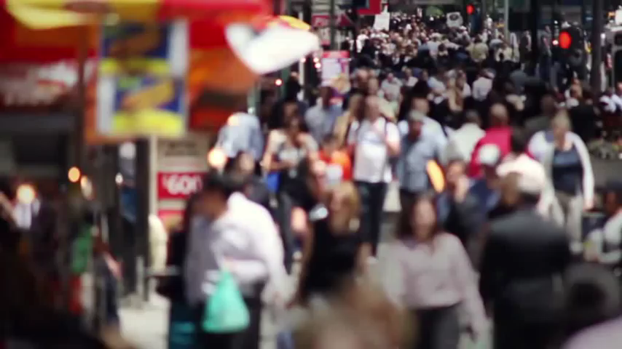

Slide 9
How do you feel after watching the video?
relaxed
stressed

Slide 10
HEALTHY LIVING

Slide 11
HOW TO BE HEALTHY?
DO EXERCISE / PLAY SPORTS
EAT A LOT OF FRUIT & VEGETABLES
GET ENOUGH SLEEP
DON’T STAY UP LATE

Slide 12

LESSON 1: GETTING STARTED
WARM-UP
Brainstorming
PRESENTATION
Vocabulary
Listen and read.
Aims of the stage:
to provide students with vocabulary
to help students prepare well for the listening and reading tasks

Slide 13


PRESENTATION
popular (a)
/ˈpɒpjələ(r)/
phổ biến, nổi tiếng

Slide 14

PRESENTATION
fresh (a)
/freʃ/
tươi, mới

Slide 15
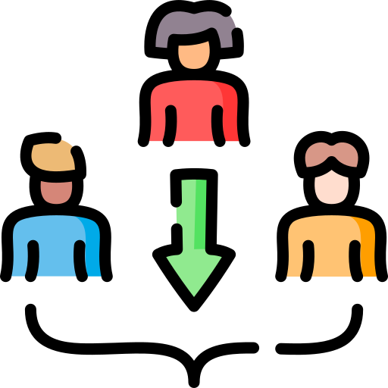
PRESENTATION
join (v)
/dʒɔɪn/
tham gia

Slide 16
PRESENTATION
New words | Pronunciation | Meaning
popular (a) | /ˈpɒpjələr/ | phổ biến, nổi tiếng
fresh (a) | /freʃ/ | tươi, mới
join (v) | /dʒɔɪn/ | tham gia

Slide 17
LESSON 1: GETTING STARTED
WARM-UP
Brainstorming
PRESENTATION
Vocabulary
Listen and read.
Aims of the stage:
to have students get to know the topic

Slide 18
1. LISTEN AND READ
Mi: This is a nice picture, Mark.
Mark: That’s my dad and I boating at Yen So Park.
Mi: It also see a lot of people exercise there.
Mark: Yes, it’s a popular place for people in my neighborhood.
Mi: Outdoor activities are good for our health. My family often goes cycling in the countryside. It’s quiet and there’s a lot of fresh air.
Mark: It sounds interesting.
Mi: Yes, it’s lots of fun. We also bring fruit, water, and a lunch box with us.
Mark: I’d love to join you next time.
Mi: Sure. Bring along a hat and suncream.
Mark: Why suncream?
Mi: It’s really hot and sunny at noon so you might get sunburn.
Mark: I see.

Slide 19
LESSON 1: GETTING STARTED
WARM-UP
Brainstorming
PRESENTATION
Vocabulary
Listen and read.
Task 1: Circle the correct answer.
Task 2: Write a word or phrase from the box under its picture.
Task 3: Complete each sentence with a word from the conversation.
PRACTICE

Slide 20

PRACTICE
2
What are Mark and Mi talking about?
A. Health problems
B. Healthy activities
C. Sports and games
…
Mark: That’s my dad and I boating at Yen So Park.
…
Mi: Outdoor activities are good for our health. My family often goes cycling in the countryside. …

Slide 21
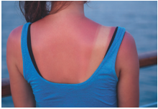
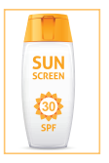
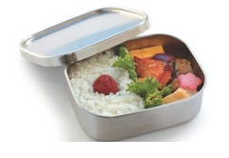
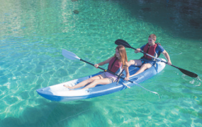
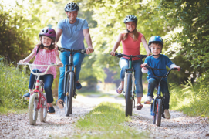
PRACTICE
3
Write a word or phrase from the box under its picture.
boating suncream lunch box sunburn cycling
1.
sunburn
2.
suncream
3.
lunch box
4.
boating
5.
cycling

Slide 22
PRACTICE
4
Complete each sentence with a word from the conversation.
1. In the picture, Mark and his father are __________.
boating
Mi: This is a nice picture, Mark.
Mark: That’s my dad and I boating at Yen So Park.
2. The people in Mark’s neighborhood love to go to the _________ .
park
Mi: It also see a lot of people exercise there.
Mark: Yes, it’s a popular place for people in my neighborhood.

Slide 23
PRACTICE
4
Complete each sentence with a word from the conversation.
3. Mi’s family often goes cycling in the ___________.
countryside
Mi: Outdoor activities are good for our health. My family often goes cycling in the countryside. It’s quiet and there’s a lot of fresh air.
4. - I don’t want to get sunburn.
- Wear a hat and use __________.
suncream
Mi: Sure. Bring along a hat and suncream.
Mark: Why suncream?
Mi: It’s really hot and sunny at noon so you might get sunburn.

Slide 24
PRACTICE
4
Complete each sentence with a word from the conversation.
5. Activity like running or cycling are good for our _________ .
health
Mi: Outdoor activities are good for our health.

Slide 25
LESSON 1: GETTING STARTED
WARM-UP
Brainstorming
PRESENTATION
Vocabulary
Listen and read.
Task 1: Circle the correct answer.
Task 2: Write a word or phrase from the box under its picture.
Task 3: Complete each sentence with a word from the conversation.
PRACTICE
PRODUCTION
Task 4: Survey: Good or bad for health.

Slide 26
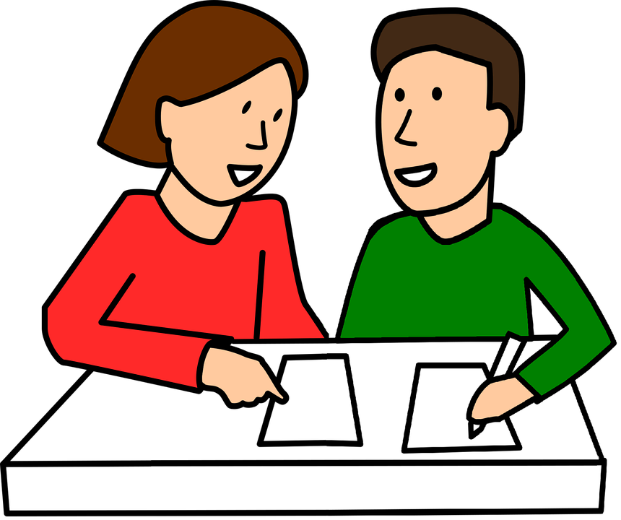
PRODUCTION
5
Game: Good/bad for health?
Work in groups of 4.
Ask and answer:
What are your daily activities?
How often do you do them?
Are they good for your health?

Slide 27
PRODUCTION
5
Game: Good/bad for health?
Example:
A: I walk to school.
B: I think it’s good for your health.
A: I rarely eat breakfast.
B: It’s not good. Breakfast is very important. It gives us energy for the day.

Slide 28
PRODUCTION
5
Game: Good/bad for health?
Daily activities | How often | Good | Bad
Walking to school | Every day | √
Eating fast food | Usually |  | √
Playing sports | Often | √
Playing video games 8 hours a day | Every day |  | √

Slide 29
LESSON 1: GETTING STARTED
WARM-UP
Brainstorming
PRESENTATION
Vocabulary
Listen and read.
Task 1: Circle the correct answer.
Task 2: Write a word or phrase from the box under its picture.
Task 3: Complete each sentence with a word from the conversation.
PRACTICE
PRODUCTION
Task 4: Survey: Good or bad for health.
CONSOLIDATION
Wrap-up
Homework

Slide 30
CONSOLIDATION
1
WRAP-UP
HEALTHY LIVING
Things to go out
Healthy activities
Topic of the unit
Vocabulary

Slide 31
CONSOLIDATION
2
HOMEWORK
Prepare for the next lesson: A closer look 1:
new words & new sounds

Slide 32

Website: hoclieu.vn
Fanpage: facebook.com/www.tienganhglobalsuccess.vn/

