Slide 2

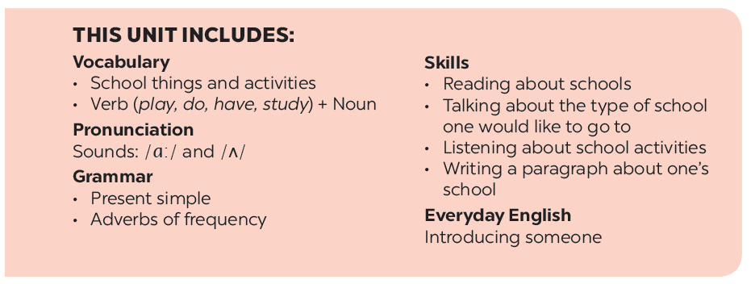

Slide 3

UNIT 1: MY NEW SCHOOL
-WARM - UP
book
School things

Slide 4
book
Eraser
ruler
School things
chalk
paper
pen
notebook
School bag

Slide 5


Objectives:
- An overview about the topic My new school.
- Vocabulary to talk about school things.

Slide 6
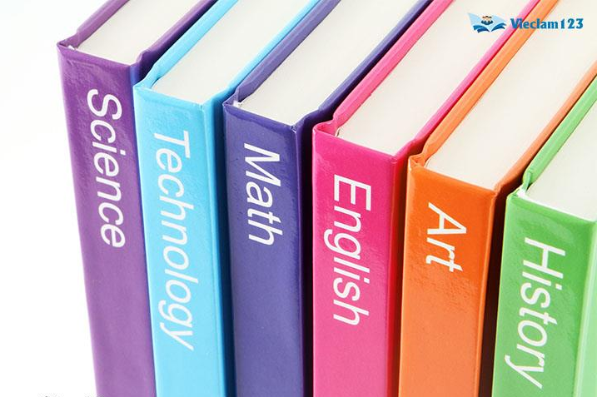

/ˈsʌbdʒekt/
subject (n)
môn học

Slide 7
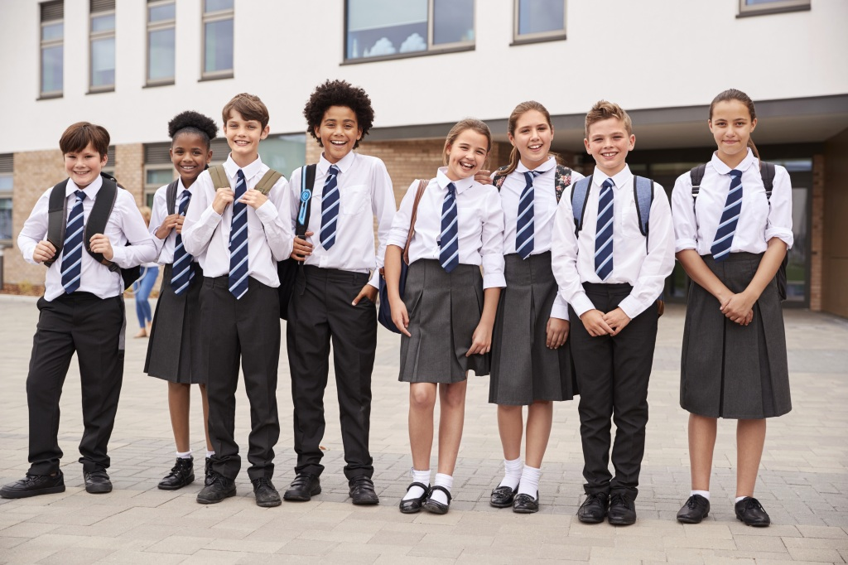
/ˈjuːnɪfɔːm/
uniform (n)
đồng phục

Slide 8
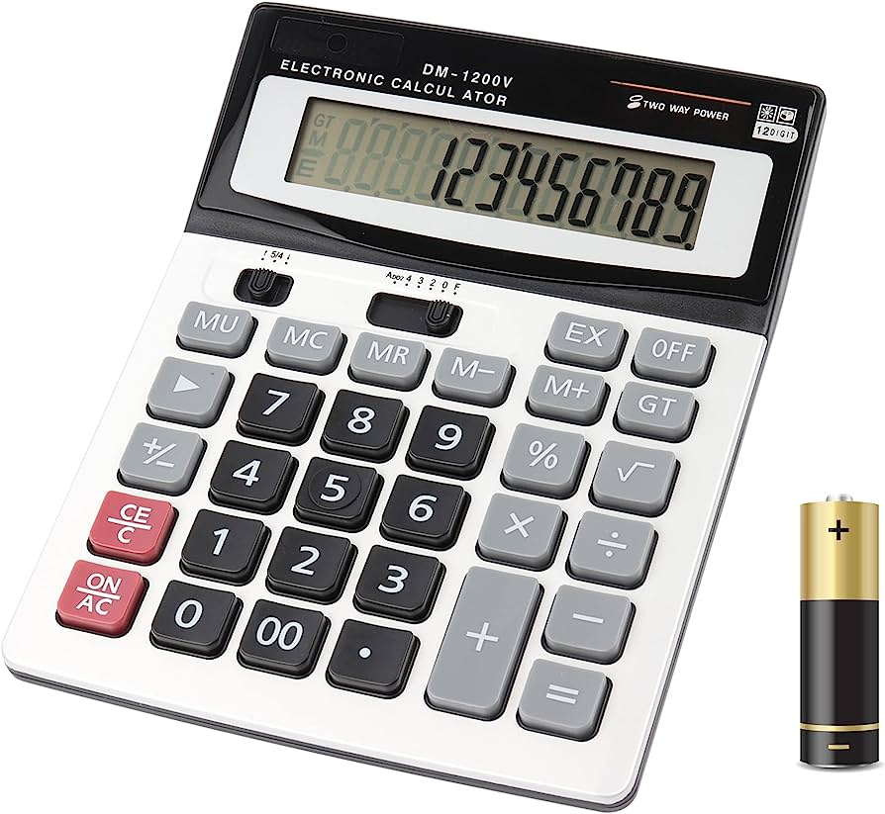
/ˈkælkjəleɪtər/
calculator (n)
máy tính
(cầm tay)

Slide 9
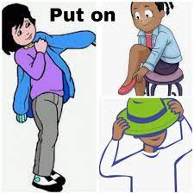
/pʊt on/
put on (phr.v)
= wear
đội, mặc

Slide 10
I. Vocabulary
1. subject (n) : môn học
2. uniform (n): đồng phục
3. calculator (n): máy tính (cầm tay)
4. put on (phr.v) = wear: đội, mặc

Slide 11
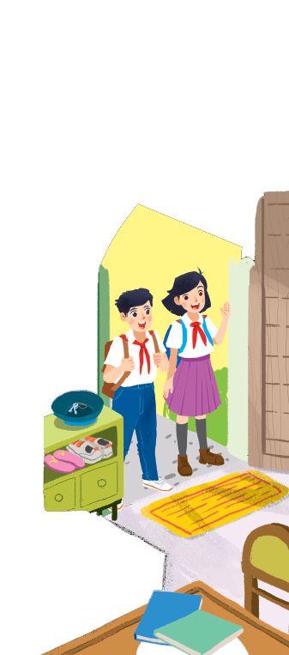
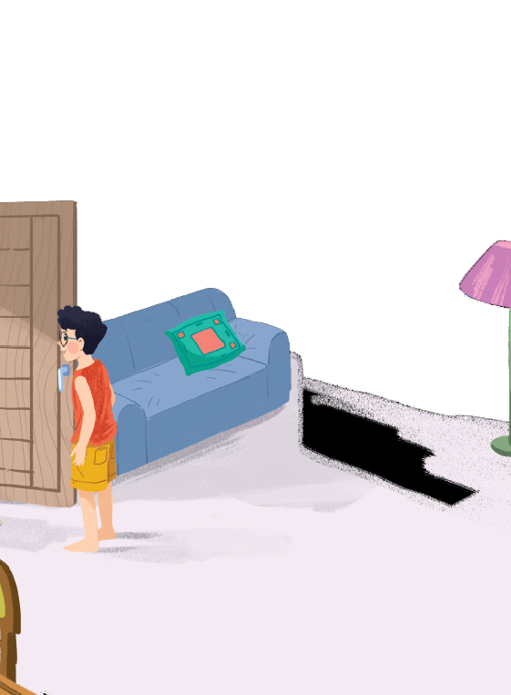


Listen and read.
A special day

Slide 12
Listen and read.
A special day
(Loud knock)
Phong: Hi, Vy.
Vy: Hi, Phong. Are you ready?
Phong: Just a minute.
Vy: Oh, this is Duy, my new friend.
Phong: Hi, Duy. Nice to meet you.
Duy: Hi, Phong. I live near here, and we go to the same school!
Phong: Good. Hmm, your school bag looks heavy.
Duy: Yes! I have new books, and we have new subjects to study.
Phong: And a new uniform, Duy! You look smart!
Duy: Thanks, Phong. We always look smart in our uniforms.
Phong: Let me put on my uniform. Then we can go.

Slide 13

Read the conversation again and tick () T (True) or F (False).
 |  | T | F
1. | Vy, Phong, and Duy go to the same school.
2. | Duy is Phong’s friend.
3. | Phong says Duy looks smart in his uniform.
4. | They have new subjects to study
5. | Phong is wearing a school uniform.
✓
✓
✓
✓
✓

Slide 14

Write ONE word from the box in each gap.
go
subjects
has
wear
uniforms
wear
1.
Students their uniforms on Monday.
has
2.
Vy a new friend, Duy.
go
3.
- Do Phong, Vy, and Duy to the same school?
- Yes, they do.
uniforms
4.
Students always look smart in their .
5.
subjects
- What do you like to study?
- I like to study English and history.

Slide 15

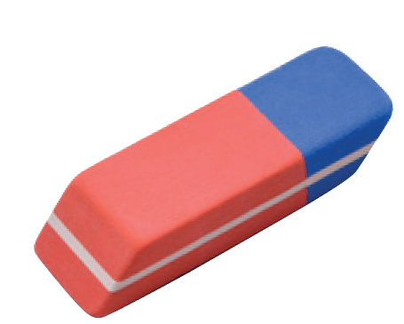
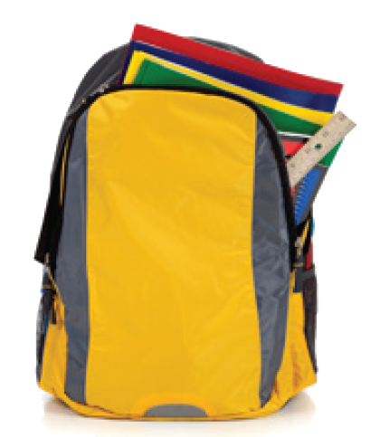
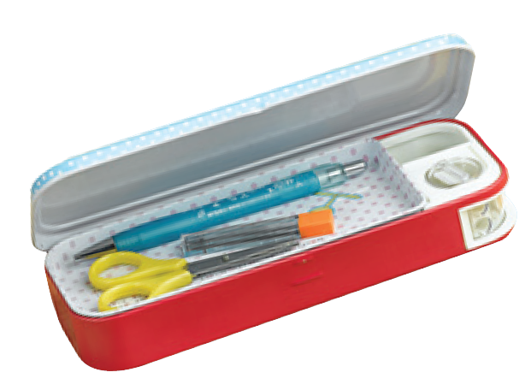
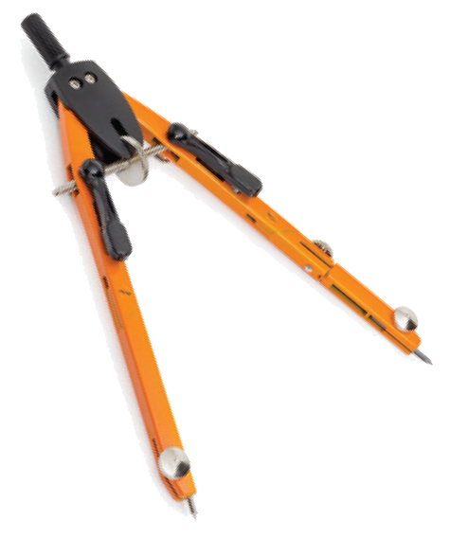
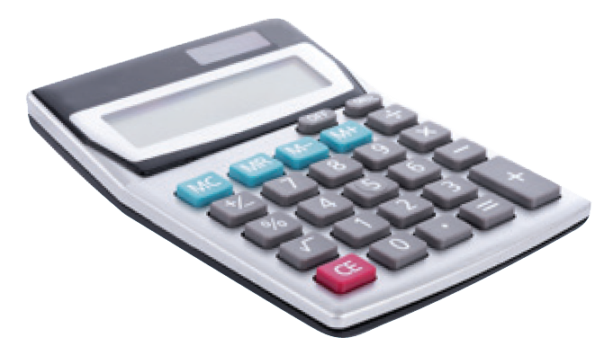
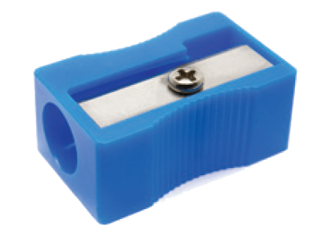
Match the word with the school things. Then listen and repeat.
pencil sharpener
4
compass
1
school bag
2
calculator
5
rubber
3
pencil case
6

Slide 16
Match the word with the school things. Then listen and repeat.
school bag
rubber
4
1
compass
pencil case
2
5
pencil sharpener
calculator
3
6

Slide 17

Look around the class. Write the names of the things you see in your notebook.
Chairs, tables, clock, school bags, board, books, pen, flower pot, pencil,…

Slide 18


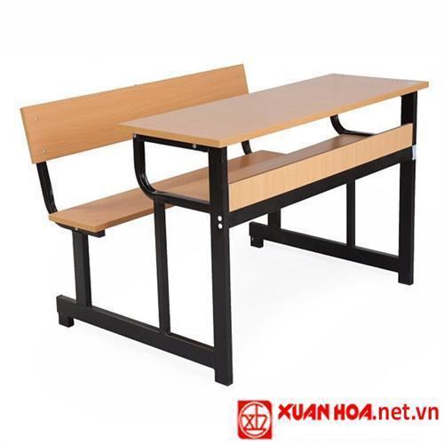
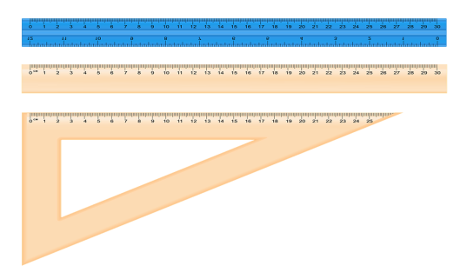
Consolidation
: Look at the pictures and say words in EL
School things

Slide 19
Wrap-up:
- Learn new words about topic New school: calculator, uniform, smart, put on, wear, compass, heavy.
- Do some vocab exercises related to the topic My new school.
What have we learnt today?

Slide 20
5. Homework
- Read again the conversation on page 6.
- Learn by heart new words.
- Do exercise 2 (page 3) in workbook.
- Prepare for the new lesson: U1- A closer look 1.

Slide 21

Goodbye
See you again!!!

