Slide 1

Warmly welcome to our class
English 6 A
Nguyen Binh Khiem Secondary School

Slide 2

WELCOME TO OUR CLASS
ENGLISH 6
Unit 4:
MY NEIGHBOURHOOD

Slide 3


Unit 4:
MY NEIGHBOURHOOD
Everyday English
An audio guide to a place
Asking for and giving directions

Slide 4
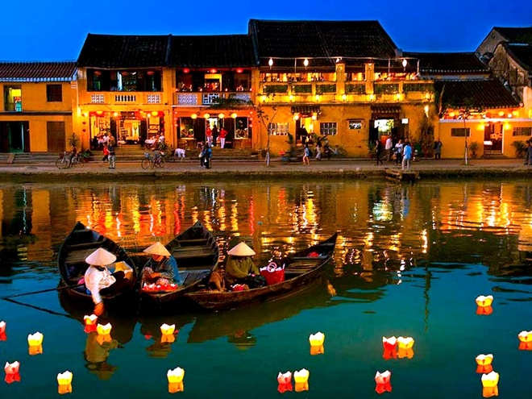
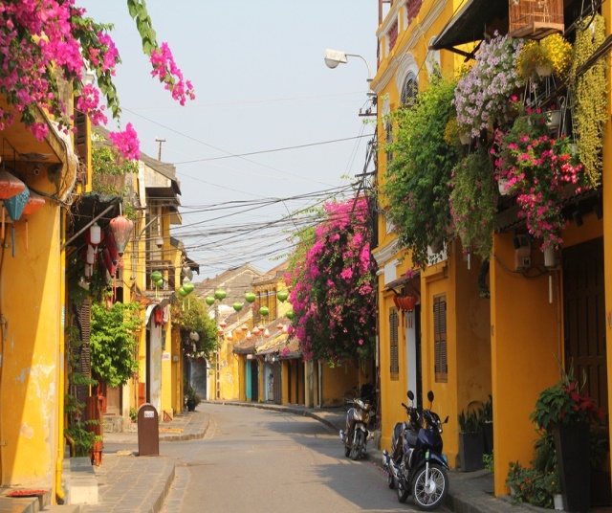
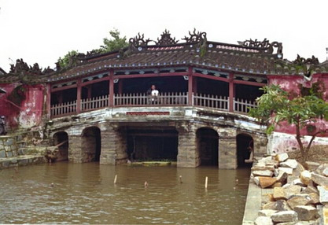
Game: Guessing game
* Which city is this?
=> Hoi An
- Have you ever been to Hoi An?
- What do you know about this place?

Slide 5


Listen and read the conversations.
A: Excuse me. Could you tell me the way to the cinema,
please?
B: Go along this street. It’s on your left.
A: Excuse me. Where’s the nearest post office, please?
B: Go out of the station. Take the first turning on the right.
Notes:
Slide này không đúng.

Slide 6

Work in pairs. Make similar conversations to ask for and give directions to places near your school.
* Example:
A: Excuse me. Could you tell me the way to Song Ve market, please?
B: Go straight and then take the second turning on the right.

Slide 7
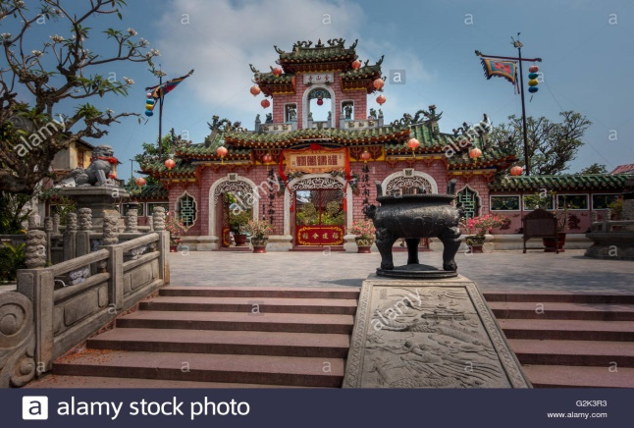
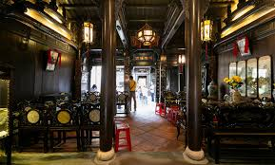
An audio guide to a place
* Listen and order of pictures’ names

Slide 8
An audio guide to a place
* Listen and order of pictures’ names
a) Ong pagoda
b) Museum of Sa Huynh Cultre
c)Hoa Nhap Workshop
c) Tan Ky house

Slide 9


Nick is listening to an audio guide to Hoi An. Listen and fill the blanks.
Let’s start our tour in Hoi An. We are in Tran Phu Street now. First, go to Ong Pagoda. To get there, go (1) along the street for five minutes. It’s on your left. Next, go to the Museum of Sa Huynh Culture. Take the (2) turning on your left. Turn (3) and it’s on your right. Finally, go to Hoa Nhap Workshop to buy some presents. Turn left and then right. It’s (4) Tan Ky House.
straight
second
right
next to
Notes:
City landmarks phải ở trên mục 3

Slide 10

Look at the map below and create an audio guide for District 1 of Ho Chi Minh City.
* Remember to:
give directions to at least three different places;
use first, then, after that and finally to link your directions.

Slide 11
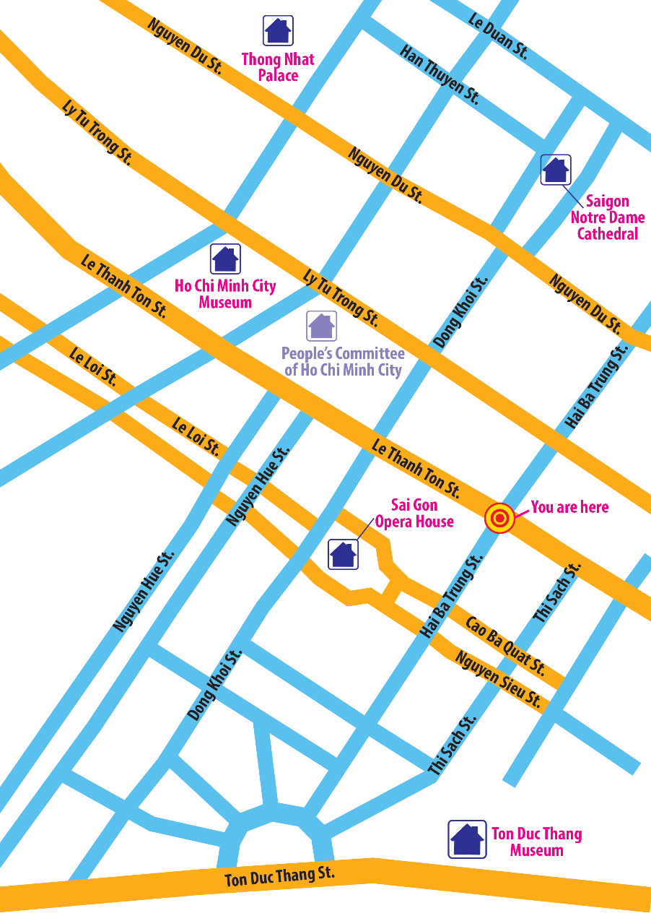
Let’s start our tour in Ho Chi Minh City. We are in Hai Ba Trung street now. First, go to

Slide 12

Now present your audio guide to your class.
* Example:
Let's start our tour in Ho Chi Minh City. We are in Hai Ba Trung Street now. First, go to Duc Ba cathedral. To get there, go straight along the street for 2 minutes then take the first turning on the right, keep going straight, Duc Ba cathedral is in front of your eyes.
Next, we go to Thong Nhat palace. Go straight along Nguyen Du street then take the first turning on the right, go straight and it's on your right.
Finally, go to the Sai Gon opera house. Go straight along Le Duan street and take the second turning on the right, keep going straight for 10 minutes, the Sai Gon opera house is on your right.

Slide 13

* HOMEWORK:
- Do Ex in WB
Prepare: Skills 1

Slide 14


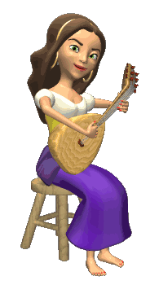








THANK YOU FOR ATTENTION!
GOOD BYE!
the end

