Slide 1


Slide 2
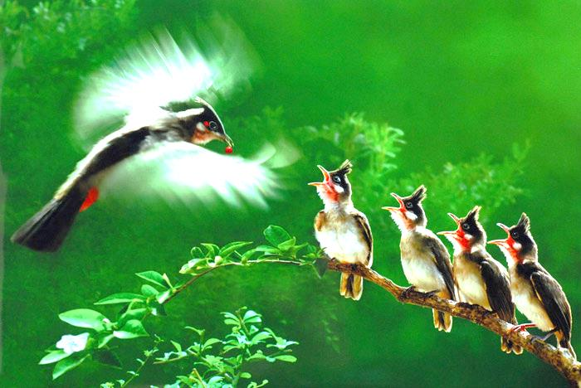

Welcome to our lesson !

Slide 3
1
C | L | E | V | E | R
2
B | U | S | T | O | P
3
T | E | M | P | L | E
4
P | E | A | C | E | F | U | L
5
C | A | T | H | E | D | R | A | L
6
S | Q | U | A | R | E
7
N | O | I | S | Y
8
E | X | P | E | N | S | I | V | E
9
B | O | R | I | N | G
10
M | O | D | E | R | N

Slide 4
1. He always get good marks. He does exercises at school quickly. He is…………
CLEVER

Slide 5
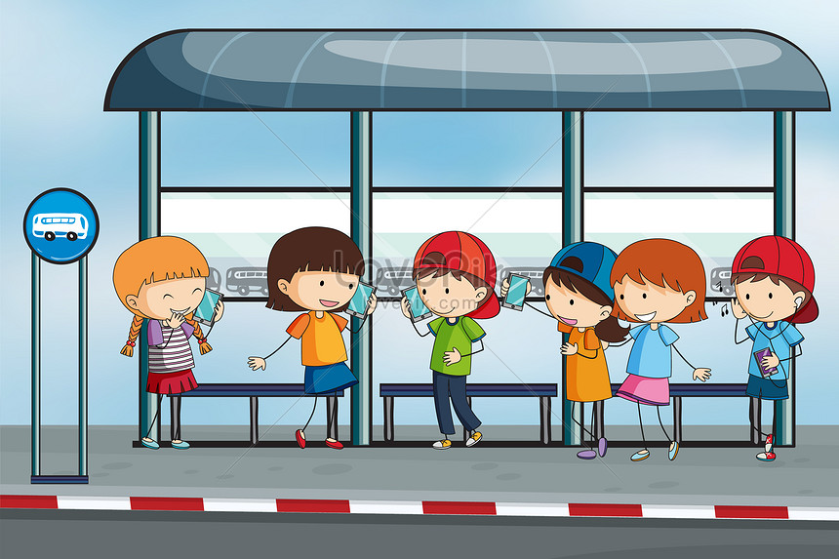
2. What is this?
Bus stop

Slide 6
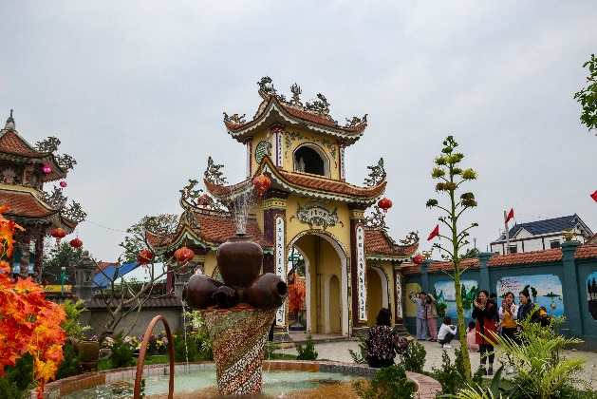
3. What is this?
a
TEMPLE

Slide 7
4. ……………# NOISY
PEACEFUL

Slide 8
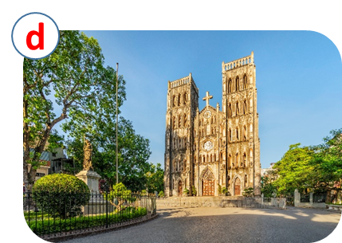
5. What is this?
CATHEDRAL

Slide 9
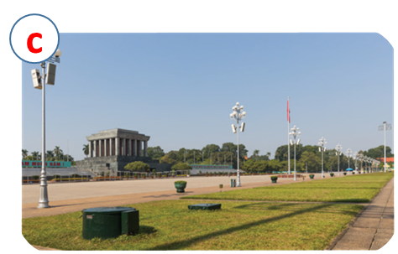
6. What is this?
SQUARE

Slide 10
7. The city is crowed. It is…………
NOISY

Slide 11
8. ……………# cheap
EXPENSIVE

Slide 12
9. I don’t like living in the countryside because it is…………….
BORING

Slide 13
10…………………….# HISTORIC
MODERN

Slide 14

UNIT 4: MY NEIGHBOURHOOD
LESSON 3
A CLOSER LOOK 2
OBJECTIVES
understand and use comparative adjectives to make sentences, dialogues

Slide 15

*Grammar
Comparative adjectives
We can use comparative adjectives to compare two people or things.

Slide 16
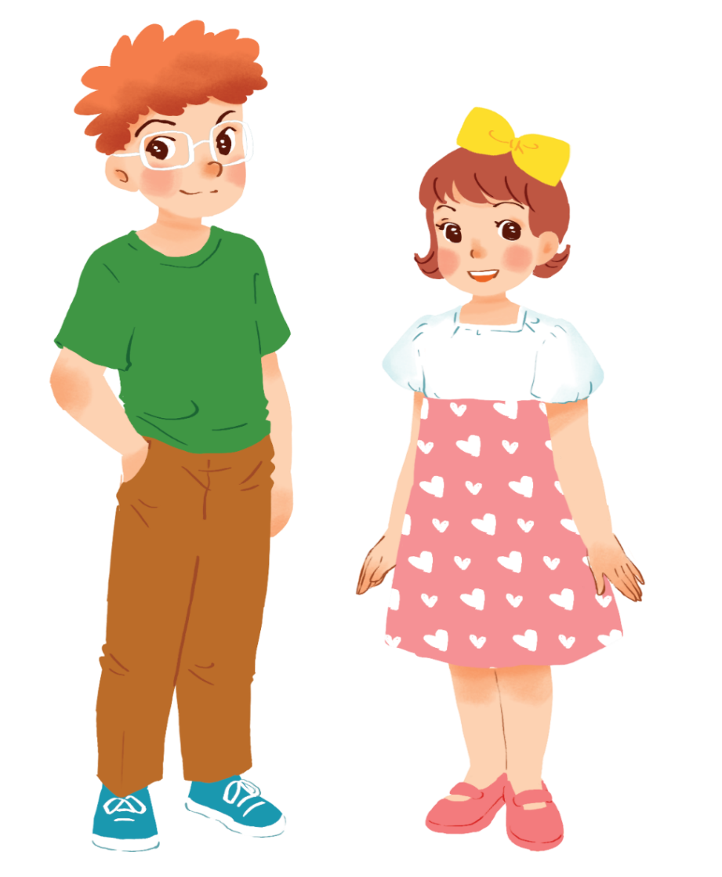
Example:
Tom is taller than Mary.

Slide 17
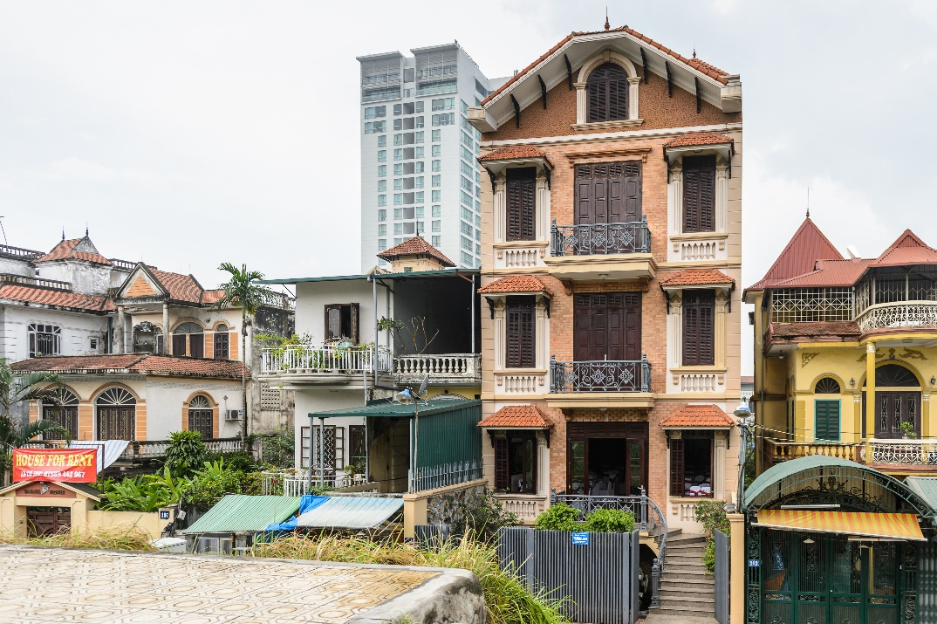
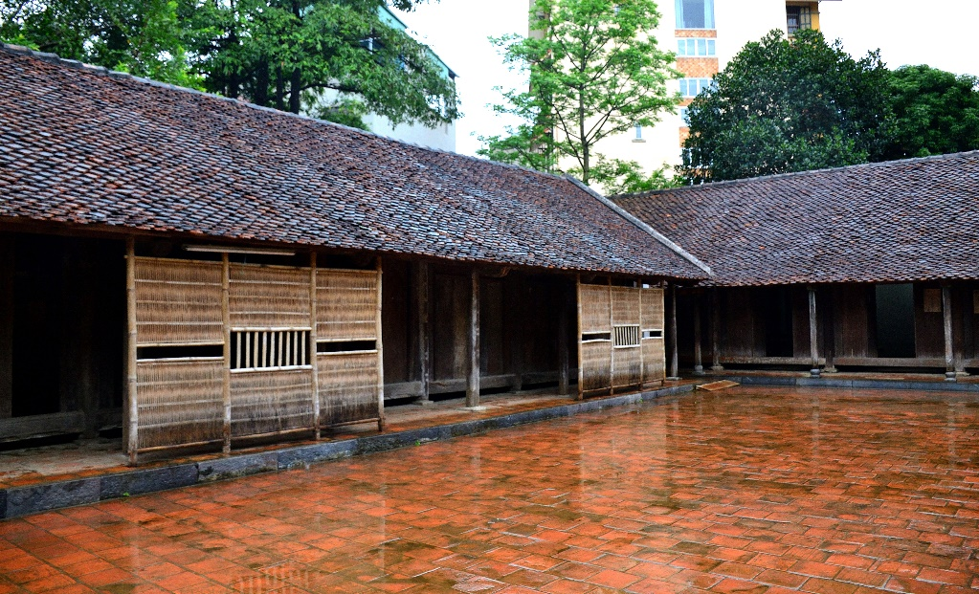
Example:
A house in a city is normally more expensive than a house in the countryside.

Slide 18
* Form:
Comparative adjectives: (Cấp so sánh hơn của tính từ).
+ Short Adj:
S1 + be + adj-ER + than + S2.
+ Long Adj:
S1 + be + MORE + adj + than + S2.

Slide 19
* Note:
syllable | Positive | Comparative | Rule
fast
faster
+ er
one
syllable
large
larger
+ r
big
bigger
+ ...er
two
syllables
noisy
noisier
y → ier

Slide 20

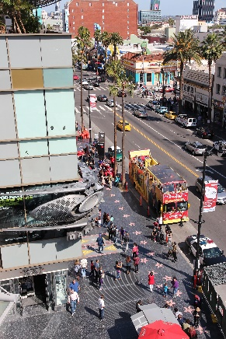

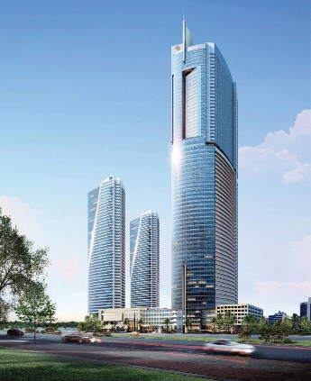
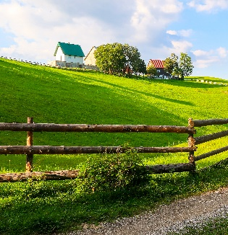
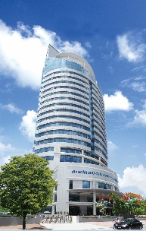
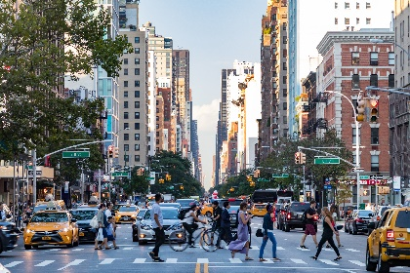
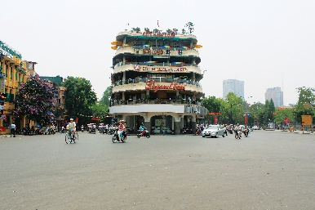
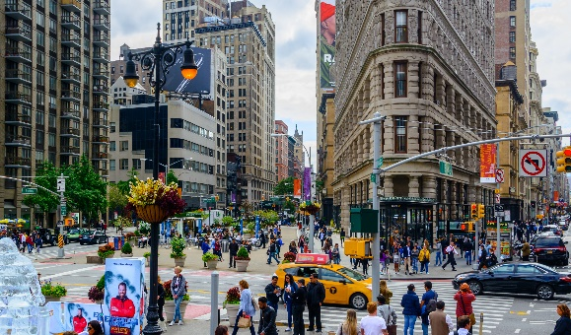
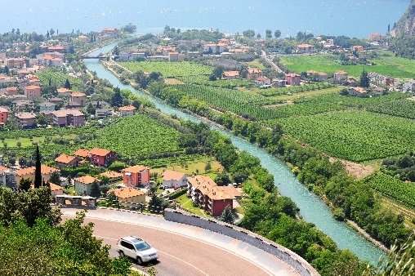
Complete the following sentences with the comparative form of the adjectives in brackets. Number 1 is an example.

Slide 21





Tom
Jerry
40
Lucky Numbers
10
20
30
60
70
80
50
70
10
40
20
30
60
50
1
2
3
4
5
6
7
8

Slide 22
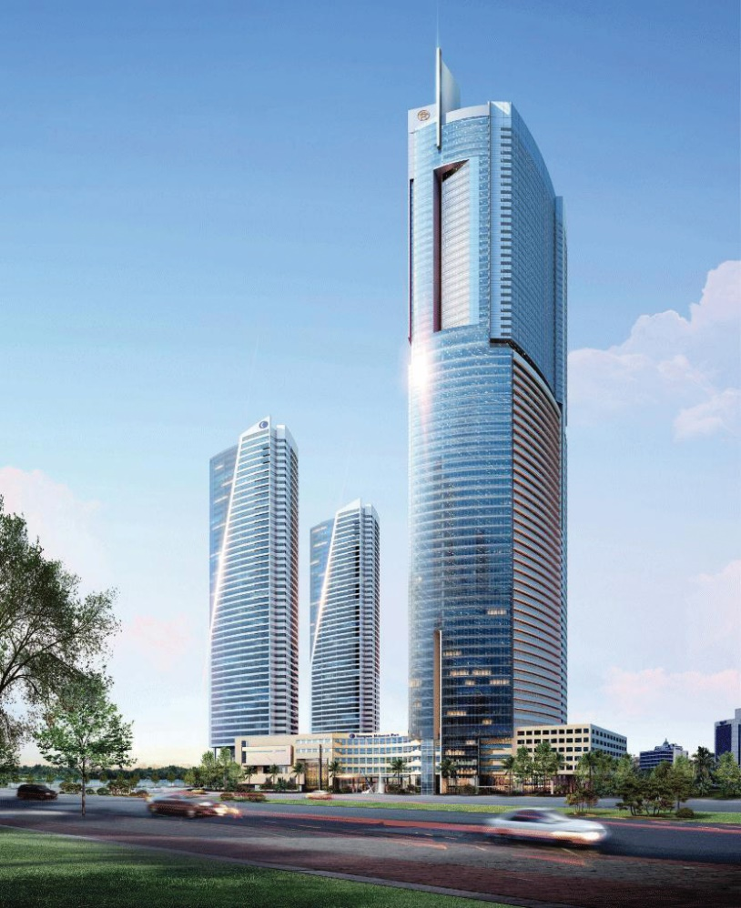

1.
taller
This building is…. ……….than that building. (tall)

Slide 23
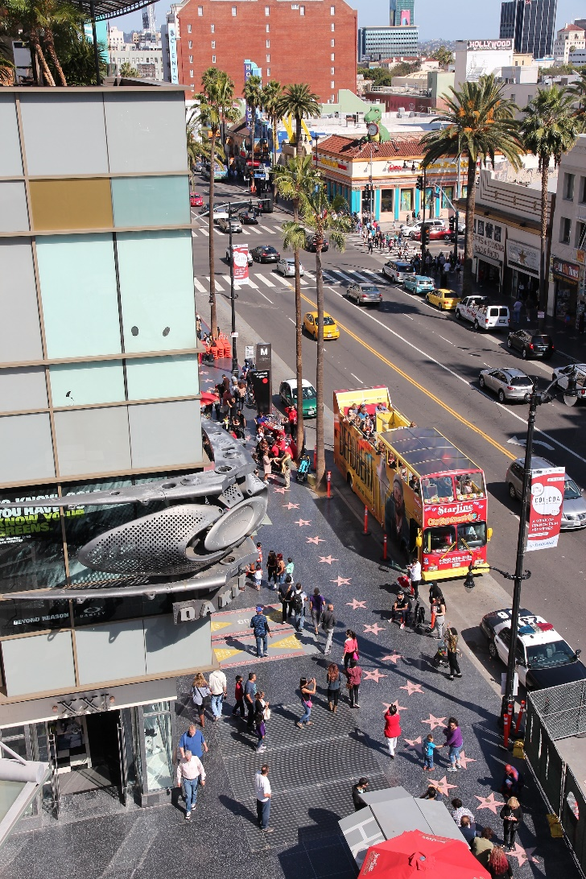

2.
My neighbourhood is than your neighbourhood. (noisy)
noisier

Slide 24

The square in Ha Noi is than the square in Hoi An. (big)
3.
bigger

Slide 25


4.
Living in the countryside is
in a city. (peaceful)
more peaceful
than living

Slide 26
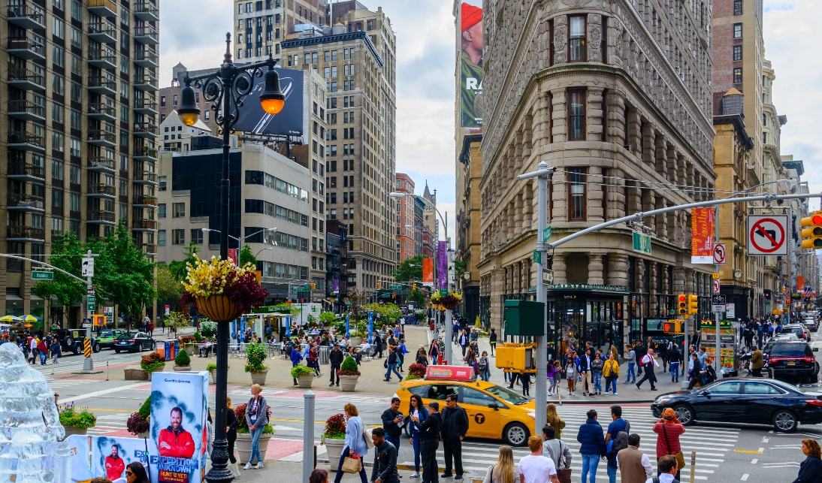

more exciting
than living
5.
Is living in a city
in the countryside? (exciting)

Slide 27
Things in this shop is ………………than things in the supermarket ( expensive).
more expensive

Slide 28

LUCKY NUMBER!

Slide 29
LUCKY NUMBER!

Slide 30


Use the correct form of the words in brackets to complete the letter.
Dear Nick,
How are you?
Ha Noi is beautiful but it’s too busy for me. I’m having a great time at Cua Lo Beach now. The weather is (1. hot) hotter than that in Ha Noi. The houses and buildings are (2. small) _______ and (3. old) _______ than those in Ha Noi.
The streets are (4. wide) _______ with less traffic. the seafood here is (5. delicious) _______ and (6. cheap) _______ than the seafood in Ha Noi.
See you soon,
Vy

Slide 31
Use the correct form of the words in brackets to complete the letter.
Dear Nick,
How are you?
Ha Noi is beautiful but it’s too busy for me. I’m having a great time at Cua Lo Beach now. The weather is (1. hot) hotter than that in Ha Noi. The houses and buildings are (2. small) smaller and (3. old) older than those in Ha Noi.
The streets are (4. wide) wider with less traffic. the seafood here is (5. delicious) more delicious and (6. cheap) cheaper than the seafood in Ha Noi.
See you soon,
Vy

Slide 32

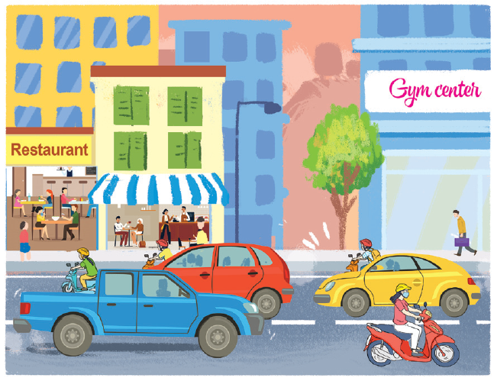
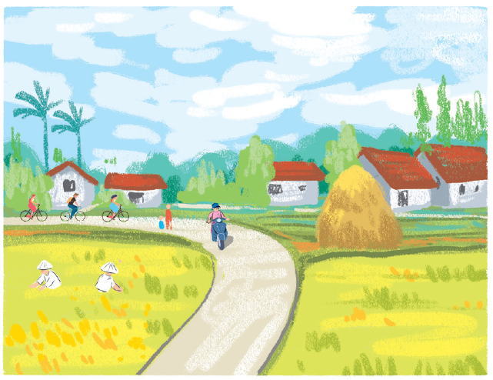
Look at the pictures of the two neighbourhoods: Binh Minh and Long Son. Compare two neighbourhoods. You can use the adjectives below.
noisy
quiet
modern
boring
crowded
peaceful
busy
Example:
Binh Minh is noisier than Long Son.
Binh Minh
Long Son

Slide 33
BM is more modern than LS
LS is more peaceful than BM
BM is busier than LS
LS is more boring than BM.

Slide 34

Work in pairs. Ask and answer questions about Binh Minh and Long Son neighbourhoods using the pictures in 3.
1. Yen Binh / crowded / Long Son?
2. Long Son / modern / Yen Binh?
3. Yen Binh / noisy / Long Son?
4. Long Son / beautiful / Yen Binh?
5. Long Son / peaceful / Yen Binh?
Example:
A: Is Binh Minh noisier than Long Son?
B: Yes, it is.
A: Is Long Son more modern than Binh Minh?
B: No, it isn’t.

Slide 35
WRAP-UP
Learn about form and usage of Comparative Adjectives

Slide 36

* Home work
Learn by heart grammar.
Do exercise in workbook.
Prepare new lesson:
Unit 4. Lesson 4. Communication

Slide 37

Thank you very much.

