Slide 2


I. Objectives By the end of this lesson, students will be able to: 1. Knowledge - Get an overview about the topic Our Tet holiday - Use the lexical items related to “Tet” - Use the vocabulary and structures to describe things and activities at Tet 2. Core competence - Develop communication skills and creativity - Be collaborative and supportive in pair work and team work - Actively join in class activities 3. Personal qualities - Develop self-study skills - Develop their understanding of Tet holiday

Slide 3

Warm- up
Say any word which belongs to this topic.
Tet

Slide 4








Happy New Year!
Listen and read.
Match the words / phrases in the box with the pictures.
What are Linda and Phong talking about?
Is it about Tet?
Write two things or activities and share them with the class. The class listen and decide whether they are about or not about Tet.
Complete the sentences about Tet with the information from the conversation in 1.

Slide 5

VOCABULARY
celebrate (v)
/ˈselɪbreɪt/
tổ chức

Slide 6
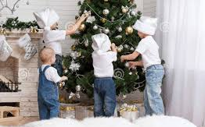
VOCABULARY
decorate (v)
/ˈdekəreɪt/
trang trí

Slide 7
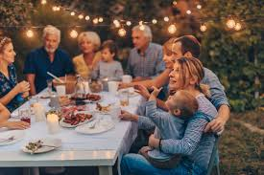
VOCABULARY
family gathering (N)
/ˈfæməli ˈɡæðərɪŋ/
sum họp gia đình

Slide 8
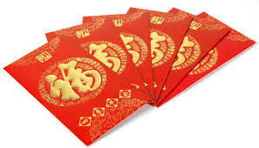
VOCABULARY
lucky money (N)
/ˈlʌki ˈmʌni/
tiền lì xì

Slide 9
VOCABULARY
peach flowers (N)
/piːtʃ ˈflaʊərz/
hoa đào

Slide 10


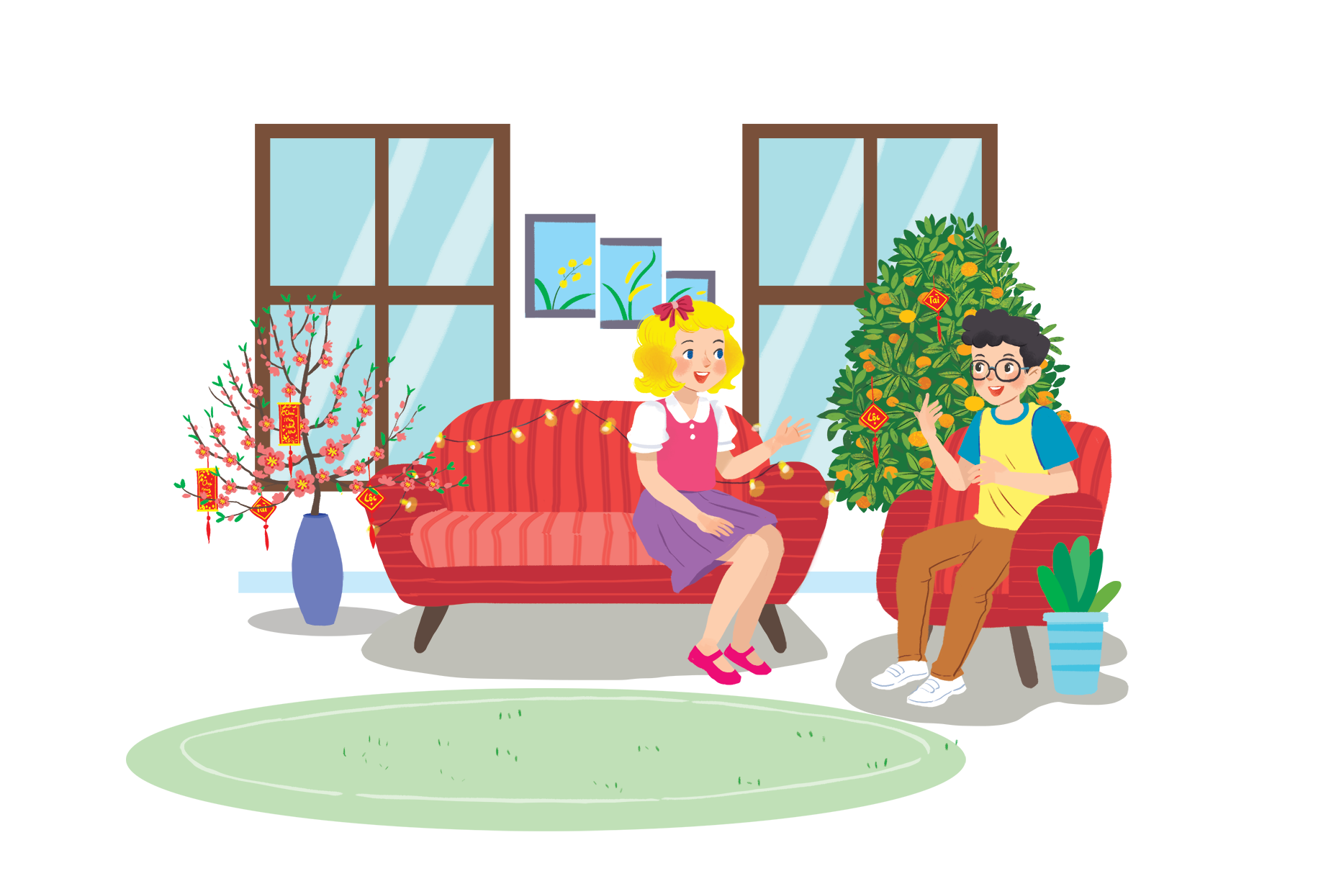
Listen and read.
Happy New Year!

Slide 11
Happy New Year!
Linda: Phong, does Viet Nam celebrate New Years?
Phong: Yes, we do. We have Tet.
Linda: When is Tet?
Phong: At different times. This year, it’s in January.
Linda: What do you do at Tet?
Phong: We clean our homes and decorate them with ﬂowers.
Linda: Is Tet a time for family gatherings?
Phong: Yes. It’s a happy time for everybody.
Linda: Great.
Phong: Yes, and another good thing about Tet is that children get lucky money.
Linda: That sounds interesting. Is there anything special people should do?
Phong: We should say “Happy New Year” when we meet people, and we shouldn’t break anything.

Slide 12

What are Linda and Phong talking about?
A.
New Years in the world
B.
Tet in Viet Nam
C.
What to eat and wear during tet

Slide 13






Complete the sentences about Tet with the information from the conversation in 1.
1.
January
This year Tet is in
.
.
2.
We decorate our
homes
.
.
3.
Tet is a time for family
gatherings
.
.
4.
Children get
lucky money
.
.
5.
People shouldn’t
break
anything.
anything.

Slide 14

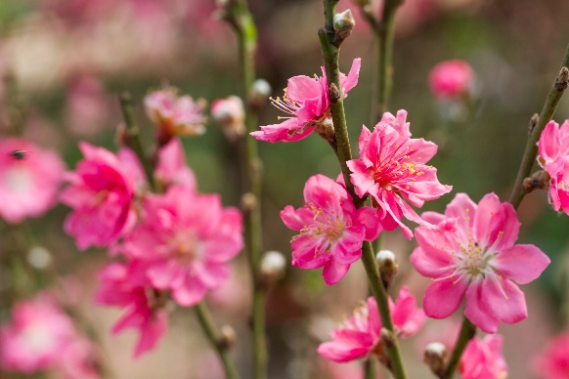
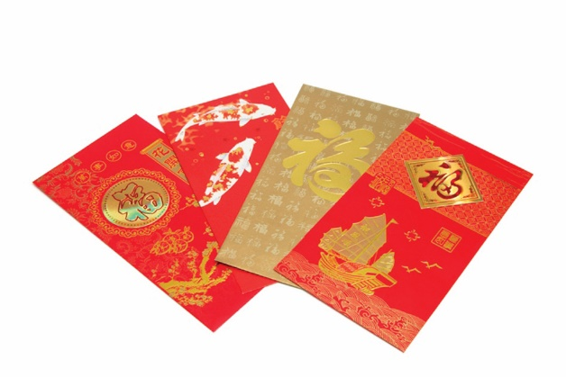
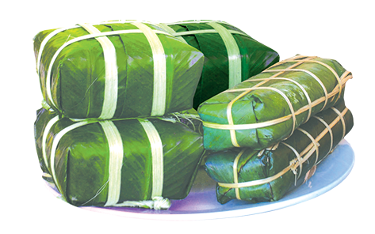
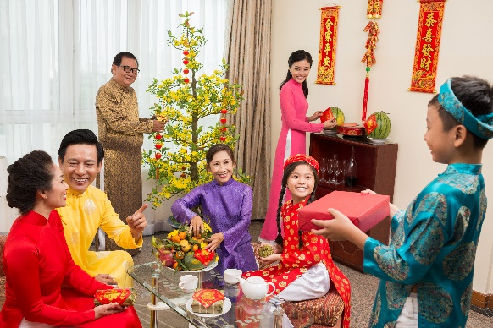
Match the words / phrases in the box with the pictures.
a. lucky money
a. lucky money
c. banh chung and banh tet
c. banh chung and banh tet
b. peach flowers
b. peach flowers
d. family gathering
d. family gathering
1
2
b. peach flowers
a. lucky money
3
4
c. banh chung and banh tet
d. family gathering

Slide 15

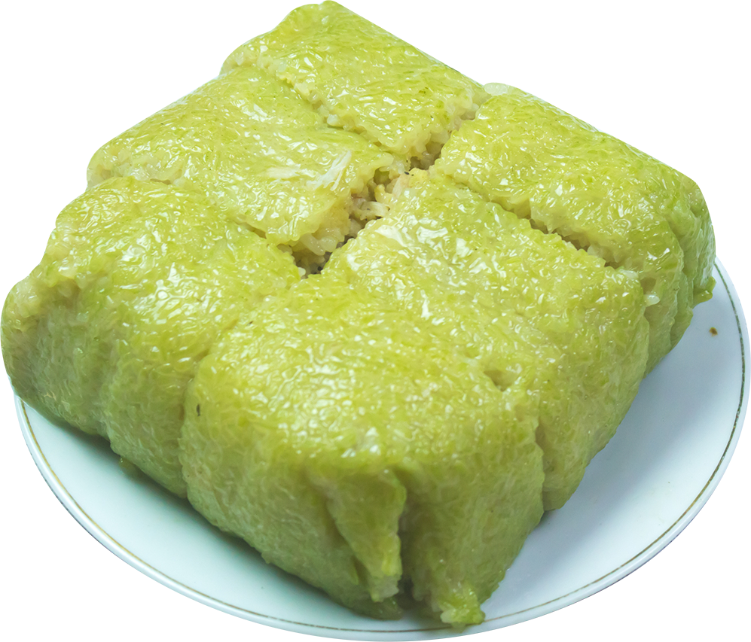
Is it about Tet?
Write two things or activities and share them with the class. The class listen and decide whether they are about or not about Tet.
Example:
Student: banh chung
Class: It’s about Tet.
Student: flying a kite.
Class: It’s not about Tet.

Slide 16
Wrap- up
- Get an overview about the topic Our Tet holiday - Use the lexical items related to “Tet” - Use the vocabulary and structures to describe things and activities at Tet

Slide 17
Homework
- Write new words 2 lines.
- Do more exercises in workbook.
- Prepare new lesson: U6- A close look 1.

Slide 18







