Slide 2


WARM- UP
* Game: Hidden picture - Teacher shows the slide with the picture that was hidden. - Teacher gradually unhides the picture while having the class guess the name of the destination.

Slide 3
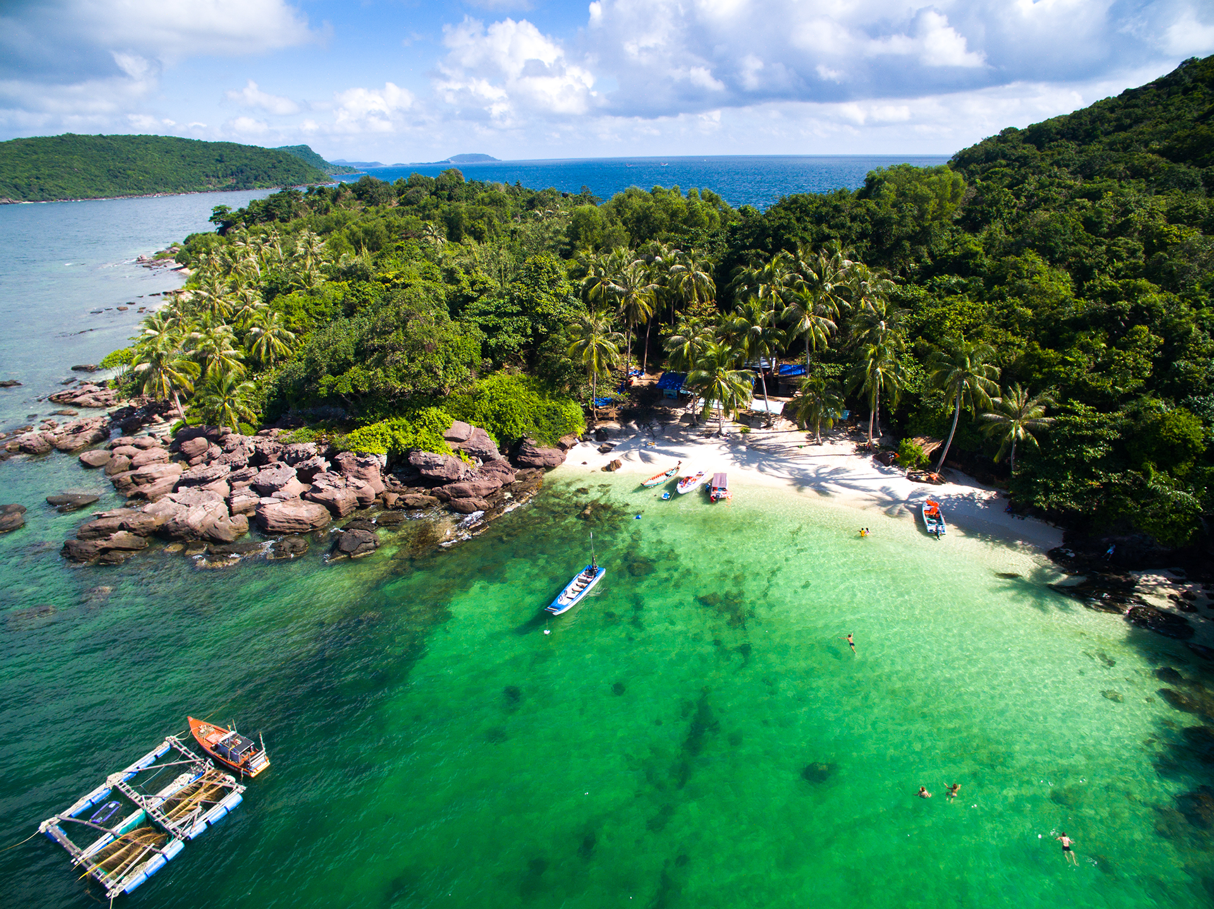
Phu Quoc Island
SHOW

Slide 4







Listening
Writing
Work in groups. Discuss the question.
Fill each blank in the network with the information about a travel attraction you know.
Listen again and tick () T (True) or F (False).
Use the notes in 3 to write a paragraph of about 50 words.

Slide 5
Listening

Slide 6



Work in groups. Discuss the question.
What do you know about Phu Quoc Island?
1. Phu Quoc is a beautiful island in Viet Nam.
2. Tourists can enjoy many entertaining activities such as visiting the night market, sightseeing, visiting the Safari,... The food in here is delicious and unique.
Listen to the talk and check your answers.
Audio script

Slide 7
AUDIO SCRIPT
Phu Quoc is a very beautiful island in Viet Nam. It is in Kien Giang. It has beautiful beaches and green forests. It also has resorts, hotels, and bars. The people here are friendly. Phu Quoc has an international airport, and travelling there is easy. Tourists can visit fishing villages, national parks, pagodas and temples. They also like to eat the seafood here. It is delicious. Sailing and fishing are popular water sports. You can buy interesting things at the markets on the island.

Slide 8

Listen again and tick () T (True) or F (False).
 |  | T | F
1. | Phu Quoc is a very beautiful island in Viet Nam.
2. | There are no green forests in Phu Quoc.
3. | Tourists can visit fishing villages and national parks there.
4. | You cannot play water sports in Phu Quoc.
5. | People sell interesting things at the markets.





Audio script

Slide 9
AUDIO SCRIPT
Phu Quoc is a very beautiful island in Viet Nam. It is in Kien Giang. It has beautiful beaches and green forests. It also has resorts, hotels, and bars. The people here are friendly. Phu Quoc has an international airport, and travelling there is easy. Tourists can visit fishing villages, national parks, pagodas and temples. They also like to eat the seafood here. It is delicious. Sailing and fishing are popular water sports. You can buy interesting things at the markets on the island.

Slide 10
Writing

Slide 11

Fill each blank in the network with the information about a travel attraction you know.
(2) Where is it?
(3) How can you go there?
(1) Name of the attraction
(5) What can you do there?
(4) What is special about it?

Slide 12


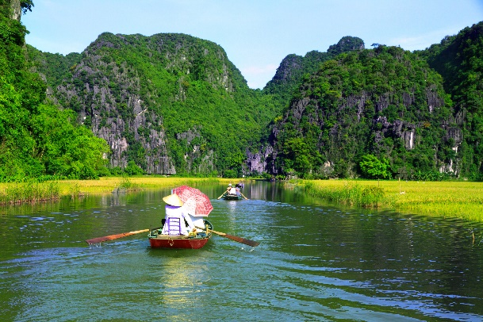
Use the notes in 3 to write a paragraph of about 50 words.
I am writing about
It is in

Slide 13
Wrap- up
1. Knowledge:
- Recognize to the topic of the lesson, Natural wonders of Viet Nam.
- Remmemer some lexical items related to the topic Natural wonders of Viet Nam.
2. Skills:
- Use some lexical items related to the topic Natural wonders of Viet Nam to do exercise.
3. Quality:
- Enhance Ss’ love for natural wonders in Viet Nam, the love for the hometown and the country.
- Enhance Ss’ good attitude to protect and conserve the natural wonders.

Slide 14
HOMEWORK
- Write new words 2 lines.
- Do more exercises in workbook.
- Prepare new lesson: U5- Looking back & Project.

Slide 15







