Slide 2



Objectives
1. Knowledge:
- Remember some lexical items related to travelling.
- Dishtinguish how to pronounce the sounds /t/ and /d/.
2. Skills:
- Use some lexical items related to travelling to do exercise.
- Identify and pronounce the sounds /t/ and /d/ correctly.
3. Quality:
- Enhance Ss’ love for natural wonders in Viet Nam, the love for the hometown and the country.
- Enhance Ss’ good attitude to protect and conserve the natural wonders.

Slide 3

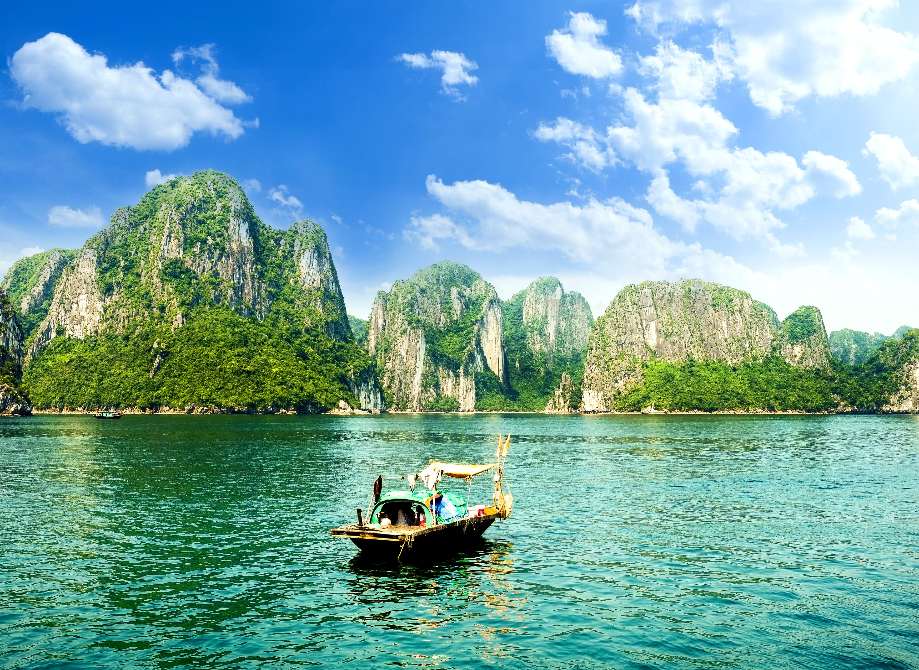
VOCABULARY
natural (adj)
/ˈnætʃrəl/
thuộc về thiên nhiên

Slide 4
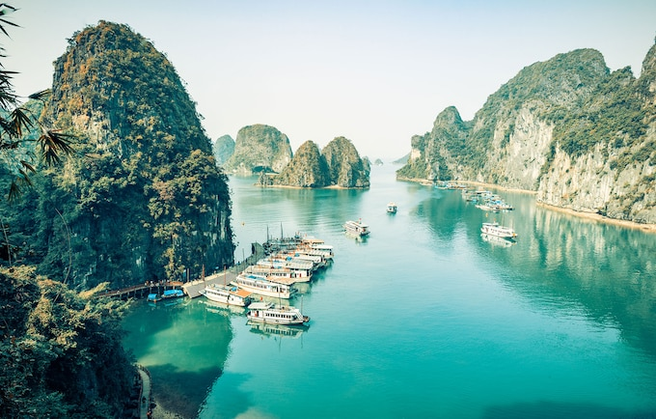
VOCABULARY
wonder (n)
/ˈwʌndər/
kì quan

Slide 5

VOCABULARY
amazing (adj)
/əˈmeɪzɪŋ/
tuyệt vời

Slide 6
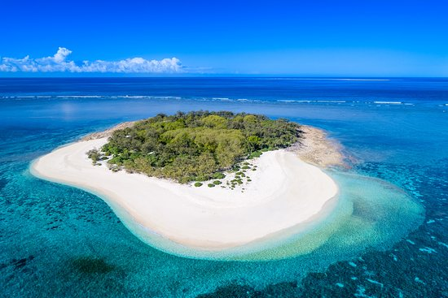
VOCABULARY
island (n)
/ˈaɪlənd/
hòn đảo

Slide 7

VOCABULARY
scenery (n)
/ˈsiːnəri/
phong cảnh

Slide 8
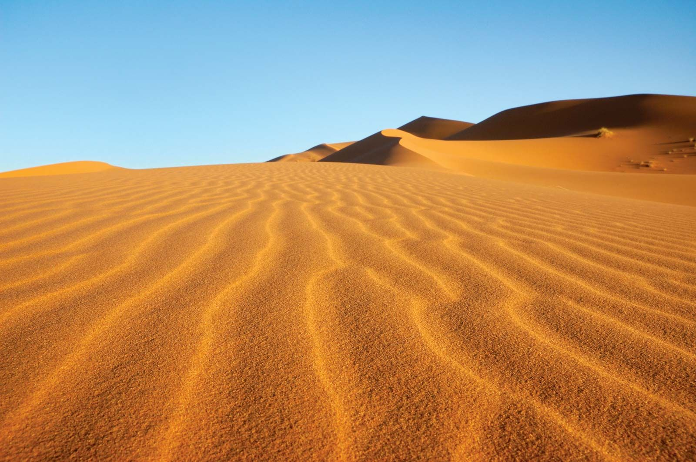
VOCABULARY
desert (n)
/ˈdezət/
sa mạc

Slide 9
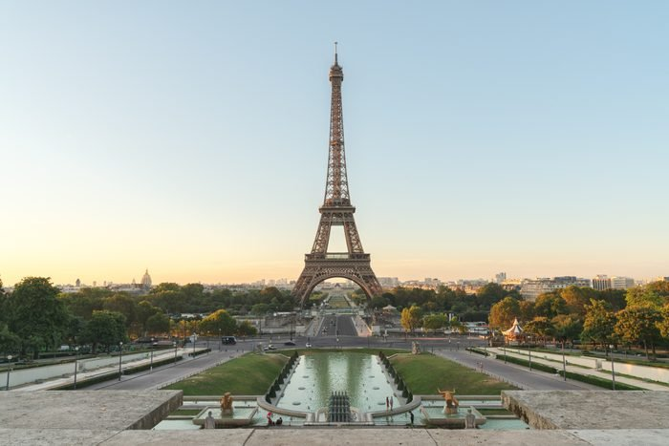
VOCABULARY
man-made (adj)
/ˌmæn ˈmeɪd/
nhân tạo

Slide 10
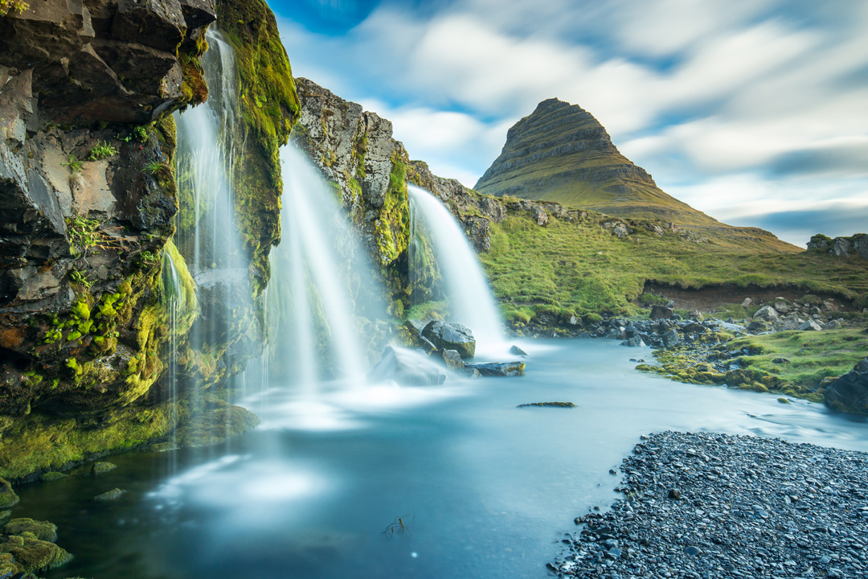
VOCABULARY
waterfall (n)
/ˈwɔːtəfɔːl/
thác nước

Slide 11

VOCABULARY
(be) on time
đúng giờ

Slide 12

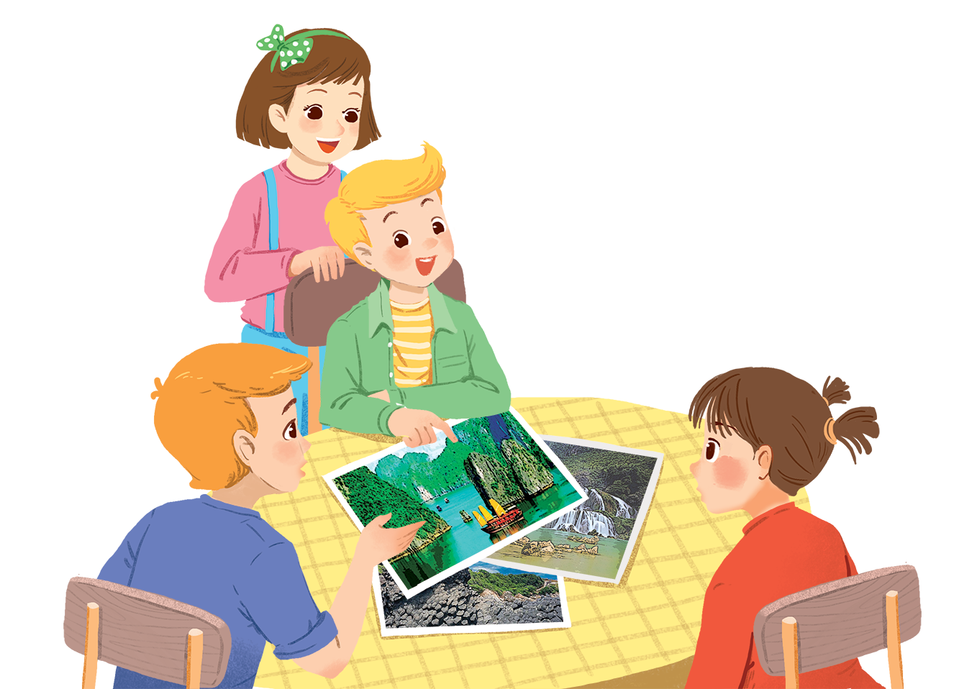
Listen and read.
Geopraphy Club

Slide 13
Geopraphy Club
Alice: Hello, welcome to our Geography Club.
(Knock at door)
Alice: Come in, Elena. We’re just starting now.
But remember you must always be on time.
Elena: Sure. Sorry.
Alice: Today I’m going to talk about some natural wonders of Viet Nam.
Nick: Great! What’s that in the first picture?
Alice: It’s Ganh Da Dia in Phu Yen.
Elena: Wow. It looks amazing!
Nick: Is picture 2 Ha Long Bay?
Alice: Right. What do you know about it?
Nick: It has many islands.
Alice: Yeah! The scenery is wonderful. This picture shows Tuan Chau, a large island.
Tommy: How about picture 3?
…

Slide 14

Complete the following sentences with the words from the box.
scenery
amazing
natural
islands
wonders
1.
People didn’t make Ganh Da Dia.
They are rocks.
natural
Ha Long Bay has thousands of big and small .
2.
islands
scenery
3.
Ha Long Bay is charming and the is wonderful.
Ganh Da Dia has rock columns of different shapes and sizes.
4.
amazing
5.
wonders
There are many natural and man-made in Viet Nam.

Slide 15


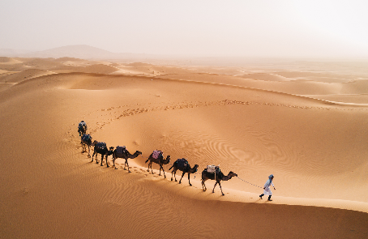
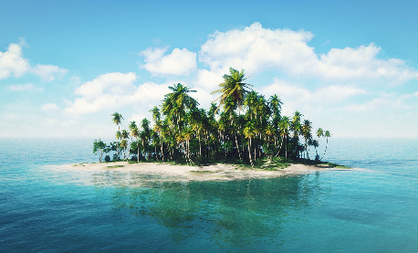
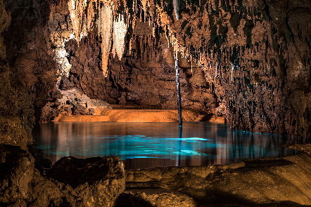
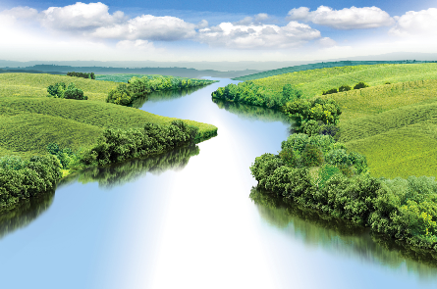
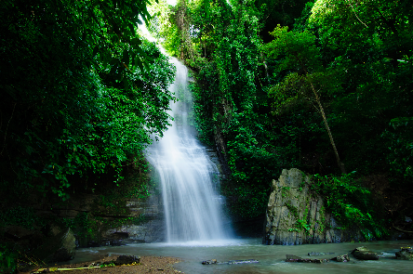
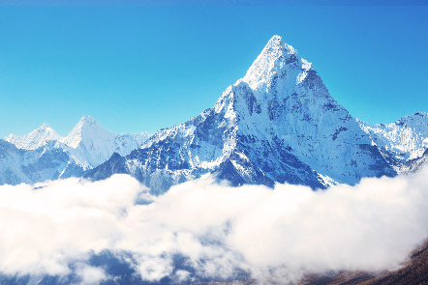
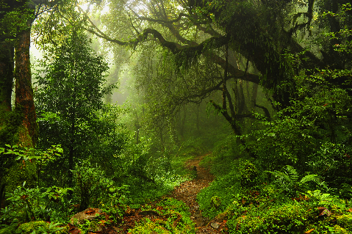
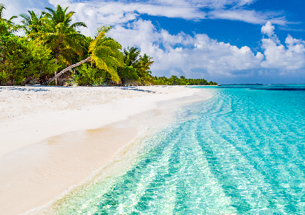
Listen and repeat the words, then label the pictures.
1. mountain
3. waterfall
5. cave
7. beach
2. river
4. forest
6. desert
8. island
a.
b.
c.
d.
e.
f.
g.
h.

Slide 16

1. mountain
3. waterfall
5. cave
7. beach
2. river
4. forest
6. desert
8. island
a.
a. desert

Slide 17
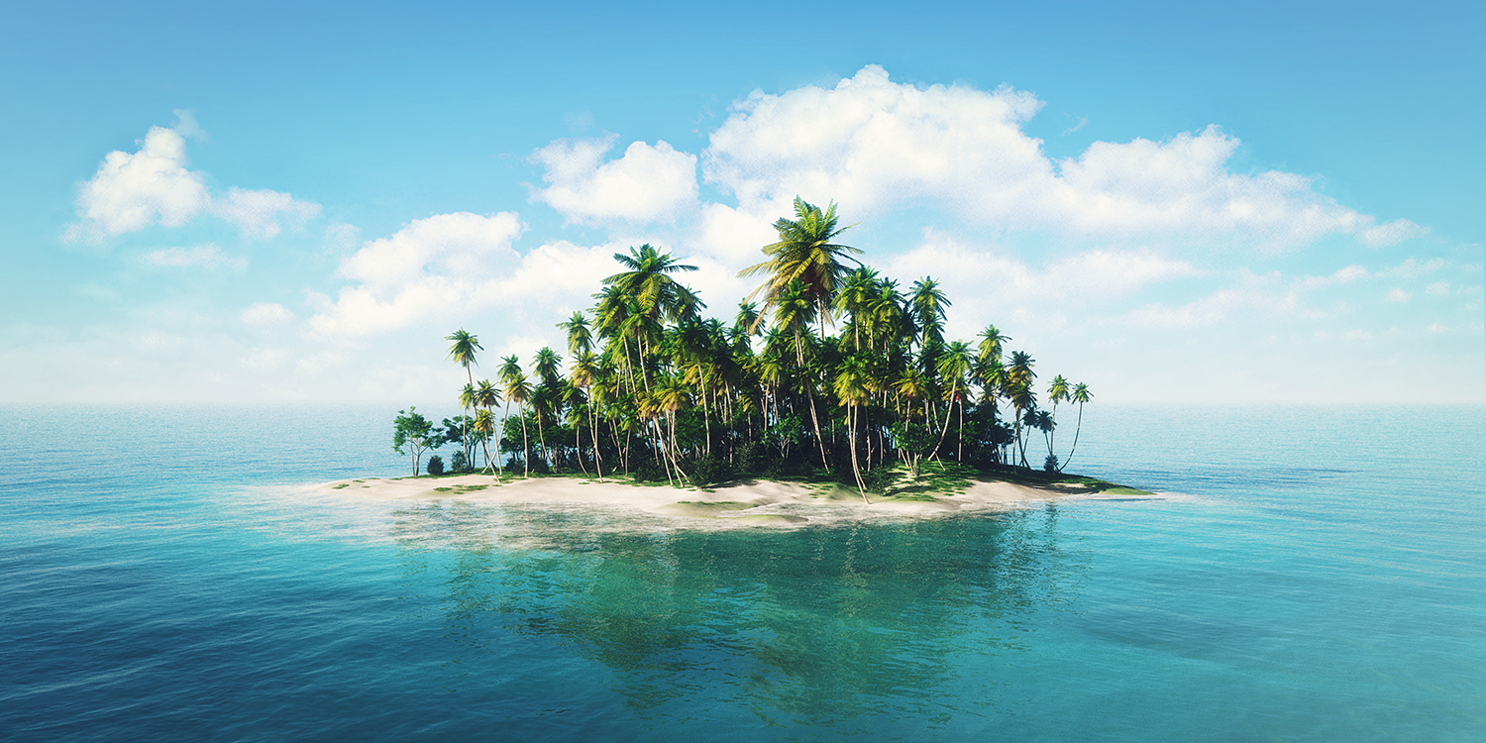
1. mountain
3. waterfall
5. cave
7. beach
2. river
4. forest
6. desert
8. island
b.
b. island

Slide 18
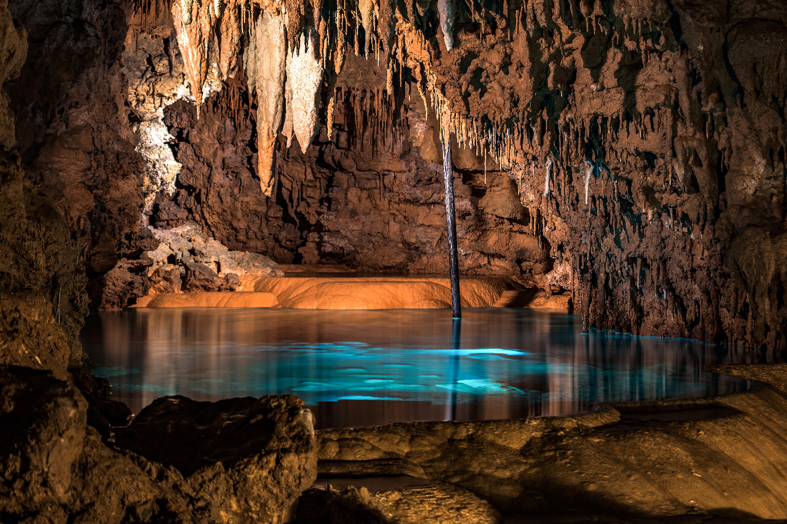
1. mountain
3. waterfall
5. cave
7. beach
2. river
4. forest
6. desert
8. island
c.
c. cave

Slide 19

1. mountain
3. waterfall
5. cave
7. beach
2. river
4. forest
6. desert
8. island
d.
d. river

Slide 20

1. mountain
3. waterfall
5. cave
7. beach
2. river
4. forest
6. desert
8. island
e.
e. waterfall

Slide 21
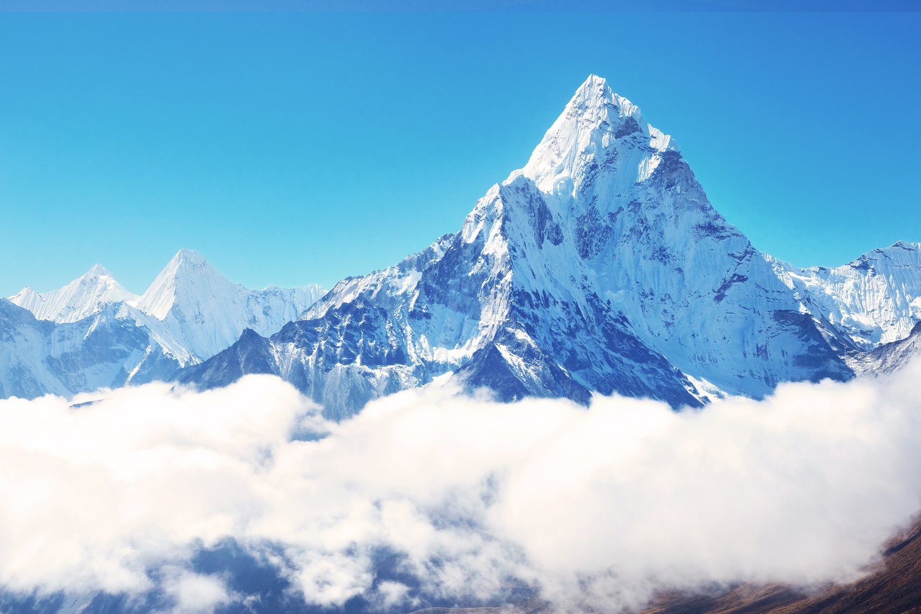
1. mountain
3. waterfall
5. cave
7. beach
2. river
4. forest
6. desert
8. island
f. mountain
f.

Slide 22

1. mountain
3. waterfall
5. cave
7. beach
2. river
4. forest
6. desert
8. island
g.
g. forest

Slide 23
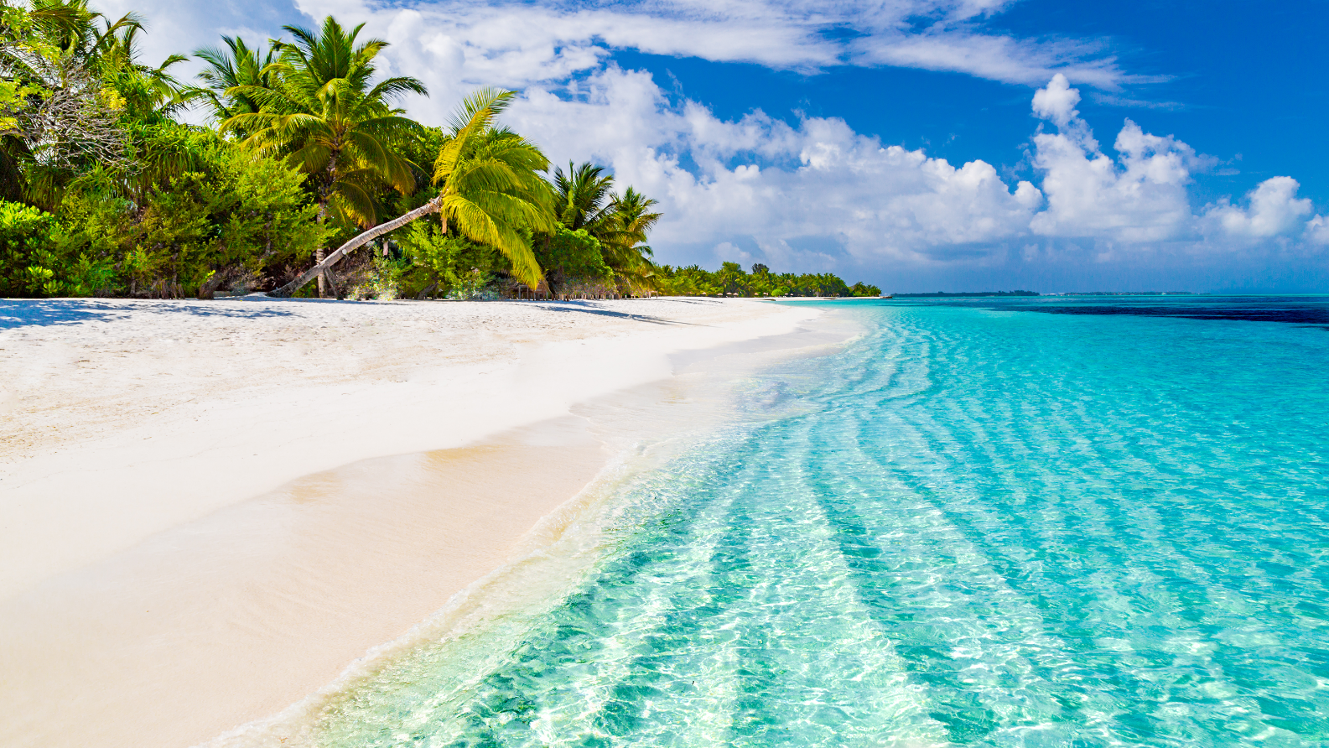
1. mountain
3. waterfall
5. cave
7. beach
2. river
4. forest
6. desert
8. island
h.
h. beach

Slide 24


Work in groups. Choose the correct answer to each of the questions.
1.
Which is an island in Viet Nam?
A.
Con Dao
B.
Son Doong
2.
Where is Mount Fansipan?
A.
In Lao Cai
B.
In Quang Binh
3.
Which of the following is a national park?
A.
Thong Nhat Park
B.
Cat Tien Park
4.
Which of the following wonders is a cave?
A.
Cuc Phuong
B.
Phong Nha
5.
Which waterfall is in Cao Bang?
A.
Giang Dien Waterfall
B.
Ban Gioc Waterfall

Slide 25
Wrap- up
1. Knowledge:
- Recognize to the topic of the lesson, Natural wonders of Viet Nam.
- Remmemer some lexical items related to the topic Natural wonders of Viet Nam.
2. Skills:
- Use some lexical items related to the topic Natural wonders of Viet Nam to do exercise.
3. Quality:
- Enhance Ss’ love for natural wonders in Viet Nam, the love for the hometown and the country.
- Enhance Ss’ good attitude to protect and conserve the natural wonders.

Slide 26
HOMEWORK
- Write new words 2 lines.
- Do more exercises in workbook.
- Prepare new lesson: U5- A close look 1.

Slide 27







