Slide 2



Objectives
- Reading: Develop Ss’ reading skill for general information and specific information
- Speaking:
+ identify different features of a place
+ use what they have learnt to talk about a city

Slide 3
Warm-up
1. Where do you think Khang’s neighbourhood is?
2. What do you think about it?
3. What are there in the neighbourhood?
4. Do you like living there? Why? / Why not?
In the countryside.
I think Khang’s neighbourhood is very nice and peaceful.
There are a lot of trees, markets ...
Yes, I do. Because it is very peaceful.

Slide 4
Reading

Slide 5

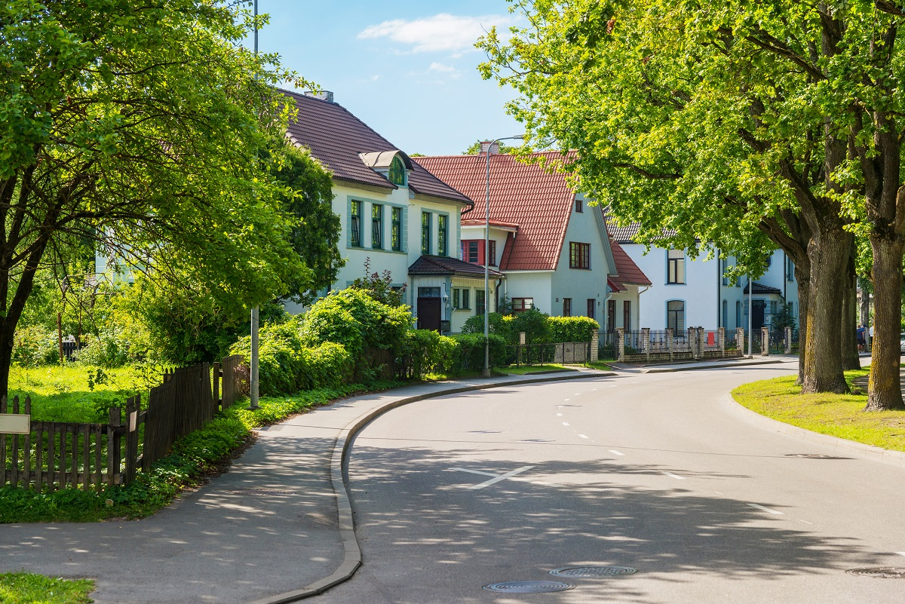
VOCABULARY
suburb (N)
/ˈsʌbɜːb/
khu ngoại ô
(Synonym: countryside)

Slide 6
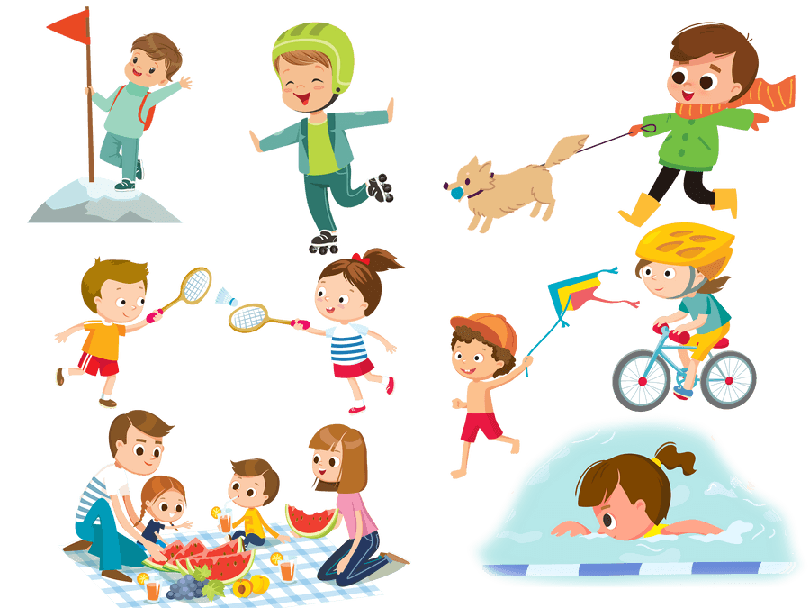
VOCABULARY
outdoor activity (N)
hoạt động ngoài trời

Slide 7
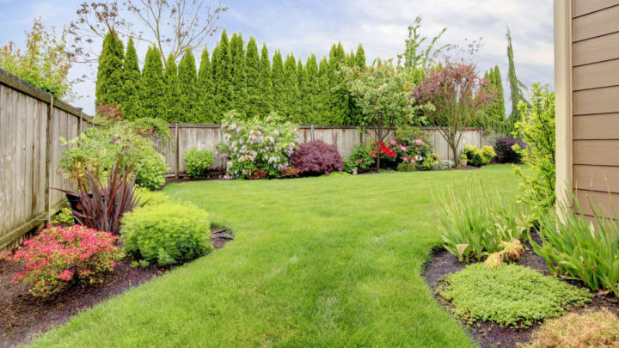
VOCABULARY
backyard (n)
/ˌbækˈjɑːd/
sân sau

Slide 8

VOCABULARY
dislike (v)
/dɪsˈlaɪk/
không thích
(antonym: like, love…)

Slide 9

VOCABULARY
incredibly (adv)
/ɪnˈkredəbli/
cực kỳ, một cách đáng kinh ngạc
(synonym: very, extremely)

Slide 10

Read Khang’s blog. Look at the words in the box, then find them in the text and underline them. What do they mean?
suburbs
dislike
outdoor

Slide 11





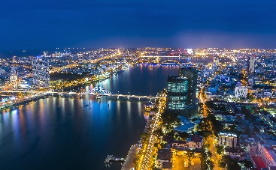
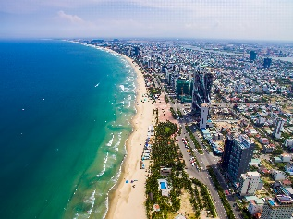
http://www.myblog.com.vn/Khang
KHANG’S BLOG
Friday, December 23rd ...
MY NEIGHBOURHOOD
I live in the suburbs of Da Nang City. There are many things I like about my neighbourhood.
It’s great for outdoor activities because it has beautiful parks, sandy beaches and fine weather. There’s almost everything I need here: shops, restaurants, and markets. The people here are friendlier, and the food is better than in other places.
However, there are two things I dislike about it: there are many modern buildings and offices; and the streets are busy and crowded.
Posted by Khang at 4:55 PM

Slide 12

Read Khang’s blog again and fill the table with the information.
LIKES | DISLIKES
beautiful parks
modern buildings and offices
sandy beaches
busy and crowded streets
fine weather
shops, restaurant, markets
friendly people
good food

Slide 13

Read Khang’s blog again. Then answer the questions.
1.
Where is khang’s neighbourhood?
It is in the suburbs of Da Nang City.
2.
Why is his neighbourhood great for outdoor activities?
Because it has beautiful parks, sandy beaches and fine weather.
3.
What are the people in his neighbourhood like?
They are very friendly.
4.
How are the streets in his neighbourhood?
They are busy and crowded.

Slide 14
Speaking

Slide 15

Make notes about your neighbourhood.
Think about what you like / dislike about it.
LIKES | DISLIKES

Slide 16

Work in pairs. Ask and answer about what you like and dislike about your neighbourhood.
Example:
A: Where do you live?
B: I live in the suburbs of Da Nang City.
A: What do you like about it?
B: The weather is fine. The people are friendly
and the food is good.
A: What do you dislike about it?
B: The streets are busy and crowded.

Slide 17
Wrap-up
- Reading: Develop Ss’ reading skill for general information and specific information
- Speaking:
+ identify different features of a place
+ use what they have learnt to talk about a city

Slide 18
HOMEWORK
Write new words 2 lines.
Do more exercises in workbook.
Prepare new lesson: U4- Skills 2

Slide 19







