Slide 2

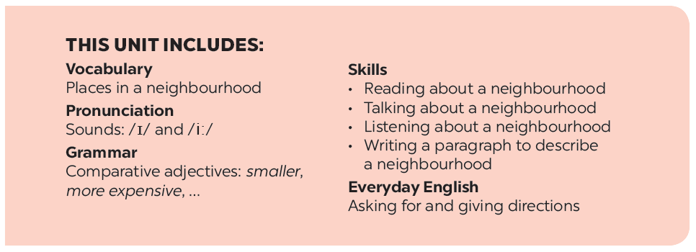

Slide 3


Objectives
- Recognize some adjectives to describe the places.
- Identify how to pronounce sounds /ɪ/ and /ɪ:/ correctly.

Slide 4





Vocabulary
Pronunciation
/ɪ/ and /ɪ:/
Match the places below with the pictures. Then listen, check and repeat the words.
Listen and repeat the words. Pay attention to the sounds
/ɪ/ and /ɪ:/
Work in pairs. Ask and answer questions about where you live.
Listen and practise the chant. Notice the sounds /ɪ/ and /ɪ:/.
Work in groups. Ask and answer about your neighbourhood. You can use the adjectives below.

Slide 5

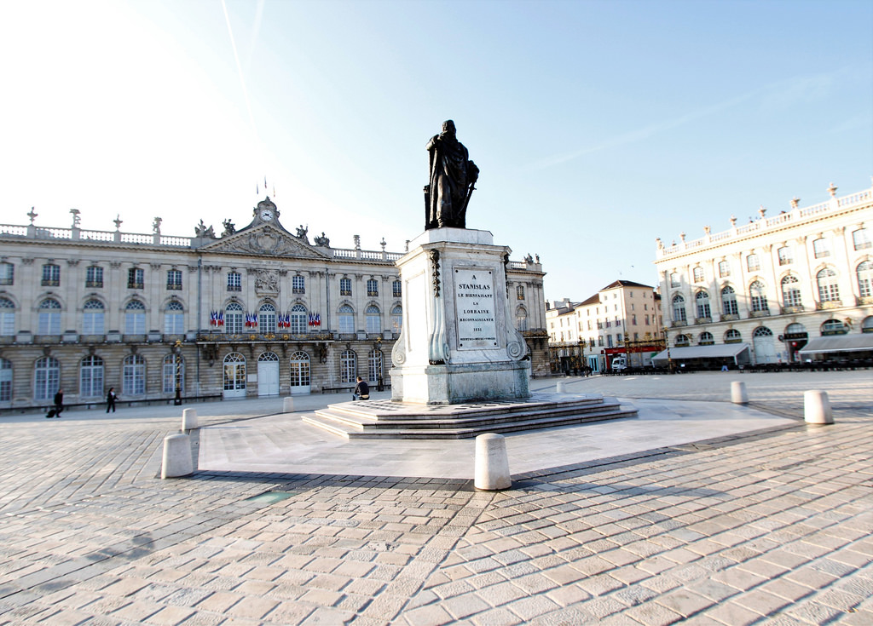
VOCABULARY
square (n)
/skweə(r)/
quảng trường

Slide 6
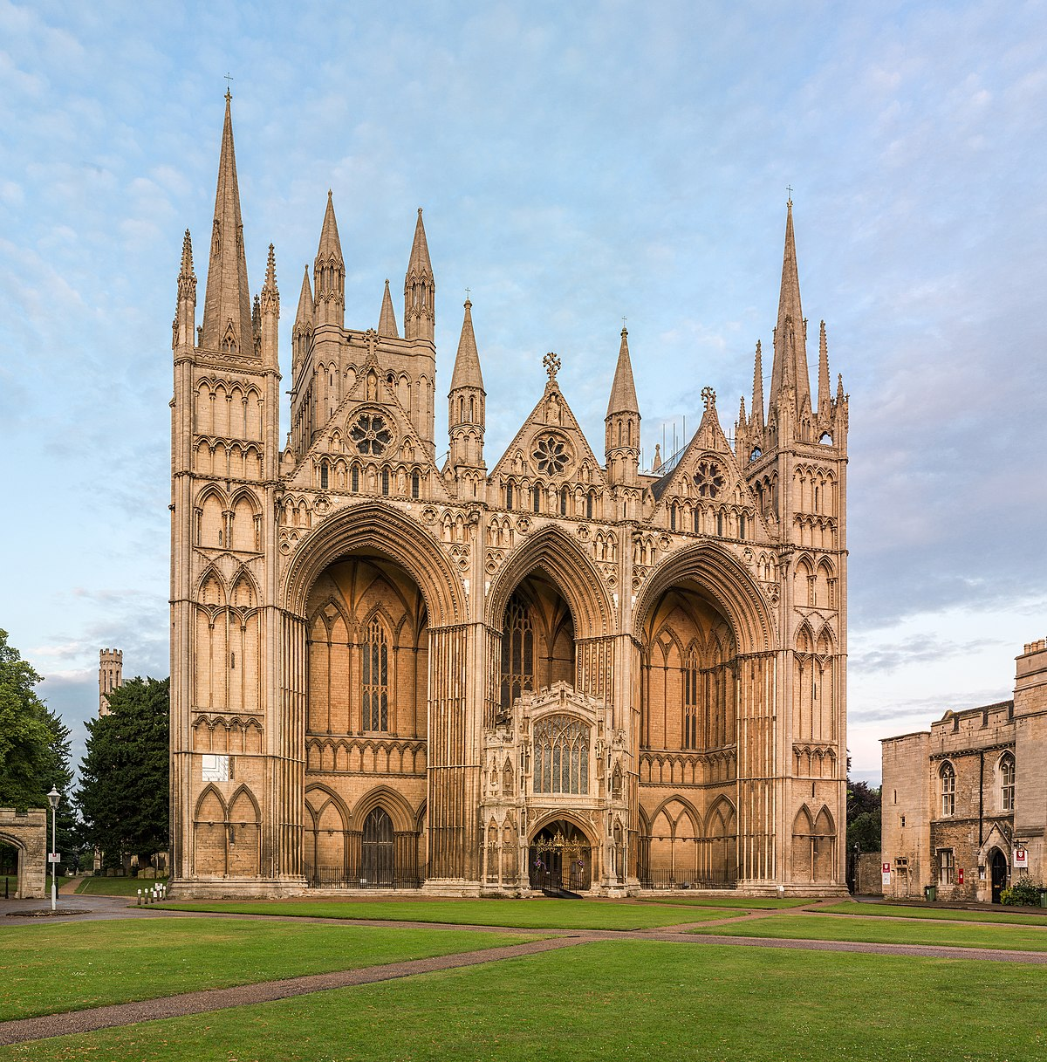
VOCABULARY
cathedral (n)
/kəˈθiːdrəl/
nhà thờ lớn

Slide 7
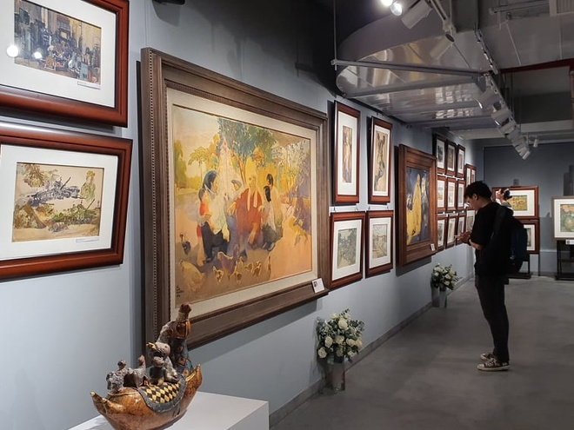
VOCABULARY
art gallery (n)
/ˈɑːt ɡæləri/
triển lãm, các tác phẩm…

Slide 8
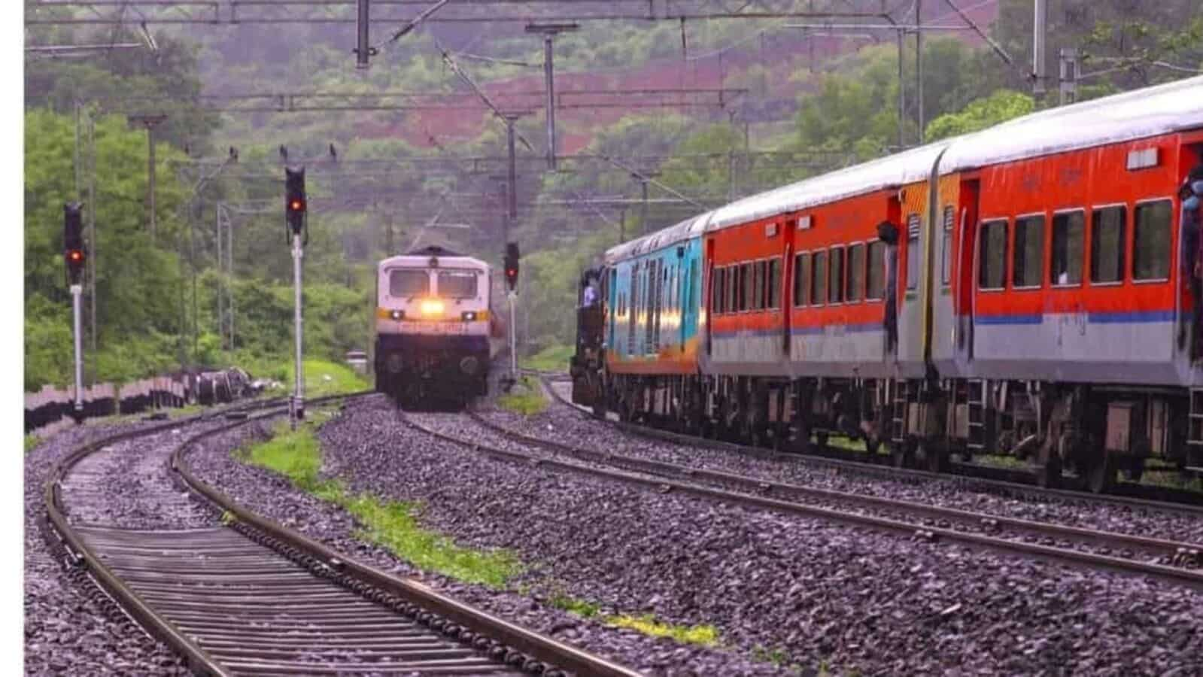
VOCABULARY
railway (n)
/ˈreɪlweɪ/
xe lửa

Slide 9
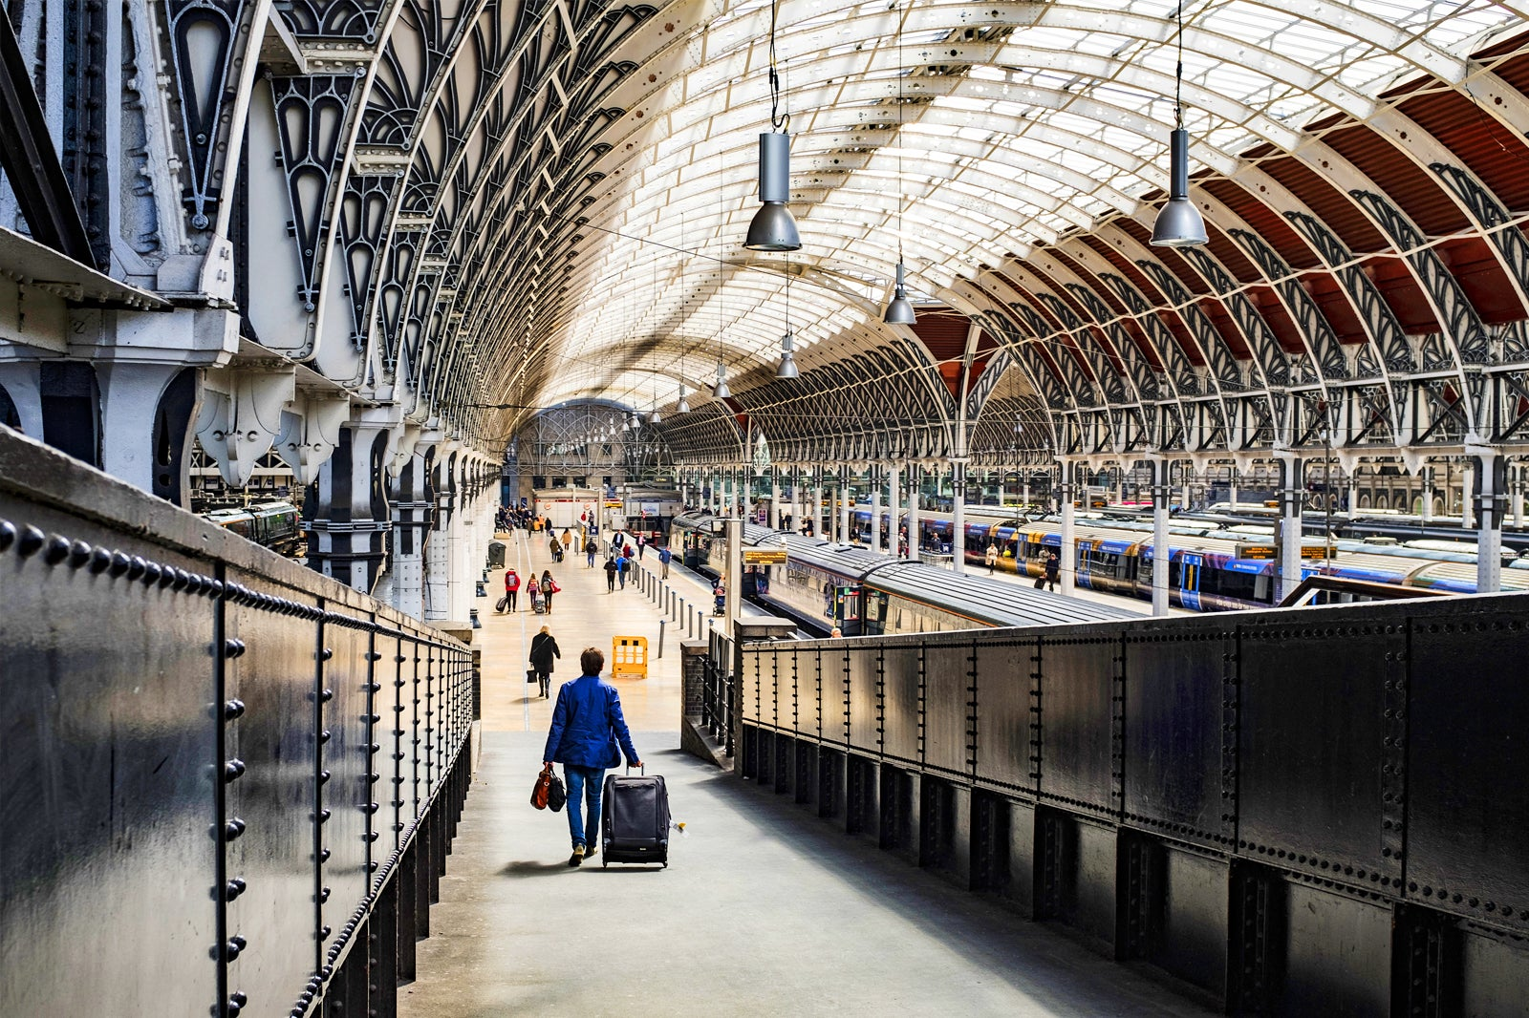
VOCABULARY
station (n)
/ˈsteɪʃn/
nhà ga

Slide 10
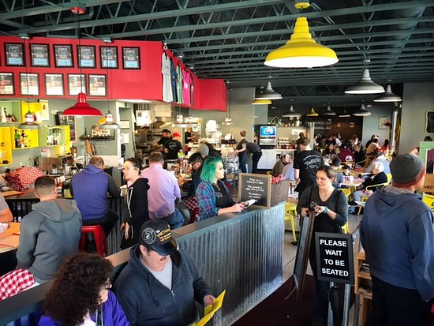
VOCABULARY
busy (adj)
/ˈbɪzi/
bận rộn, sầm uất

Slide 11
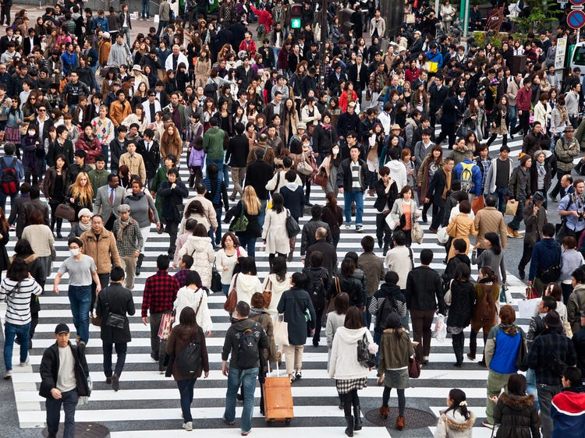
VOCABULARY
crowded (adj)
/ˈkraʊdɪd/
đông đúc

Slide 12


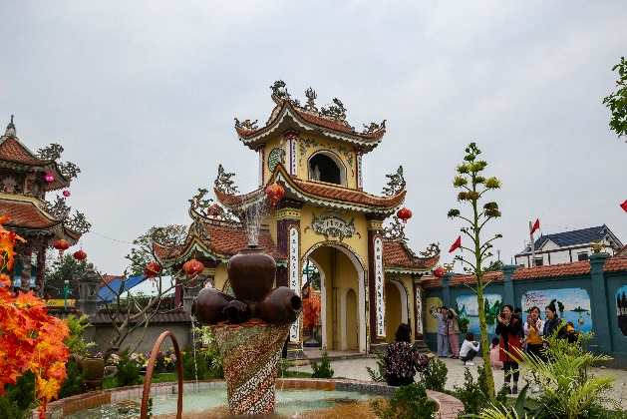
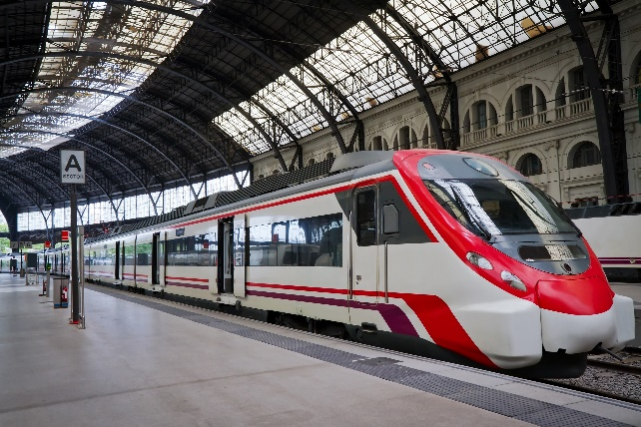
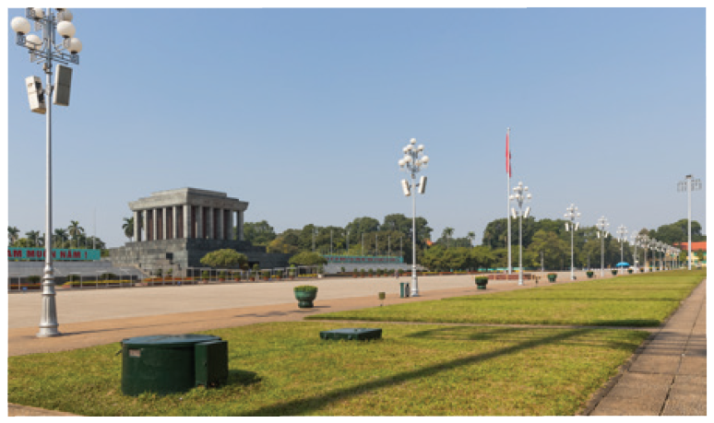
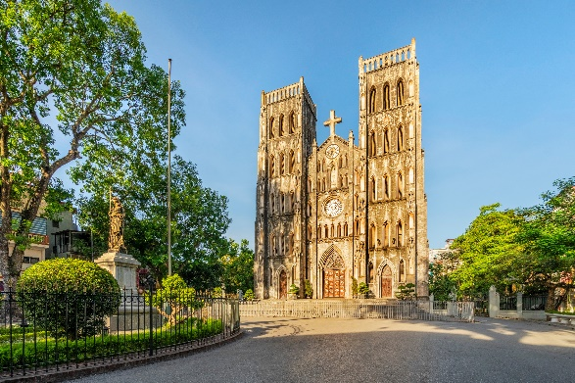
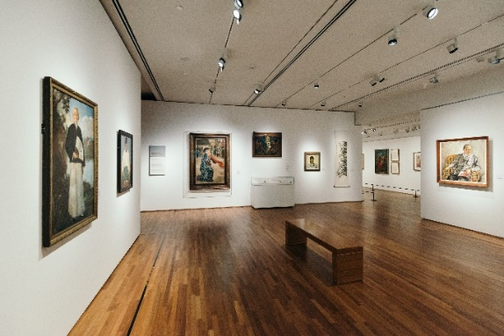
Match the places below with the pictures. Then listen, check and repeat the words.
a
b
b
a
1. square
2. art gallery
3. catherdral
4. temple
4. temple
4. temple
5. railway station
5. railway station
5. railway station
c
d
e
1. square
3. catherdral
2. art gallery
Name some other places in your neighbourhood.

Slide 13

Work in pairs. Ask and answer questions about where you live.
Example:
A: Is there a square in your neighbourhood?
B: Yes, there is. / No, these isn’t.

Slide 14

Work in groups. Ask and answer about your neighbourhood. You can use the adjectives below.
noisy
busy
modern
peaceful
quiet
crowded
boring
beautiful
Example:
A: Is your neighbourhood quiet?
B: Yes, it is. / No, it’s noisy.

Slide 15
Pronunciation
/ɪ/ and /i:/

Slide 16

Listen and repeat the words. Pay attention to the sounds /ɪ/ and /i:/.
noisy
cheap
peaceful
expensive
noisy
cheap
peaceful
expensive
clean
exciting
friendly
convenient
clean
exciting
friendly
convenient
Now, in pairs put the words in the correct column.
/ɪ/ | /i:/
noisy
convenient
expensive
cheap
exciting
peaceful
friendly
clean

Slide 17

Listen and practise the chant. Notice the sounds /ɪ/ and /i:/.
MY NEIGHBOURHOOD
My city is very noisy.
There are lots of trees growing. The people here are busy.
It’s a lively place to live in.
My village is very pretty.
There are lots of places to see.
The people here are friendly.
It’s a fantastic place to be.

Slide 18
Wrap-up
- Recognize some adjectives to describe the places.
- Identify how to pronounce sounds /ɪ/ and /ɪ:/ correctly

Slide 19
Homework
Write new words 2 lines.
Do more exercises in workbook.
Prepare new lesson: U4- A close look 2.

Slide 20







