Slide 1


Slide 2






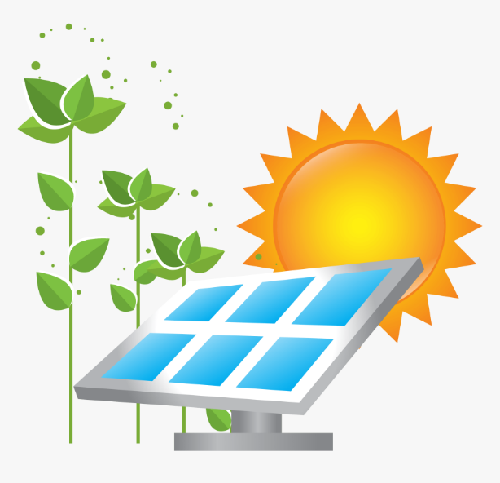
Unit
10
ENERGY SOURCES
LESSON 1: GETTING STARTED
Types of energy sources
HOBBIES

Slide 3

OBJECTIVES
By the end of the lesson, students will be able to gain:
an overview about the topic Energy sources
vocabulary to talk about types of energy

Slide 4
LESSON 1: GETTING STARTED
WARM-UP
Brain storming
PRESENTATION
Vocabulary
Task 1: Listen and read.
Task 2: What are Lan and her father talking about?
Task 3: Read the conversation again and answer the questions.
Task 4: Match the words / phrases in the box with the correct pictures.
Task 5: Complete each of the sentences with the correct word from the conversation.
PRACTICE
PRODUCTION
Task 6: Group discussion
CONSOLIDATION
Wrap-up
Homework

Slide 5
LESSON 1: GETTING STARTED
WARM-UP
Brain storming
Aims of the stage:
To activate students’ knowledge on the topic of the unit
To enhance students’ skills of cooperating with teammates

Slide 6
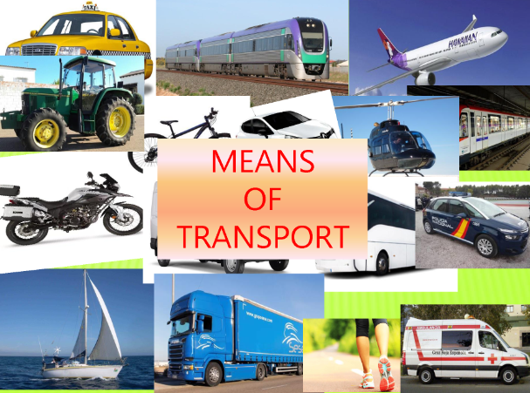

WARM-UP

Slide 7
LESSON 1: GETTING STARTED
WARM-UP
Brain storming
PRESENTATION
Vocabulary
Task 1: Listen and read.

Slide 8
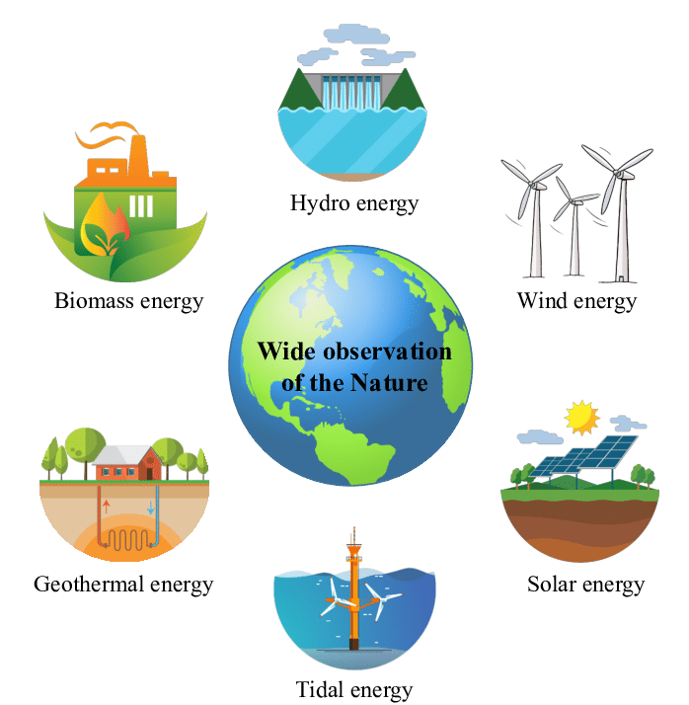
PRESENTATION
energy source (n)
/ˈenədʒi sɔːs/
nguồn năng lượng

Slide 9
PRESENTATION
coal (n)
/kəʊl/
than đá

Slide 10
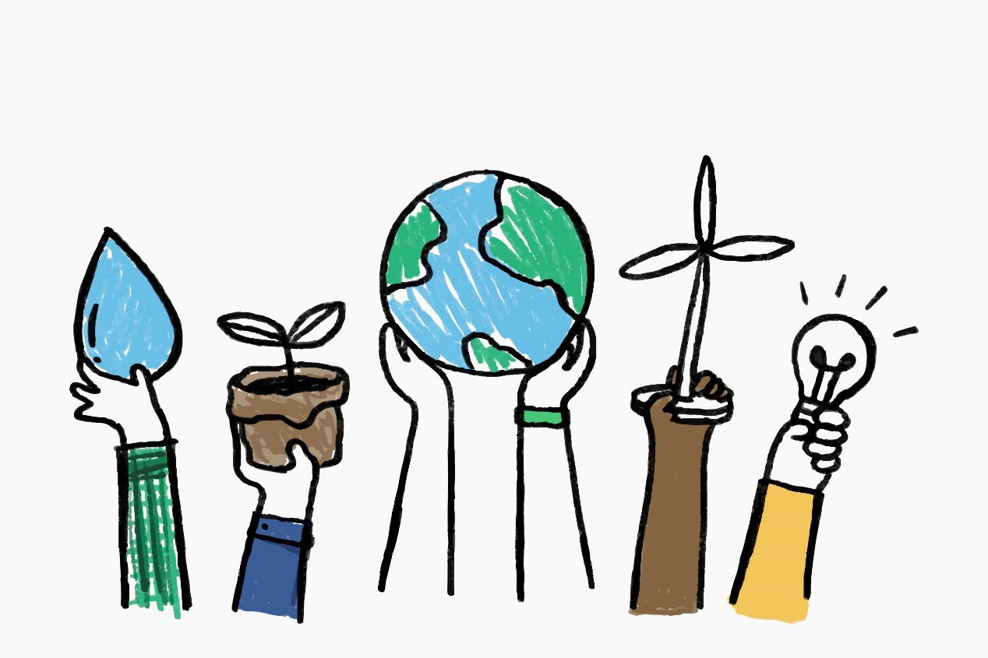
PRESENTATION
renewable (a)
/rɪˈnjuːəbl/
có thể tái tạo được

Slide 11
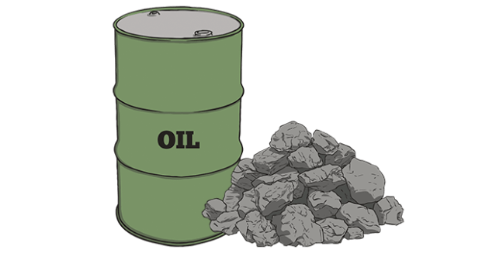
PRESENTATION
non-renewable (a)
/nɒn rɪˈnjuːəbl/
không thể tái tạo được

Slide 12
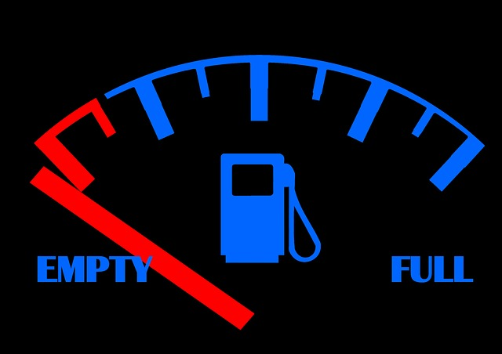
PRESENTATION
run out (+of) (phr. v)
/rʌn aʊt/
cạn kiệt

Slide 13

PRESENTATION
replace (v)
/rɪˈpleɪs/
thay thế

Slide 14
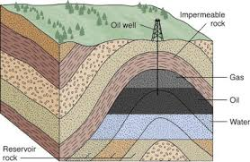
PRESENTATION
natural gas (n)
/ˌnætʃrəl ˈɡæs/
Khí tự nhiên
gas that is found under the ground or the sea and that is used as a fuel

Slide 15
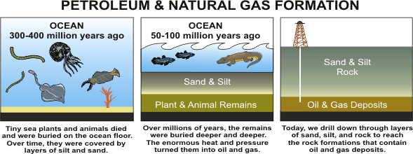
PRESENTATION

Slide 16

PRESENTATION
do a project on ( +sth)
làm dự án về cái gì

Slide 17

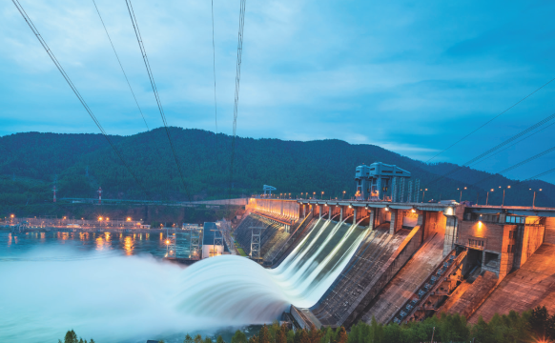
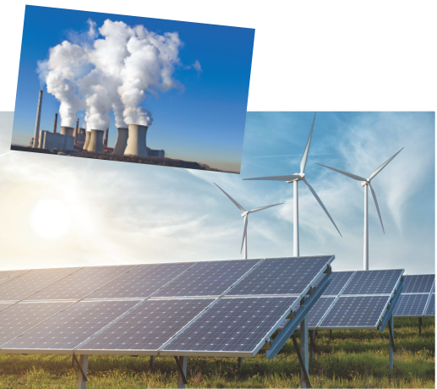
PRESENTATION
2
LISTEN AND READ.
Lan: Hi, Dad. Mr Tan: Lan, what are you doing? It’s pretty late now. Lan: I’m doing a project on energy sources. But I don’t quite understand what energy is. Mr Tan: Well, it’s power that we use to provide us with light, heat or electricity. Lan: Oh. Where does it come from? Mr Tan: It comes from many diﬀerent sources like coal, oil, natural gas, … We call them non-renewable sources. Lan: Can it come from the sun, wind or water too? Mr Tan: Yes, it can. We call those types of energy renewable sources because we cannot run out of them. Renewable means we can easily replace them. Lan: I get it now. Mr Tan: You know, some types of energy are cheap and easy to use, but others are more expensive and harder to find …

Slide 18
LESSON 1: GETTING STARTED
WARM-UP
Brain storming
PRESENTATION
Vocabulary
Task 1: Listen and read.
Task 2: What are Lan and her father talking about?
Task 3: Read the conversation again and answer the questions.
Task 4: Match the words / phrases in the box with the correct pictures.
Task 5: Complete each of the sentences with the correct word from the conversation.
PRACTICE

Slide 19

PRACTICE
2
What are Lan and her father talking about?
A. Energy B. Sources C. Energy sources
Mr Tan: Lan, what are you doing? It’s pretty late now. Lan: I’m doing a project on energy sources. But I don’t quite understand what energy is.

Slide 20
PRACTICE
3
Read the conversation again and answer the questions.
1. What is Lan doing?
_______________________________________________________________
2. What does energy mean?
_______________________________________________
3. Where does energy come from?
_____________________________________________________________________
4. What are renewable sources?
_______________________________________________
She’s doing a project on energy sources.
It’s power that we use to provide us with light, heat or electricity.
From many diﬀerent sources such as coal, oil, natural gas, water, wind, and the sun.
They are energy that comes from the sun, wind and water.

Slide 21
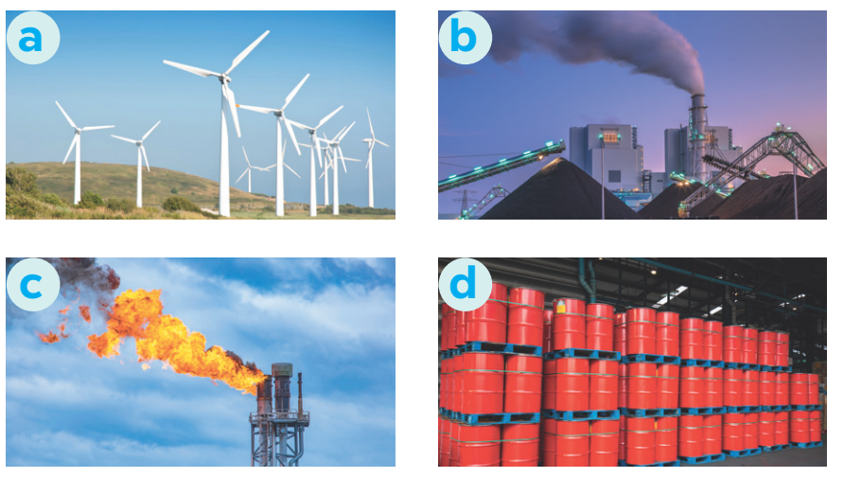
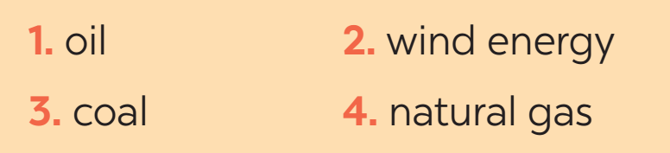
PRACTICE
3
Match the words / phrases in the box with the correct pictures.

Slide 22
PRACTICE
4
Complete each of the sentences with the correct word from the conversation
1. Energy is ______ that we use to provide us with light, heat or electricity.
2. When energy comes from the ______, wind and water, we call it renewable energy.
3. When energy comes from wind, we call it _______________ energy.
4. We cannot ______ out of renewable energy.
5. Some types of energy are ______ and easy to use.
power
sun
renewable/ wind
run
cheap

Slide 23
LESSON 1: GETTING STARTED
WARM-UP
Brain storming
PRESENTATION
Vocabulary
Task 1: Listen and read
Task 2: What are Lan and her father talking about?
Task 3: Read the conversation again and answer the questions.
Task 4: Match the words / phrases in the box with the correct pictures.
Task 5: Complete each of the sentences with the correct word from the conversation
PRACTICE
PRODUCTION
Task 6: Group discussion

Slide 24

PRODUCTION
GROUP DISCUSSION
1. What is the best source of energy?
2. Why do you think it is the best one?

Slide 25
LESSON 1: GETTING STARTED
WARM-UP
Brain storming
PRESENTATION
Vocabulary
Task 1: Listen and read.
Task 2: What are Lan and her father talking about?
Task 3: Read the conversation again and answer the questions.
Task 4: Match the words / phrases in the box with the correct pictures.
Task 5: Complete each of the sentences with the correct word from the conversation
PRACTICE
PRODUCTION
Task 6: Group discussion
CONSOLIDATION
Wrap-up
Homework

Slide 26
CONSOLIDATION
1
WRAP-UP
ENERGY SOURCES
TYPES OF ENERGY
SOURCES OF ENERGY
Topic of the unit
Vocabulary

Slide 27

CONSOLIDATION
2
HOMEWORK
Write new words 2 lines and learn by heart.
Do exercises in your workbook (B-1)
Prepare the vocabulary for the next lesson: A closer look 1.

Slide 28

Website: sachmem.vn
Fanpage: facebook.com/sachmem.vn/

