Slide 2


OBJECTIVES
By the end of the lesson, students will be able to gain:
an overview about the topic My new school
vocabulary to talk about school things

Slide 3
1. New words

Slide 4

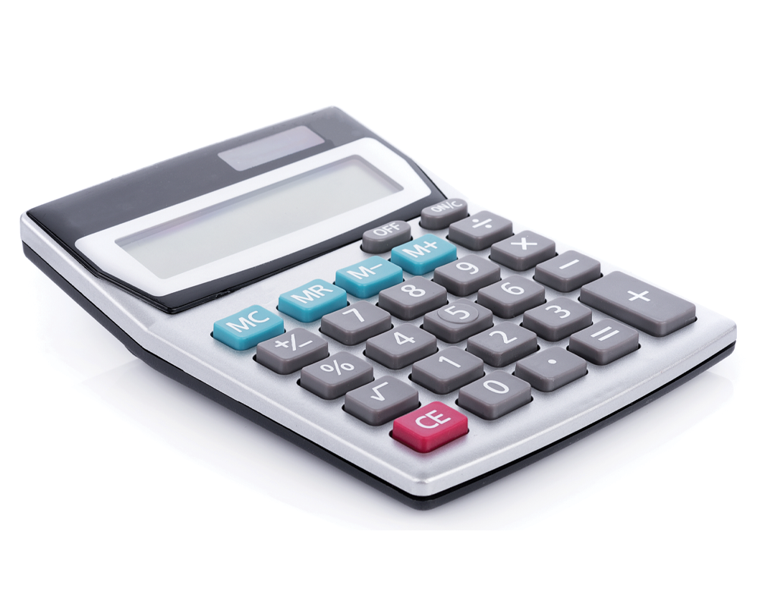
calculator (n)
/ˈkælkjuleɪtə(r)/
máy tính

Slide 5
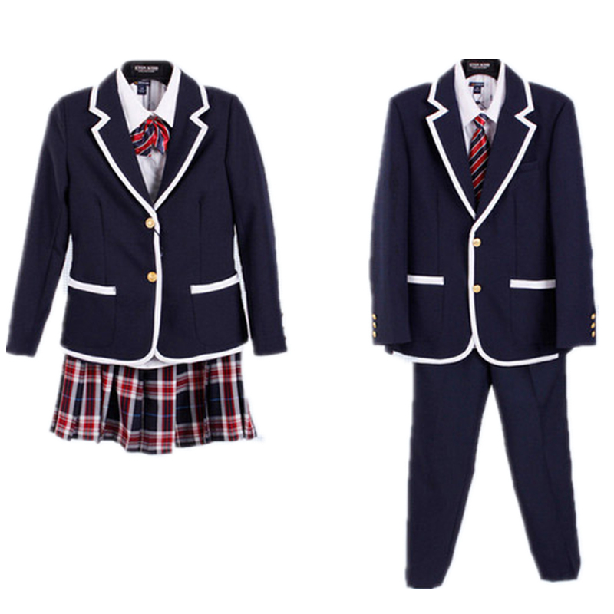
uniform (n)
/ˈjuːnɪfɔːm/
đồng phục

Slide 6
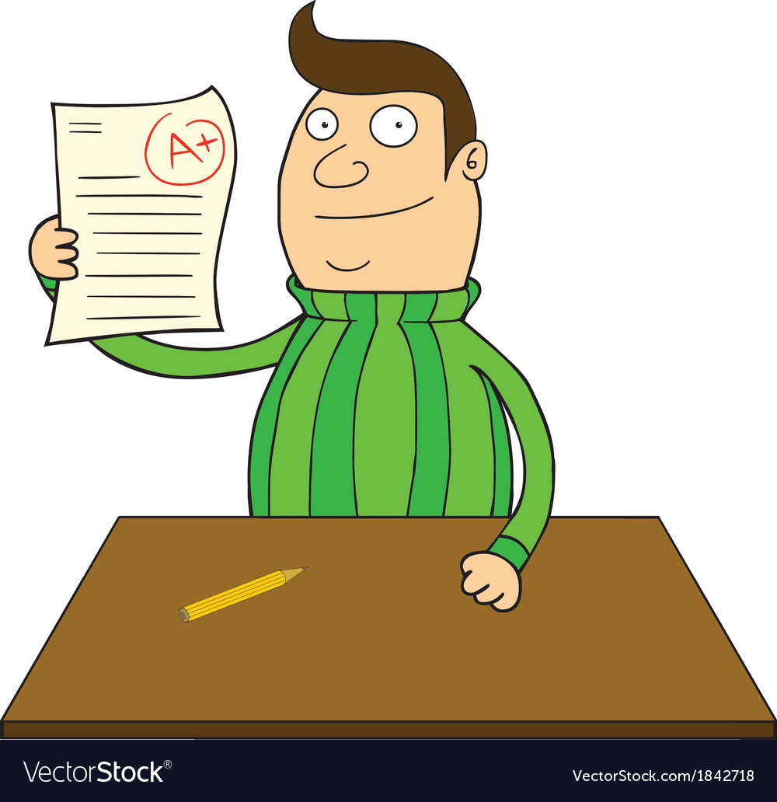
smart (adj)
/smɑːt/
thông minh

Slide 7

wear (V)
/weə(r)/
mang, mặc, đội

Slide 8
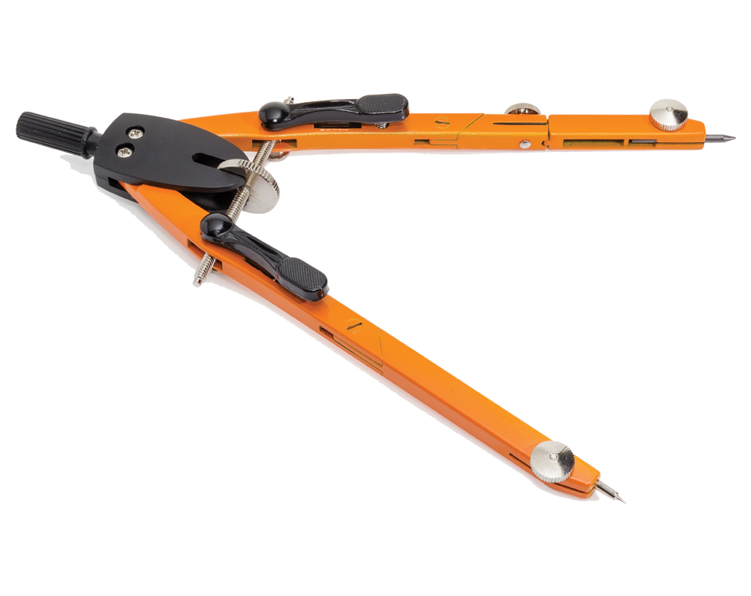
compass (N)
/ˈkʌmpəs/
com-pa

Slide 9
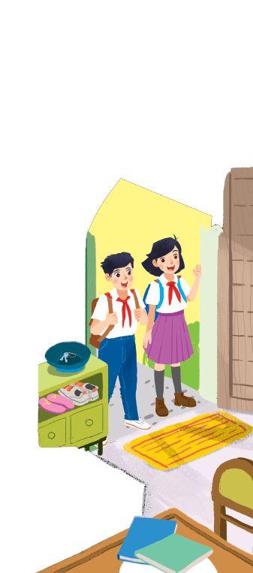
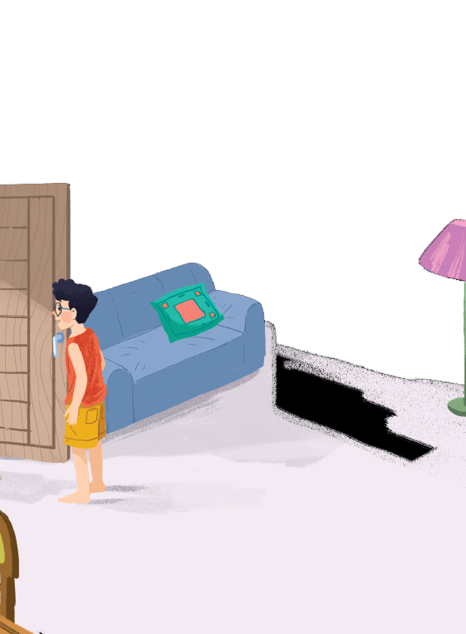


Listen and read.
1. Where are they?
2. Who are they?
3. Why is it a special day?
A special day

Slide 10
A special day
(Loud knock)
Phong: Hi, Vy.
Vy: Hi, Phong. Are you ready?
Phong: Just a minute.
Vy: Oh, this is Duy, my new friend.
Phong: Hi, Duy. Nice to meet you.
Duy: Hi, Phong. I live near here, and we go to the same school!
Phong: Good. Hmm, your school bag looks heavy.
Duy: Yes! I have new books, and we have new subjects to study.
Phong: And a new uniform, Duy! You look smart!
Duy: Thanks, Phong. We always look smart in our uniforms.
Phong: Let me put on my uniform. Then we can go.

Slide 11

Read the conversation again and tick () T (True) or F (False).
 |  | T | F
1. | Vy, Phong, and Duy go to the same school.
2. | Duy is Phong’s friend.
3. | Phong says Duy looks smart in his uniform.
4. | They have new subjects to study
5. | Phong is wearing a school uniform.
✓
✓
✓
✓
✓

Slide 12

Write ONE word from the box in each gap.
go
subjects
has
wear
uniforms
Students their uniforms on Monday.
1.
wear
has
2.
Vy a new friend, Duy.
- Do Phong, Vy, and Duy to the same school?
3.
go
- Yes, they do.
Students always look smart in their .
4.
uniforms
5.
- What do you like to study?
subjects
- I like to study English and history.

Slide 13

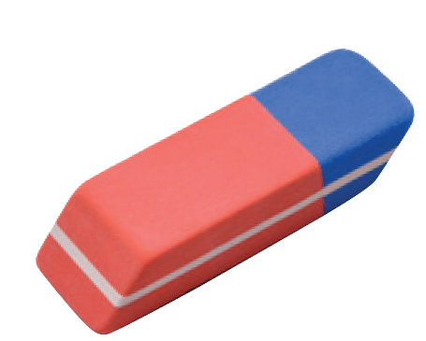
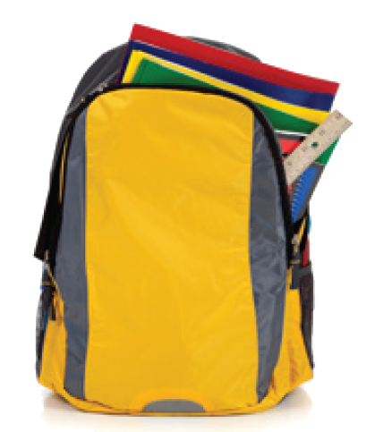
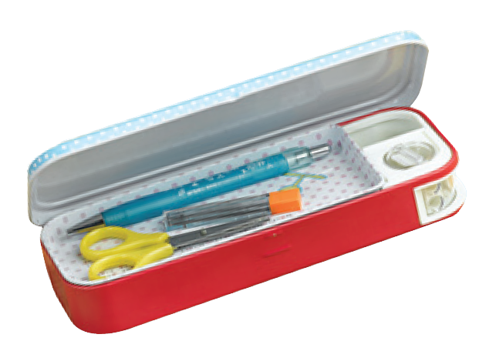
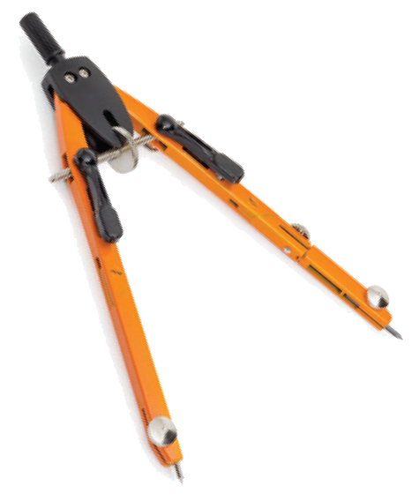
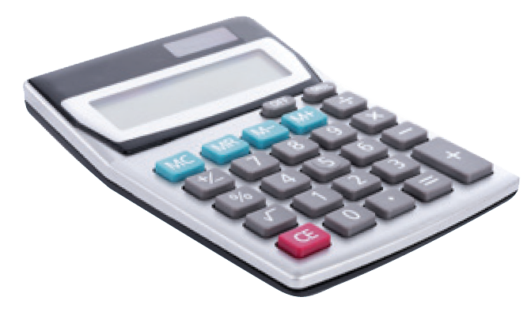
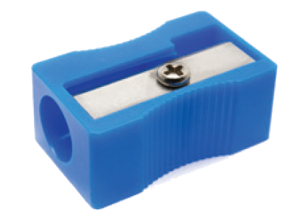
Match the word with the school things. Then listen and repeat.
pencil sharpener
4
compass
1
school bag
2
calculator
5
rubber
3
pencil case
6

Slide 14
Match the word with the school things. Then listen and repeat.
school bag
rubber
4
1
compass
pencil case
2
5
pencil sharpener
calculator
3
6
https://www.sachmem.vn/books/256/exercises/16052

Slide 15

Look around the class. Write the names of the things you see in your notebook.

Slide 16
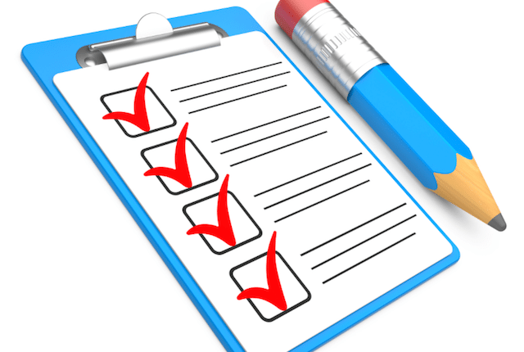
CONSOLIDATION
1
WRAP-UP
What have we learnt in this lesson?
an overview about the topic My new school
vocabulary to talk about school things

Slide 17

CONSOLIDATION
2
HOMEWORK
Practice reading the conversation on page 6.
Do exercise in Workbook.
Write new words 2 lines.
Prepare the next lesson.

