Slide 2

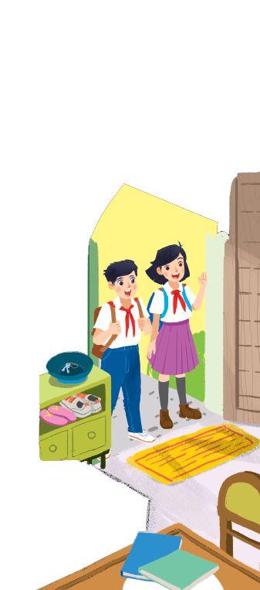
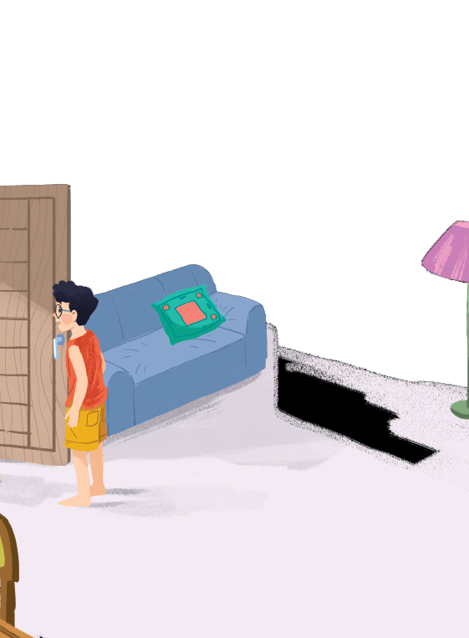
Underline the present simple sentences
A special day
Duy: Hi, Phong. I live near here, and we go to the same school!
Phong: Good. Hmm, your school bag looks heavy.
Phong: And a new uniform, Duy! You look smart!
Duy: Thanks, Phong. We always look smart in our uniforms.

Slide 3



Grammar
The present simple
Adverbs of frequency

Slide 4


Slide 5


interview (N, V)
/ˈɪntəvjuː/
phỏng vấn

Slide 6
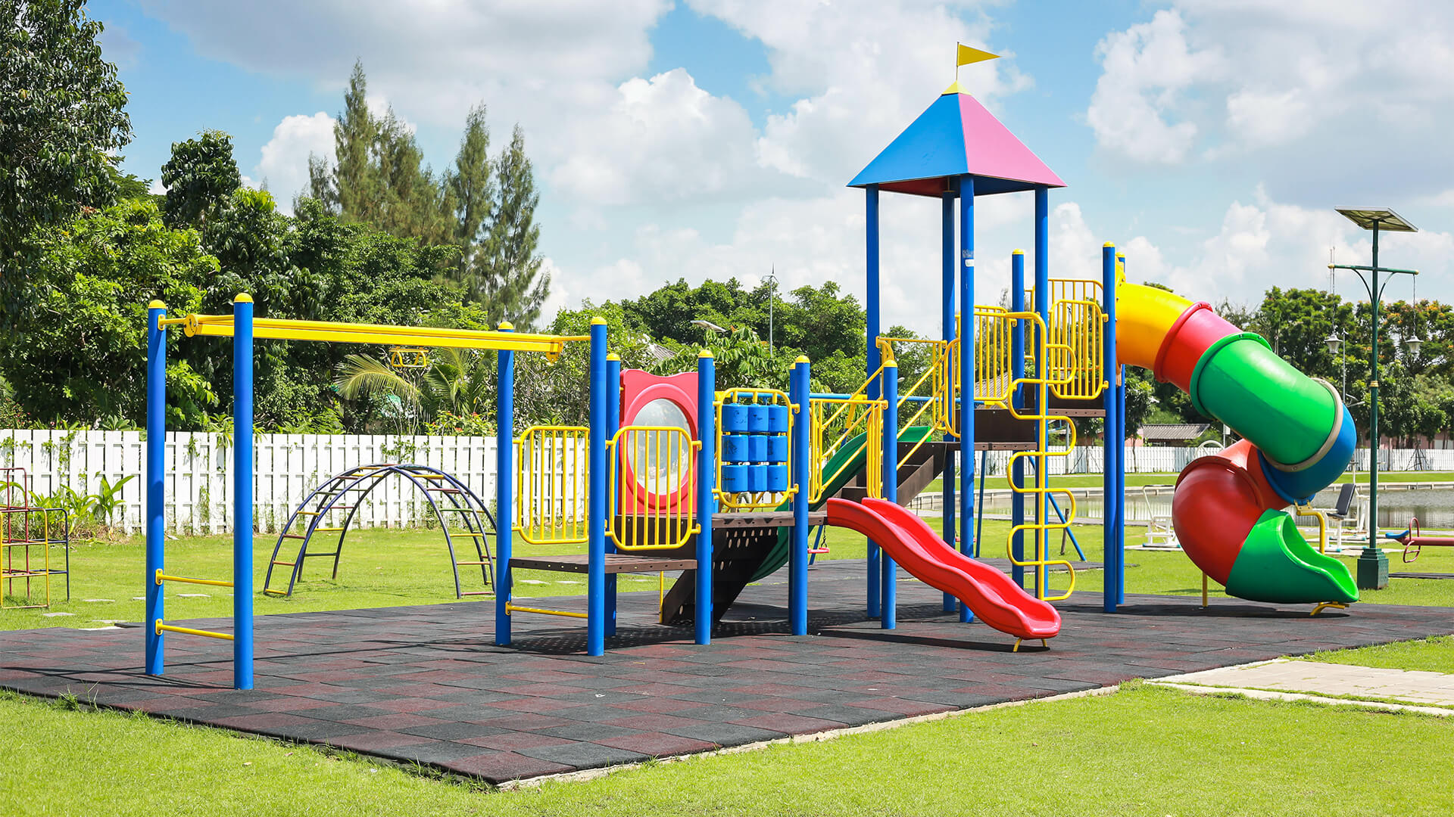
playground (n)
/ˈpleɪɡraʊnd/
sân chơi

Slide 7

Grammar
The present simple
We use the present simple to talk about actions or events that often happen, or are fixed.
Example:
We usually go to school by bus.
I don’t like school lunch very much.

Slide 8
Grammar
The present simple
Be
Verb
(+) S + am/ is/ are + O
(-) S + am/ is/ are + not + O
(?) Am/ Is/ Are + s + O?
- Yes, S + am/ is/ are
- No, S + am/ is/ are + not.
( I + am; he/ she/ it + is; You/ we/ they + are)
(+) S + V_{inf/ s, es} + O
(-) S + don’t/ doesn’t + V_{inf} + O
(?) Do/ Does + S + V_{inf} + O?
- Yes, S +do/ does
- No, S + don’t/ doesn’t.
( I / you/ we/ they + V_{inf}; He/ She/ It + V_{s/es})

Slide 9

Choose the correct answer A, B, or C.
1.
We new subjects for this school year.
A.
B.
has
C.
having
have
2.
Duy to school every day.
A.
cycling
B.
cycle
C.
cycles
3.
My new school in the centre of the village.
B.
C.
doesn’t
A.
not
isn’t
4.
I live near here. Where live?
A.
B.
you
C.
are you
do you
5.
My friend has a sister, but she a brother.
A.
B.
don’t have
C.
doesn’t have
not has

Slide 10

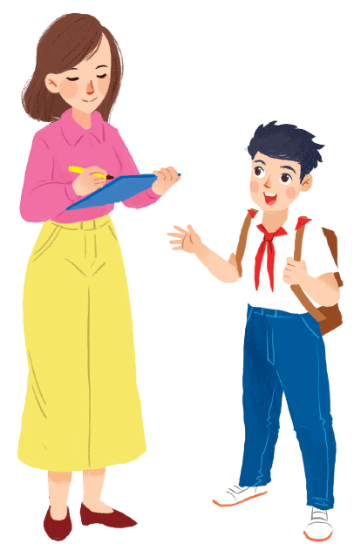
Miss Nguyet is interviewing Duy for the school newsletter. Write the correct form of the verbs.
Miss Nguyet: Tell us about your new school, Duy.
has
Duy: Sure! My school (1.have) a large playground.
Do
have
Mis Nguyet: you (2. have) any new friends?
like
Duy: Yes. And I (3. like) my new friends, Vy and Phong.
Does
walk
Mis Nguyet: Vy (4. walk) to school with you?
ride
Duy: Well, we often (5. ride) our bicycles to school.
Mis Nguyet: What time do you go home?
Duy: I (6. go) home at 4 p.m. every day.
go
Mis Nguyet: Thank you!

Slide 11
Grammar
Adverbs of frequency
We use adverbs of frequency to show how often something happens.
We often use them with the present simple.
We usually place the adverb of frequency before the main verb.
Example:
Tom usually takes the bus to school.
They don’t often go to the cinema.

Slide 12

Fill the blanks with usually, sometimes or never.
1.
always
2.
usually
3.
sometimes
4.
rarely
5.
never

Slide 13
1.
always
2.
usually
3.
sometimes
4.
rarely
5.
never
Write a sentence with one of these adverbs.
1.
He always gets up early.
2.
3.
4.
5.

Slide 14

Choose the correct answer A or B to complete each sentence.
1.
I late on Saturdays.
A.
get up usually
B.
usually get up
2.
My mum to work late.
A.
rarely goes
B.
goes rarely
3.
at weekends?
A.
Do you often travel
B.
Often do you travel
4.
What kind of music ?
A.
Usually does Susan listen to
B.
does Susan usually listen to?
5.
When go on holiday each year?
A.
do you usually
B.
you usually

Slide 15

Choose the correct word to complete the sentences.
1.
you / often / ride your bicycle / to school
Do you often ride your bicycle to school?
2.
you / sometimes / study / in the school libraby
Do you sometimes study in the school library?
3.
you / like / your new school
Do you like your new school?
4.
your friends / always / go to school / with you
Do your friends always go to school with you?
5.
you / usually / do homework / after school
Do you usually do homework after school?

Slide 16

Wrap up
Present Simple
always
rarely
Adverbs of frequency
usually
never
often

Slide 17

- Write new words 2 lines.
- Do more exercises in workbook.
- Make 5 sentences using adverbs of frequency and present simple.

