Slide 1


Slide 2



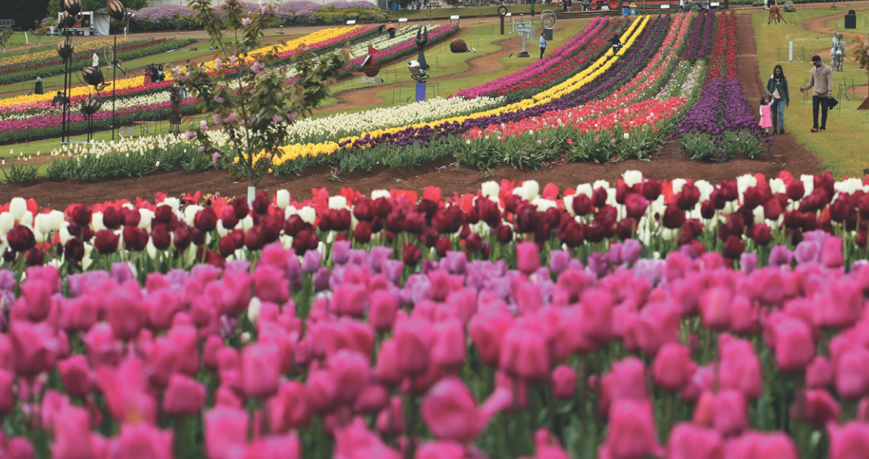
Unit
9
FESTIVALS AROUND THE WORLD
LESSON 1: GETTING STARTED
A Tulip Festival
HOBBIES

Slide 3

OBJECTIVES
By the end of this lesson, Ss will be able to:
have an overview about the topic Festivals around the world
gain vocabulary to talk about festivals

Slide 4
LESSON 1: GETTING STARTED
WARM-UP
Chatting
PRESENTATION
Vocabulary
Task 1: Listen and read.
Task 2: Read the conversation again and tick the correct column.
Task 3: Write the correct word or phrase from the box under each picture.
Task 4: Fill in each blank with a word from 3.
Task 5: Quiz. What festival is it? Match each description with a festival.
PRACTICE
CONSOLIDATION
Wrap-up
Homework

Slide 5

LESSON 1: GETTING STARTED
WARM-UP
Chatting
Stage aim:
To introduce and lead in the topic

Slide 6

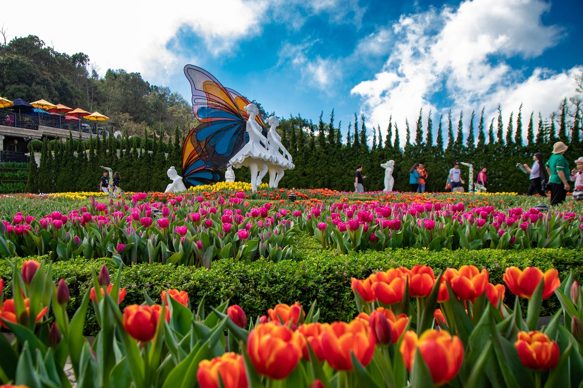
WARM-UP
What can you see in the picture?
Can you guess the name of the festival?
Have you ever heard of this festival? What do you know about it?

Slide 7

LESSON 1: GETTING STARTED
WARM-UP
Chatting
PRESENTATION
Vocabulary
Aims of the stage:
To help students use key language more appropriately before they read and listen.

Slide 8
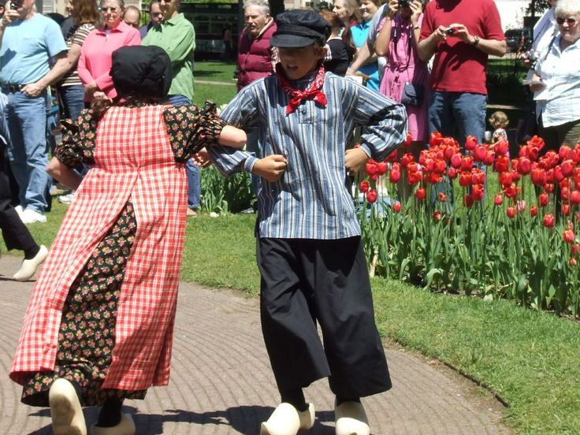
VOCABULARY
folk dance (n)
/ˈfəʊkdɑːns/
điệu nhảy/ múa dân gian

Slide 9
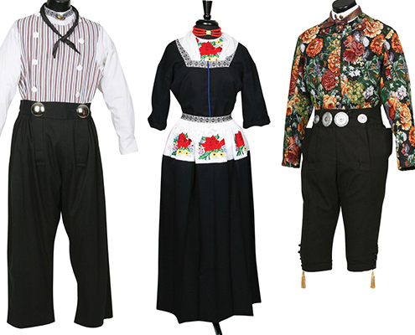
VOCABULARY
costume (n)
/ˈkɒstjuːm/
trang phục

Slide 10
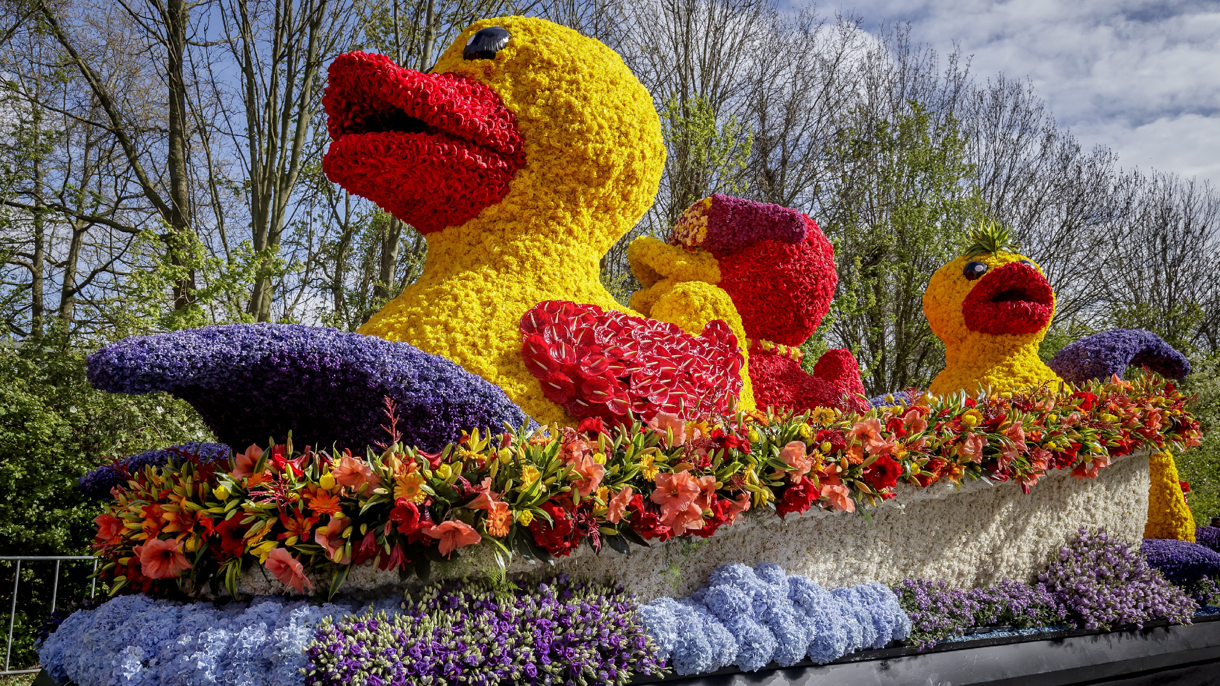
VOCABULARY
float (n)
/fləʊt/
xe diễu hành

Slide 11
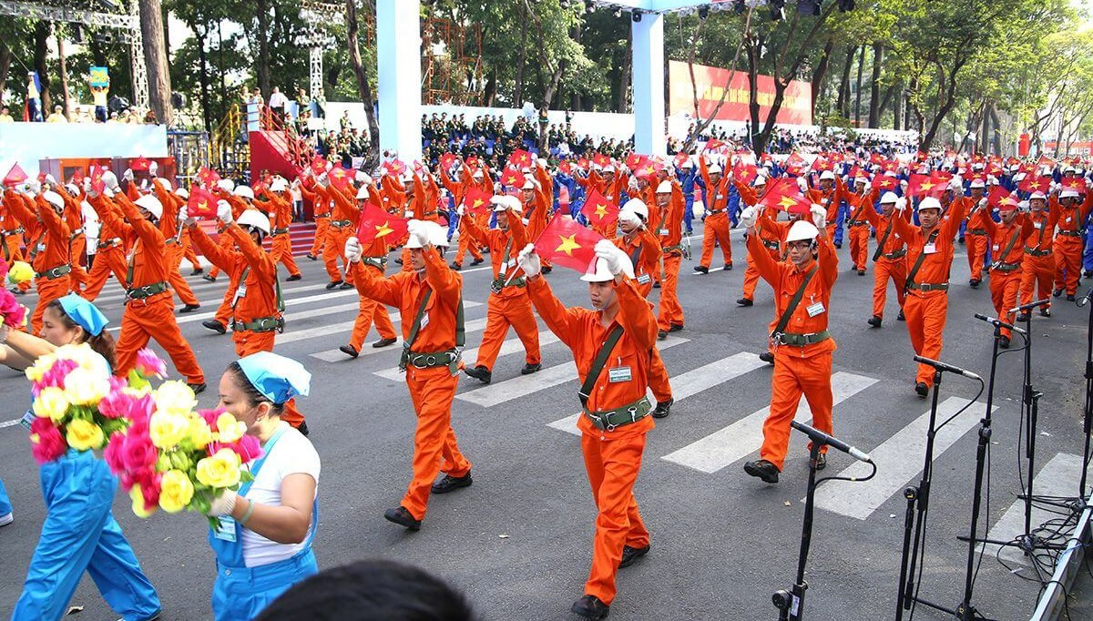
VOCABULARY
parade (n)
/pəˈreɪd/
diễu hành

Slide 12
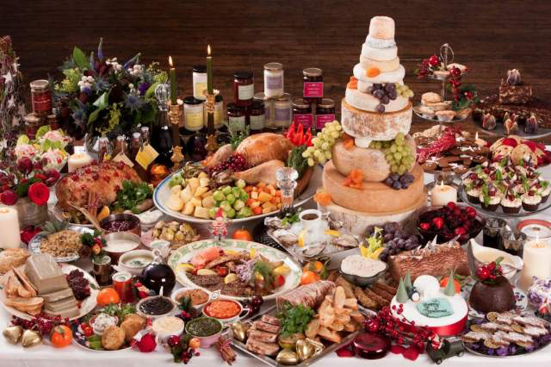
VOCABULARY
feast (n)
/fiːst/
bữa tiệc

Slide 13
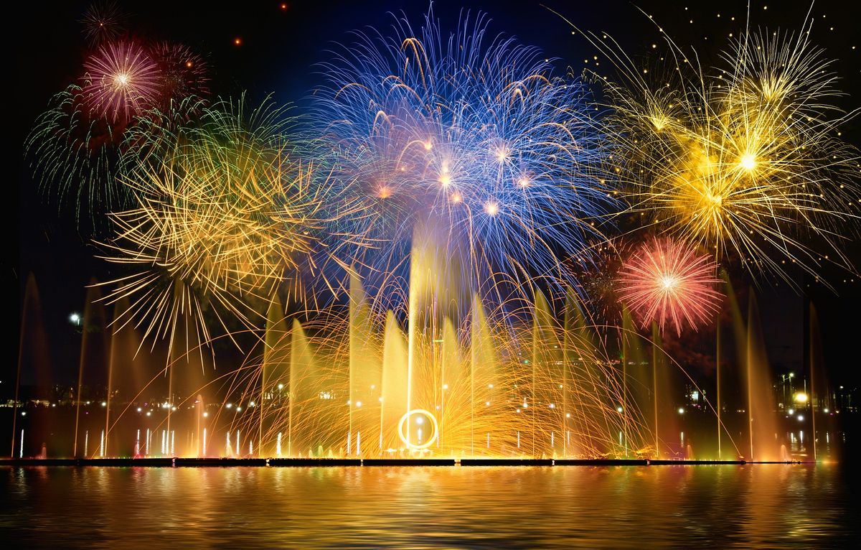
VOCABULARY
fireworks display (n)
/ˈfɑɪəwɜ:rks dɪˈspleɪ/
màn bắn pháo hoa

Slide 14
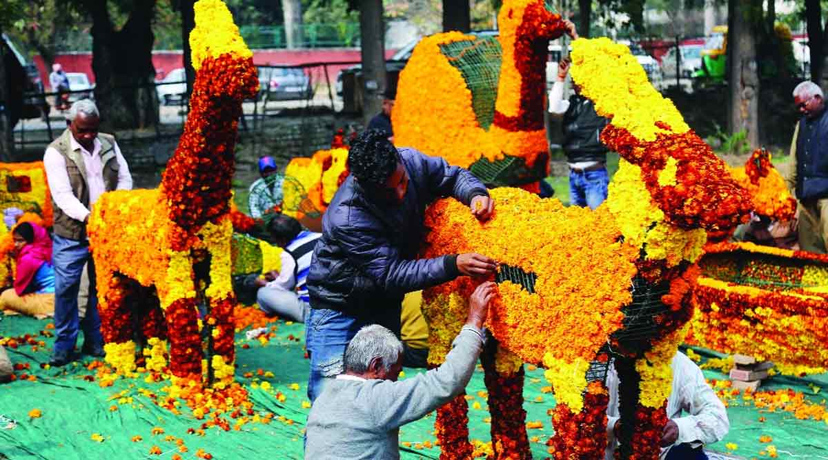
VOCABULARY
hold (v)
/həʊld/
tổ chức
* Past Simple: held

Slide 15
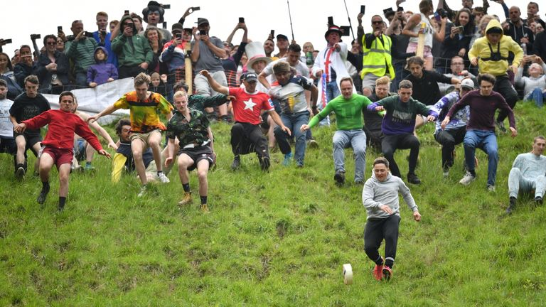
VOCABULARY
chase (v)
/tʃeɪs/
chạy, đuổi theo
* Past Simple: chased

Slide 16
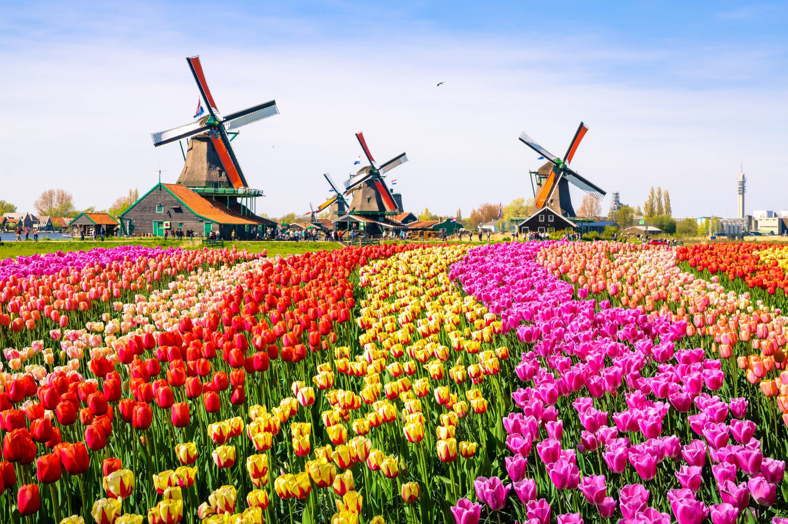
VOCABULARY
(the) Netherlands
/ˈneðələndz/
nước Hà Lan

Slide 17
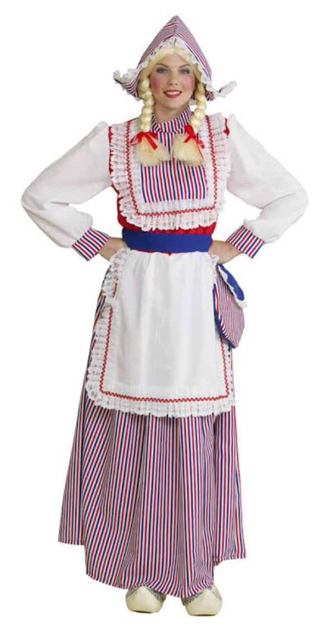
VOCABULARY
Dutch (adj, N)
/dʌtʃ/
thuộc về Hà Lan, người Hà Lan

Slide 18
LESSON 1: GETTING STARTED
WARM-UP
Chatting
PRESENTATION
Vocabulary
Task 1: Listen and read.
Task 2: Read the conversation again and tick the correct column.
Task 3: Write the correct word or phrase from the box under each picture.
Task 4: Fill in each blank with a word from 3.
Task 5: Quiz. What festival is it? Match each description with a festival.
PRACTICE

Slide 19

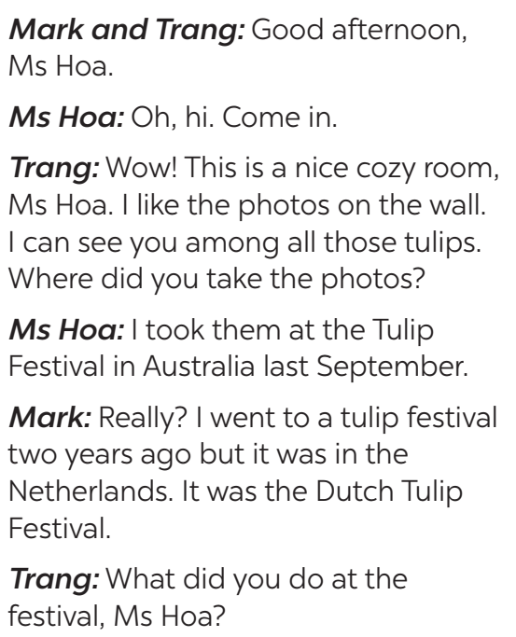
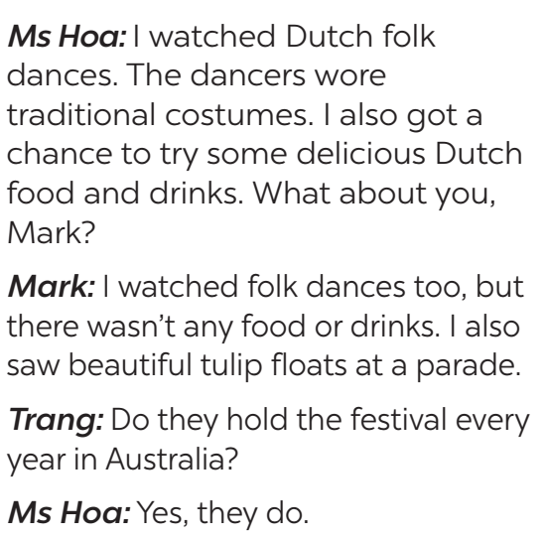
PRACTICE
1
Listen and read.

Slide 20
PRACTICE
2
Read the conversation again. Who did the following activities? Tick (✓) the correct column. Sometimes you need to tick both.
 | Ms Hoa | Mark
1. went to the Tulip Festival in Australia
2. went to the Tulip Festival in the Netherlands
3. tried Dutch food and drinks
4. watched traditional Dutch dancing
5. saw tulip floats
✓
✓
✓
✓
✓
✓

Slide 21
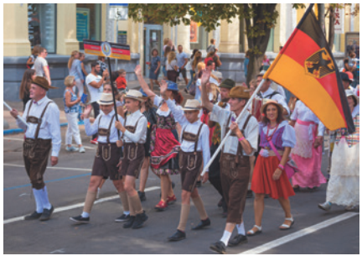
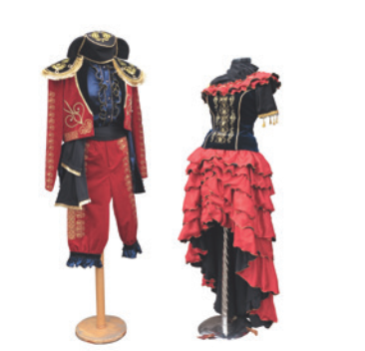
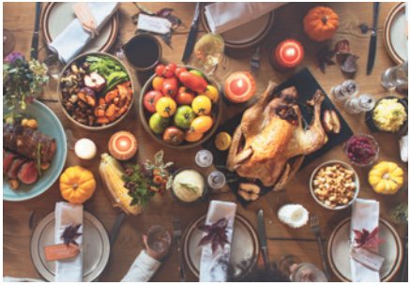
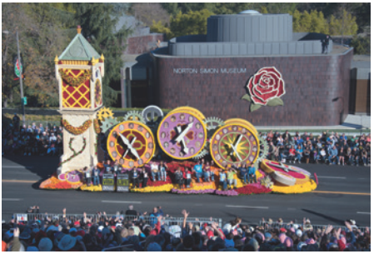
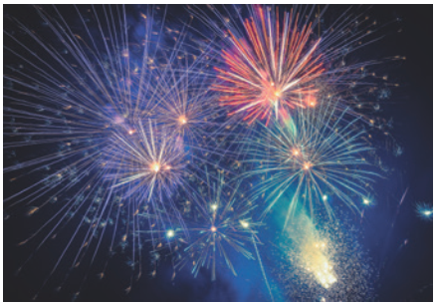
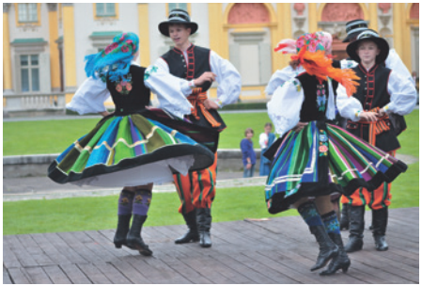
PRACTICE
3
Write a word or phrase from the box under each picture.
costumes feast float fireworks display parade folk dance
1. ___________
2. ___________
3. ___________
parade
costumes
feast
4. ___________
5. _________________
6. ___________
float
fireworks display
folk dance

Slide 22
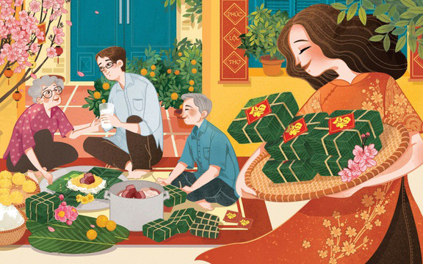
PRACTICE
4
Fill in each blank with a word or phrase from 3. You may have to change the form of the word or phrase.
Aim of the task:
to help Ss practise the words/phrases in 3.

Slide 23
PRACTICE
4
Fill in each blank with a word or phrase from 3. You may have to change the form of the word or phrase.
1. The dancers performed ___________ at the Tulip Festival.
2. On New Year’s Eve, we went to Hoan Kiem Lake to watch the ______________.
3. For Tet, we usually prepare a ___________ with special food.
4. People hold flower ___________ in several countries to welcome the new season.
5. The ___________ carried the dancers in special ___________.
folk dances
fireworks display
feast
parades
floats
costumes

Slide 24

PRACTICE
5
What festival is it? Match each description with a festival.
1. At this festival, people eat moon cakes. |  | a. La Tomatina
2. At this festival, people throw tomatoes. |  | b. Cheese rolling
3. People eat banh chung at this festival. |  | c. Christmas
4. People decorate pine trees and give each other gifts. |  | d. Tet
5. People chase after a wheel of cheese. |  | e. Mid-Autumn Festival
1. e
2. a
3. d
4. c
5. b

Slide 25
LESSON 1: GETTING STARTED
WARM-UP
Chatting
PRESENTATION
Vocabulary
Task 1: Listen and read.
Task 2: Read the conversation again and tick the correct column.
Task 3: Write the correct word or phrase from the box under each picture.
Task 4: Fill in each blank with a word from 3.
Task 5: Quiz. What festival is it? Match each description with a festival.
PRACTICE
CONSOLIDATION
Wrap-up
Homework

Slide 26
CONSOLIDATION
1
WRAP-UP
Topic of the unit
Festivals around the world
Vocabulary
Festivals

Slide 27

CONSOLIDATION
2
HOMEWORK
Write new words 2 lines and learn them by heart.
Do exercises in Workbook. (B-1,2)
Prepare for Unit 9- A closer look 1.

Slide 28

Website: sachmem.vn
Fanpage: facebook.com/sachmem.vn/

