Slide 1


Slide 2



Unit
9
FESTIVALS AROUND THE WORLD
LESSON 2: A CLOSER LOOK 1
VOCABULARY
PRONUNCIATION
Unit
HOBBIES

Slide 3

OBJECTIVES
By the end of the lesson, students will be able to gain:
- Vocabulary: types of festivals and festival activities
- Pronunciation: pronounce two-syllable words with correct stress

Slide 4
LESSON 2: A CLOSER LOOK 1
WARM-UP
Game: Hot seat
Task 1: Write under each picture a festival name.
Task 2: Complete the table below with the phrases.
Task 3: Fill in each blank with a word or phrase.
VOCABULARY
Task 4: Listen and repeat. Then underline the stressed syllable.
Task 5: Listen and repeat the sentences. Underline the stressed syllables.
PRONUNCIATION
PRODUCTION
Game: Up and down
CONSOLIDATION
Wrap-up
Homework

Slide 5
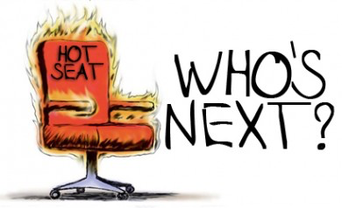
LESSON 2: A CLOSER LOOK 1
WARM-UP
Game: Hot seat
Aims of the stage:
To activate students’ knowledge

Slide 6
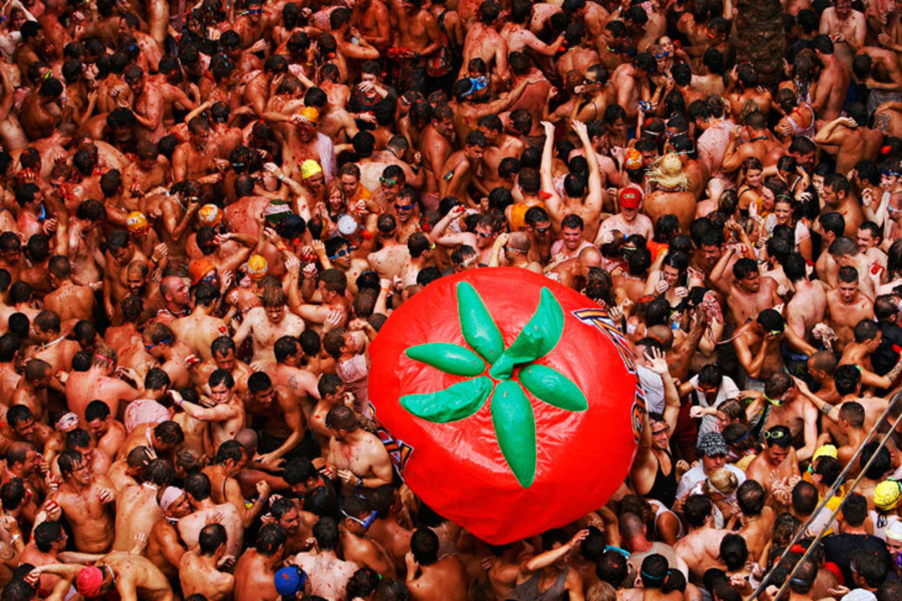
WARM-UP
La Tomatina

Slide 7
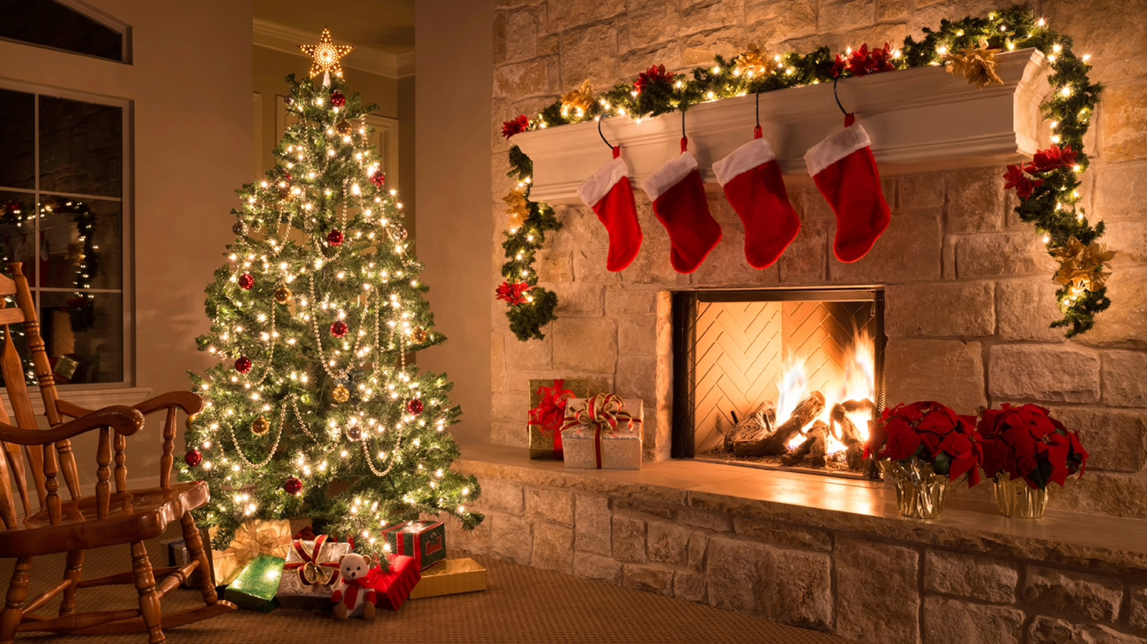
WARM-UP
Christmas

Slide 8
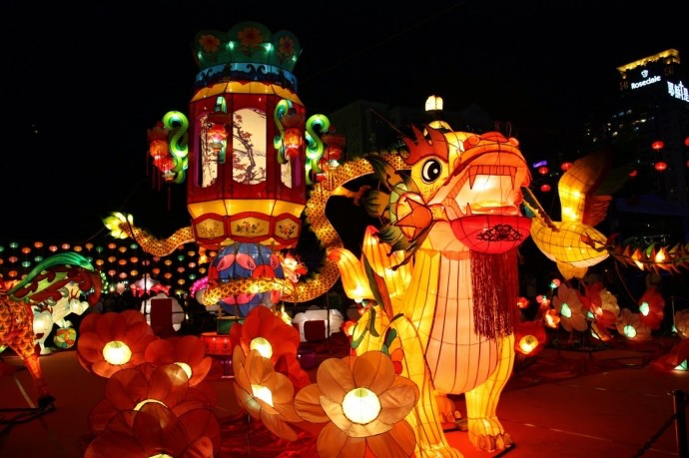
WARM-UP
Mid-Autumn Festival

Slide 9
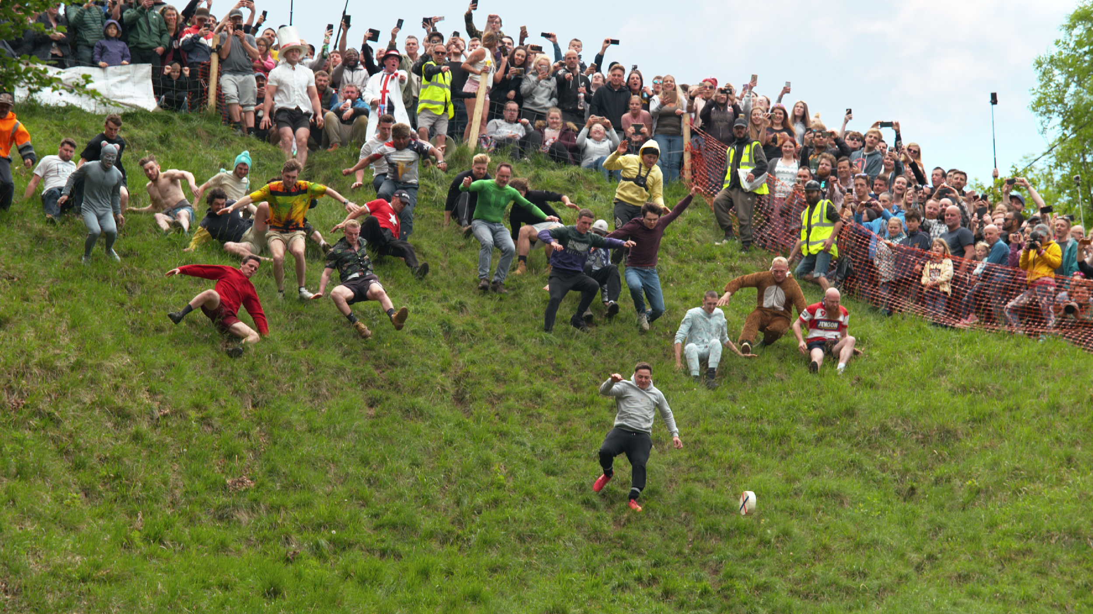
WARM-UP
Cheese Rolling

Slide 10
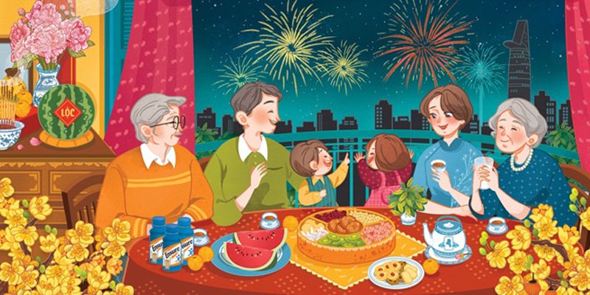
WARM-UP
Tet

Slide 11
LESSON 2: A CLOSER LOOK 1
WARM-UP
Game: Hot seat
Task 1: Write under each picture a festival name.
Task 2 Complete the table below with the phrases.
Task 3: Fill in each blank with a word or phrase.
VOCABULARY

Slide 12

VOCABULARY
Cannes Film Festival
/kæn fɪlm festɪvl/
Liên hoan phim Cannes

Slide 13
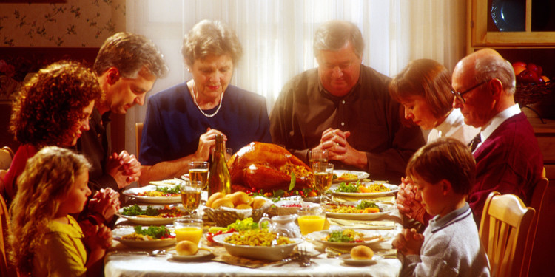
VOCABULARY
Thanksgiving
/ˌθæŋksˈɡɪvɪŋ/
Lễ Tạ ơn

Slide 14
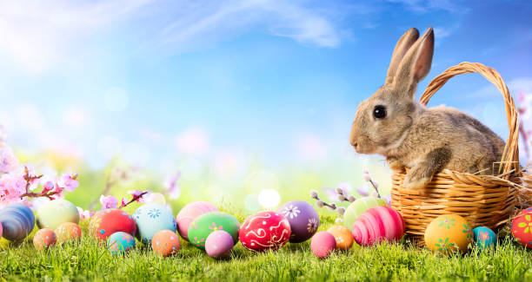
VOCABULARY
Easter (n)
/ˈiːstər/
Lễ Phục sinh

Slide 15
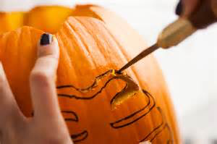
VOCABULARY
carve (v)
/kɑːv/
chạm, khắc

Slide 16
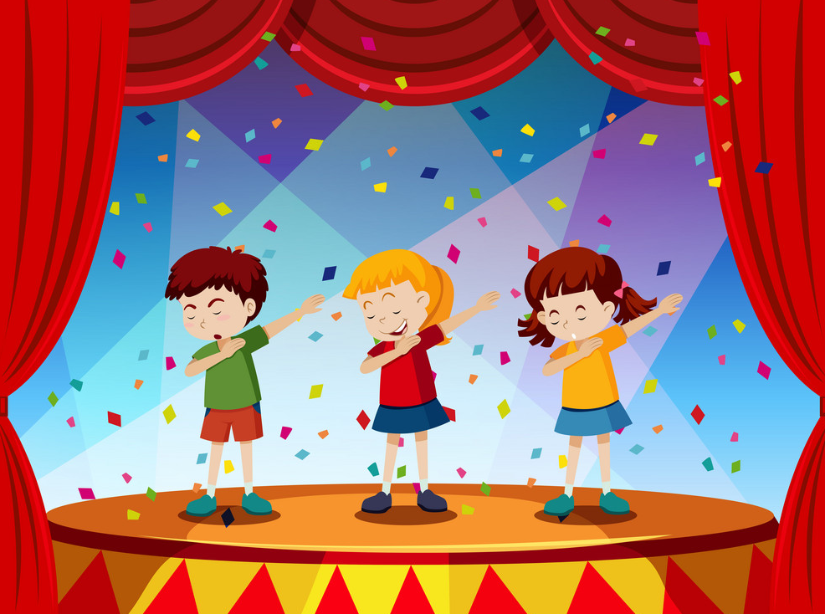
VOCABULARY
perform (v)
/pəˈfɔːm/
biểu diễn

Slide 17
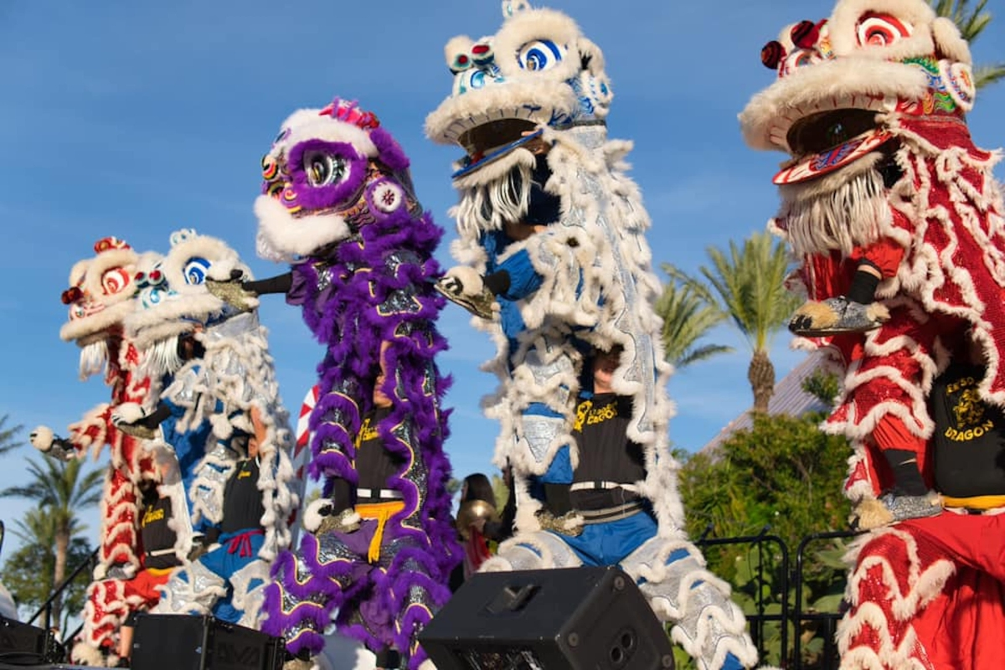
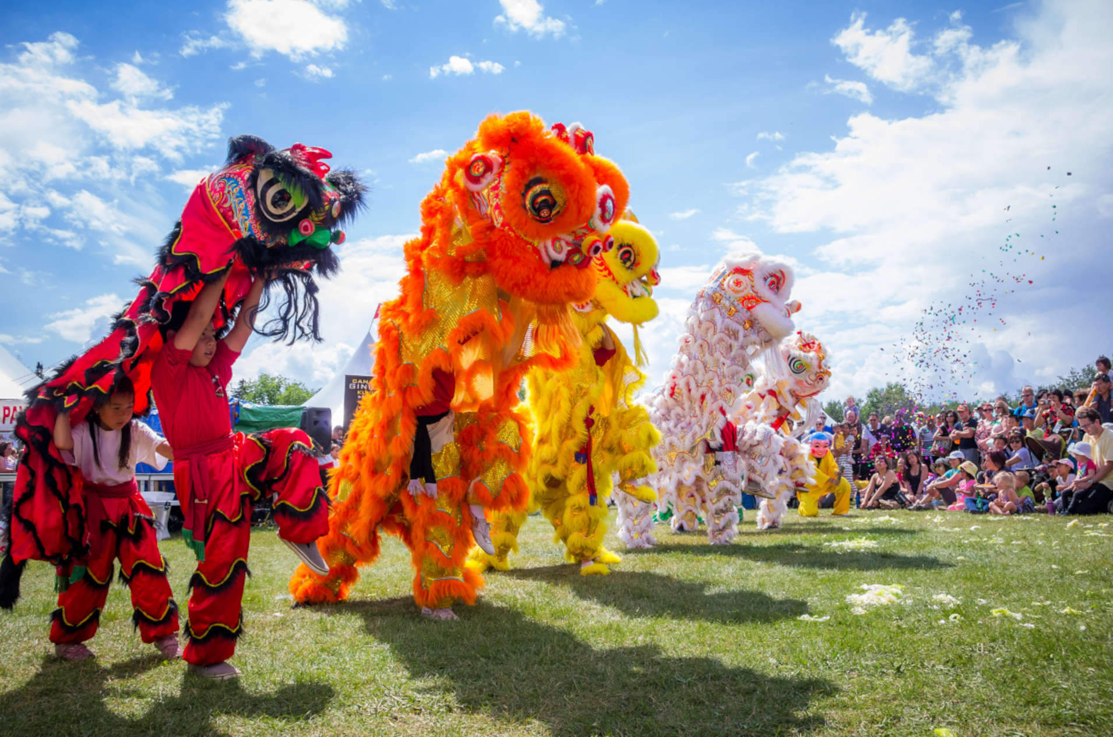
VOCABULARY
lion dance (n)
/pəˈfɔːm/
múa lân

Slide 18
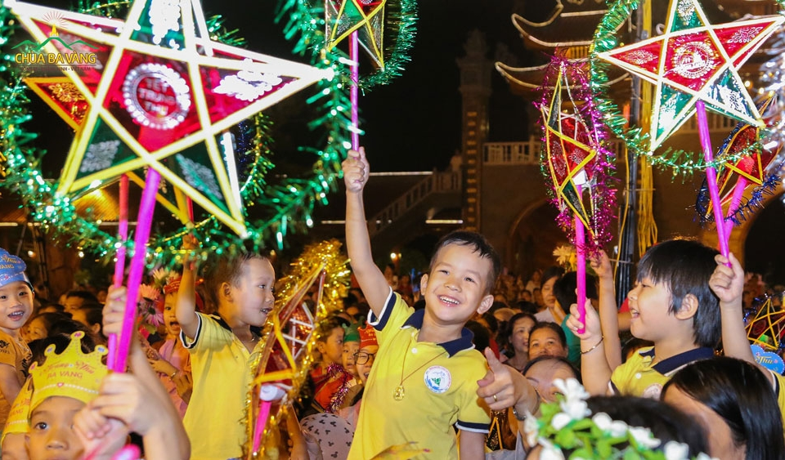
VOCABULARY
Mid-Autumn Festival
(n)
Tết Trung thu

Slide 19
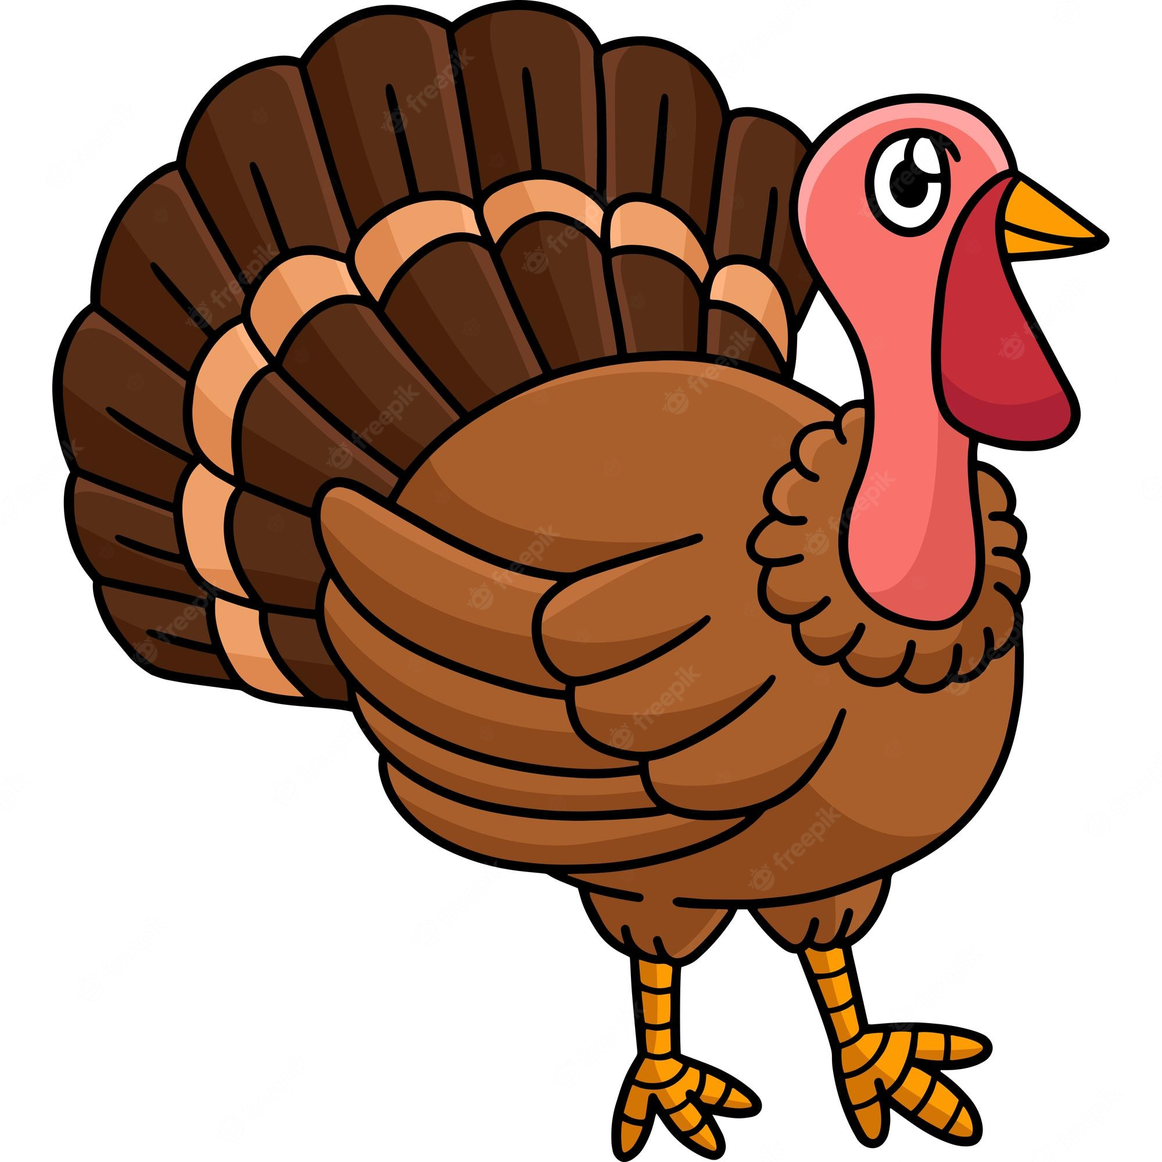
VOCABULARY
turkey (n)
/ˈtɜːki/
gà tây

Slide 20
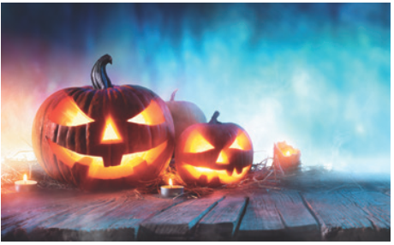
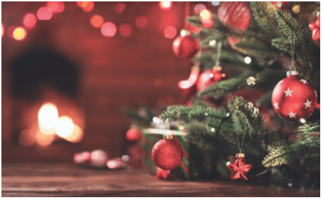
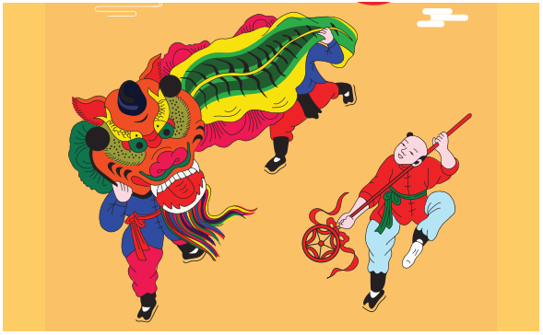
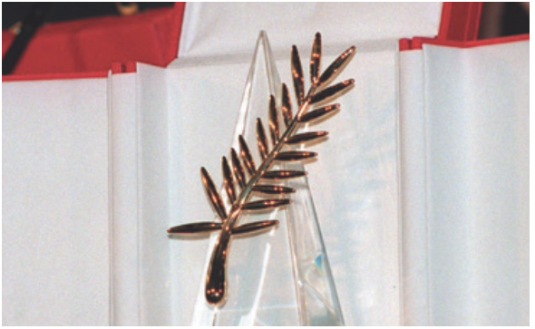
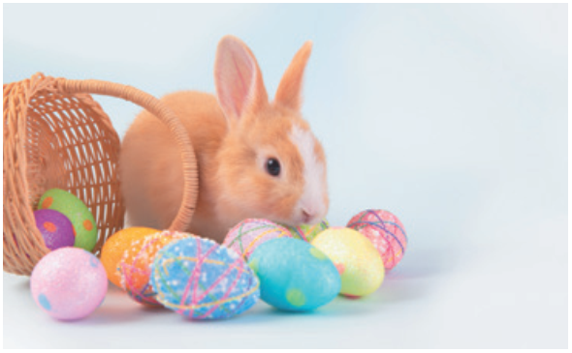
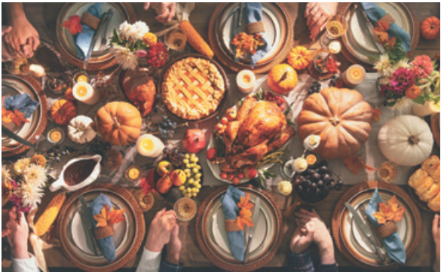
VOCABULARY
1
Write under each picture a festival name from the box.
Cannes Film Festival Mid-Autumn Festival Thanksgiving Christmas Halloween Easter
2. _________
3. _________________
Halloween
Christmas
Mid-Autumn Festival
1. ___________
4. _________________
5. _______
6. _____________
Cannes Film Festival
Easter
Thanksgiving

Slide 21
VOCABULARY
2
Complete the table below with the phrases from the box.
having a feast moon cakes chocolate eggs candy apples turkey painting eggs carving pumpkins performing a lion dance
Festival | Food | Activity
Easter
Halloween
Mid-Autumn Festival
Thanksgiving
chocolate eggs
painting eggs
candy apples
carving pumpkins
moon cakes
performing a lion dance
turkey
having a feast

Slide 22
VOCABULARY
3
Fill in blank with a word/ phrase from the box.
painting eggs Christmas Mid-Autumn Festival candy apples Cannes Film Festival turkey
1. At ______________, people give gifts to each other.
2. My children love ______________ at Easter.
3. How many ______________ do you need for the Halloween party?
4. At the _________________, there are many interesting films.
5. Performing lion dances is one of the activities at the __________________.
6. Bill’s mum is cooking a ___________ for Thanksgiving.
Christmas
painting eggs
candy apples
Cannes Film Festival
Mid-Autumn Festival
turkey

Slide 23
LESSON 2: A CLOSER LOOK 1
WARM-UP
Game: Hot seat
Task 1: Write under each picture a festival name.
Task 2: Complete the table below with the phrases.
Task 3: Fill in each blank with a word or phrase.
VOCABULARY
Task 4: Listen and repeat. Then underline the stressed syllable.
Task 5: Listen and repeat the sentences. Underline the stressed syllables.
PRONUNCIATION

Slide 24

PRONUNCIATION
Stress in two-syllable words
Aims of the stage:
To let students identify how to pronounce two-syllable words with correct stress
To let students practise pronouncing two-syllable words with correct stress in sentences

Slide 25

PRONUNCIATION
4
Listen and repeat. Then underline the stressed syllable in each word.
Nouns and Adjectives | Verbs
costume fireworks turkey happy | enjoy decide discuss prepare

Slide 26
PRONUNCIATION
5
Listen and repeat the sentences. Underline the stressed syllables in the bold words.
1. We’re going to attend an Easter party at Nick’s house.
2. The dancers will perform traditional dances at the festival.
3. At Christmas, people usually buy presents for their family.
4. Did you go to the Da Lat Flower Festival with your parents?
5. My aunt is clever and patient.

Slide 27
LESSON 2: A CLOSER LOOK 1
WARM-UP
Game: Hot seat
Task 1: Write under each picture a festival name.
Task 2: Complete the table below with the phrases.
Task 3: Fill in each blank with a word or phrase.
VOCABULARY
Task 4: Listen and repeat. Then underline the stressed syllable.
Task 5: Listen and repeat the sentences. Underline the stressed syllables.
PRONUNCIATION
PRODUCTION
Game: Up and down

Slide 28
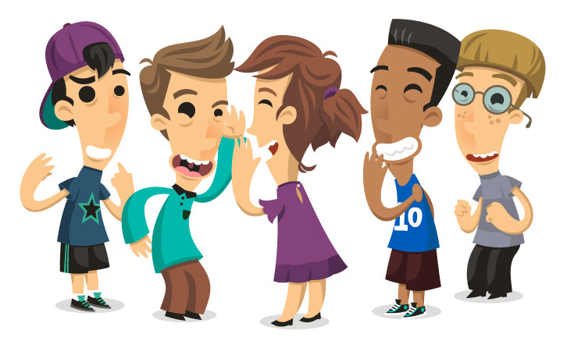
PRODUCTION
Game: Up and down
Aims of the stage:
To test students' quick reaction
Notes:
Teacher says 1-15 words containing two-syllable words. Students stand up for the words having stress on the first syllable, sit down for the ones having stress on the second syllable.

Slide 29
LESSON 2: A CLOSER LOOK 1
WARM-UP
Game: Hot seat
Task 1: Write under each picture a festival name.
Task 2: Complete the table below with the phrases.
Task 3: Fill in each blank with a word or phrase.
VOCABULARY
Task 4: Listen and repeat. Then underline the stressed syllable.
Task 5: Listen and repeat the sentences. Underline the stressed syllables.
PRONUNCIATION
PRODUCTION
Game: Up and down
CONSOLIDATION
Wrap-up
Homework

Slide 30
CONSOLIDATION
1
WRAP-UP
VOCABULARY
PRONUNCIATION

Slide 31

CONSOLIDATION
2
HOMEWORK
Write new words 2 lines and learn by heart.
Do exercises in workbook (A-1,2; B-3)
Preapare Unit 9- A closer look 2

Slide 32

Website: sachmem.vn
Fanpage: facebook.com/sachmem.vn/

