Slide 1
gm

Slide 2



Objectives
- Recognize listening skill for specific information of a conversation between Khang and Vy about directions to some places in a neighbourhood.
- Revise some words related to places.
- Use some words related to places and verb “like”, “dislike”, structure “There is”, “There are” to write a paragraph of about 50 words about your neighbourhood.

Slide 3
Listening

Slide 4


VOCABULARY
faraway (adj)
/ˈfɑːrəweɪ/
xa xôi

Slide 5
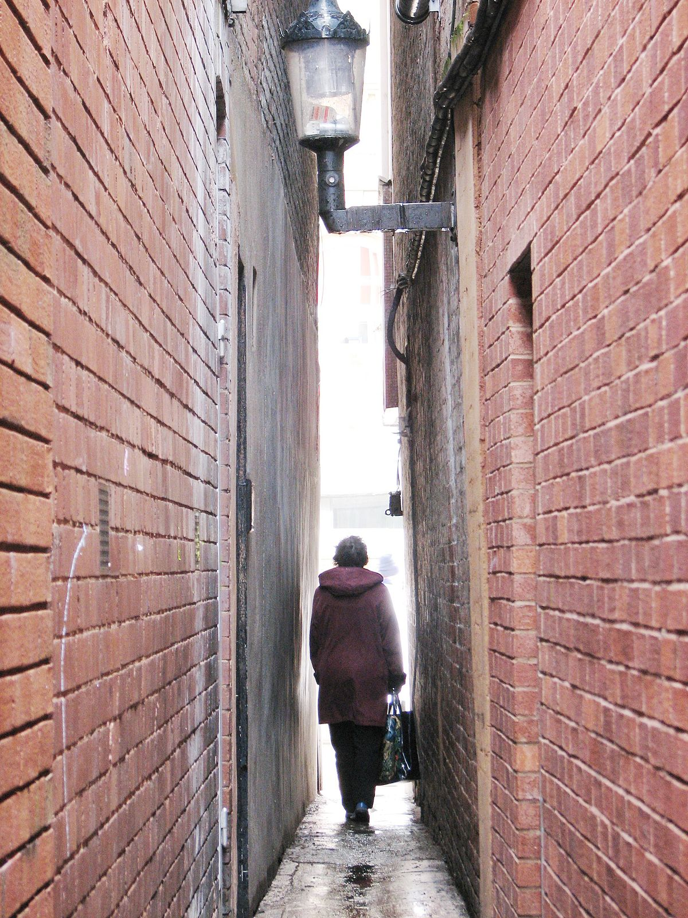
VOCABULARY
narrow (adj)
/ˈnærəʊ/
chật hẹp

Slide 6
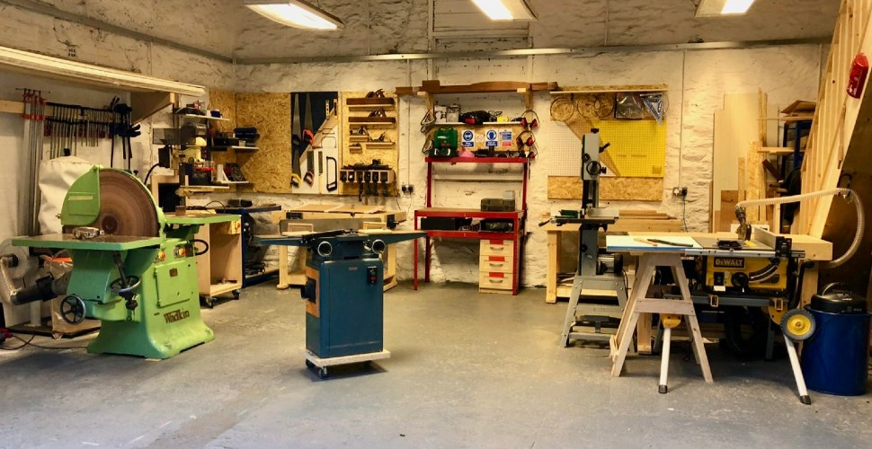
VOCABULARY
workshop (N)
/ˈwɜːkʃɒp/
phân xưởng (sản xuất, sửa chữa)

Slide 7
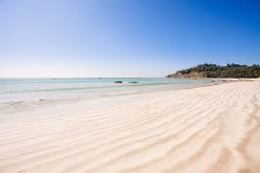
VOCABULARY
sandy (adj)
/ˈsændi/
có cát, phủ cát

Slide 8


Listen to the conversation between Khang and Vy and tick () T (true) or F (False).
 |  | T | F
1. | Vy lives in the centre of Ho Chi Minh City.
2. | There is a big market near her house.
3. | The streets are narrow.
4. | The schools are faraway.
5. | There are some factories near her neighbourhood.





Audio script

Slide 9
AUDIO SCRIPT
Khang: Where do you live, Vy?
Vy: I live in the suburbs of Ho Chi Minh City.
Khang: What do you like about it?
Vy: There are many things I like about it. There’s a big
market near my house. There are also many shops,
restaurants and art galleries here. The streets are
wide. The people here are helpful and friendly.
Khang: What do you dislike about it?
Vy: The schools are too faraway. There are also some
factories near here, so the air isn’t very clean and the
streets are noisy and crowded.

Slide 10

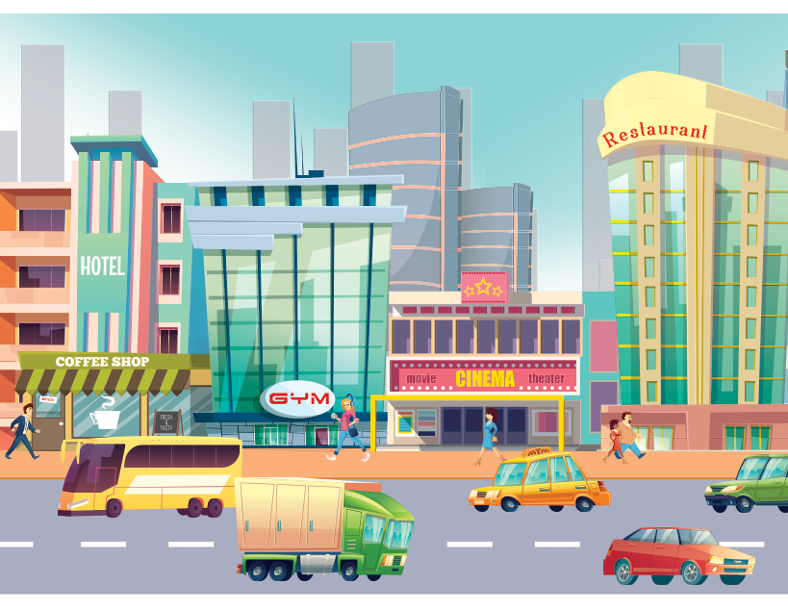
Listen to the conversation again and fill the blanks.
What Vy likes
What Vy dislikes
- many shops, restaurants, and (1) _______ in her neighbourhood
- too (4) _______ school
- dirty air
- (2) _______ streets
- noisy and (5) _______ streets
- helpful and (3) _______ people
Audio script

Slide 11
AUDIO SCRIPT
Khang: Where do you live, Vy?
Vy: I live in the suburbs of Ho Chi Minh City.
Khang: What do you like about it?
Vy: There are many things I like about it. There’s a big
market near my house. There are also many shops,
restaurants and art galleries here. The streets are
wide. The people here are helpful and friendly.
Khang: What do you dislike about it?
Vy: The schools are too faraway. There are also some
factories near here, so the air isn’t very clean and the
streets are noisy and crowded.

Slide 12
What Vy likes
- many shops, restaurants, and (1) in her neighbourhood
art galleries
- (2) streets
wide
- helpful and (3) people
friendly

Slide 13
What Vy dislikes
- too (4) school
faraway
- dirty air
- noisy and (5) streets
crowded

Slide 14
Writing

Slide 15

Tick () what you like or dislike about a neighbourhood.
 |  | Like | Dislike
1. | sandy beaches
2. | heavy traffic
3. | many modern buildings and offices
4. | peaceful streets
5. | good restaurants and cafés
6. | sunny weather
7. | helpful and friendly people
8. | many shops and markets

Slide 16


Write a paragraph of about 50 words about your neighbourhood saying what you like and dislike about it. Use Khang’s blog as a model.
I live in _______. There are many / some things I like about my neighbourhood.
However, there are some / many / one thing(s) I dislike about it.

Slide 17
Wrap-up
- Recognize listening skill for specific information of a conversation between Khang and Vy about directions to some places in a neighbourhood.
- Revise some words related to places.
- Use some words related to places and verb “like”, “dislike”, structure “There is”, “There are” to write a paragraph of about 50 words about your neighbourhood.

Slide 18
HOMEWORK
Write new words 2 lines.
Do more exercises in workbook.
Prepare new lesson: U4- Looking back & Project

Slide 19







