Slide 1

Welcome to our class today!
Class: 6A3
Teacher: Vũ Thị Hoài Thu
School: Nguyễn Bỉnh Khiêm Secondary school

Slide 2

GAME: CROSSWORD
1
C | L | E | V | E | R
2
B | U | S | - | S | T | O | P
3
T | E | M | P | L | E
4
P | E | A | C | E | F | U | L
5
C | A | T | H | E | D | R | A | L
6
S | Q | U | A | R | E
7
N | O | I | S | Y
8
E | X | P | E | N | S | I | V | E
9
C | O | N | V | E | N | I | E | N | T
10
M | O | D | E | R | N
COMPARISON

Slide 3


Question 1
Mary is_____. She learns things quickly and easily.
A. clever
B. caring

Slide 4
Question 2
You can wait for the bus at the______.
A. stations
B. bus stop

Slide 5
Question 3
On Tet holiday,we always go to the ______ .
A. temple
B. square

Slide 6
Question 4
Life in the countryside is very____.
It isn’t noisy.
A. beautiful
B. peaceful

Slide 7
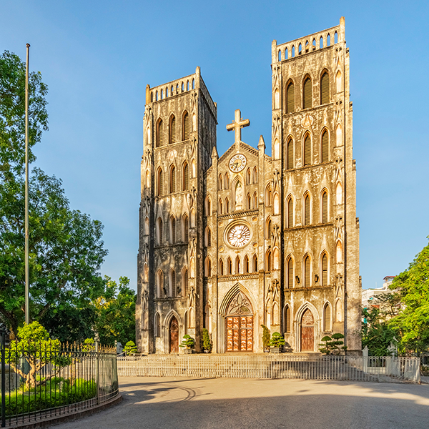
Question 5
Where is this?
A. classroom
B. cathedral

Slide 8
Question 6
Ba Dinh_____ is very famous in Ha Noi city.
A. museum
B. square

Slide 9
Question 7
My city is so_____.There are a lot of cars and people.
A. quiet
B. noisy

Slide 10
Question 8
This lamp is _____. I don’t have much money.
A. expensive
B. convenient

Slide 11
Question 9
Living in the city is____.
You can buy a lot of things.
A. expensive
B. convenient

Slide 12
Question 10
This isn’t an old school.
It’s very____.
A. modern
B. crowded

Slide 13

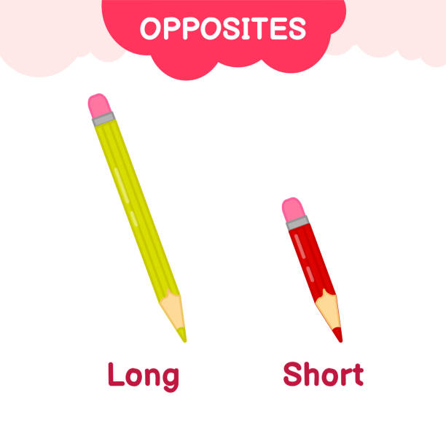
Comparison
(So sánh hơn)
The yellow pencil is longer than the red pencil.

Slide 14

Unit 4: My neighbourhood Period 29: A closer look 2

Slide 15

Objectives
Recognize the form of comparative adjectives.
Recognize the usage of comparative adjectives.
Make the correct comparative form of adjectives.
Apply comparative form of adjectives to make a short dialogue to compare some information between two given places.

Slide 16
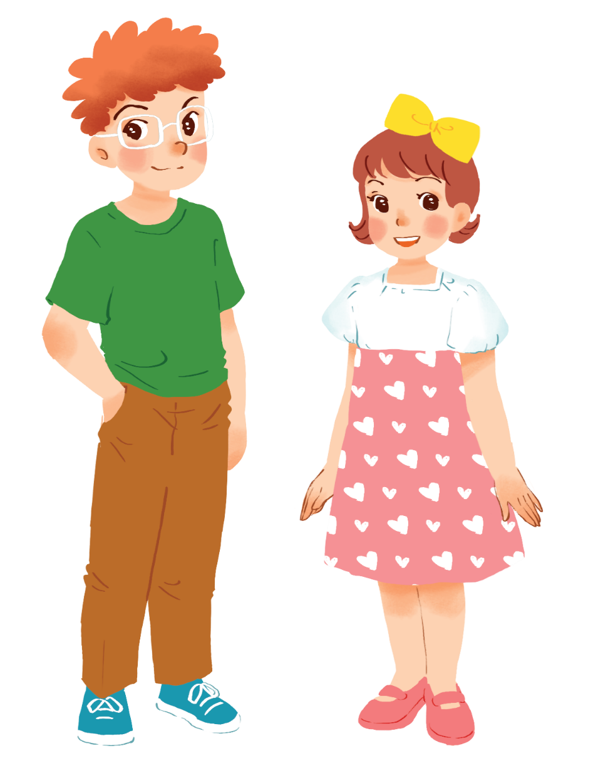
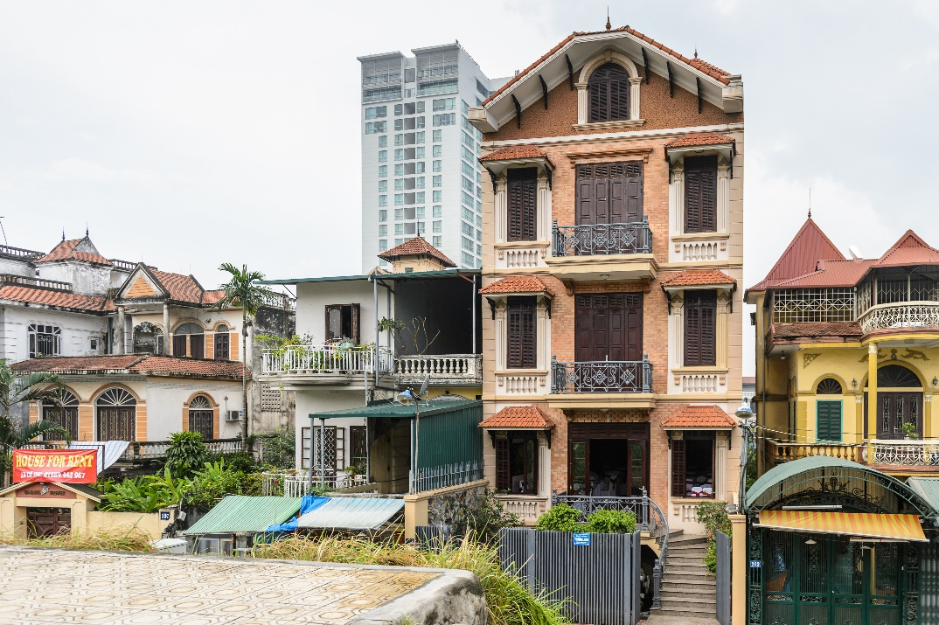
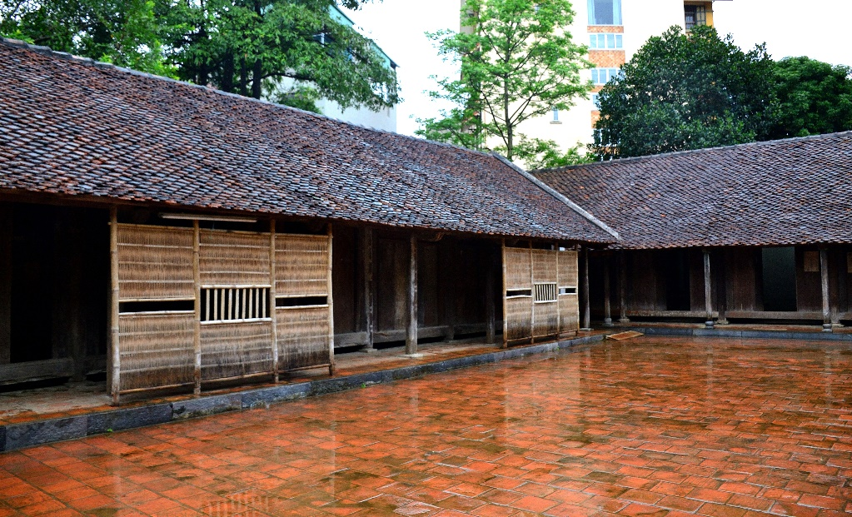
1. Use:
We can use comparative adjectives to compare two people or things.
Example:
A house in a city is more expensive than a house in the countryside.
Tom is taller than Mary.

Slide 17
2. Form:
 | Positive | Comparative | Rule
one syllable | fast |  | + er
 | large |  | + r
 | big |  | double the consonant + er
two syllables | noisy |  | y → ier
 | quiet |  | +er
 | modern |  | more + adj
three or more syllables | expensive |  | more + adj
faster
larger
bigger
noisier
quieter
more modern
more expensive

Slide 18
2. Form:
Short adjectives
Long adjectives
S₁ + be + adj-er + than + S₂
E.g: This green ruler is longer than the blue ruler.
S₁ + be + “more”+ adj + than + S₂
E.g: My TV is more expensive than her TV.

Slide 19


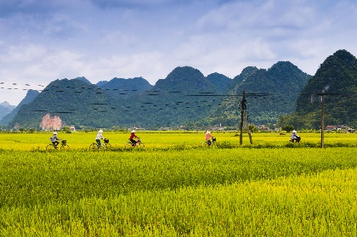
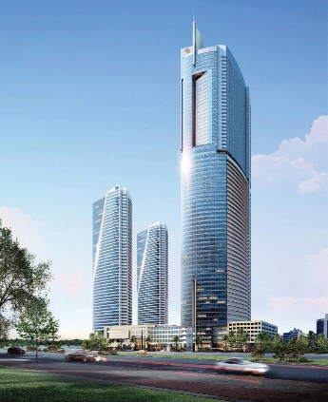
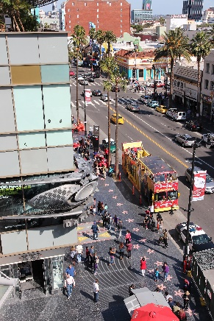
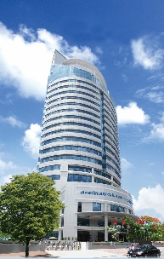
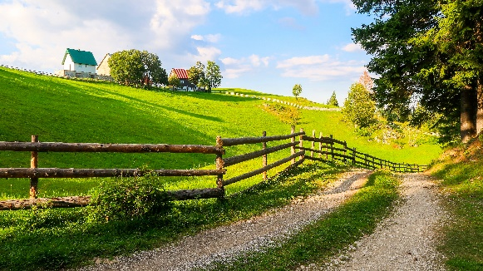
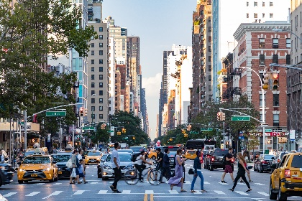
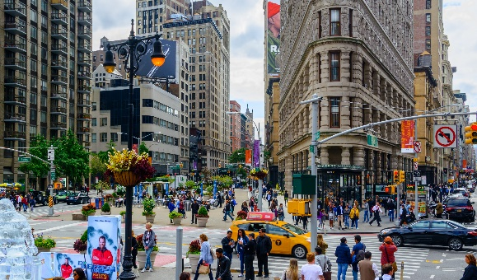
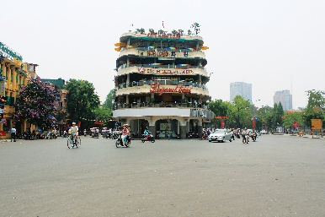
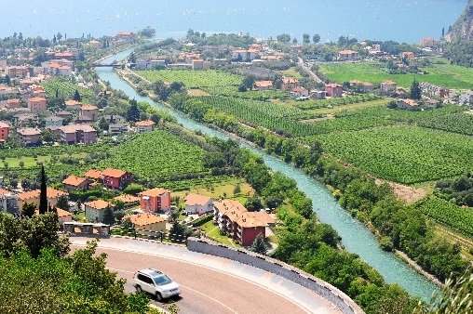
Complete the following sentences with the comparative form of the adjectives in brackets. Number 1 is an example.

Slide 20
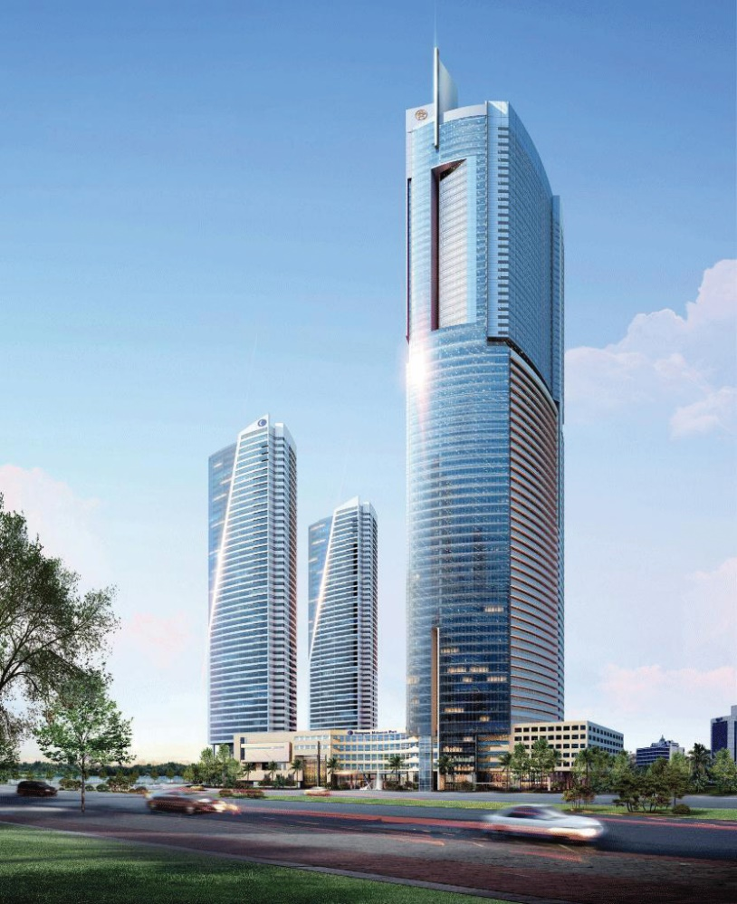

1.
taller
This building is ________ than that building. (tall)

Slide 21
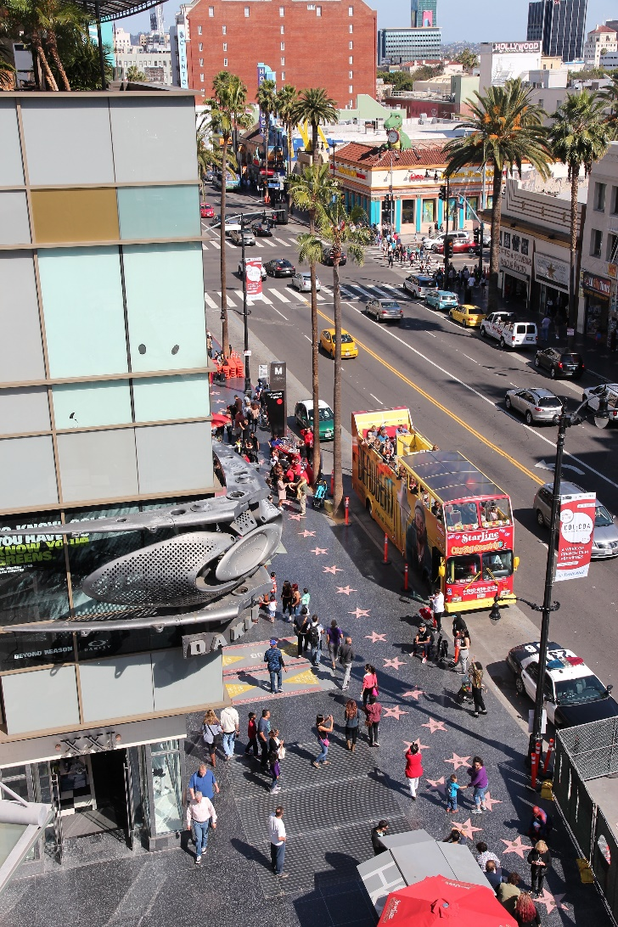

2.
My neighbourhood is than your neighbourhood. (noisy)
noisier

Slide 22

3.
The square in Ha Noi is than the square in Hoi An. (big)
bigger

Slide 23


more peaceful
4.
Living in the countryside is
in a city. (peaceful)
than living
than living

Slide 24
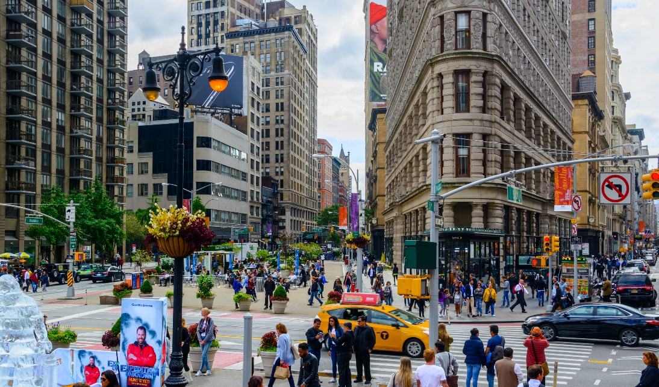

than living
than living
5.
more exciting
Is living in a city
in the countryside? (exciting)

Slide 25


Use the correct form of the words in brackets to complete the letter.
Dear Nick,
How are you?
Ha Noi is beautiful but it’s too busy for me. I’m having a great time at Cua Lo Beach now. The weather is (1. hot) hotter than that in Ha Noi. The houses and buildings are (2. small) _______ and (3. old) _______ than those in Ha Noi.
The streets are (4. wide) _______ with less traffic. the seafood here is (5. delicious) _______ and (6. cheap) _______ than the seafood in Ha Noi.
See you soon,
Vy

Slide 26






GOLD MINER
START

Slide 27
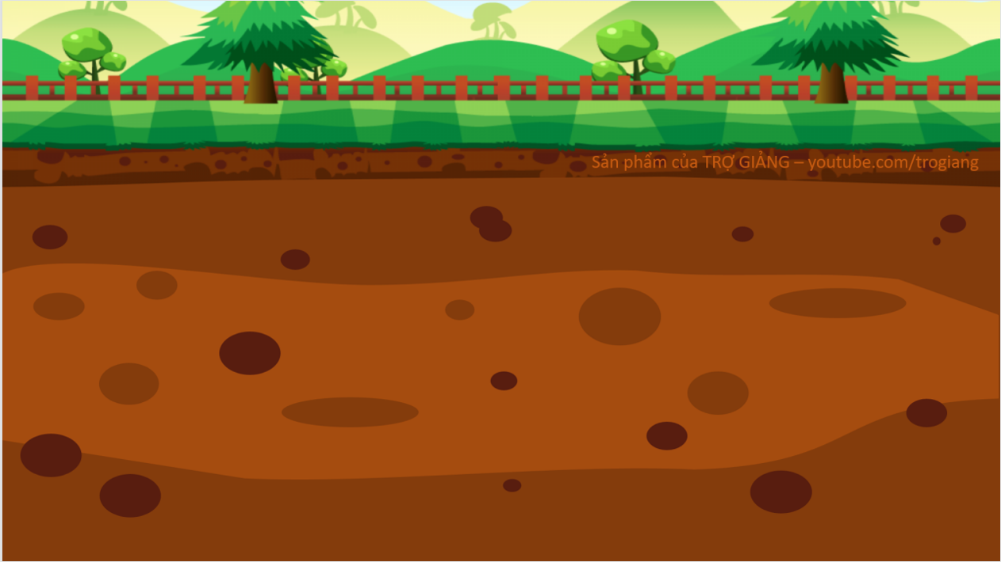






100$
150$
50$
20$
10$
100$
10$
150$
50$
20$

Slide 28

Question 1
The houses and buildings are____ (small) than those in Ha Noi.
=> smaller

Slide 29
Question 2
The houses and buildings are _____(old) than those in Ha Noi.
=> older

Slide 30
Question 3
The streets are________ ( wide) with less traffic.
=> wider

Slide 31
Question 4
The seafood here is _____(delicious) than the seafood in Ha Noi.
=> more delicious

Slide 32
Question 5
The seafood here is ______(cheap) than the seafood in Ha Noi.
=> cheaper

Slide 33
Use the correct form of the words in brackets to complete the letter.
Dear Nick,
How are you?
Ha Noi is beautiful but it’s too busy for me. I’m having a great time at Cua Lo Beach now. The weather is (1. hot) hotter than that in Ha Noi. The houses and buildings are (2. small) smaller and (3. old) older than those in Ha Noi.
The streets are (4. wide) wider with less traffic. The seafood here is (5. delicious) more delicious and (6. cheap) cheaper than the seafood in Ha Noi.
See you soon,
Vy

Slide 34

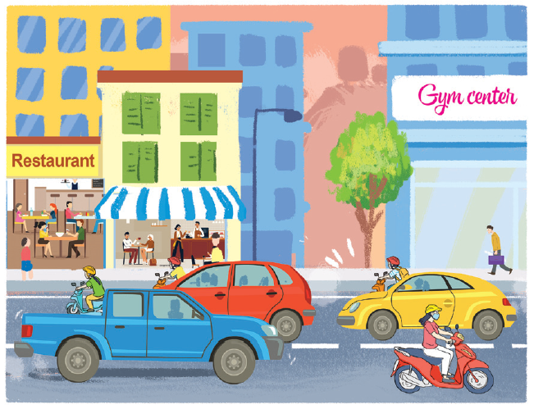
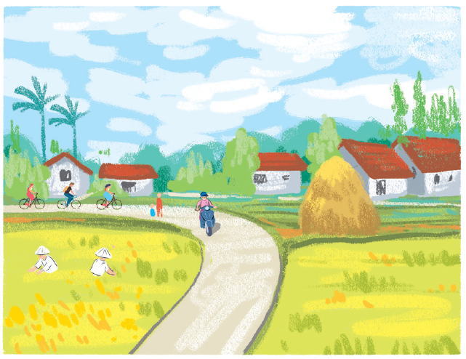
Look at the pictures of the two neighbourhoods: Binh Minh and Long Son. Compare two neighbourhoods. You can use the adjectives below.
noisy
quiet
modern
boring
crowded
peaceful
busy
Example:
Binh Minh is noisier than Long Son.
Binh Minh
Long Son

Slide 35

noisy
quiet
modern
boring
crowded
peaceful
busy
Binh Minh
Long Son

Slide 36

Work in pairs. Ask and answer questions about Binh Minh and Long Son neighbourhoods using the pictures in 3.
Example:
A: Is Binh Minh noisier than Long Son?
B: Yes, it is.
A: Is Long Son more modern than Binh Minh?
B: No, it isn’t.
Binh Minh
Long Son

Slide 37


Wrap-up
Recognize the form of comparative adjectives.
Make the correct comparative form of adjectives.
A closer look 2
S₁ + be +short adj-er + than + S₂ .
S₁ + be + more + long adj + than + S₂ .
Apply comparative form of adjectives to make a short dialogue.
Recognize the usage of comparative adjectives.
Is A + more + adj/ adj- er + than B?
to compare two people or things.
Yes, it is
No, it isn’t

Slide 38

HOMEWORK
Revise comparative adjectives
Do exercises 3-6 in Workbook (p. 28-29).
Prepare new lesson: Unit 4 My neighbourhood- Communication

Slide 39


