Slide 1


WELCOME  TO  OUR  CLASS
Teacher: Đồng Thị Huyền
ENGLISH 6

Slide 2

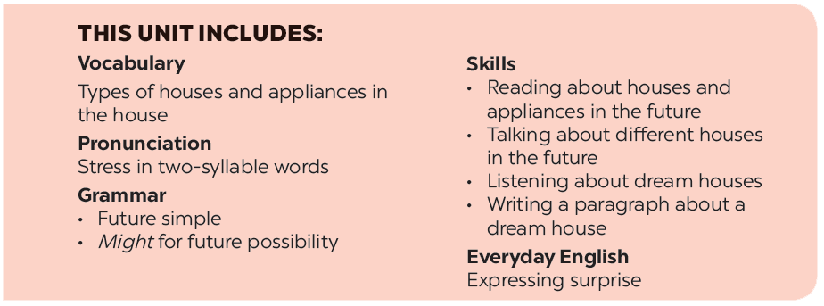

Slide 3







Everyday English
Houses and appliances in the future
Expressing surprise
Read the questions in the class survey below. Tick () Y (Yes) or N (No).
Listen and read the conversation. Pay attention to the highlighted sentences.
Work in pairs. Use the questions in 3 to interview your partner.
Work in pairs. Express your surprise when you see your partner’s new watch, TV, mobile phone, etc.
Tell the class about your interview.

Slide 4
1. 2. 4. 5. 6. | future solar energy hi-tech fly take care of = | /ˈfjuːtʃə(r)/ /ˈmaʊntən/ /hai - tek/ /flai/ look after | (n): tương lai (np): năng lượng mặt trời công nghệ cao bay chăm sóc
1. 2. 3. 4. 5. 6. 7. 8. | in the sea in the city in the town in the mountains in the countryside on the Moon in the sky in the ocean |  | (ở biển) (trong thành phố) (trong thị trấn) (trên núi) (ở nông thôn) (trên mặt trăng) (trên bầu trời) (trong đại dương)

Slide 5




How do they feel?
They are surprised
How can we express surprise?

Slide 6
Everyday English
Expressing surprise

Slide 7
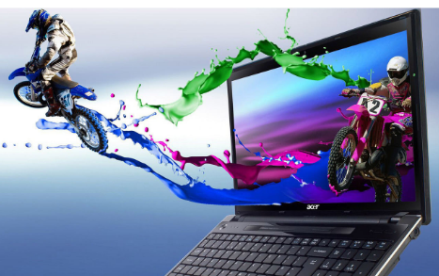
The structure to express surprise
* Wow! Is that + object?
* It looks + adjective.
computer
/ great

Slide 8



Listen and read the conversation. Pay attention to the highlighted sentences.
David: John! Hello!
John: Oh, hi, David. Wow! Is that your computer? It looks great.
David: Yes, it’s my new computer. My parents gave it to me for my birthday.

Slide 9

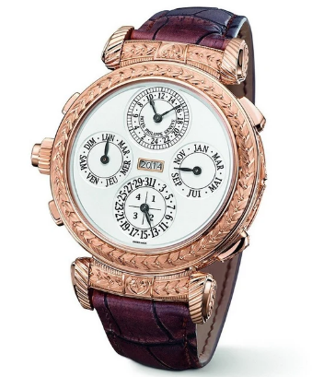
Work in pairs. Express your surprise when you see your partner’s new watch, TV, mobile phone, etc.
E.g. A: Wow! Is that your mobile phone? It looks great.
B: Yes, it’s my new mobile phone. My grandparents
gave it to me for my birthday.
watch
/ beautiful and modern

Slide 10
Houses and appliances in the future

Slide 11

Read the questions in the class survey below.
Tick () Y (Yes) or N (No).
 | Y | N
1. Will you live in a hi-tech house?
2. Will your house be in space?
3. Will you have a lot of trees and ﬂowers around your house?
4. Will you have a fridge that can cook your meals?
5. Will you have a robot that can look after your children?
6. Will you have a car that can ﬂy?
✓
✓
✓
✓
✓
✓
✓
✓
✓
✓
✓
✓

Slide 12

Work in pairs. Use the questions in 3 to interview your partner.
Example:
You: Hi, Nam. Will you live in a hi-tech house in the future?
Nam: Yes, I will.
You: Will your house be in space?
Nam: Oh, no. It won’t.
You: So where will it be?
Nam: I’m not sure. It might be by the sea.
Notes:
City landmarks phải ở trên mục 3

Slide 13
 | Y | N
1. Will you live in a hi-tech house?
2. Will your house be in space?
3. Will you have a lot of trees and ﬂowers around your house?
4. Will you have a fridge that can cook your meals?
5. Will you have a robot that can look after your children?
6. Will you have a car that can ﬂy?
Yes, I will. No, I won’t
Yes, It will. No, It won’t
Yes, I will. No, I won’t
Yes, I will. No, I won’t
Yes, I will. No, I won’t
Yes, I will. No, I won’t

Slide 14
Will you live in a hi-tech house?
2. Will your house be in space?
3. Will you have a lot of trees and flowers around your house?
4. Will you have a fridge that can cook your meals?
5. Will you have a robot that can look after your children?
6. Will you have a car that can fly?
I will live in a hi-tech house
I won’t live in a hi-tech house
My house will be in space
My house won’t be in space
I will have a lot of trees and flowers around my house
I won’t have a lot of trees and flowers around my house
I will have a fridge that can help me to cook meals
I won’t have a fridge that can help me to cook meals
I will have a robot that can help me to look after my children
I won’t have a robot that can help me to look after my children
I will have a car that can fly
I won’t have a car that can fly

Slide 15

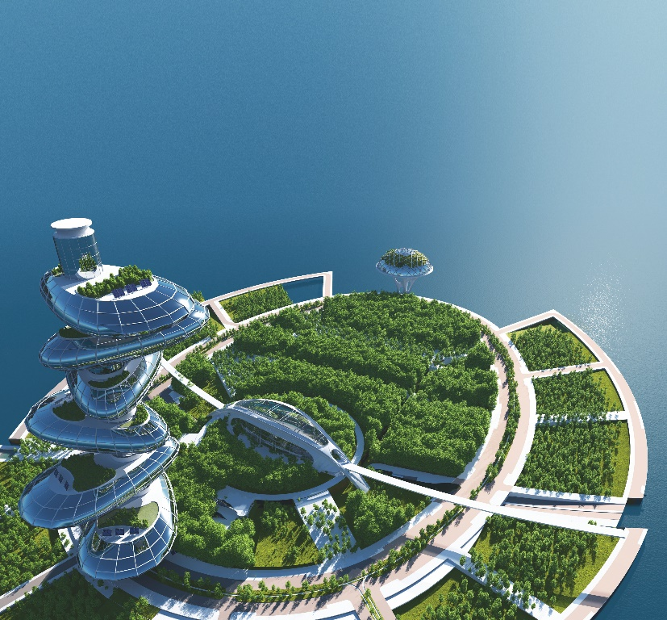
Tell the class about your interview.
Example:
In the future, Nam will live in a hi-tech house.
It won’t be in space. It might be by the sea.
He might have a robot to help him with his home.

Slide 16







