Slide 1

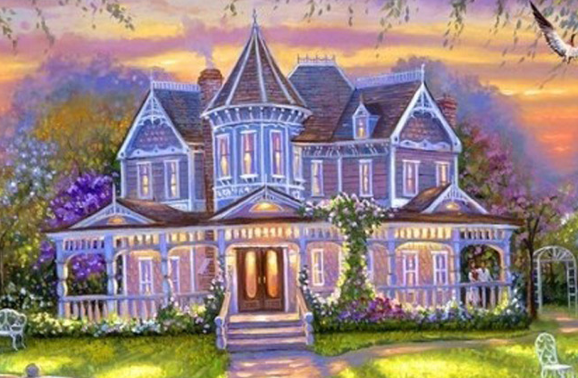

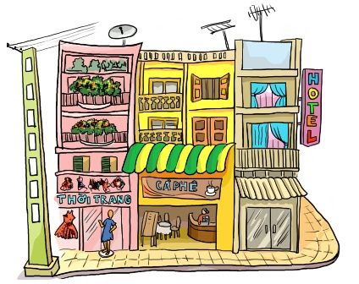
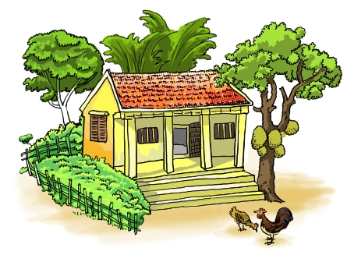
Types of house
Stilt house
apartment
villa
town house
country house

Slide 2
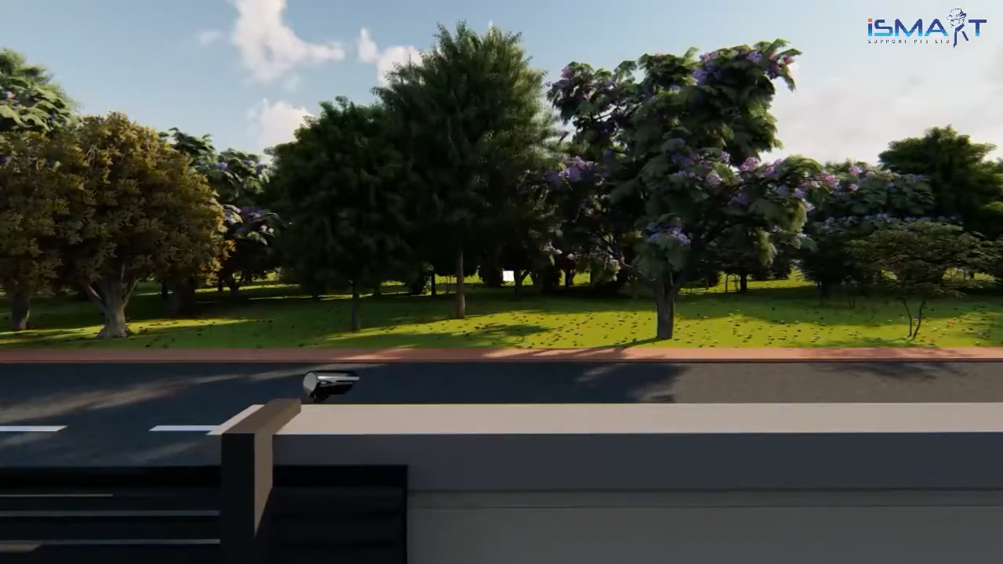
What does this house have?

Slide 3
Key
Smart gate
Smart Air conditioner
Smart Assistant
Smart Fridge
Smart Air fryer
Smart Oven
Smart Rice cooker
Smart Coffee maker
Smart Panel
Smart Water tap
Dynamic Lighting
Smart Alarm clock
Smart Blind

Slide 4

Unit 10: OUR HOUSES IN THE FUTURE
Period 151: Getting started (p.38)

Slide 5
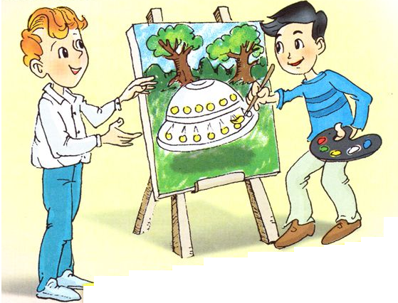
Look at the picture and answer the questions
1. Who are they?
They are Nick and Phong.
2. What is Phong doing?
He is painting a UFO.
3. What are they talking about?
They are talking about Phong’s house in the future.

Slide 6
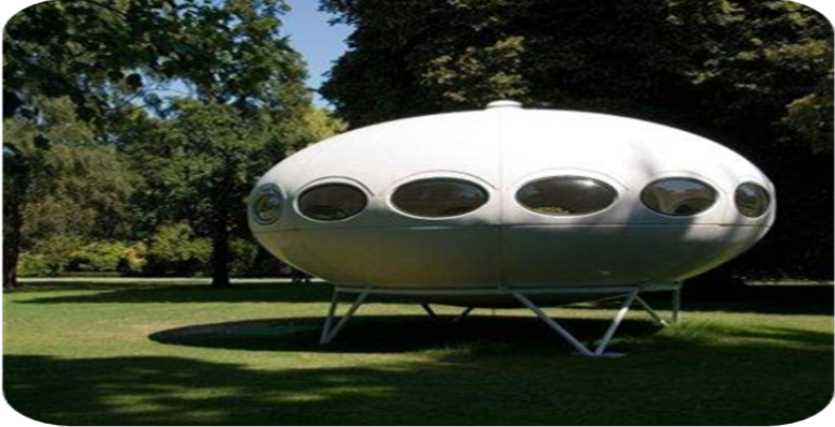
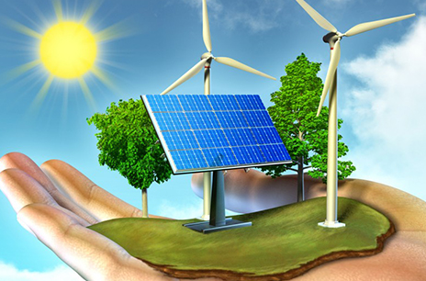

Vocabulary
Location (n) /ləʊˈkeɪ.ʃən/ :
Vị trí, địa điểm
UFO(n) = Unidentified Flying Object:
Đĩa bay
Solar energy (n) /ˌsəʊ.lər ˈen.ə.dʒi/ :
Năng lượng mặt trời
Appliance (n) /əˈplaɪ.əns/
= equipment:
Thiết bị
Ocean (n) /ˈəʊ.ʃən/:
Đại dương
ĐẠI DƯƠNG

Slide 7
Matching
a. Thiết bị
1. UFO
b. Năng lượng mặt trời
2. Appliance
c. Đĩa bay
3. Location
4. Solar energy
d. Đại dương
5. Ocean
e. Vị trí, địa điểm

Slide 8

My future house
Nick: What are you doing, Phong?
Phong: I’m painting a picture of my house.
Nick: Your house! That’s a UFO.
Phong: It looks like a UFO but it’s my house in the future.
Nick: Where will it be?
Phong: It’ll be in the mountains.
Nick: What will it be like?
Phong: It’ll be a large house. It’ll have twenty rooms.
Nick: Twenty rooms!
Phong: Yes, and it’ll have solar energy.
Nick: Fantastic! Which room will you like best?
Phong: My bedroom, of course.
Nick: What appliances might the house have?
Phong: My house might have some smart TVs and ten robots.
Nick: Sounds great! And how much will ...

Slide 9

2. Read the conversation again. Find and write down the words or phrases that show:
Type of house
Location
Appliances in the house

Slide 10
Find and write down the words
My future house
Nick: What are you doing, Phong?
Phong: I’m painting a picture of my house.
Nick: Your house! That’s a UFO.
Phong: It looks like a UFO but it’s my house in the future.
Nick: Where will it be?
Phong: It’ll be in the mountains.
Nick: What will it be like?
Phong: It’ll be a large house. It’ll have twenty rooms.
Nick: Twenty rooms!
Phong: Yes, and it’ll have solar energy.
Nick: Fantastic! Which room will you like best?
Phong: My bedroom, of course.
Nick: What appliances might the house have?
Phong: My house might have some smart TVs and ten robots.
Nick: Sounds great! And how much will ...
1. Type of house
UFO

Slide 11
Find and write down the words
My future house
Nick: What are you doing, Phong?
Phong: I’m painting a picture of my house.
Nick: Your house! That’s a UFO.
Phong: It looks like a UFO but it’s my house in the future.
Nick: Where will it be?
Phong: It’ll be in the mountains.
Nick: What will it be like?
Phong: It’ll be a large house. It’ll have twenty rooms.
Nick: Twenty rooms!
Phong: Yes, and it’ll have solar energy.
Nick: Fantastic! Which room will you like best?
Phong: My bedroom, of course.
Nick: What appliances might the house have?
Phong: My house might have some smart TVs and ten robots.
Nick: Sounds great! And how much will ...
2. Location
In the mountains

Slide 12
Find and write down the words
My future house
Nick: What are you doing, Phong?
Phong: I’m painting a picture of my house.
Nick: Your house! That’s a UFO.
Phong: It looks like a UFO but it’s my house in the future.
Nick: Where will it be?
Phong: It’ll be in the mountains.
Nick: What will it be like?
Phong: It’ll be a large house. It’ll have twenty rooms.
Nick: Twenty rooms!
Phong: Yes, and it’ll have solar energy.
Nick: Fantastic! Which room will you like best?
Phong: My bedroom, of course.
Nick: What appliances might the house have?
Phong: My house might have some smart TVs and ten robots.
Nick: Sounds great! And how much will ...
3. Appliances in the house
Some smart TVs and ten robots

Slide 13
2. Read the conversation again. Find and write down the words or phrases that show:
Type of house
Location
Appliances in the house
UFO
in the mountains
some smart TVs and ten robots

Slide 14
True (T) or False (F) sentences
 | T | F
1. Phong’s house will be in the mountains.
2. His house will be large.
3. There’ll be a lot of rooms in his house.
4. He might have a smart TV and five robots.

Slide 15
True (T) or
False (F)
My future house
Nick: What are you doing, Phong?
Phong: I’m painting a picture of my house.
Nick: Your house! That’s a UFO.
Phong: It looks like a UFO but it’s my house in the future.
Nick: Where will it be?
Phong: It’ll be in the mountains.
Nick: What will it be like?
Phong: It’ll be a large house. It’ll have twenty rooms.
Nick: Twenty rooms!
Phong: Yes, and it’ll have solar energy.
Nick: Fantastic! Which room will you like best?
Phong: My bedroom, of course.
Nick: What appliances might the house have?
Phong: My house might have some smart TVs and ten robots.
Nick: Sounds great! And how much will ...
1. Phong’s house will be in the mountains.
T

Slide 16
True (T) or
False (F)
My future house
Nick: What are you doing, Phong?
Phong: I’m painting a picture of my house.
Nick: Your house! That’s a UFO.
Phong: It looks like a UFO but it’s my house in the future.
Nick: Where will it be?
Phong: It’ll be in the mountains.
Nick: What will it be like?
Phong: It’ll be a large house. It’ll have twenty rooms.
Nick: Twenty rooms!
Phong: Yes, and it’ll have solar energy.
Nick: Fantastic! Which room will you like best?
Phong: My bedroom, of course.
Nick: What appliances might the house have?
Phong: My house might have some smart TVs and ten robots.
Nick: Sounds great! And how much will ...
2. His house will be large.
T

Slide 17
True (T) or
False (F)
My future house
Nick: What are you doing, Phong?
Phong: I’m painting a picture of my house.
Nick: Your house! That’s a UFO.
Phong: It looks like a UFO but it’s my house in the future.
Nick: Where will it be?
Phong: It’ll be in the mountains.
Nick: What will it be like?
Phong: It’ll be a large house. It’ll have twenty rooms.
Nick: Twenty rooms!
Phong: Yes, and it’ll have solar energy.
Nick: Fantastic! Which room will you like best?
Phong: My bedroom, of course.
Nick: What appliances might the house have?
Phong: My house might have some smart TVs and ten robots.
Nick: Sounds great! And how much will ...
3. There’ll be a lot of rooms in his house.
T

Slide 18
True (T) or
False (F)
My future house
Nick: What are you doing, Phong?
Phong: I’m painting a picture of my house.
Nick: Your house! That’s a UFO.
Phong: It looks like a UFO but it’s my house in the future.
Nick: Where will it be?
Phong: It’ll be in the mountains.
Nick: What will it be like?
Phong: It’ll be a large house. It’ll have twenty rooms.
Nick: Twenty rooms!
Phong: Yes, and it’ll have solar energy.
Nick: Fantastic! Which room will you like best?
Phong: My bedroom, of course.
Nick: What appliances might the house have?
Phong: My house might have some smart TVs and ten robots.
Nick: Sounds great! And how much will ...
4. He might have a smart TV and five robots.
F

Slide 19
3. Check T/F sentences
 | T | F
1. Phong’s house will be in the mountains.
2. His house will be large.
3. There’ll be a lot of rooms in his house.
4. He might have a smart TV and five robots.




some smart TVs and ten robots.

Slide 20
My future house
Nick: What are you doing, Phong?
Phong: I’m painting a picture of my house.
Nick: Your house! That’s a UFO.
Phong: It looks like a UFO but it’s my house in the future.
Nick: Where will it be?
Phong: It’ll be in the mountains.
Nick: What will it be like?
Phong: It’ll be a large house. It’ll have twenty rooms.
Nick: Twenty rooms!
Phong: Yes, and it’ll have solar energy.
Nick: Fantastic! Which room will you like best?
Phong: My bedroom, of course.
Nick: What appliances might the house have?
Phong: My house might have some smart TVs and ten robots.
Nick: Sounds great! And how much will ...

Slide 21
4. Order the words to make a phrase about a place.
Each group has one extra word.
1.
sea / a / in / the
5.
countryside / a / the / in
in the sea
in the countryside
2.
on / in / the / city
6.
Moon / in / the / on
in the city
on the Moon
3.
the / in / at / town
7.
in / at / the / sky
in the town
in the sky
4.
the / on / in / mountains
in the mountains

Slide 22

What have you learnt today?

Slide 23
HOMEWORK
- Learn new words by heart.
Do exercise B1,2,3 in workbook
Prepare for Unit 10: A closer look 1.

