Slide 1


Slide 2
NGUYEN BINH KHIEM SECONDARY SCHOOL
Welcome to our class

Slide 3
GAME
* Jumbled words
TACIEV =
Answer key:
- ACTIVE
- FRIENDLY
- FUNNY
- KIND
- CAREFUL
- CONFIDENT
LFIEDRNY =
UNFNY =
INKD =
RCUFEAL =
TOFCNDITEN =

Slide 4


UNIT 3: MY FRIENDS
LESSON 6
OBJECTIVES:
- listen for specific information about best friends;
- write a diary entry about best friends.

Slide 5

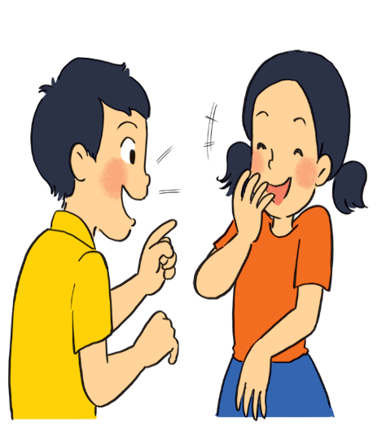
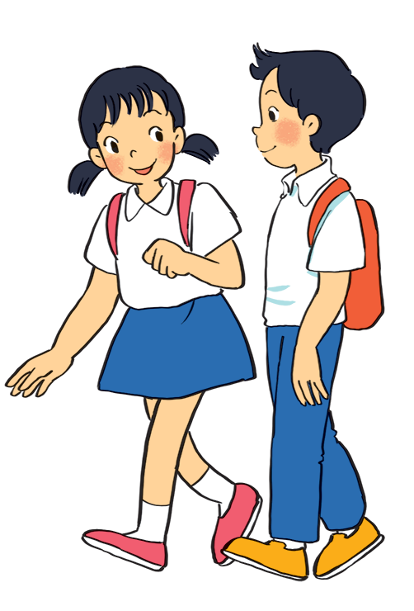
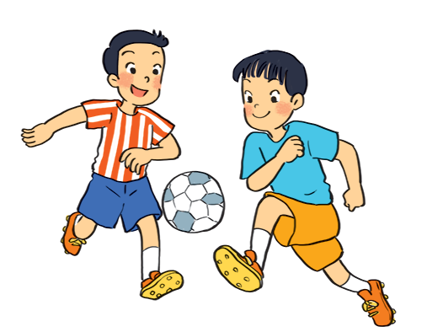
What are the students doing in each picture?
a
c
b

Slide 6
a
They are talking.

Slide 7
b
They are playing football.

Slide 8
c
They are walking.

Slide 9


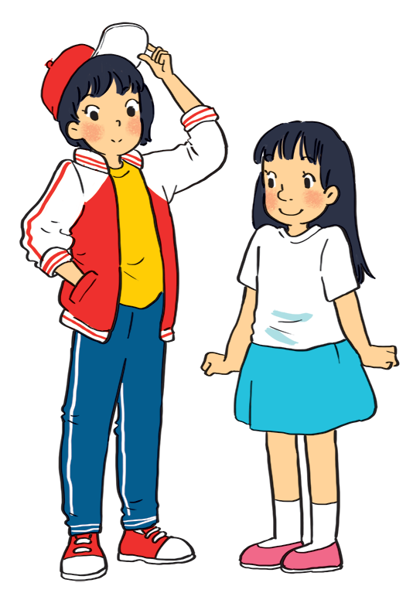
Listen to Mi and Minh talking about their best friends. Look at the picture below and say which one is Lan and which one is Chi.
Lan
Chi
Lan has short black hair and a small mouth
Chi is short with long black hair and a big nose

Slide 10

Listen to the talk again. Fill each blank with a word / number you hear.
1.
Mi and Lan are studying in class
6A.
.
Lan has short hair and a small .
2.
black
mouth
Lan is active and .
3.
friendly
Chi’s hair is long and black, and her nose is
4.
big.
.
5.
Chi is
kind
to Minh.
T

Slide 11
AUDIO SCRIPT
Mi: My best friend is Lan. She studies with me in class 6A. She’s tall and slim. She has short black hair and a small mouth. She’s very active and friendly. She likes playing sports and has many friends. Look, she’s playing football over there!
Minh: Chi is my best friend. We’re in class 6B. She’s short with long black hair and a big nose. I like her because she’s kind to me. She helps me with my English. She’s also hard-working. She always does her homework before class. Look, she’s going to the library.

Slide 12

II. Writing
Work in pairs. Ask and answer about your best friend. Use these notes to help you.
1. What’s his / her name?
His name’s Huy / My best friend is Huy.
2. What does he / she look like?
He is tall and has short black hair.
3. What’s he / she like?
He is active and funny.
4. Why do you like him / her?
I like him (her)because we often do our homework together, and he helps me a lot.

Slide 13


Write a diary entry of about 50 words about your best friend. Use the answers to the questions in 4.
Dear Diary,
My best friend is
I like
because

Slide 14
Model writing:
My best friend is Lan. She studies with me in class 6A. She’s tall and slim. She has long black hair and a small mouth. She’s very active and friendly. She likes playing sports and has many friends. I like being with her. I hope that in the future we’ll still be best friends.
My best friend is Minh. He studies with me in class 6A. He’s tall and thin. He has short black hair and a high nose. He’s very active and friendly. He likes playing sports and has many friends. I like being with him. I hope that in the future we’ll still be best friends.

Slide 15
WRAP-UP:
What have we learnt today?
- Listen a passage about Mi and Minh talk about their best friends.
- Write a diary entry about your best friend.

Slide 16
HOMEWORK
- Rewrite the writing in the notebook.
- Do exercises in the workbook.
- Prepare “Looking back and project”.

Slide 17

Thank you very much.

