Slide 1


Slide 2
NGUYEN BINH KHIEM SECONDARY SCHOOL
Welcome to our class

Slide 3
* CHECK UP
* Talk about your best friend

Slide 4
CHATTING
- Do you like to go camping?
- Where do you like to camp?
- Who do you like to go with?
- What things will you bring?
- What skills do you need to have?

Slide 5



UNIT 2: MY HOUSE
LESSON 5

Slide 6
UNIT 2: MY HOUSE
LESSON 5
OBJECTIVES:
read for specific information about friends and summer camps;
talk about friends and summer camps.

Slide 7
I/ Reading
* Vocabulary
- superb (adj):
tuyệt vời
- perfect (adj):
hoàn hảo
- sporty (adj):
yêu thích thể thao
- leadership (n):
sự lãnh đạo
- field trip (n):
chuyến đi thực địa

Slide 8
* Checking Vocab:
RUB OUT AND REMEMBER
- superb (adj) :
tuyệt vời
- perfect (adj) :
hoàn hảo
- sporty (adj):
yêu thích thể thao
- leadership (n) :
sự lãnh đạo
- field trip (n):
chuyến đi thực địa

Slide 9

Look at the advertisement above and answer the questions.
1.
Who is the Superb Summer Camp for?
It’s for kids between 10 and 15 years old.
2.
What can people do at this summer camp?
They play sports and games, draw pictures, play music, learn life skills, go on field trips, etc.

Slide 10


Slide 11

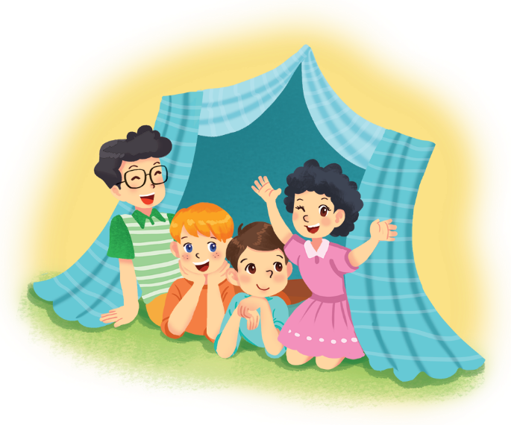

Read the text and write T (True) or F (False). Correct the false statements.
To: My parents <parents.nguyen@webmail.com>
Subject: My first day at the superb summer camp
Hi Mum and dad,
Here I am at the Superb Summer Camp. Mr Black asked us to write emails in English! Wow, everything here is in English! I have some new friends: Jimmy, Phong, and Nhung. They’re in the photo. Jimmy has blonde hair and blue eyes. He’s clever and creative. He likes taking photos. Phong is the tall boy. He’s sporty and plays basketball very well. Nhung has curly black hair. She’s kind. She shared her lunch with me today.
We’re having fun. Jimmy’s taking photos of me. Phong’s reading a comic book, and Nhung’s playing the violin. I must go now.
Please write soon.
Love,
Nam

Slide 12
Example:
Nam is writing to his teacher. F
(his parents)
1.
The children can speak Vietnamese at the camp.
F
They speak English only.
2.
Nam has four new friends.
F
He has three.
3.
Phong likes taking photos.
F
Jimmy likes taking photos.
4.
Nam thinks Nhung is kind.
T
5.
Phong is tall and sporty.
T

Slide 13

II. Speaking
Work in groups. Read about the three students below. Is the Superb Summer Camp suitable for all of them? Why or Why not?
1.
Mi is 12 years old. she likes drawing and writing stories. She’s good at english. she’s creative and friendly.
Suggested answers
The camp is suitable for her because it suits her age and she can use English. She can also develop her creativity at the camp.
An is 16 years old. he doesn’t know English. He’s funny and kind.
2.
The camp isn’t suitable for An because he can’t speak English.
3.
Vy is 14 years old. She likes playing sports. Her English isn’t very good. She’s clever, but she isn’t active.
The camp suits Vy. It suits her age and it can help her improve her English.

Slide 14

Think about yourself. Do you want to go to this kind of camp? Why or Why not?
Example:
I want to go to this camp because I can speak English there.
- I want to go to this camp because I can speak English and I love sports.
- I don’t want to go to this camp because I’m not good at English.

Slide 15



WRAP-UP
What have we learnt today?
Learn some vocab.
Read the advertisement about the Superb Summer Camp.

Slide 16
Homework
Learn by heart the new words.
Prepare: Unit 3- Skills 2.
Good bye !

