Slide 1


Friday, septmber 1st , 2021
love
Grade: 6

Slide 2
Warm up:
Game:Pelmanism
KIND
FRIENDLY
FUNNY
CLEVER
1
2
3
4
ACTIVE
6
7
CREATIVE
Vui vẻ
Năng động
5
8
9
10
11
12
Thân thiện
Sáng tạo
Tốt bụng
Thông minh

Slide 3


UNIT 3: MY FRIENDS
LESSON 4
OBJECTIVES:
ask and answer about people’s appearance and personalities;
practice to talk about people’s appearance and personalities.

Slide 4
UNIT 3: MY FRIENDS
LESSON 4
Everyday English
Asking about appearance and personality

Slide 5


Listen and read the dialogue between Linda and Mi. Pay attention to the highlighted.
…
Linda: What does your best friend look like?
Mi: She’s short with long black hair.
She has bright brown eyes.
Linda: What’s she like?
Mi: She’s very kind and creative.
…
Notes:
Slide này không đúng.

Slide 6
* Note: Dùng động từ Be và Have dùng để miêu tả
1. Với động từ "tobe“ ( Dùng để miêu tả về tính cách)
S + be + adj
Ex: He is kind.
She is friendly
2. Với động từ Have (Dùng để miêu tả về ngoại hình)
S + have/has + (a/an) + adj + N
EX: My best friend has a round face.
He has big ears

Slide 7

Work with a classmate. Ask him / her about his / her best friend. Remember to use the two questions highlighted in 1.
Tuan: What does your best friend look like?
Hoa : She’s (He’s)………………………….
She(he) has bright brown eyes.
Tuan: What’s she like?
Hoa : She’s( He’s)………………………………

Slide 8
Date of birth and personality

Slide 9

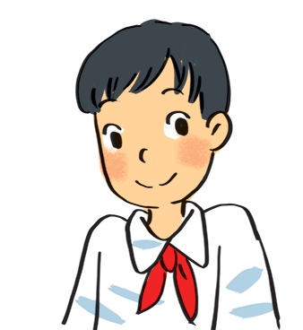
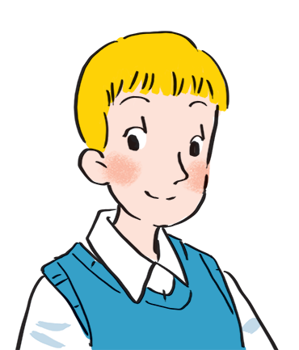
Read about these students in 4Teen magazine. Use one or two adjectives to describe them.
clever
I live in Da Nang. At home, I can do my homework without my parents’ help. At school, I like speaking English. I’m going to an English club now.
hard-working
I come from Cambridge. In my free time, I draw pictures and play the piano. I also help some old people near my house. I usually read to them at the weekend. Now I’m drawing in my garden.
creative
kind
Notes:
City landmarks phải ở trên mục 3

Slide 10

We may have different personalities because we have different birthdays.
Read the descriptions below. Do you think they match the friends in 3?
21/3 – 19/4 | confident, active
20/4 – 20/5 | loving, hard-working
21/5 – 21/6 | active, friendly
22/6 – 22/7 | caring, clever
23/7 – 22/8 | confident, creative
23/8 – 22/9 | careful, hard-working
23/9 – 23/10 | creative, friendly
24/10 – 21/11 | careful, funny
22/11 – 21/12 | clever, confident
22/12 – 19/1 | careful, hard-working
20/1 – 18/2 | friendly, clever
19/2 – 20/3 | kind, creative

Slide 11

Read the descriptions in 4.
Share your opinion with the class.
Example:
My birthday is …
It’s true that …
It isn’t true that …

Slide 12
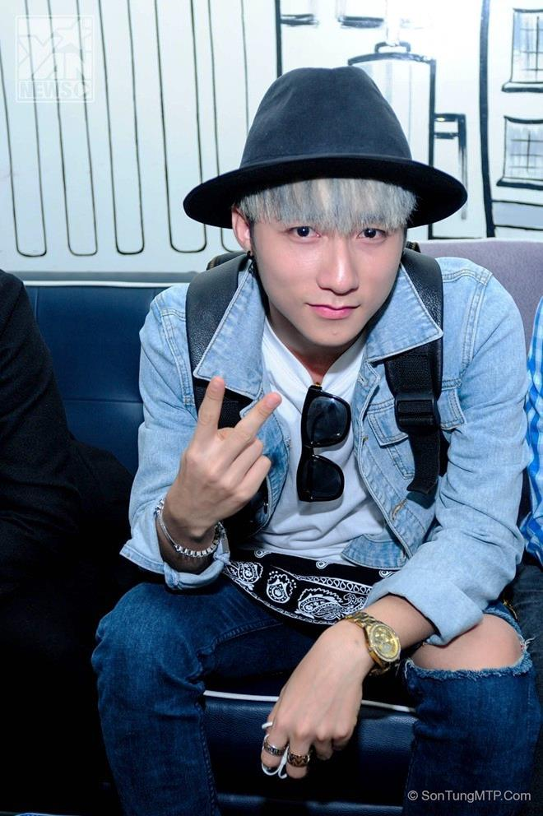
Can you describe him?
He has………….
He is

Slide 13
PRODUCTION
Talk about your best friend
MODEL
  My best friend is Mai. We go to the same school, and we’ve been together for five years.
  Mai is very pretty. She has short black hair and big brown eyes. She is clever and hard-working, and she is also very funny. I like being with her. We often do our homework together, and she helps me a lot. I hope that in the future we’ll still be best friends.

Slide 14
WRAP-UP
What have we learnt today?
- Ask and answer about people’ appearance and personalities.
- Guess personality depend on date of birth.

Slide 15
Homework
- Practice speaking about your best friend.
- Prepare next lesson.

Slide 16
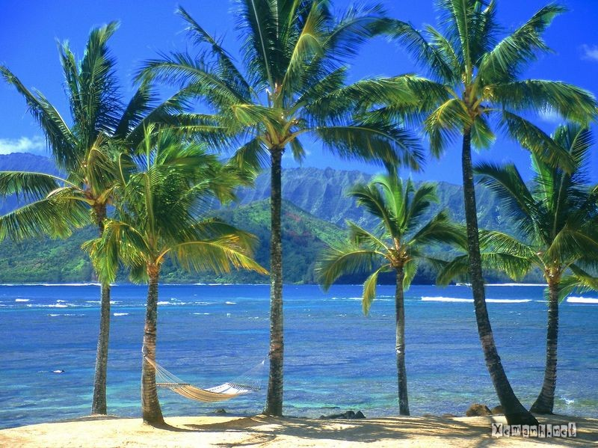
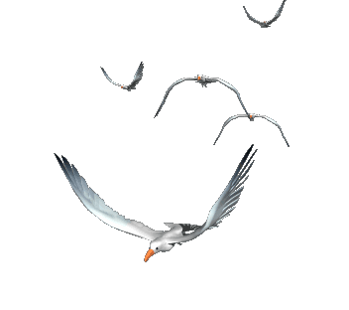




Goodbye!
See you again!

