Slide 1


Slide 2
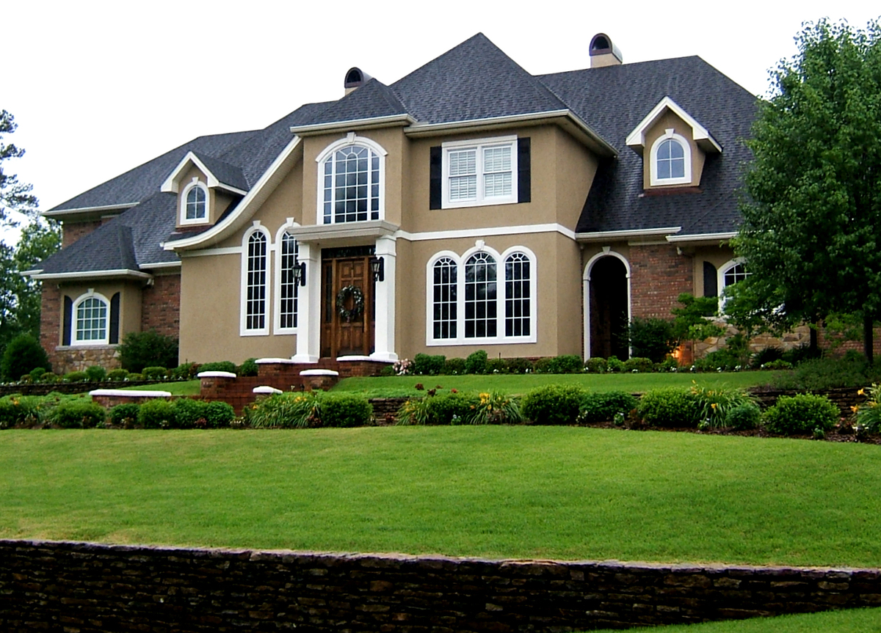
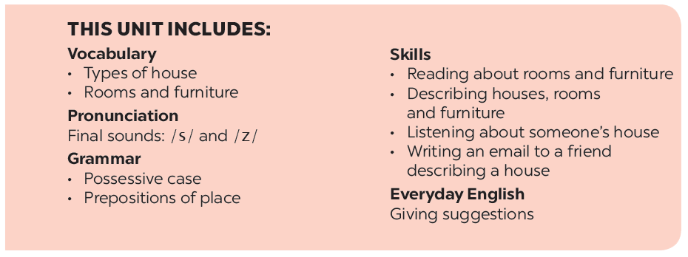
UNIT 2: MY HOUSE
LESSON 7

Slide 3
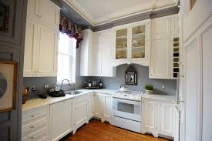
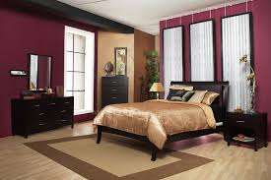
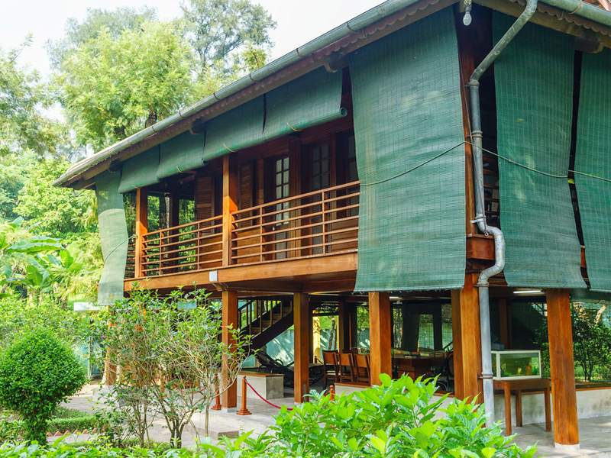
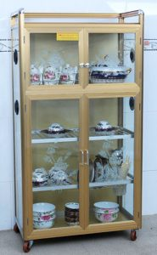
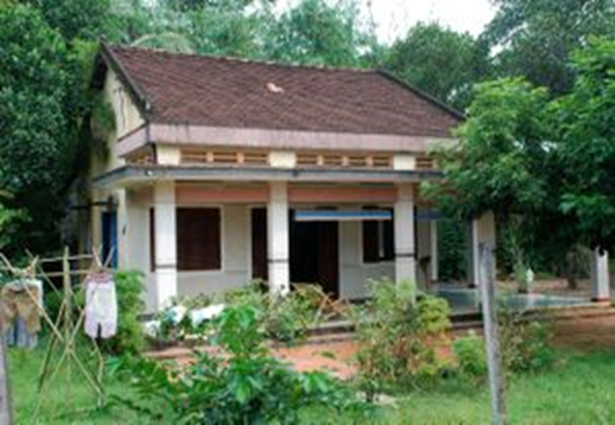
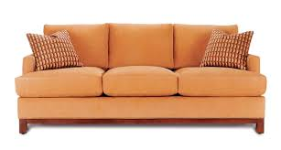
KIM’S GAME
kitchen
bedroom
stilt house
cupboard
country house
sofa

Slide 4
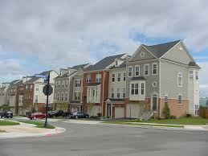
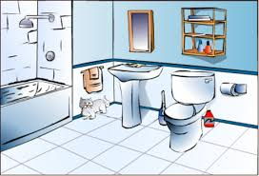
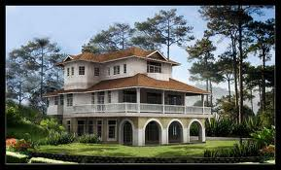
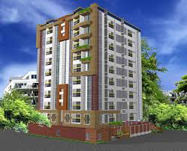
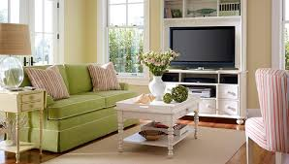
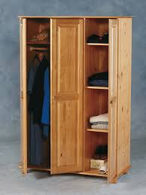
town house
bathroom
apartment
villa
livingroom
wardrobe

Slide 5
* Write the name of the pictures.
2 munites
Work in groups
KEYS

Slide 6


UNIT 2: MY HOUSE
LESSON 7:
- review the vocabulary and grammar of Unit 2;
- apply what they have learnt (vocabulary and grammar) into practice through a project.

Slide 7

* Vocabulary
Put the words into the correct group. Add a new word to each group.
dishwasher
dishwasher
country house
kitchen
bedroom
country house
kitchen
bedroom
town house
sink
fridge
town house
chest of drawers
sink
fridge
chest of drawers
living room
cupboard
living room
flat
bathroom
cupboard
flat
bathroom
Types of house | Rooms | Furniture
flat
bedroom
chest of drawers
town house
bathroom
sink
country house
kitchen
fridge
living room
dishwasher
cupboard

Slide 8

II. Grammar
Complete the second sentence with the correct possessive form.
1.
My teacher has a house next to our house.
teacher’s
house.
Our house is next to my
house.
2.
My brother has a TV.
This is my
TV.
TV.
brother’s
3.
Elena has a big bookshelf in her bedroom.
There’s a big bookshelf in
Elena’s
bedroom.
bedroom.
4.
My grandfather likes the kitchen the best.
The kitchen is my
grandfather’s
favourite room.
favourite room.
5.
My aunt has a daughter, Vy.
Vy’s
I’m cousin.

Slide 9


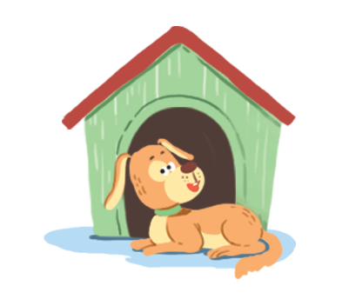
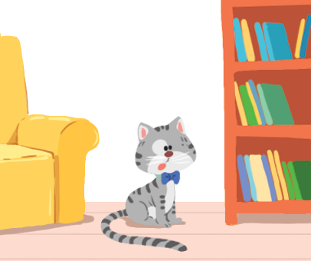


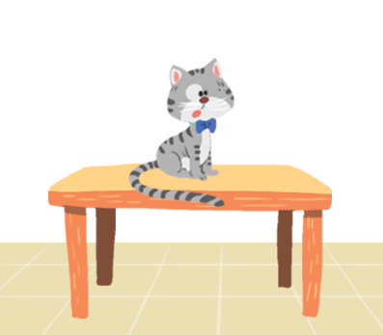
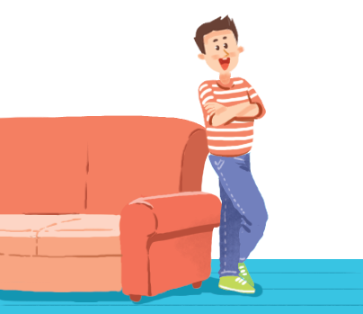
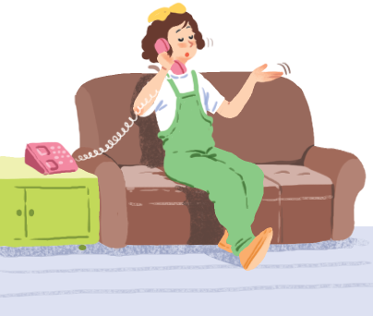
Make sentences. Use prepositions of place.
K
Game: Lucky number
1
2
3
4
5
6
7
8
1. The cat is on the table
4. The cat is behind the computer
2. The dog is in front of the doghouse
5. The girl is on the sofa
3. The cat is between the sofa and the bookshelf
6. The boy is next to the sofa

Slide 10

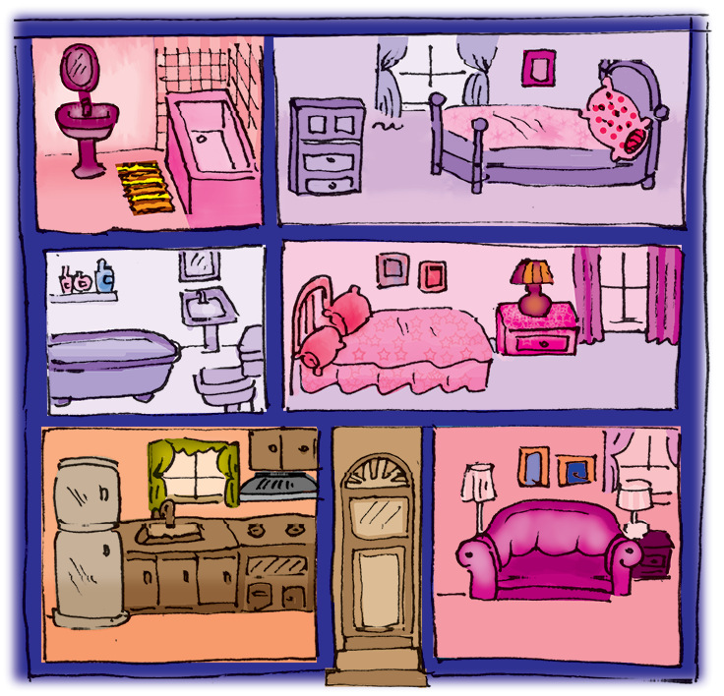
Write three sentences to describe your favourite room in your house. Write the sentences in your notebook.

Slide 11
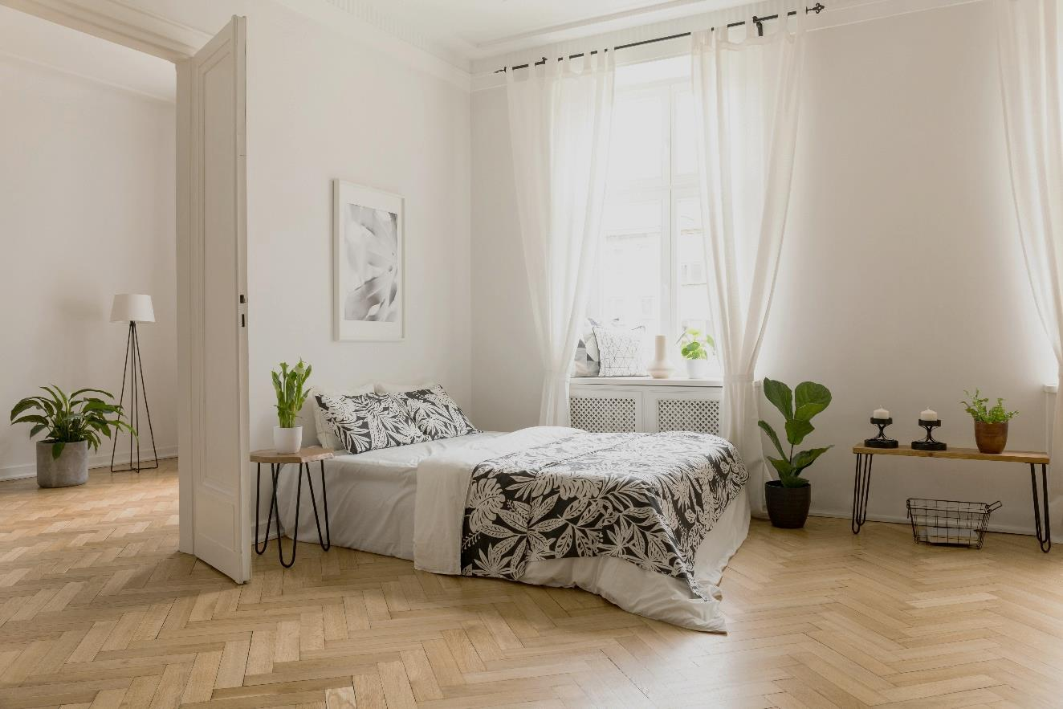
* Write three sentences to describe your favourite room in your house.
Example:
There’s a big bed next to the door.

Slide 12
1. There is a clock on the wall in my living room.
2. There are two posters on the wall.
3. There are three small plants in the corner.
1. There are books on the bookshelf in my bedroom.
2. There is a desk next to the bookshelf.
3. There is a laptop and a lamp on the desk.

Slide 13


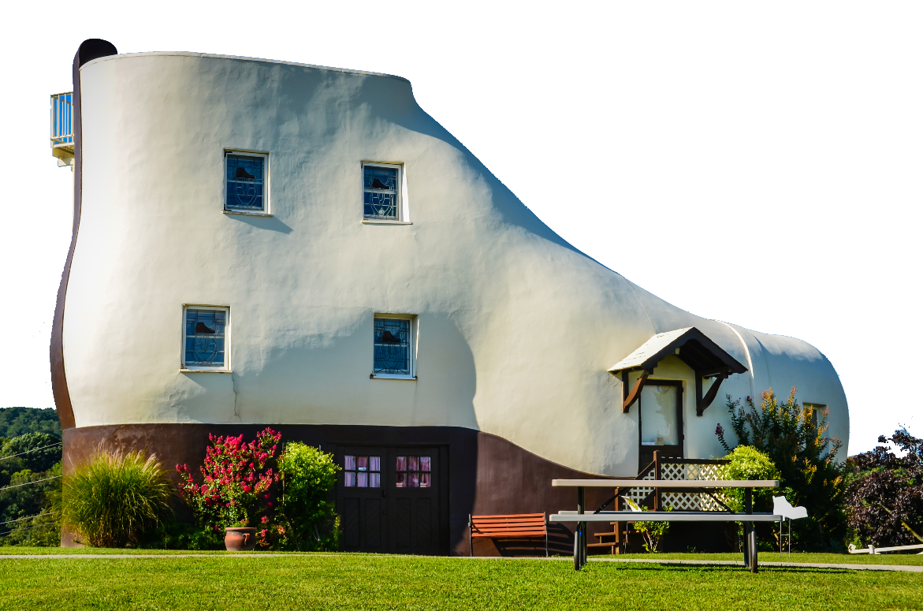
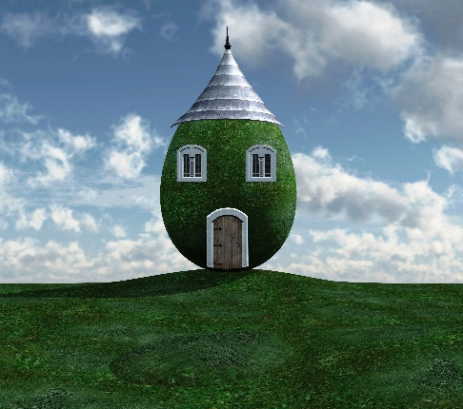
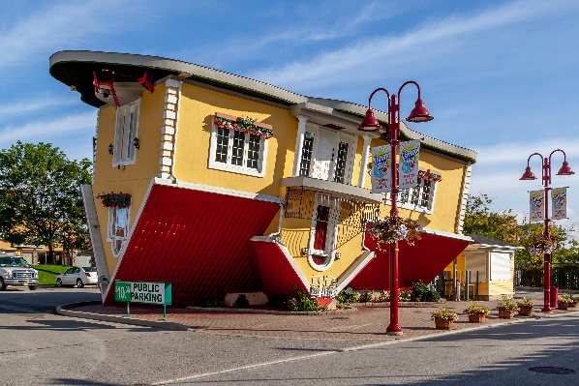
Which one would you like to live in? Why?
Now work in groups.
There are some strange houses
around the world.
Draw your own strange house.
Decorate it.
Tell the class about your house.
C
A
B

Slide 14

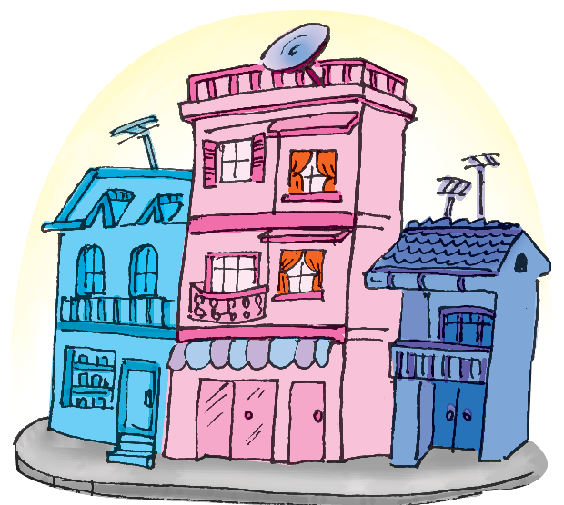
Communication, Activity 4, Page 21
Mi’s house

Slide 15
WRAP-UP
Revise vocabulary and grammar point in Unit 2.
Revise the possessive case and the prepositions of place.
Draw a strange house.

Slide 16
Homework
Learn by heart all the new words, grammar points.
Write a short passage about a dream house (80 words).
Do exercises in the workbook.
Prepare Unit 3: Getting started.

Slide 17

Goodbye
See you again!!!

