Slide 2

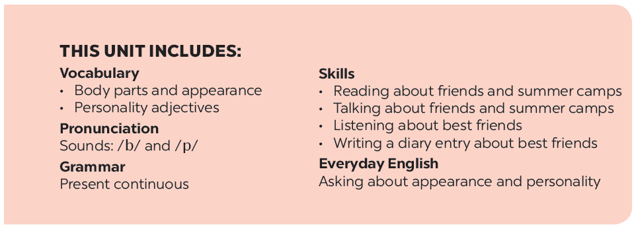

Slide 3


A surprise guest
OBJECTIVES:
- Have an overview and know vocabulary about the topic My friends.
- Know vocabulary to talk about body parts and appearance to describe people’s appearance.

Slide 4


VOCABULARY
idea /aɪˈdɪə/ (n):
ý tưởng
Eg: That was a great idea.

Slide 5
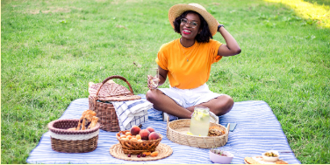
VOCABULARY
picnic /ˈpɪk.nɪk/ (n):
dã ngoại
Eg: I go on a picnic alone.

Slide 6

VOCABULARY
magazine /ˌmæɡəˈziːn/ (n):
tạp chí
Eg: It is my favorite magazine.

Slide 7
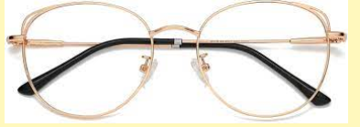
VOCABULARY
glasses /ɡlɑːsiz/ (n):
kính
Eg: She has glasses.

Slide 8
VOCABULARY
eyes /aɪ/ (n):
arm /ɑːm/ (n):
foot /fʊt/ (n):
hair /heə(r)/ (n):
nose /nəʊz/ (n):
hand /hænd/ (n):
mắt
cánh tay
bàn chân
tóc
mũi
bàn tay

Slide 9

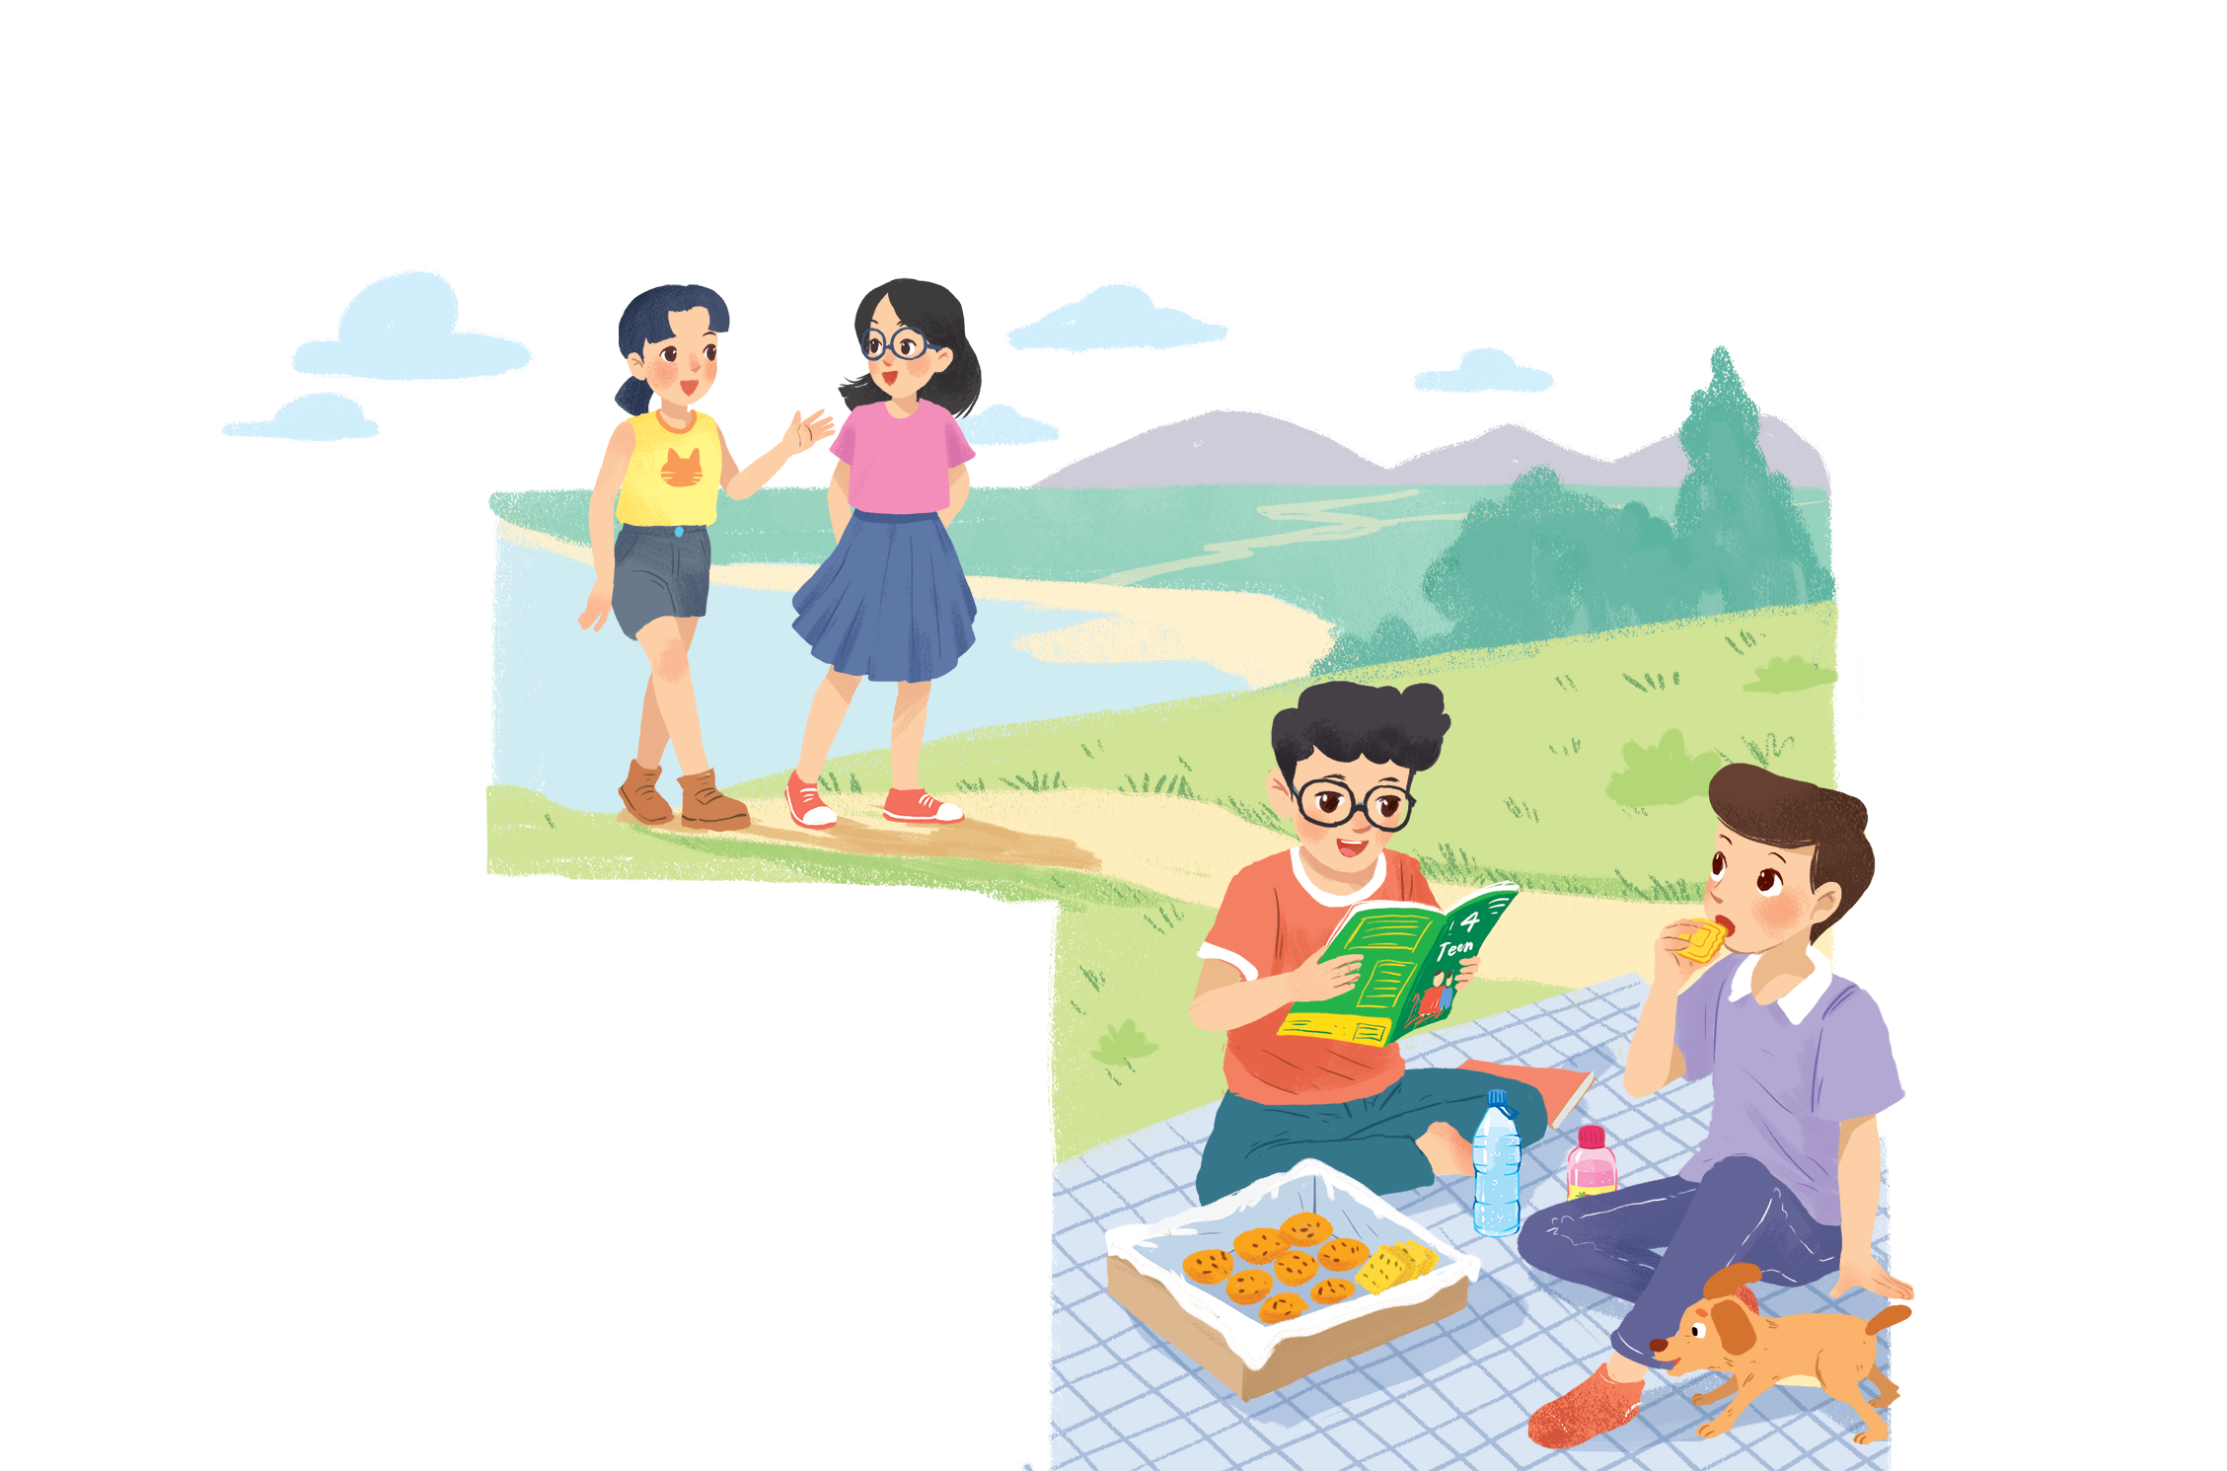

Listen and read.
A surprise guest

Slide 10
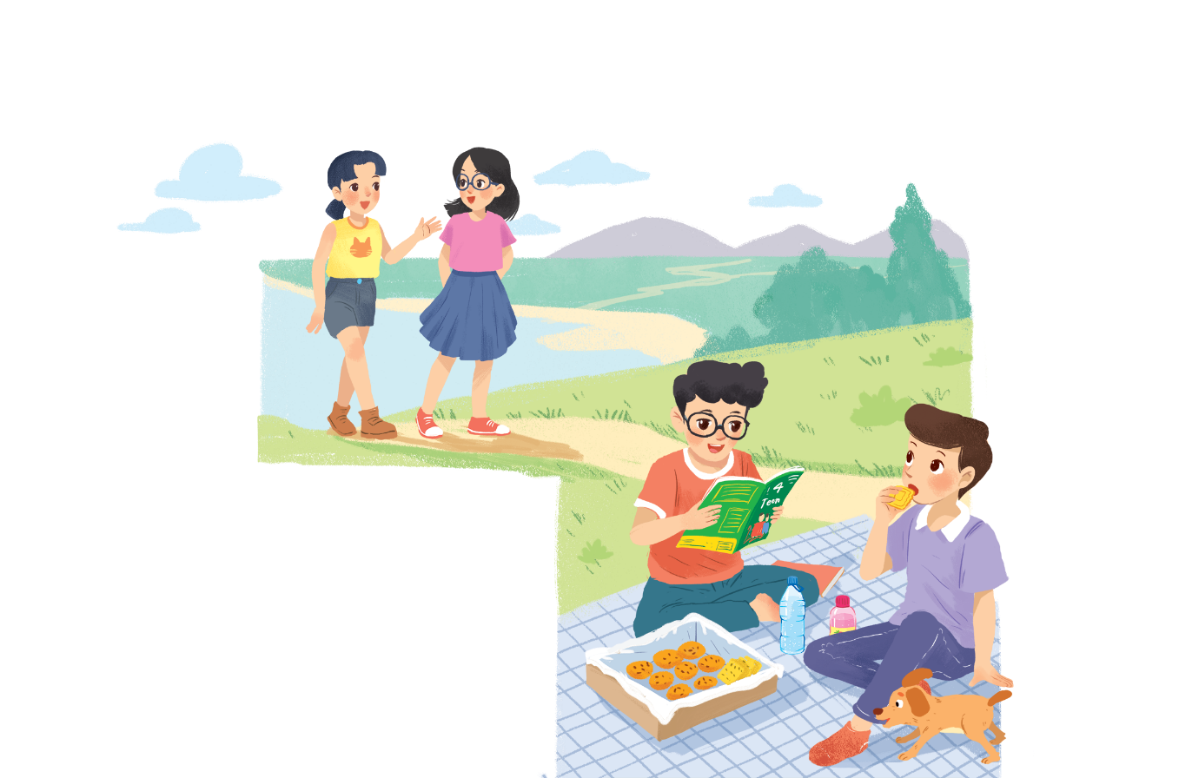
A surprise guest
Phong: That was a great idea, Nam.
I love picnics!
Nam: Please pass me the biscuits.
Phong: Sure. Here you are.
Nam: Thanks. What are you reading, Phong?
Phong: 4Teen. It’s my favourite magazine!
Nam: Look! It’s Mai. And she is with someone.
Phong: Oh, who’s that? She has glasses and long black hair.
Nam: I don’t know. They’re coming over.
Mai: Hi there. This is my friend Chau.
Phong & Nam: Hi, Chau. Nice to meet you.
Chau: Nice to meet you, too.
Nam: Would you like to sit down? We have lots of food.
Mai: Oh, sorry, we can’t. We’re going to the bookshop.
Chau: Bye for now.
Phong & Nam : Bye bye.

Slide 11

Fill the blanks with the words from the conversation.
Phong and Nam are having a .
1.
picnic
4Teen is Phong’s
favorite magazine.
2.
.
3.
Phong and Nam see and
Chau.
Mai
.
4.
glasses
Chau has and
long black hair.
.
5.
are going to
the bookshop.
Mai and Chau
the bookshop.

Slide 12

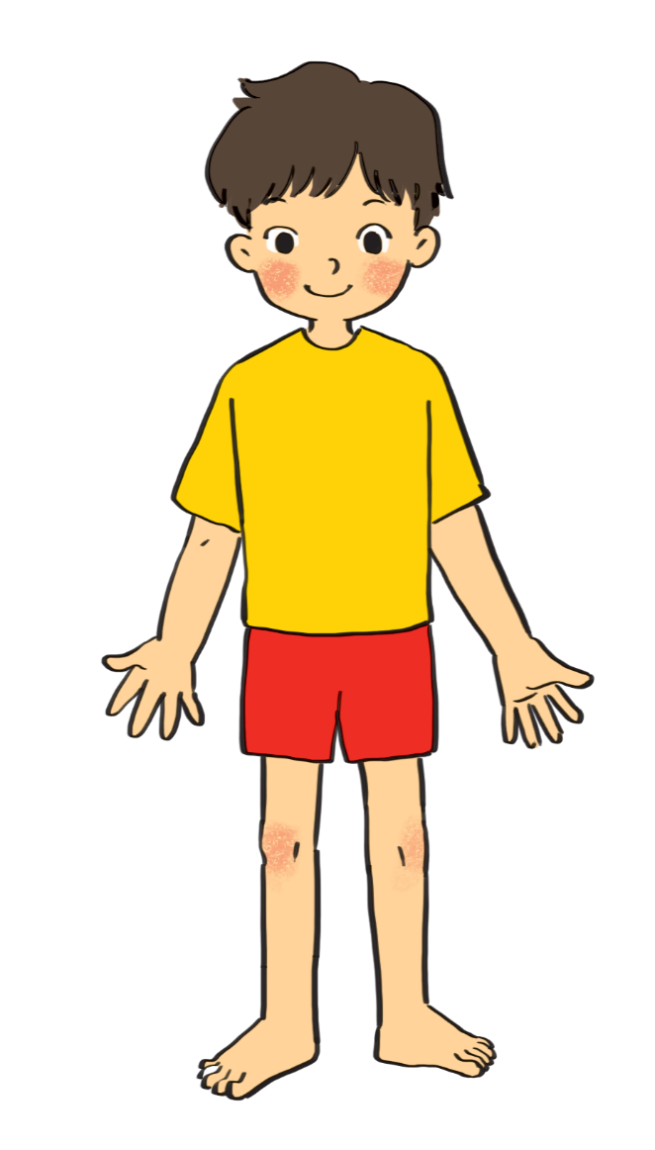
Label the body parts with the words in the box.
1.
10.
9.
2.
8.
3.
7.
4.
5.
6.
Do you know any other words for body parts?

Slide 13
cheek
eye
hand
arm
mouth
cheek
eye
hand
arm
mouth
leg
shoulder
leg
nose
hair
shoulder
foot
nose
hair
foot
eye
hair
1.
10.
cheek
nose
9.
2.
mouth
8.
shoulder
3.
arm
7.
hand
4.
leg
5.
foot
6.
Do you know any other words for body parts?

Slide 14

Work in groups. Complete the word webs.
Example:
arms
hair
nose
eyes
long / short
big / small
blonde
curly
hair

Slide 15
Work in groups. Complete the word webs.
Example:
arms
hair
long / short
leg

Slide 16
Work in groups. Complete the word webs.
Example:
nose
eyes
big / small
head
feet
hand
ears

Slide 17
Work in groups. Complete the word webs.
Example:
blonde
curly
long/short
black
hair
wavy
straight
fair

Slide 18


Guessing
Work in groups. Take turns to describe a classmate. Other group members guess who he / she is.
Example:
A: She has long hair and big eyes.
B: Is that Lan?
A: That’s right.

Slide 19
WRAP-UP
Learn some words related to body parts.
Understanding generally about topic My friend.

Slide 20
HOMEWORK
Learn by heart new words related to body parts.
Make sentences with new words.
Deadline: before Thursday (14/10).

Slide 21







