Slide 2



OBJECTIVES:
- Use vocabulary and structures about body parts, appearance and personality.
- Correctly pronounce the sound /p/ and /b/ in isolation and in context.

Slide 3
Vocabulary
Personality adjectives

Slide 4
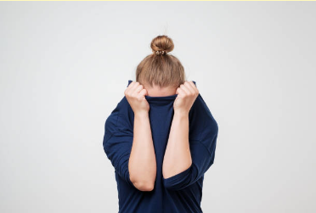
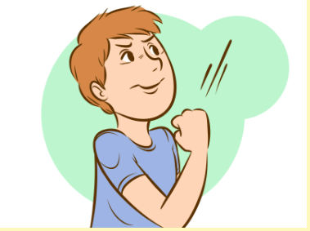
Vocabulary
Personality adjectives
shy /ʃaɪ/ (adj):
ngại
confident /ˈkɒnfɪdənt/ (adj):
tự tin

Slide 5
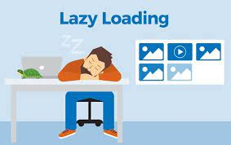

Vocabulary
Personality adjectives
lazy /ˈleɪ.zi/ (adj):
lười biếng
hard working /hɑːd/ /ˈwɜːkɪŋ/ (adj):
chăm chỉ

Slide 6

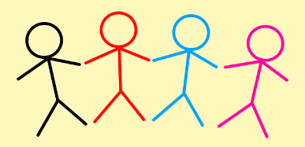
Vocabulary
Personality adjectives
friendly /ˈfrendli/ (adj):
thân thiện
clever /ˈklevə(r)/ (adj):
thông minh, khéo léo

Slide 7
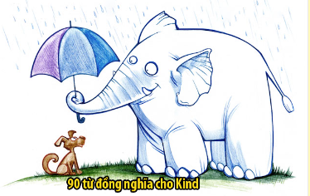

Vocabulary
Personality adjectives
kind /kaɪnd/ (adj):
tốt bụng
creative /kriˈeɪtɪv/ (adj):
sáng tạo

Slide 8

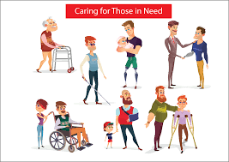
Vocabulary
Personality adjectives
careful /ˈkeəfl/ (adj):
cẩn thận
caring /kriˈeɪtɪv/ (adj):
chu đáo

Slide 9
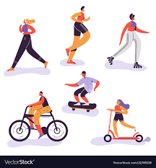

Vocabulary
Personality adjectives
active /ˈæk.tɪv/ (adj):
năng động
funny /ˈfʌn.i/ (adj):
hài hước, vui vẻ

Slide 10


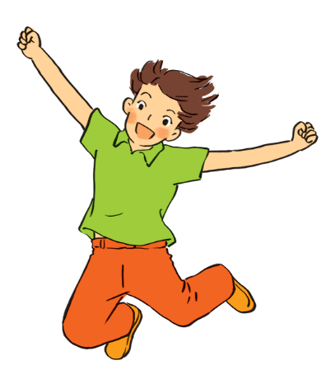
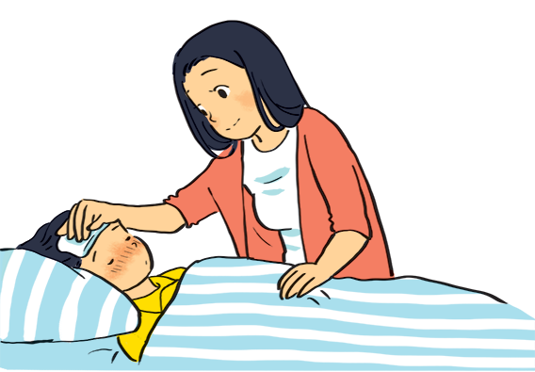
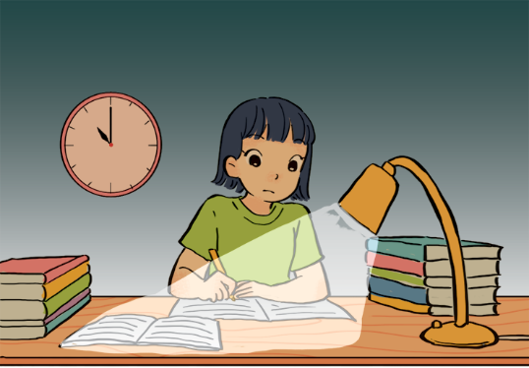
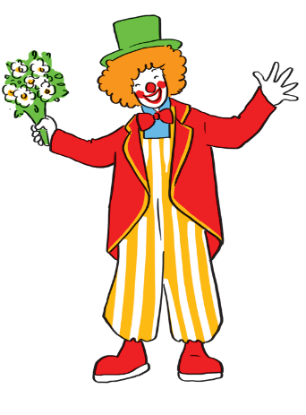
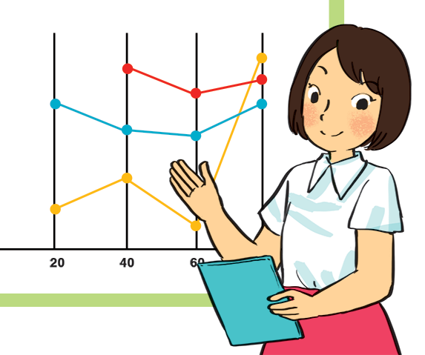
Match the adjectives to the pictures.
a
a
1. hard - working
b
b
2. confident
4. caring
3. funny
4. caring
4. caring
5. active
5. active
5. active
c
d
e
1. hard - working
3. funny
2. confident

Slide 11

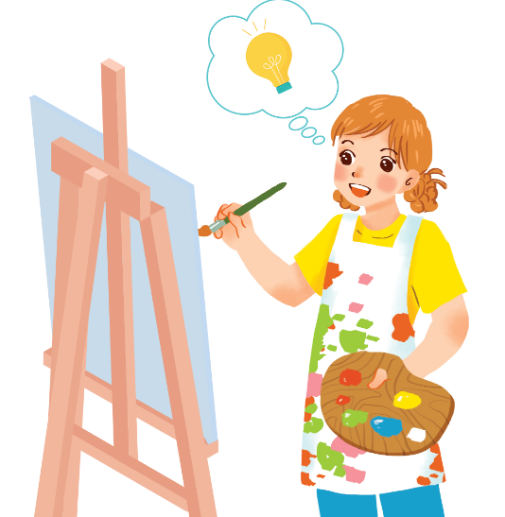
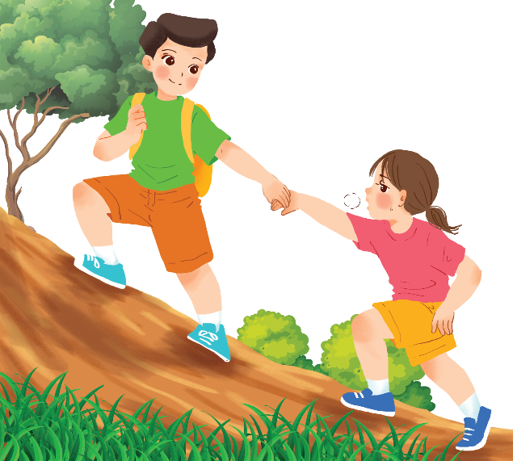
Use the adjectives in the box to complete the sentences.
Pay attention to the highlighted words / phrases.
carefull
clever
shy
kind
creative
friendly
1.
Mina is very . She likes drawing pictures. She always has lots of new ideas.
creative
Nam is .
He likes helping his friends.
2.
kind

Slide 12
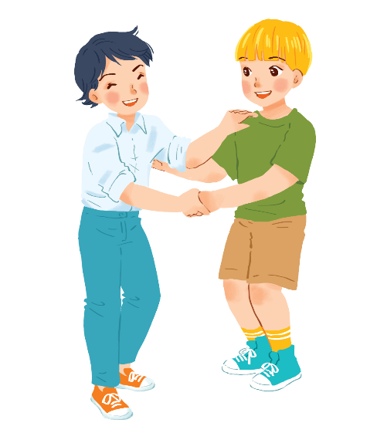
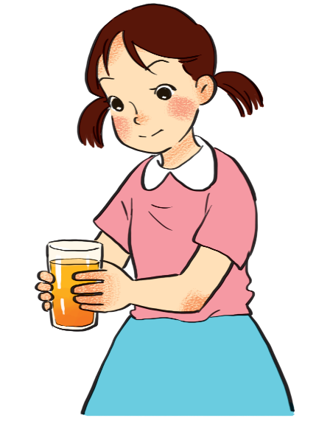
Use the adjectives in the box to complete the sentences.
Pay attention to the highlighted words / phrases.
carefull
clever
shy
kind
creative
friendly
Minh Duc is
He likes meeting new people.
3.
friendly.
.
Kim is very .
She pays attention to what she’s doing.
4.
carefull

Slide 13
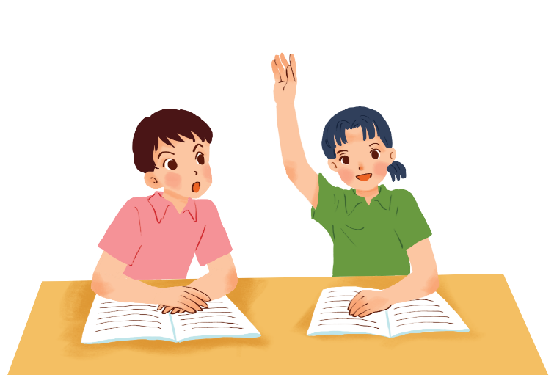
Use the adjectives in the box to complete the sentences.
Pay attention to the highlighted words / phrases.
carefull
clever
shy
kind
creative
friendly
5.
Mai is .
She learns things quickly and easily.
clever

Slide 14



Friendship ﬂower.
Work in groups. Write two personality adjectives for each group member.
Minh: kind funny

Slide 15
Pronunciation
/b/ and /p/

Slide 16


Listen and circle the words you hear. Then repeat.
 | /b/ | /p/
1. | big | pig
2. | bear | pear
3. | buy | pie
4. | robe | rope

Slide 17

WRAP-UP
Learn some personality adjectives to describe people.
Do exercises to practice them.
Learn how to pronounce sound /b/ and /p/.

Slide 18
HOMEWORK
Learn by heart some personality adjectives to describe people and make sentences with each adjective.
Do exercises A. Pronunciation and B. Vocabulary 1 (p. 16), 2,3 (p.17).
Deadline: before Friday (14/10).

Slide 19







