Slide 2

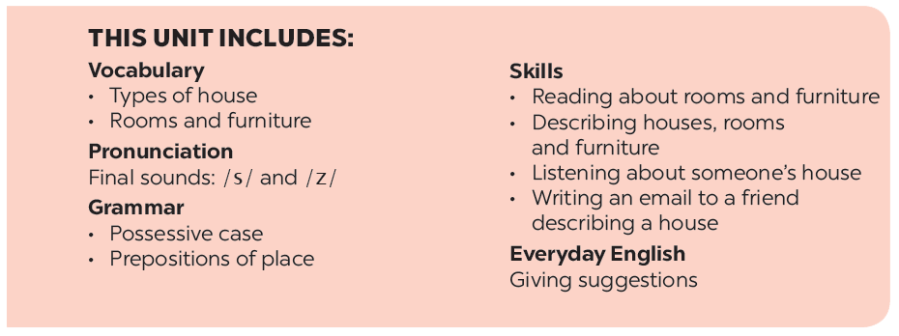

Slide 3


A look inside - OBJECTIVES
- Use the lexical items related to the topic My house.
- Ask and answer about where someone lives.

Slide 4

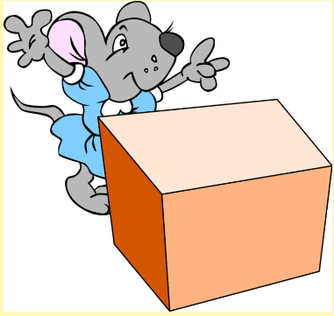
VOCABULARY
A look inside
behind /bɪˈhaɪnd/ (prep):
phía sau

Slide 5
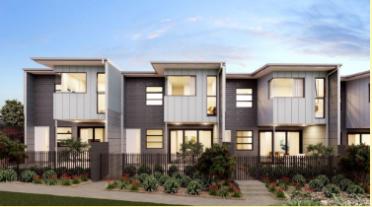
VOCABULARY
A look inside
townhouse /ˈtaʊn.haʊs/ (n):
nhà phố

Slide 6
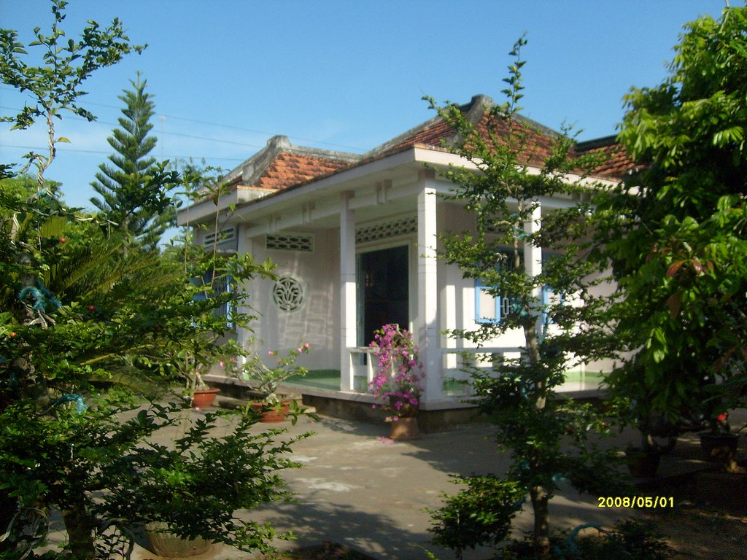
VOCABULARY
A look inside
country house /ˌkʌn.tri ˈhaʊs/ (n):
nhà ở quê
Meaning: a large traditional house in the countryside
This Photo by Unknown Author is licensed under CC BY-ND

Slide 7
VOCABULARY
A look inside
flat /flæt/ (n):
căn hộ

Slide 8
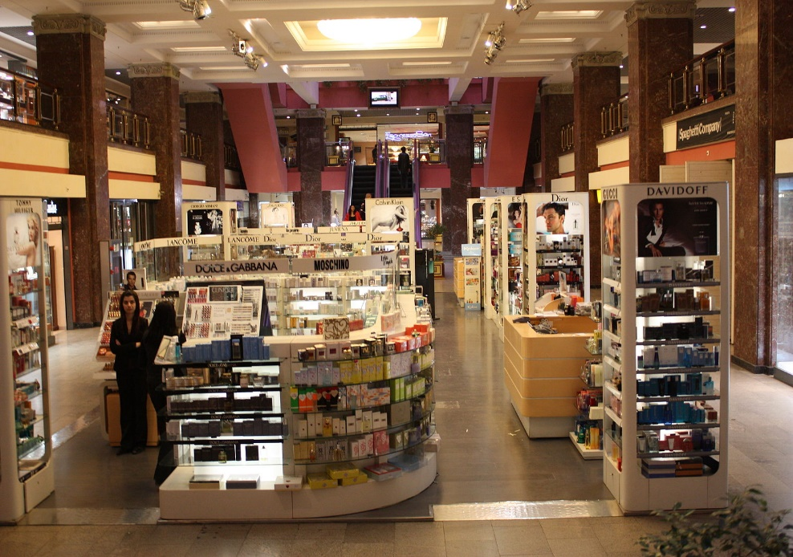
VOCABULARY
A look inside
department store /dɪˈpɑːt.mənt ˌstɔːr/ (n):
cửa hàng tạp hóa
Meaning: a large shop divided into several different parts, each of which sells different things.
This Photo by Unknown Author is licensed under CC BY-SA

Slide 9
VOCABULARY
A look inside
live /lɪv/ (v):
sống
E.g: I live in Ha Noi city.

Slide 10

VOCABULARY
A look inside
aunt /ɑːnt/ (n):
dì, cô
Meaning: the sister of someone's father or mother, or the wife of someone's uncle

Slide 11
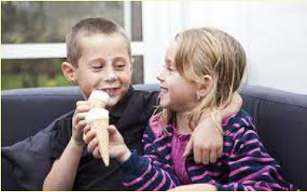
VOCABULARY
A look inside
cousin /ˈkʌzn/ (n):
anh chị em họ
Meaning: a child of a person's aunt or uncle

Slide 12
VOCABULARY
A look inside
buy /baɪ/ (v):
mua
Meaning: to get something by paying money for it
E.g: I need to go to the supermarket to buy some bread.

Slide 13
VOCABULARY
A look inside
buy /baɪ/ (v):
mua
Meaning: to get something by paying money for it
E.g: I need to go to the supermarket to buy some bread.

Slide 14


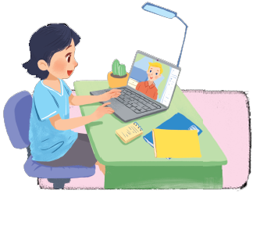
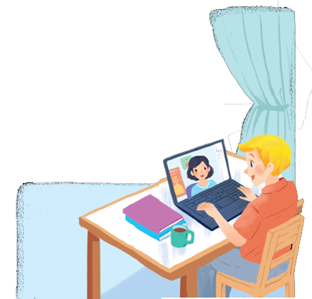
Listen and read.
A look inside

Slide 15
A look inside
Mi: Wow! Your room looks so big, Nick.
Nick: It’s elena’s room. she’s my sister.
Mi: I see. Is there a TV behind you?
Nick: Yes, there is. Where do you live, Mi?
Mi: I live in a town house. And you?
Nick: I live in a country house. Who do you live with?
Mi: My parents and younger brother. We’re moving to a ﬂat next month!
Nick: Are you?
Mi: Yes. My aunt lives near there, and I can play with my cousin.
Nick: Are there many rooms in your new ﬂat?
Mi: Yes, there are. There’s a living room, three bedrooms, a kitchen and two bathrooms.

Slide 16

Which family members does Mi talk about?
Put a tick ().
1. | parents
2. | sister
3. | brother
4. | aunt
5. | cousin





Slide 17

Read the conversation again. Complete each sentence with ONE word.
sister
1.
Elena is Nick’s .
2.
TV
There is a in Elena’s room.
3.
Now Mi lives in a house.
town
country
4.
Nick lives in a house.
5.
Mi’s new flat has bedrooms.
three

Slide 18

Complete the word web. Use the words from the conversation and the ones you know.
town house
TYPES OF HOUSE

Slide 19
Complete the word web. Use the words from the conversation and the ones you know.
villa
cottage
town house
country house
TYPES OF HOUSE
flat
stilt house
farmhouse

Slide 20

Work in groups. Ask your friends where they live. Then report their answers.
A: Where do you live?
B: I live in a flat.

Slide 21
WRAP-UP
Learn new words of house things, houserooms, types of house, family members…
Do exercises to understand the topic My house.

Slide 22
HOMEWORK
Learn by heart new words.
Do exercises 1, 2, 3 in Workbook.
Deadline: before Tuesday morning (27/9).

Slide 23







