Slide 2



OBJECTIVES:
- Vocabulary:
+ Use the lexical items related to the topic My house;
+ Use the vocabulary and structures to talk about the names of rooms and furniture pieces in the house.
- Pronunciation: pronounce and recognize the sounds /s/ and /z/.

Slide 3
Vocabulary
Rooms and furniture

Slide 4
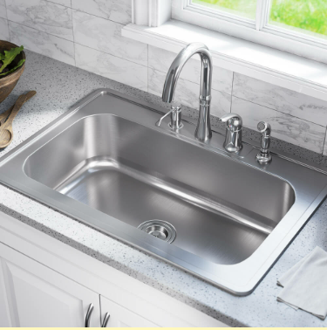
Vocabulary
Rooms and furniture
sink /sɪŋk/ (n):
bồn rửa

Slide 5
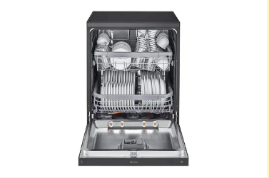
Vocabulary
Rooms and furniture
dishwasher /ˈdɪʃwɒʃə(r)/ (n):
máy rửa bát

Slide 6
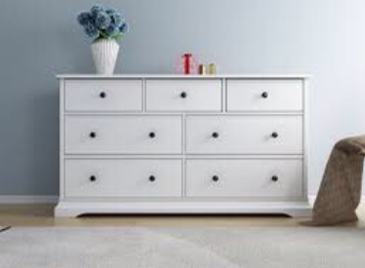
Vocabulary
Rooms and furniture
chest of drawer /ˌtʃest əv ˈdrɔːrz/ (n):
tủ có ngăn kéo

Slide 7
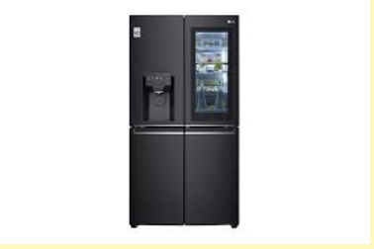
Vocabulary
Rooms and furniture
fridge /frɪdʒ/ (n):
tủ lạnh

Slide 8
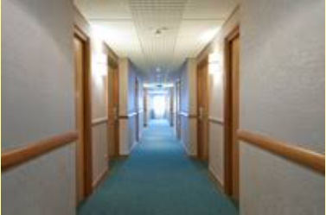
Vocabulary
Rooms and furniture
hall /hɔːl/ (n):
hành lang
Meaning: the area just inside the main entrance of a house, apartment, or other building that leads to other rooms and usually to the stairs.

Slide 9
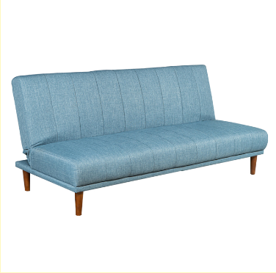
Vocabulary
Rooms and furniture
sofa /ˈsəʊfə/ (n):
ghế sô-fa
Meaning: a long, soft seat with a back and usually arms

Slide 10
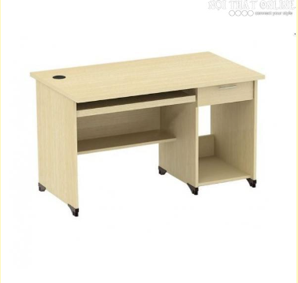
Vocabulary
Rooms and furniture
desk /desk/ (n):
cái bàn học
E.g: This is my sister’s desk.

Slide 11
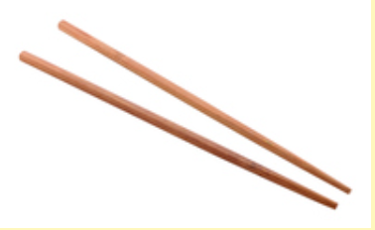
Vocabulary
Rooms and furniture
chopstick /ˈtʃɒpstɪks/ (n):
đôi đũa

Slide 12
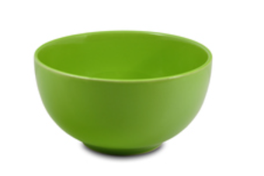
Vocabulary
Rooms and furniture
bowl /bəʊl/ (n):
cái bát
E.g: My house has a lot of bowls.

Slide 13


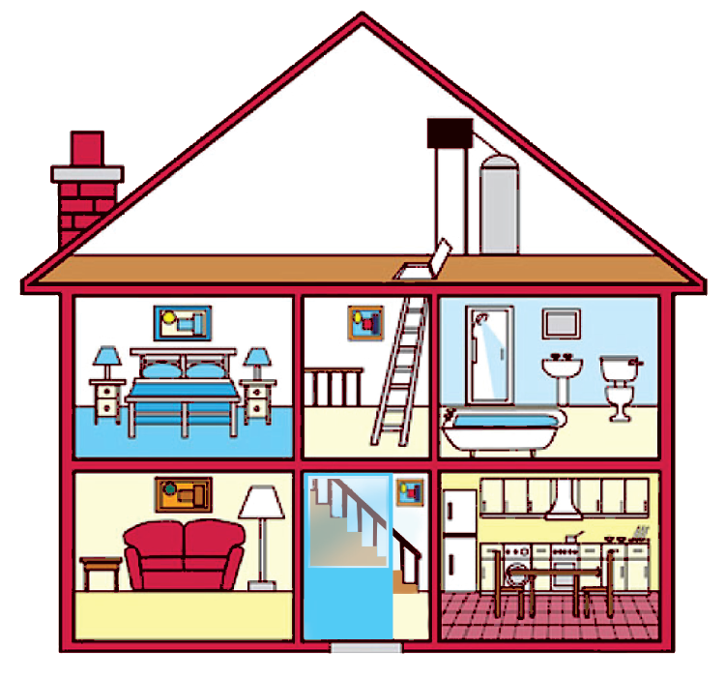
Look at the house. Name the rooms in it.

Slide 14





hall
bathroom
hall
bathroom
living room
kitchen
living room
kitchen
bedroom
bedroom
c.
bedroom
d.
bathroom
b.
living room
e.
kitchen
a.
hall

Slide 15

Name the things in each room in 1. Use the word list below. (You may use a word more than once.)
lamp
toilet
picture
cupboard
dishwasher
sink
fridge
shower
sofa
chest of drawers
hall | kitchen | bedroom | bathroom | living room
picture
fridge
lamp
shower
lamp
cupboard
picture
sink
sofa
dishwasher
chest of drawers
toilet
picture
sink

Slide 16

Think of a room in your house. In pairs, ask and answer questions to guess it.
Example:
A: What’s in your room?
B: A sofa and a television.
A: Is it the living room?
B: Yes.

Slide 17
Pronunciation
Final sounds: /s/ and /z/

Slide 18


Listen and repeat these words.
lamps
cupboards
sink
sofas
flats
kitchen
toilets
rooms

Slide 19

Listen to the conversation. Underline the final s in the words and put them into the correct column.
Mi: Mum, are you home?
Mum: Yes, honey. I’m in the kitchen. I’ve bought these new bowls and chopsticks.
Mi: They’re beautiful, Mum. Where did you buy them?
Mum: In the department store near our house. They have a lot of things for homes.
Mi: Don’t forget we need two lamps for my bedroom, Mum.
Mum: Let’s go there this weekend.
bowls
chopsticks
things
homes
lamps
Now practise the conversation with a partner.
/s/ | /z/
bowls
chopsticks
lamps
things
homes
Audio script

Slide 20
AUDIO SCRIPT
Mi: Mum, are you home?
Mum: Yes, honey. I’m in the kitchen. I’ve bought these new bowls
and chopsticks.
Mi: They’re beautiful, Mum. Where did you buy them?
Mum: In the department store near our house. They have a lot of
things for homes.
Mi: Don’t forget we need two lamps for my bedroom, Mum.
Mum: Let’s go there this weekend.

Slide 21
WRAP-UP
- Learn new words related to the house: House furniture and rooms.
- Do exercises to improve vocabulary.
- Distinguish sounds /s/ & /z/.

Slide 22
HOMEWORK
- Learn by heart new words.
- Do exercises 1,2 (p.10), 5 (p.11) in Workbook.
Deadline: before Friday morning (30/9).

Slide 23







