Slide 1

Welcome teachers
to our class !

Slide 2


Slide 3
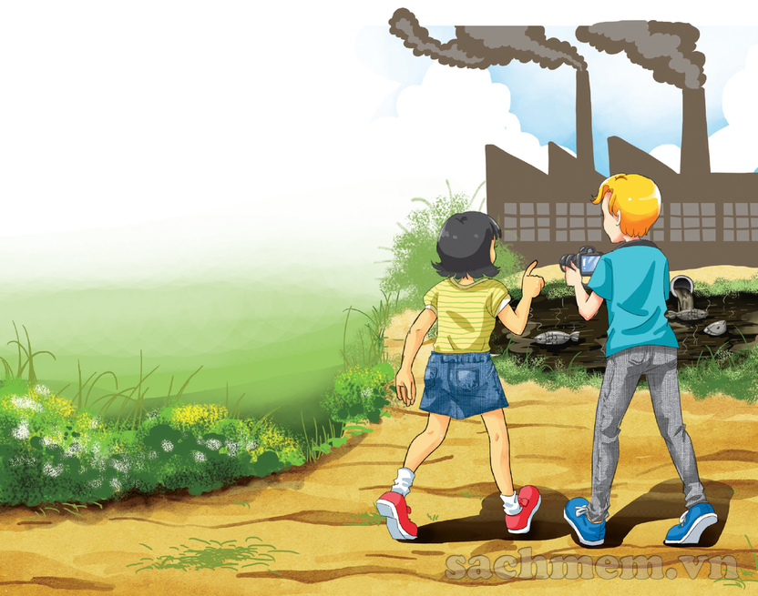

Slide 4
Monday, Januaray 15th, 2018
Period 55. Unit 8: POLLUTION
Lesson 1: Getting started

Slide 5
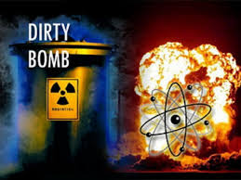

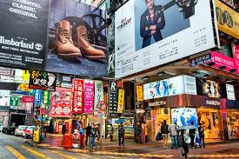
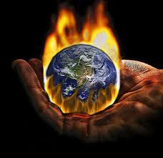
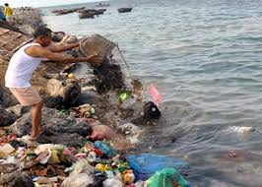
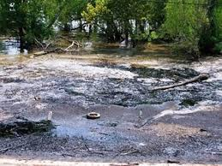
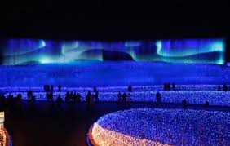
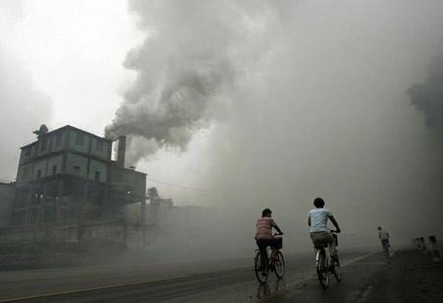
water pollution land/soil pollution air pollution
noise pollution thermal pollution light pollution
Radioactive pollution visual pollution
2. There are different types of pollution. Write each type
under a picture:
noise
pollution
C.
visual
pollution
thermal
pollution
radioactive
pollution
B.
D.
A.
E.
water
pollution
land/ soil
pollution
light
pollution
air
pollution
F.
G.
H.

Slide 6
3. Complete the sentences with the types of pollution.
thermal pollution
When ……………............. happens, the water temperature in streams, rivers, lakes, or oceans changes.
2. ……………………. occurs when the atmosphere contains gases, dust, or fumes in harmful amounts.
3. When radiation goes into the land, air or water, it is called ………………………
4. Too much use of electric lights in cities may cause …………..
5. ………………….. is the contamination of lakes, rivers, oceans, or groundwater, usually by human activities.
6. ………………………… happens when human activities destroy the Earth’s surface.
7. …………..…… occurs because there are too many loud sounds in the environment.
8. The sight of too many telephone poles, advertising billboards, overhead power lines, or shop signs may case ……………………
Air pollution
radioactive pollution
light pollution
Water pollution
Land / Soil pollution
Noise pollution
visual pollution

Slide 7

I. NEW WORDS
- pollution (n)
sự ô nhiễm
→poison (n)
chất độc
- die (v)
chết
→ die – dead - dead
- aquatic (adj)
dưới nước
- dump (v)
thải
- bless you !
cầu chúa phù hộ cho bạn
- to come up with
nghĩ ra

Slide 8

1. Listen and read. A project on pollution
Nick: Your home village is so beautiful. There are so many trees, flowers and birds.
Mi: Yes, that’s why I like coming back here on holiday.
Nick: Mi, what’s that factory? It looks new.
Mi: I don’t know. There wasn’t a factory here last year.
Nick: Mi, look at the lake! Its water is almost black.
Mi: Let’s go closer. ... I can’t believe my eyes. The fish are dead!
Nick: I think the waste from the factory has polluted the lake. The fish have died because of the polluted water.
Mi: That’s right. If the factory continues dumping poison into the lake, all the fish and other aquatic animals will die.
Nick: Ahchoo!
Mi: Bless you! What’s the matter?
Nick: Thanks. Ahchoo! I think there’s air pollution here as well. If the air wasn’t dirty, I wouldn’t sneeze so much. Ahchoo!
Mi: I’ve come up with an idea about our environmental project! How about giving a presentation about water and air pollution?
Nick: That’s a good idea. Let’s take some pictures of the factory and the lake to illustrate our presentation. Ahchoo!

Slide 9
1a. Find a word / phrase that means :
1. no longer alive
dead
L10
aquatic
2. growing or living in, on, or near water
L16
dump
3. throwing away something you do not want, especially in a place which is not allowed.
L10
poison
4. A substance that can make people or animals ill or kill them if they eat or drink it
L15
5. Made unclear or unsafe to use
polluted
L13
6. To think of an idea, or a plan
to come up with
L22

Slide 10
b. Answer the questions.
1. Where are Nick and Mi ?
→ They are in Mi’s home village.
2. What does the water in the lake look like ?
→ Almost black
3. Why is Mi surprised when they get closer to the lake?
→ Because she sees the fish dead.
4. What is the factory dumping into the lake?
→ poison.
5. Why is Nick sneezing so much ?
→ Because the air is not clean.

Slide 11

c. Tick ( )true (T) , false (F), or no information (NI)
T | F | NI
1. The water in the lake has been polluted by a ship.
2. Water pollution in the lake has made the fish die.
3. Aquatic plants may also die because of the polluted water.
4. Nick wouldn’t sneeze so much if the air was clean.
5.Nick and Mi will give a talk about water and air pollution.

Slide 12
4. Work in groups. Which types of pollution in 3 does your neighbourhood face? Rank them in order of seriousness. Give reasons for your group’s order.
→ It’s air pollution, noise pollution and visual pollution.
→ Air pollution does harm to your health. Noise pollution can make you stressed. Visual pollution is nit good for sight around.

Slide 13


Revise the new words, exercises in the work notebook.
Prepare the new lesson : A closer look 1

