Slide 1


WELCOME TO OUR CLASS!

Slide 2



What type of house is it?

Slide 3
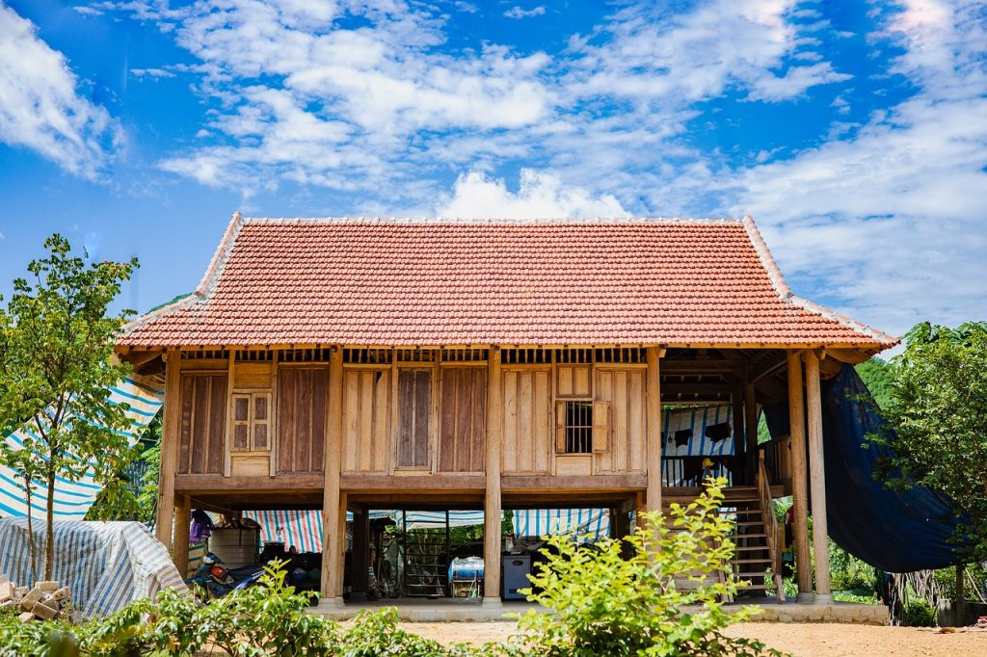
stilt house

Slide 4









Unit 4:
ETHNIC GROUPS OF VIETNAM
Lesson 5: Skills 1

Slide 5
reading

Slide 6

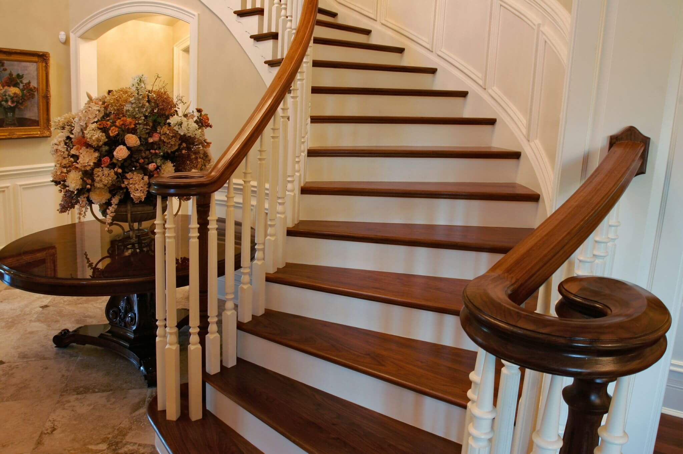

VOCABULARY
staircase (n)
/ˈsteəkeɪs/
cầu thang bộ

Slide 7

VOCABULARY
material (n)
/məˈtɪəriəl/
vật liệu

Slide 8
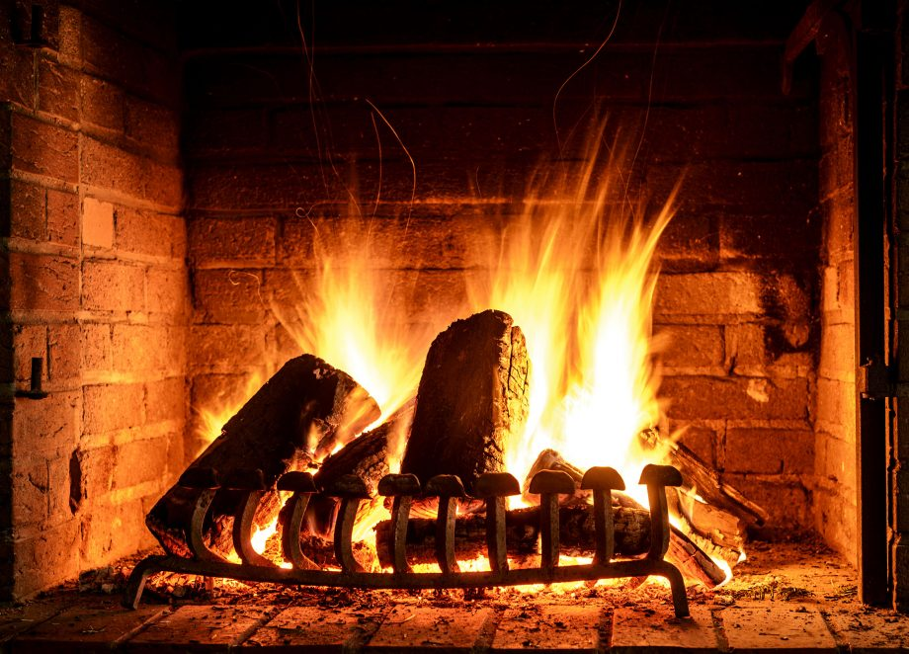
VOCABULARY
open fire (n)
/ˌəʊpən ˈfaɪə/
lò sưởi

Slide 9

VOCABULARY
owner (n)
/ˈoʊnə/
người sở hữu

Slide 10
VOCABULARY
- staircase (n) | /ˈsteəkeɪs/ | cầu thang bộ
- material (n) | /məˈtɪəriəl/ | vật liệu
- open fire (n) | /ˌəʊpən ˈfaɪə/ | lò sưởi
- owner (n) | /ˈoʊnə/ | người sở hữu

Slide 11
1. Write the words and phrase from the box under the correct pictures.
open fire
posts
staircase
1. _______________
2. _______________
3. _______________

Slide 12
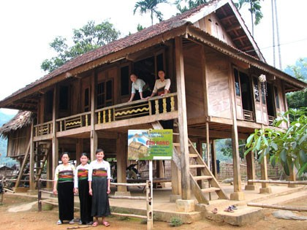
Stilt houses
Stilt houses are popular among different ethnic minority groups, from the Thai in the Northern Highlands to the Khmer in the Mekong Delta. The houses come in different sizes and styles and show the traditional culture of their owners.
Stilt houses are made from natural materials like wood, bamboo, and leaves. They stand on strong posts, about two or three metres above the ground. This allows them to keep people safe from wild animals. People climb a seven- or nine-step staircase to enter the house.
The most important place in the house is the kitchen. It has an open fire in the middle of the house. It is the place for family gatherings and receiving guests.
The stilt houses of the Tay and Nung usually overlook a field. The stilt houses of the Thai, however, face mountains or a forest. The Bahnar and Ede have a communal house (called a Rong house) as the heart of their village. These communal houses are the largest and tallest ones in the village.

Slide 13
2. Read the passage and tick T (True) or F (False)
Statements | True | False
1. Only a few minority groups live in stilt houses.
2. All stilt houses look alike.
3. Family gatherings take place by the open fire in the middle of the house.
4. The Rong house serves as the centre of an Ede village

Slide 14
Check your answers
F
1. Only a few minority groups live in stilt houses.
Stilt houses are popular among different ethnic minority groups, from the Thai in the Northern Highlands to the Khmer in the Mekong Delta. house.

Slide 15
Check your answers
F
2. All stilt houses look alike.
The houses come in different sizes and styles and show the traditional culture of their owners.

Slide 16
Check your answers
T
3. Family gatherings take place by the open fire in the middle of the house.
The most important place in the house is the kitchen. It has an open fire in the middle of the house. It is the place for family gatherings and receiving guests.

Slide 17
Check your answers
T
4. The Rong house serves as the centre of an Ede village.
The Bahnar and Ede have a communal house (called a Rong house) as the heart of their village.

Slide 18

Look at the answers again.
Statements | True | False
1. Only a few minority groups live in stilt houses.
2. All stilt houses look alike.
3. Family gatherings take place by the open fire in the middle of the house.
4. The Rong house serves as the centre of an Ede village

Slide 19
3. Read the passage again and fill in each blank with ONE word.
1. A stilt house shows the _____________ culture of the owner.
2. The Tay’s and Nung’s stilt houses overlook a _________.
3. The Thai’s stilt houses overlook a _________ or _____________.
4. The largest and tallest house in an Ede village is the _________ house.

Slide 20
3. Read the passage again and fill in each blank with ONE word.
traditional
1. A stilt house shows the _____________ culture of the owner.
The houses come in different sizes and styles and show the traditional culture of their owners.

Slide 21
3. Read the passage again and fill in each blank with ONE word.
traditional
1. A stilt house shows the _____________ culture of the owner.
field
2. The Tay’s and Nung’s stilt houses overlook a _________.
The stilt houses of the Tay and Nung usually overlook a field.

Slide 22
3. Read the passage again and fill in each blank with ONE word.
traditional
1. A stilt house shows the _____________ culture of the owner.
field
2. The Tay’s and Nung’s stilt houses overlook a _________.
forest
mountains
3. The Thai’s stilt houses overlook a _________ or _____________.
The stilt houses of the Thai, however, face mountains or a forest.

Slide 23
3. Read the passage again and fill in each blank with ONE word.
traditional
1. A stilt house shows the _____________ culture of the owner.
field
2. The Tay’s and Nung’s stilt houses overlook a _________.
forest
mountains
3. The Thai’s stilt houses overlook a _________ or _____________.
Rong
4. The largest and tallest house in an Ede village is the _________ house.
The Bahnar and Ede have a communal house (called a Rong house) as the heart of their village. These communal houses are the largest and tallest ones in the village.

Slide 24

Speaking

Slide 25


4. Work in pairs. Discuss and tick ( )the features of a stilt house from the list below. Share your opinions with the class.
A stilt house ____________.
- has a flat cement roof
- stands on big posts
- is made from natural materials
- has a modern toilet
- is a flat in a big block
- is close to nature
I think….

Slide 26
5. Work in pairs. Ask and answer about the type of home each of you lives in. Take notes of your partner’s answer and report what you find to the class.
1. What type of home do you live in?
(a flat, a house, a detached house, a stilt house, a farmhouse, a cottage, a tree house, ...)
2. What materials is it made from?
(brick, cement, tree, leaves, wood, stone, …)
3. What is the most important part of your home? What do you do there?
(living room - receiving guest - watching TV together) ; garden – where the family members relax and hold party; kitchen – place for family gathering and receiving guest

Slide 27
HOMEWORK
- Learn by heart vocabulary
- Prepare for the next lesson

Slide 28
LET’S SAY:
THANK YOU!

