Slide 1





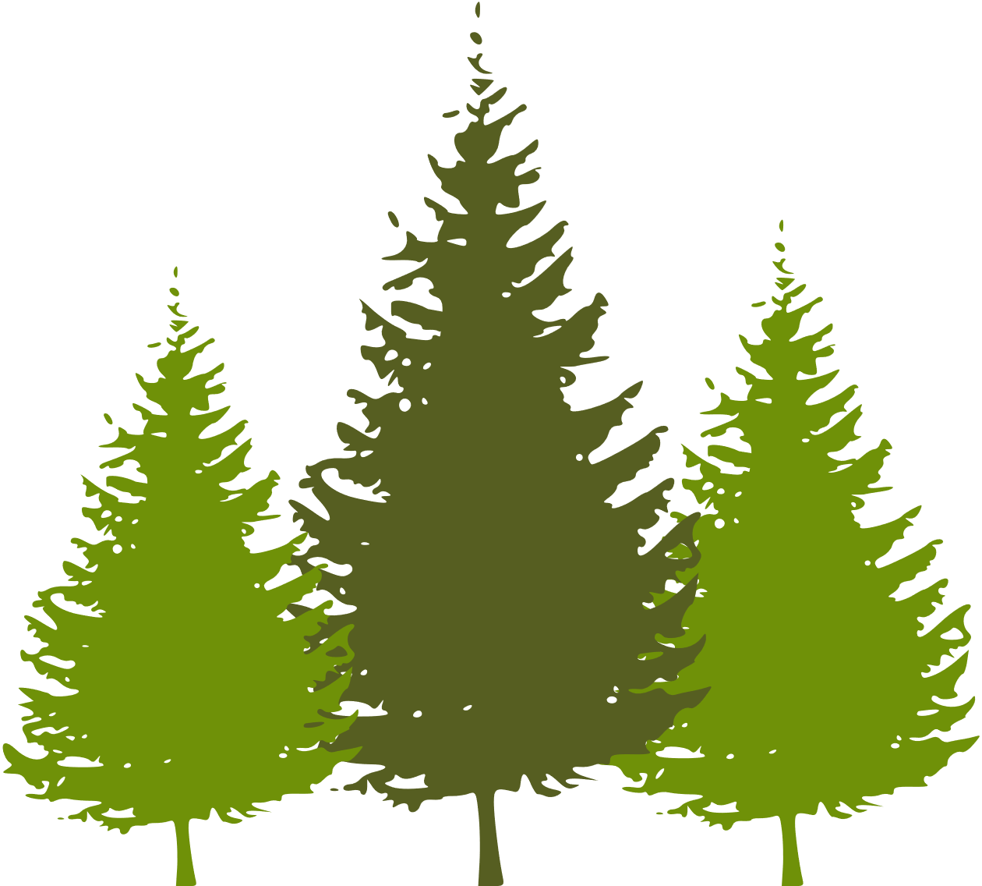



WELCOME TO OUR CLASS
Teacher: ….

Slide 2
Unit 4:
ETHNIC GROUPS OF VIET NAM
Lesson 1: Getting Started
– I’m from the Tay ethnic group

Slide 3


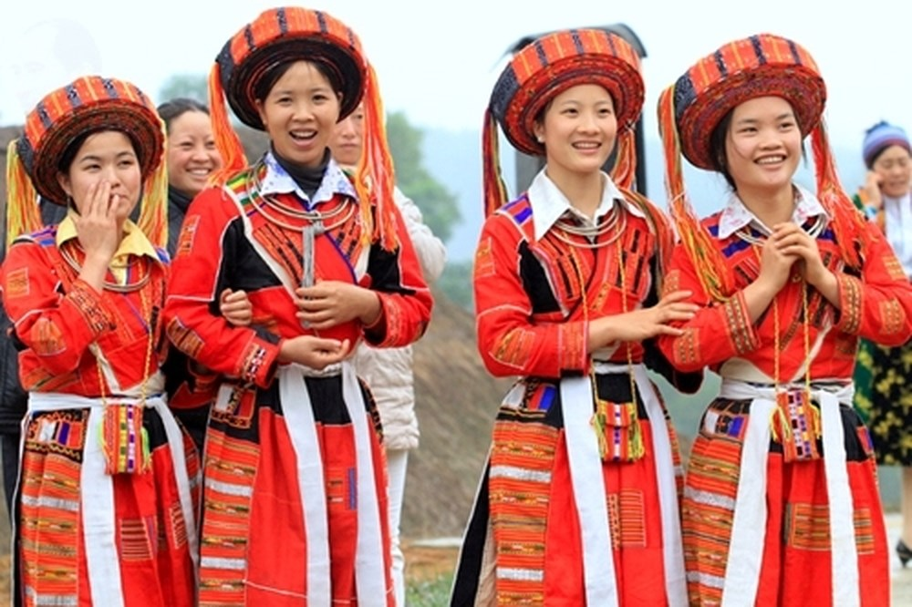


VOCABULARY
ethnic (group) (adj)
/ˈeθnɪk / (/gru:p/)
(nhóm) dân tộc

Slide 4
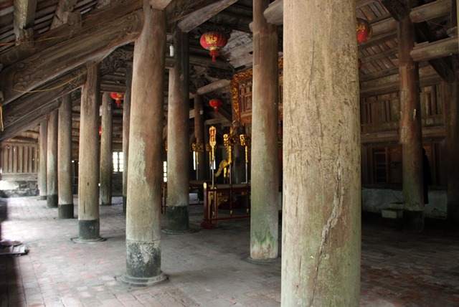
amira Hadid
VOCABULARY
post (n)
/pəʊst/
cột

Slide 5
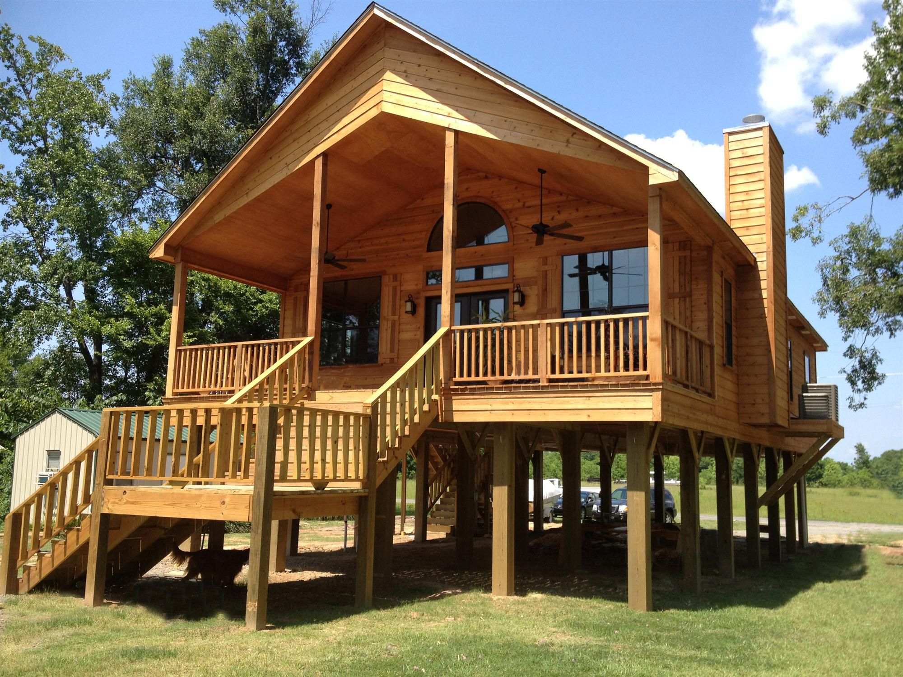
VOCABULARY
stilt house (n)
/stilt haus/
nhà sàn

Slide 6
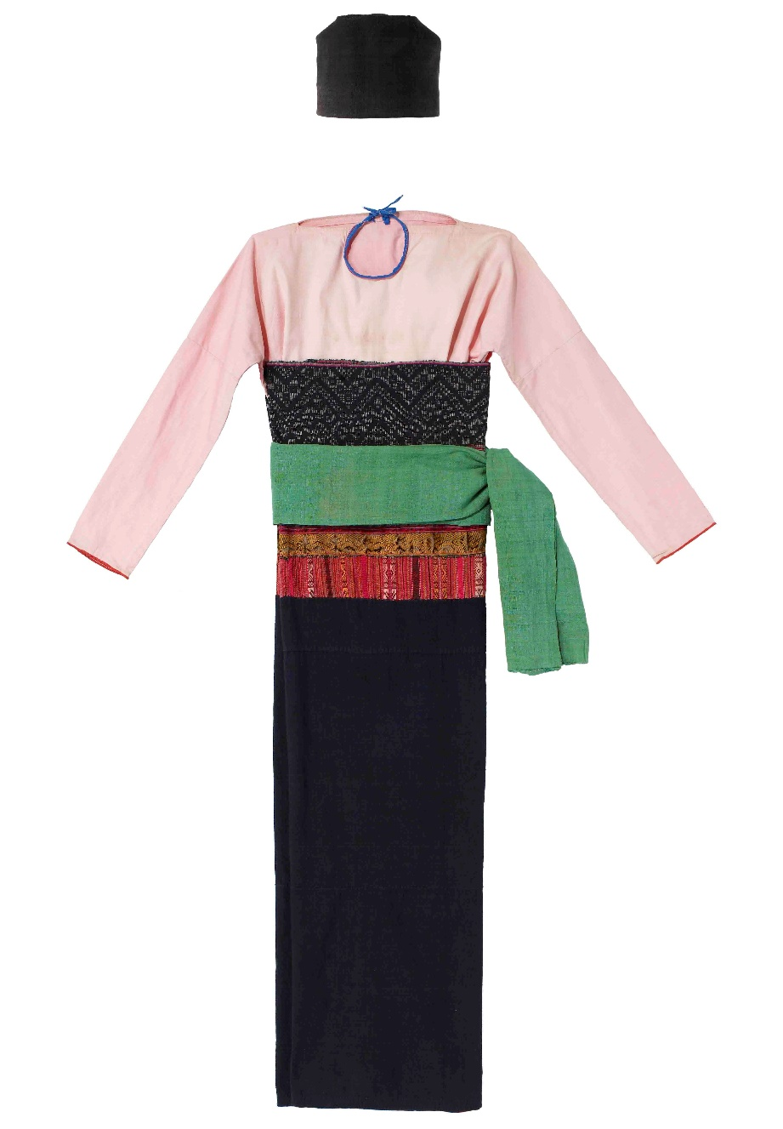
VOCABULARY
costume (n)
/'kɔstju:m/
trang phục

Slide 7

VOCABULARY
- ethnic (group) (adj) | /ˈeθnɪk / (/gru:p/) | (nhóm) dân tộc
- post (n) | /pəʊst/ | cột
- overlook (v) | /ˌəʊ.vəˈlʊk/ | nhìn ra
- stilt house (n) | /stilt haus/ | nhà sàn
- costume (n) | /'kɔstju:m/ | trang phục
- terraced field (n) | /ˈter.əst fiːld / | ruộng bậc thang

Slide 8
2.Read the conversation again and circle the best answers
What are Tom and Lai talking about?
A. Minority groups in Viet Nam.
B. Ha Giang.
C. Life of the Tay people.
1.
A “stilt house” ______.
A. is a multi-storey home
B. is on high posts
C. always faces a field
2.
Lai mentions ______ of the Tay people.
A. folk dances
B. popular festivals
C. costumes
3.

Slide 9

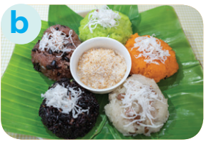
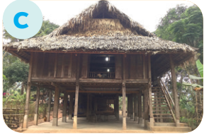

3. Match the pictures with the word and phrases from the conversation
1. stilt house
2. terraced fields
3. bamboo
4. five-colour sticky rice

Slide 10
4. Complete the sentences with the words and phrases from the box
overlooks musical instrument ethnic groups
folk dance traditional
+ noun
folk dance
1. I love mua sap, a popular _________ of the Thai people.
2. Their beautiful stilt house _________ a large rice field.
3. A: What is the name of a popular Tay’s __________________? - B: It’s dan tinh.
4. Every ethnic group has their own __________ culture.
5. Of the 54 ______________ in Viet Nam, the Kinh is the largest
+ verb
overlooks
+ noun
musical instrument
traditional
+ adj
+ noun
ethnic groups

Slide 11

THANK YOU

