Slide 1
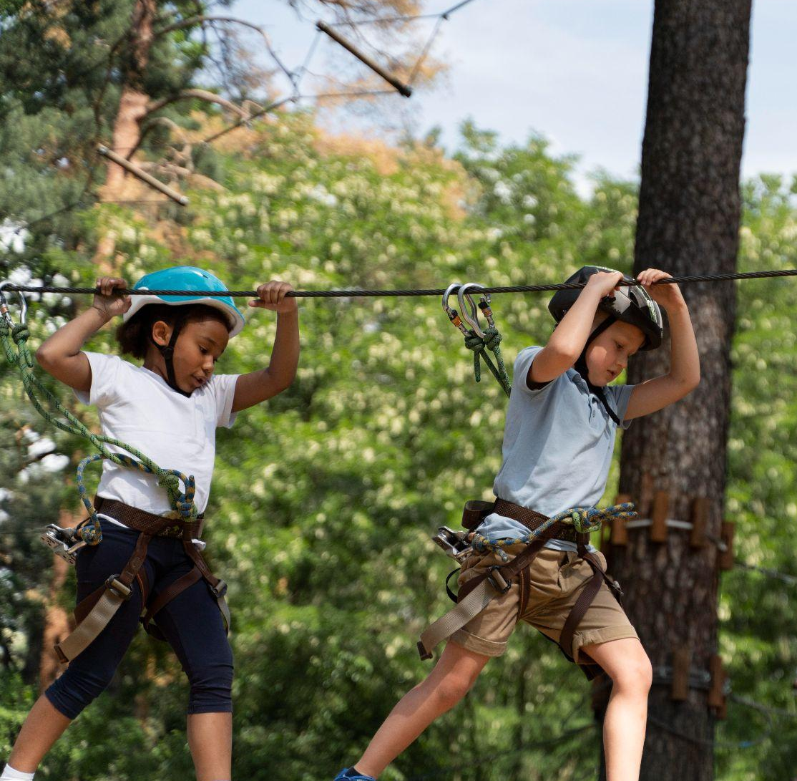
UNIT 6:
A VISIT TO A SCHOOL
7th Grade
Lesson 6: Skills 2

Slide 2
OBJECTIVES
01
READING
02
WRITING
By the end of the lesson, student can…
listen for general and special information about school activities
write a short paragraph about outdoor activities at one’s school

Slide 3
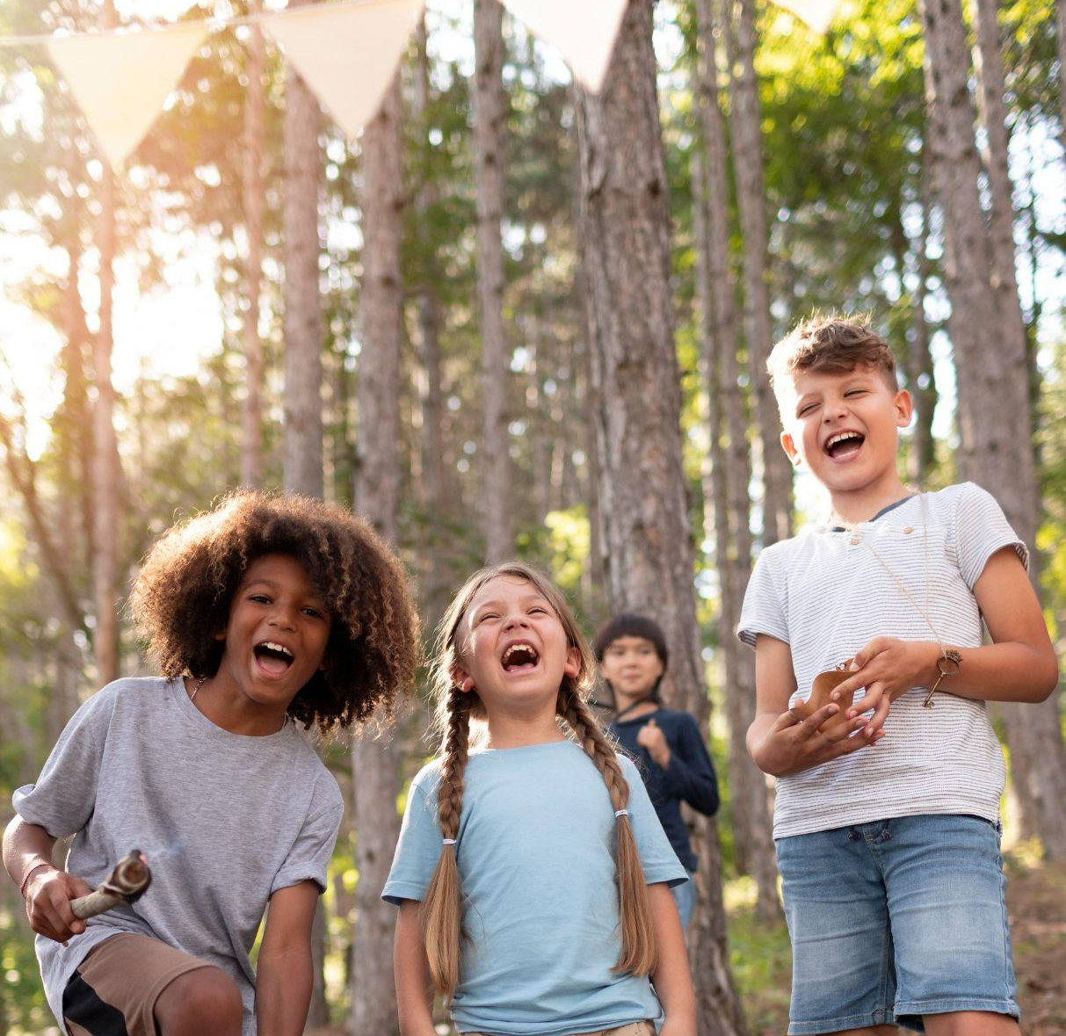
01
LISTENING
Page 67

Slide 4
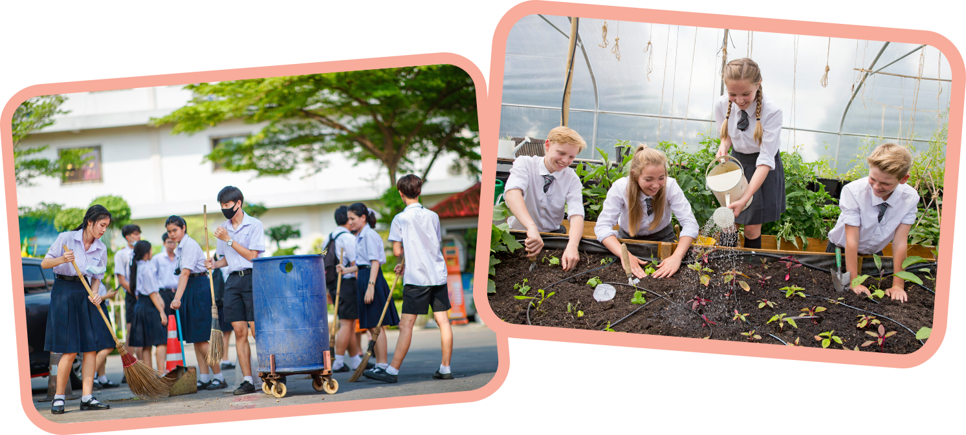
Ex 1. Work in pairs. Look and discuss.
1. What outdoor activities do they take part in?
2. Why do they do these activities?
gardening
cleaning the playground

Slide 5
Ex 2. Listen to an interview and circle the correct answer.
1. Trang and Phong are talking about _____.
A. school subjects B. school timetables C. outdoor activities
2. They are members of _____ club(s).
A. one B. two C. three
3. The Go Green Club cleans streets on _____.
A. Saturday afternoons B. Saturday mornings C. Sunday afternoons
4. They grow _____ in the school garden.
A. vegetables B. flowers C. trees

Slide 6

Underline key words
Listen and circle
1. Trang and Phong are talking about _____.
A. school subjects B. school timetables C. outdoor activities
2. They are members of _____ club(s).
A. one B. two C. three
3. The Go Green Club cleans streets on _____.
A. Saturday afternoons B. Saturday mornings C. Sunday afternoons
4. They grow _____ in the school garden.
A. vegetables B. flowers C. trees

Slide 7
Let’s check!
1. Trang and Phong are talking about _____.
A. school subjects
B. school timetables
C. outdoor activities
Reporter: Hello, Trang and Phong. Can you tell me something about your school outdoor activities?
Trang: Well. School is great. We are busy with our subjects, but we really enjoy the opportunities we have for outdoor activities.

Slide 8
Let’s check!
2. They are members of _____ club(s).
A. one
B. two
C. three
Reporter: Great. What types of outdoor activities do you take part in?
Trang: I’m a member of a club called Go Green Club. And we do lots of activities.
Reporter: What about you, Phong? What outdoor activities do you do?
Phong: Well. I’m a member of the Green Garden Club. We grow vegetables in the school garden after school.

Slide 9
Let’s check!
3. The Go Green Club cleans streets on _____.
A. Saturday afternoons
B. Saturday mornings
C. Sunday afternoons
Trang: I’m a member of a club called Go Green Club. And we do lots of activities.
Reporter: What activities, for example?
Trang: Well, our members clean streets on Saturday afternoons…

Slide 10
Let’s check!
4. They grow _____ in the school garden.
A. vegetables
B. flowers
C. trees
Reporter: What about you, Phong? What outdoor activities do you do?
Phong: Well. I’m a member of the Green Garden Club. We grow vegetables in the school garden after school.

Slide 11
Ex 3. Listen again and answer the questions.
1. What do Trang’s club members encourage their classmates to do?
2. What does the reporter think about their activities?
3. When and where do Nam’s club members grow vegetables?
Underline key words

Slide 12
Let’s check!
1. What do Trang’s club members encourage their classmates to do?
 They encourage their classmates to recycle glass, cans and paper.
Trang: I’m a member of a club called Go Green Club. And we do lots of activities.
Reporter: What activities, for example?
Trang: Well, our members clean streets on Saturday afternoons. We also encourage our classmates to recycle glass, cans, and paper.

Slide 13
Let’s check!
2. What does the reporter think about their activities?
 The reporter thinks their activities protect the environment.
Reporter: Wonderful! I’m sure your activities help us protect our environment.

Slide 14
Let’s check!
3. When and where do Nam’s club members grow vegetables?
 They grow vegetables in the school garden after school.
Reporter: What about you, Phong? What outdoor activities do you do?
Phong: Well. I’m a member of the Green Garden Club. We grow vegetables in the school garden after school.

Slide 15
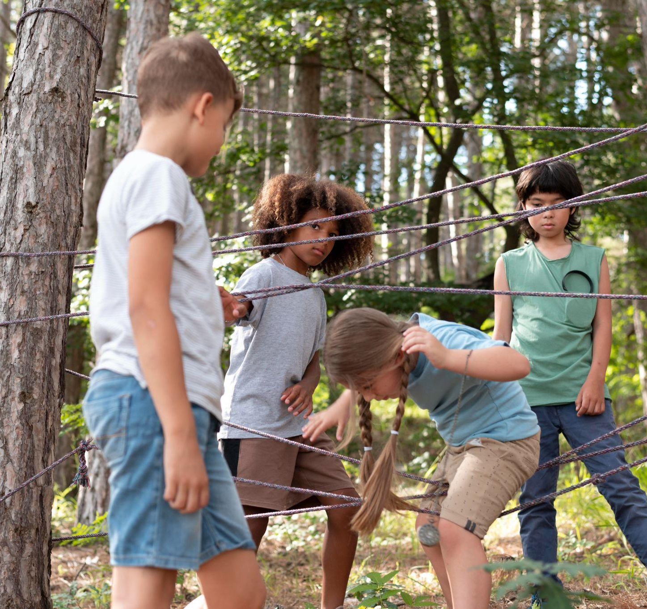
02
WRITING
Page 67

Slide 16


Ex 4. Work in pairs. Ask and answer questions about your school’s outdoor activities.
1. What outdoor activities do you take part in at school?
2. Which outdoor activity do you like the best?
3. Why do you like doing it?

Slide 17

Ex 5. Write a paragraph of about 70 words about an outdoor activity at your school.
1. What outdoor activities do you take part in at school?
2. Which outdoor activity do you like the best?
3. Why do you like doing it?

Slide 18
Writing model
My school is _______ secondary school. It is located in _______. In my school, I take part in many outdoor activities such as picking up rubbish, sorting the garbage, recycling old paper, growing flowers or planting trees. We also have other activities in the school such as football, basketball and so on. My favourite outdoor activity is planting trees. It makes me a more responsible and creative thinker. It also protects our environment.
1. What outdoor activities do you take part in at school?
2. Which outdoor activity do you like the best?
3. Why do you like doing it?
picking up rubbish, sorting the garbage, recycling old paper, growing flowers or planting trees.
planting trees
It makes me a more responsible and creative thinker. It also protects our environment.

Slide 19
Now, your turn!
1. What outdoor activities do you take part in at school?
2. Which outdoor activity do you like the best?
3. Why do you like doing it?

Slide 20
CLASS GALLERY

Slide 21

Class gallery
Students can:
go and see others’ work
give comments to one another


1. Does he/she use word phrases correctly?
2. Does he/she have spelling mistakes?

Slide 22
RECAP
LISTENING
WRITING
listen for general and special information about school activities
write a short paragraph about outdoor activities at one’s school

Slide 23
THANKS!
Do you have any questions?

