Slide 1
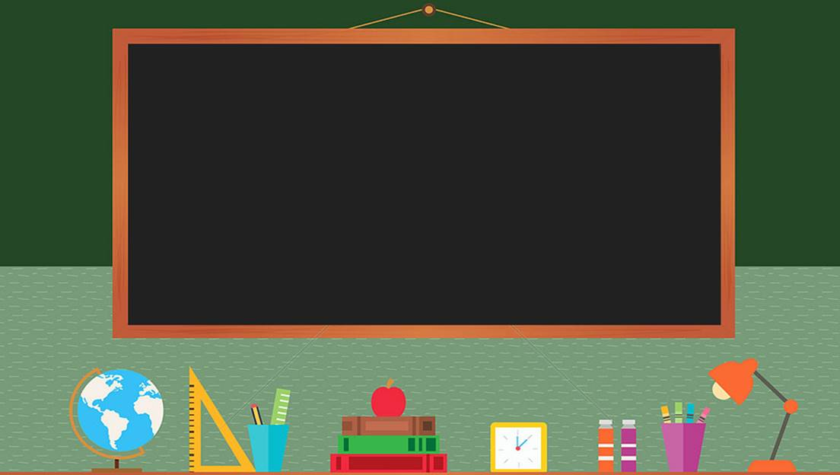
TRƯỜNG THCS LONG BIÊN
BÀI GIẢNG ĐIỆN TỬ MÔN TIẾNG ANH 6
UNIT 6: OUR TET HOLIDAY
Peroid 50 : Skills 2
GV: Trần Thị Thu Trang
Tổ Ngoại Ngữ - Năng khiếu

Slide 2







Listening
Writing
Nguyen is writing to his penfriend Tom about how his family prepares for Tet. Listen and tick () the things you hear.
Work in groups. Discuss and make a list of four things that you think children should and shouldn’t do at Tet.
Listen again and answer the questions in one or two words.
Complete the email, using your ideas in 3.

Slide 3
Listening

Slide 4



Nguyen is writing to his penfriend Tom about how his family prepares for Tet. Listen and tick () the things you hear.
1.
old things

2.
peach flowers

3.
new clothes

4.
cakes
5.
wishes

6.
good luck
T

Slide 5
AUDIO SCRIPT
Dear Tom,
Tet is coming and I’m very happy. We do a lot of things before Tet. We throw some old things away. We clean and decorate our homes. My mother goes shopping and buys food, red envelopes, and peach flowers. She also buys new clothes for us. My father makes banh chung and cooks them on an open fire. He says that I should make some wishes at Tet, and I shouldn’t break anything. It brings bad luck.
Yours
Nguyen

Slide 6

Listen again and answer the questions in one or two words.
1.
What do they throw away before Tet?
Old things.
2.
What do they clean and decorate?
(Their) houses.
3.
What colour are the envelopes?
Red.
4.
Who cooks banh chung?
(His) father.
5.
What shouldn’t they break?
Anything.
T

Slide 7
AUDIO SCRIPT
Dear Tom,
Tet is coming and I’m very happy. We do a lot of things before Tet. We throw some old things away. We clean and decorate our homes. My mother goes shopping and buys food, red envelopes, and peach flowers. She also buys new clothes for us. My father makes banh chung and cooks them on an open fire. He says that I should make some wishes at Tet, and I shouldn’t break anything. It brings bad luck.
Yours
Nguyen

Slide 8
Writing

Slide 9

Work in groups. Discuss and make a list of four things that you think children should and shouldn’t do at Tet.
Children should
1.
Decorate our homes with flowers and plants.
2.
Visit our grandparents and relatives.
Children shouldn’t
3.
Eat too much sweet food.
4.
Keep lucky money

Slide 10

Complete the email, using your ideas in 3.
To: tom@webmail.com
Subject: Tet in Viet Nam
Dear Tom,
Tet is coming. I will tell you more about our Tet.
At Tet, we should
We should
But we shouldn’t
We shouldn’t
Please write and tell me about your New Year celebration.
Yours,
Nguyen
.
, too.
.
, either.

Slide 11
Complete the email, using your ideas in 3.
To: tom@webmail.com
Subject: Tet in Viet Nam
Dear Tom,
Tet is coming. I will tell you more about our Tet.
At Tet, we should decorate our homes with flowers and plants.
We should visit our grandparents and relatives, too.
But we shouldn’t eat too much sweet food.
We shouldn’t keep lucky money, either. We should put into our piggy bank.
Please write and tell me about your New Year celebration.
Yours,
Nguyen

Slide 12
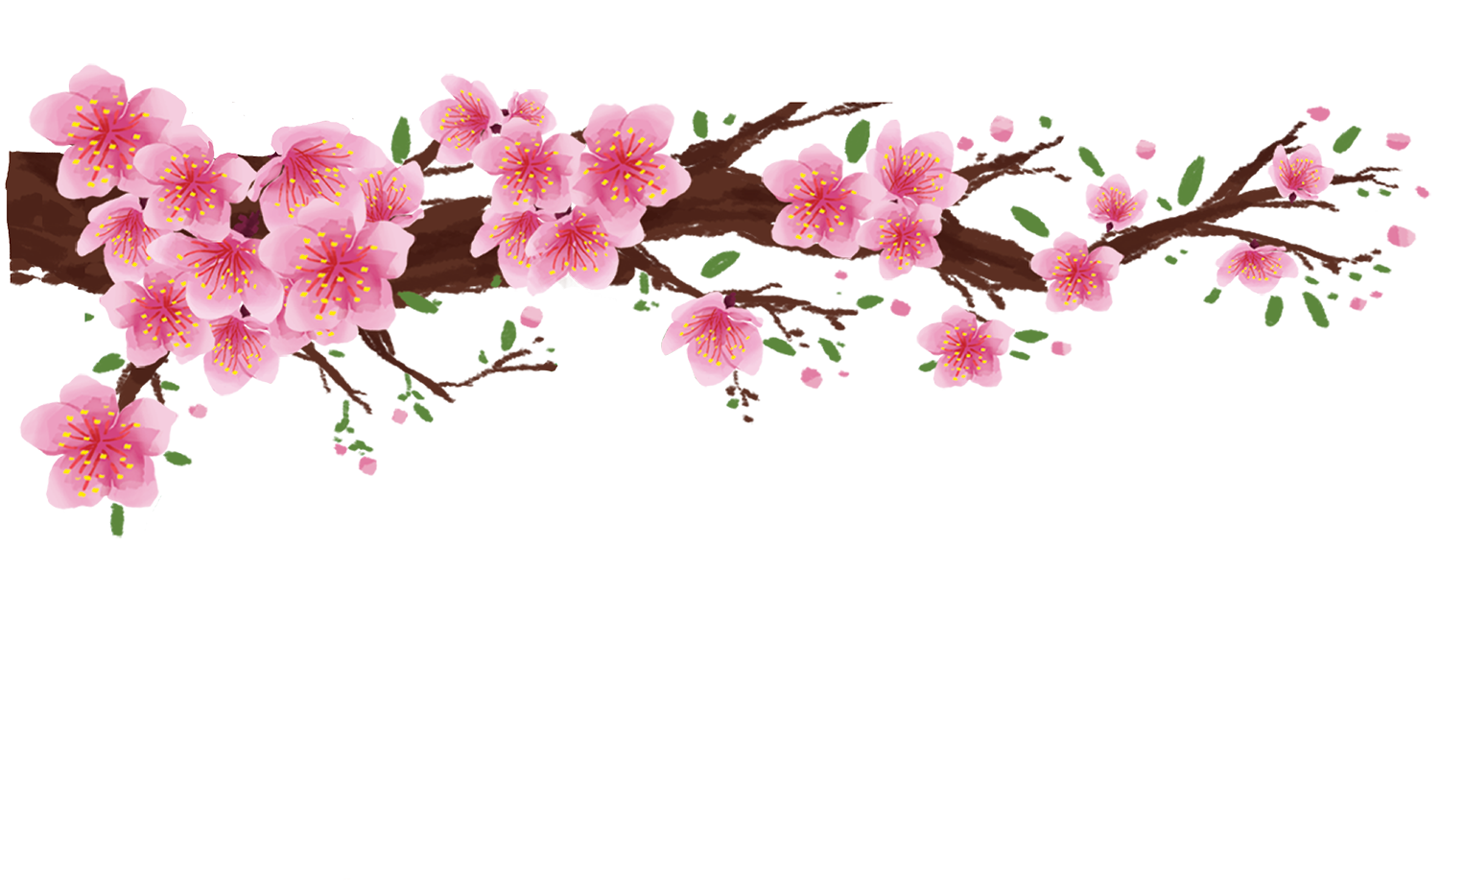
Lucky Numbers
Answer the questions
1
2
3
4
5
6
7
8

Slide 13
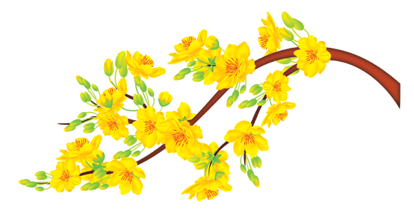
People often say these things when they meet each other on Tet holiday.
Wishes

Slide 14
A very popular and traditional flower in southern Viet Nam.
Apricot blossom

Slide 15
Something people usually do to make their house beautiful before Tet.
House decoration(s)

Slide 16
What do children like to get from their parents or grandparents/ the adults on Tet holiday?
Lucky money

Slide 17
A very popular and tradition flower in northern Viet Nam.
Peach blossom

Slide 18
Lucky number!

Slide 19
What do people cook/ eat during the Tet holiday?
Special food

Slide 20
Something people like to watch on the
New Year’s Eve.
Fireworks

Slide 21
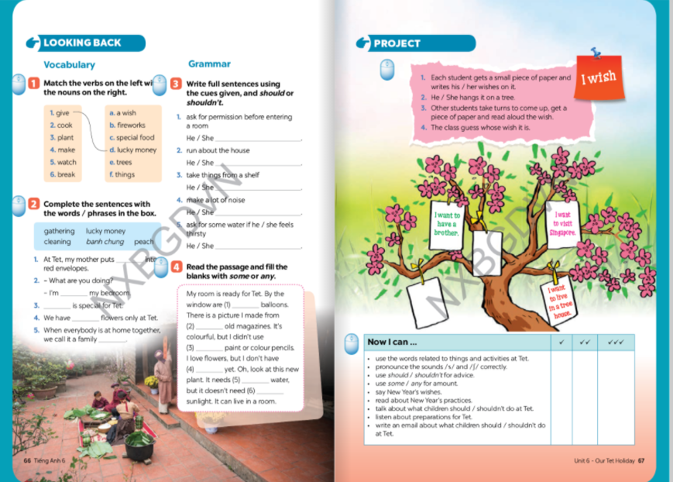
Homework
- Review all the tasks
- Repare lesson looking back and project

Slide 22



