Slide 1

TRƯỜNG THCS LONG BIÊN
BÀI GIẢNG ĐIỆN TỬ MÔN TIẾNG ANH 6
UNIT 2: MY HOUSES
Peroid 10 : A Closer Look 1
GV: Trần Thị Thu Trang
Tổ Ngoại Ngữ - Năng khiếu

Slide 2

Objectives
By the end of this lesson, students will be able to:
use the words for rooms and furniture
pronounce the final sounds /s/ and /z/ correctly

Slide 3
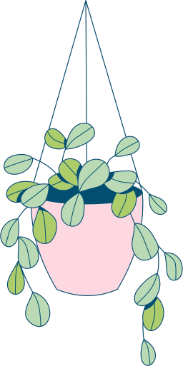
01
VOCABULARY
use the words for rooms and furniture

Slide 4

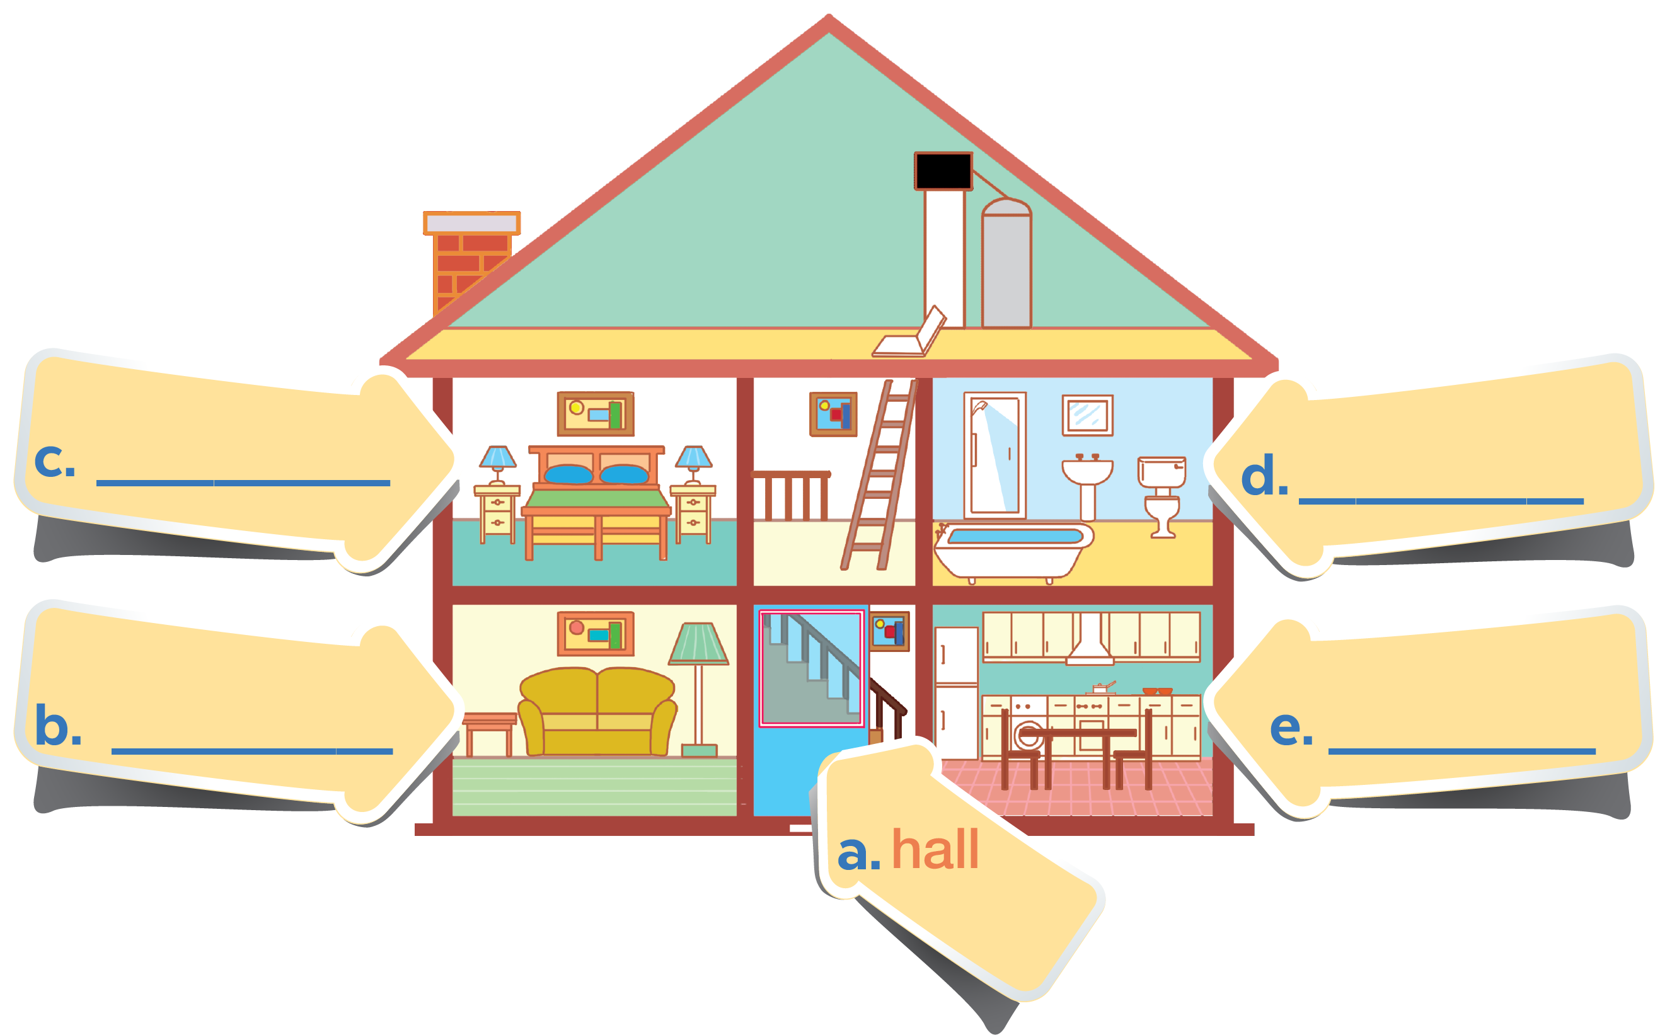
In 3 minutes. Put these things in each room.
(You may use a word more than one)
lamp
picture
chest of drawers
sofa
fridge
cupboard
dishwasher
sink
bath
toilet

Slide 5


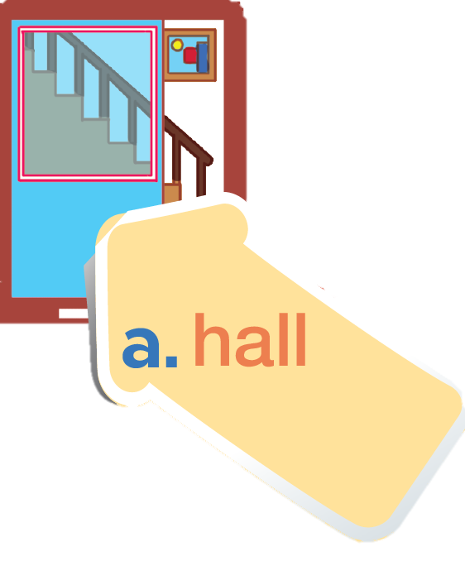

Check your answer
picture

Slide 6

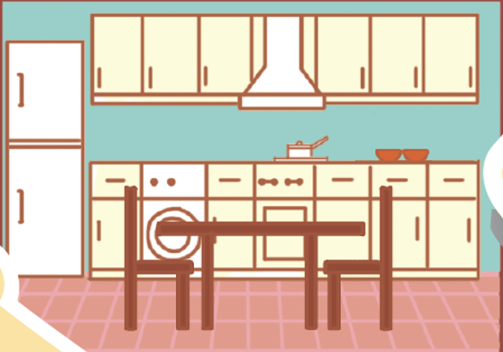
dishwasher
fridge
cupboard
kitchen

Slide 7
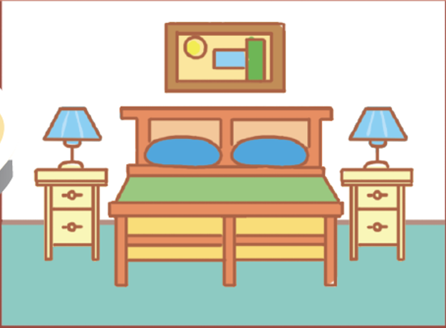
picture
lamp
chest
of drawers
bedroom

Slide 8
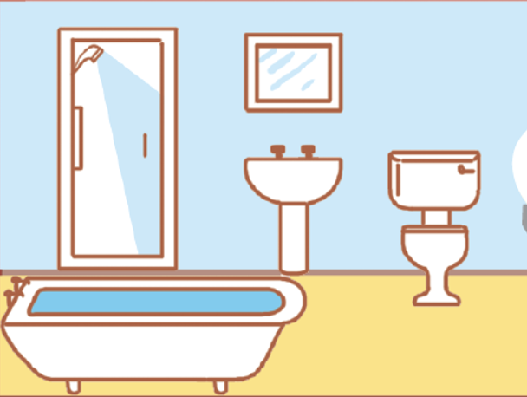
sink
bath
toilet
bathroom

Slide 9
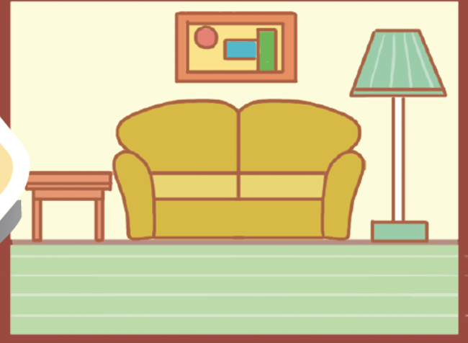
picture
sofa
lamp
living room

Slide 10
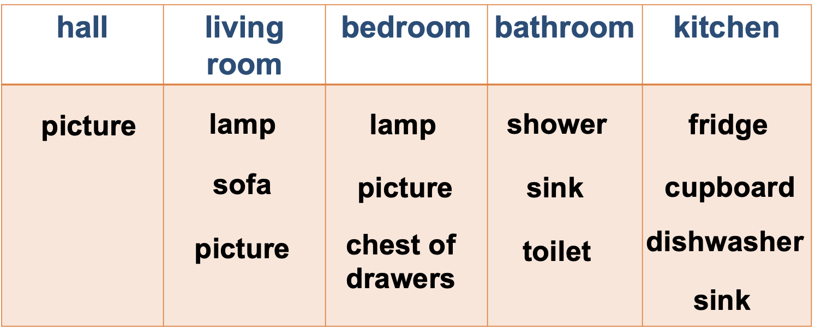
Check your answer
hall | kitchen | bedroom | bathroom | living room
picture
fridge
picture
sink
sofa
dishwasher
chest of drawers
bath
picture
cupboard
lamp
toilet
lamp

Slide 11
In groups, add more things for each room
hall | kitchen | bedroom | bathroom | living room
picture
fridge
picture
sink
sofa
dishwasher
chest of drawers
bath
picture
cupboard
lamp
toilet
lamp

Slide 12

02
PRONUNCIATION
pronounce the final sounds /s/ and /z/ correctly

Slide 13


Ex 4. Listen and repeat the words.
Pay attention to the final -s sounds.
lamps
cupboards
sinks
sofas
flats
kitchens
toilets
rooms

Slide 14

Final sounds: /s/
lamps
months
/p/
/θ/
sinks
laughs
/k/
/f/
flats
/t/
Final -s is pronounced /s/ after
voiceless sounds (/t/, /p/, /k/, /f/, /θ/).
Notes:
5. Listen to the conversation.
Underline the final - s in the words and put them into the correct column.

Slide 15
Final sounds: /z/
cupboards
kitchens
/d/
/n/
rooms
sofas
/m/
/ə/
Final -s is pronounced /z/ after voiced sounds
(/b/, /d/, /g/, /n/, /m/, /l/, etc.) and any vowel sounds.

Slide 16
Ex 5 (pg 18) Underline the final -s in the words and put them into the correct column.
Mi: Mum, are you home?
Mum: Yes, honey. I’m in the kitchen. I’ve bought these new bowls and chopsticks.
Mi: They’re beautiful, Mum. Where did you buy them?
Mum: In the department store near our house. They have a lot of things for homes.
Mi: Don’t forget we need two lamps for my bedroom, Mum.
Mum: Let’s go there this weekend.
/s/ | /z/
bowls
things
lamps
chopsticks
homes

Slide 17
SUMMARY
/s/ | /z/
Final -s is pronounced /s/ after voiceless sounds (/t/, /p/, /k/, /f/, /θ/) | Final -s is pronounced /z/ after voiced sounds (/b/, /d/, /g/, /n/, /m/, /l/, etc.) and any vowel sounds.
E.g: cats, lamps, books, months | E.g: beds, dogs, cans, rooms, videos, cookers, bees

Slide 18


* Learn all of the words by heart and make sentences using them
* Practice saying the words and sentences in front of a mirror, record and then listen again
* Do Part A – Exercise 1,2 in Workbook

