Slide 1


TRƯỜNG THCS LONG BIÊN
BÀI GIẢNG ĐIỆN TỬ MÔN TIẾNG ANH 6
UNIT 8: SPORTS AND GAMES
LESSON 1: GETTING STARTED
GV: Trần Thị Liên
Tổ NK-NN

Slide 2

Unit 8:
Sports and games
Lesson 1: Getting started

Slide 3
Objectives
By the end of the lesson, students will be able to:
- have an overview about the topic Sports and games;
- use the vocabulary and talk about sports and games.

Slide 4


At the gym
1
Listen and read.
2
Put a word from the conversation in each gap.
3
Name these sports and games, using the words from the box.
4
Work in pairs. Ask your partner these questions to find out how sporty they are.

Slide 5

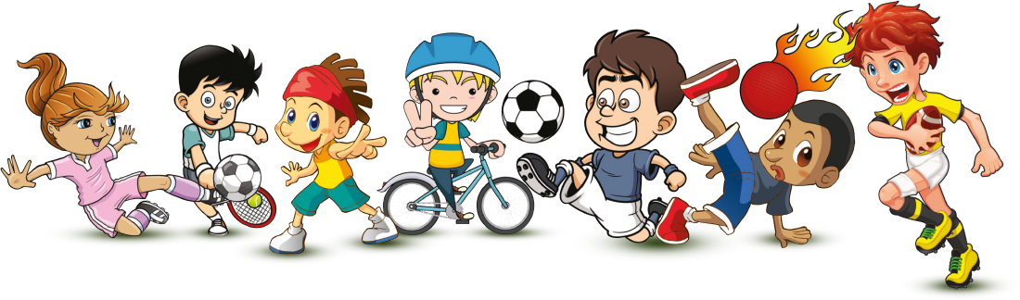

Slide 6

This is a …
bike
for going …
cycling

Slide 7


These are …
goggles
for going …
swimming

Slide 8

These are …
bats
for playing …
table tennis

Slide 9
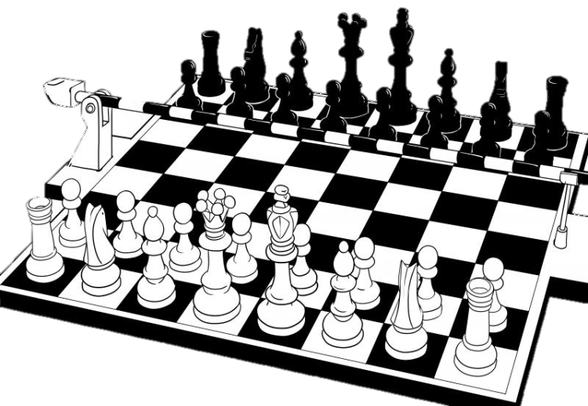
This is a …
chess board
for playing …
chess

Slide 10

This is a …
ball
for playing …
volleyball

Slide 11
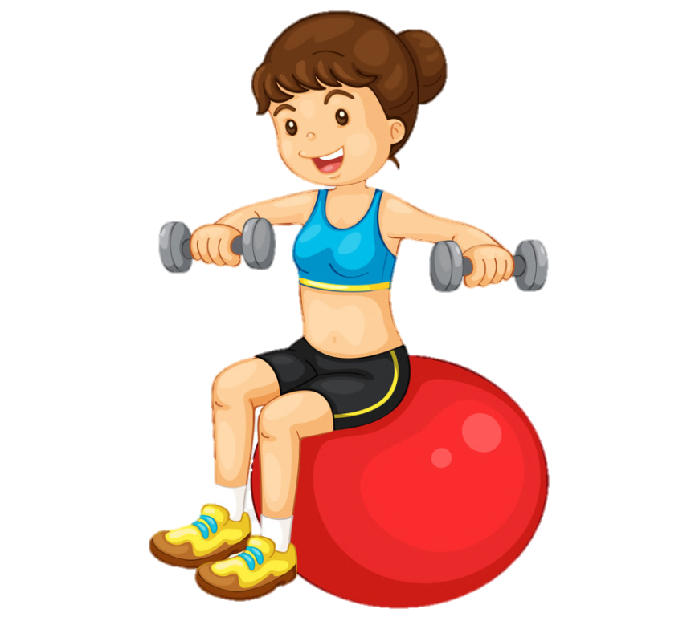

These are …
weights
for doing …
aerobics

Slide 12
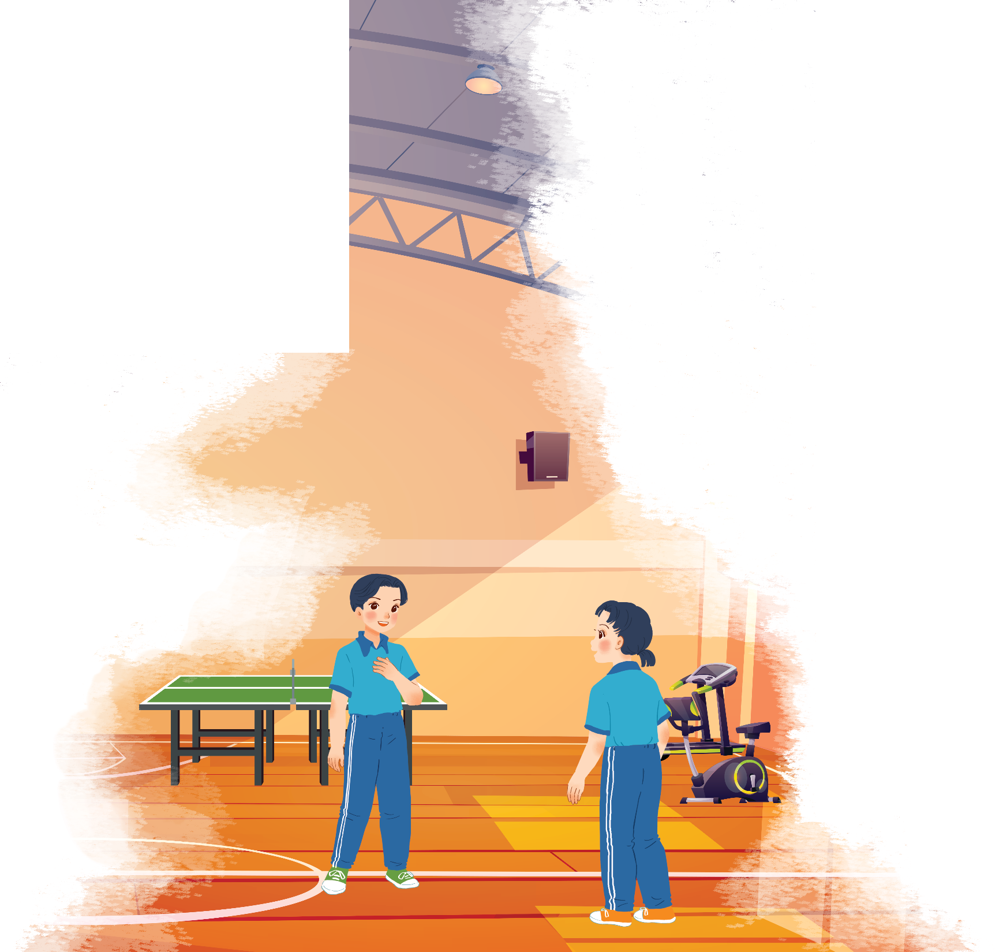

1
Listen and read.
At the gym
1. Where are the two kids?
2. What sports are they going to play?

Slide 13
At the gym
Duong: Wow! This gym is big!
Mai: Yeah. The equipment is great. What sports do you do, Duong?
Duong: Well, I do karate, and I play table tennis. Yesterday I played with Duy, and I won!
Mai: Congratulations! You look fit! I’m not good at sports.
Duong: I have an idea – you can go to the karate club with me.
Mai: No, I can’t do karate.
Duong: But you can learn! You’ll love it.
Mai: Well ... OK.
Duong: Great! I’ll meet you there at 10 a.m. on Sunday.
Mai: Where’s the club?
Duong: It’s Superfit Club, in Pham Hung Road. You can cycle there.
Mai: OK. See you then.

Slide 14


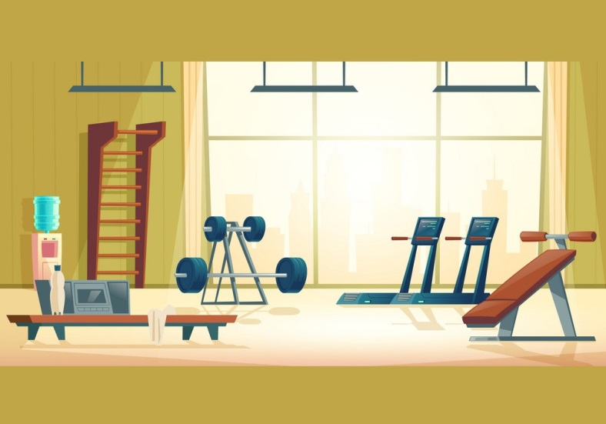
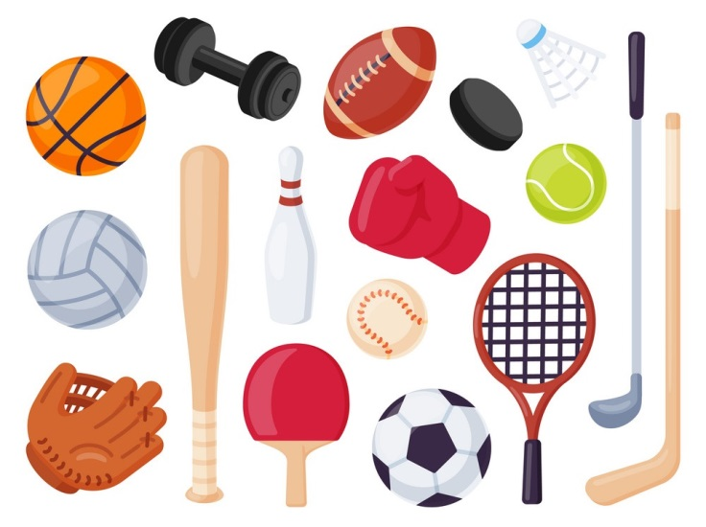

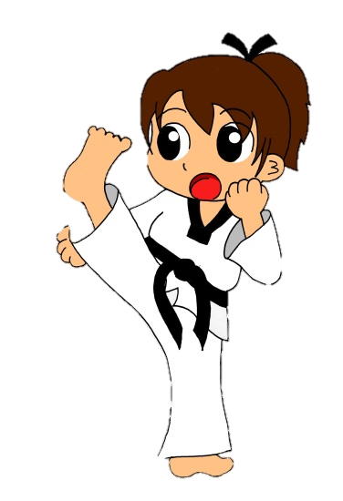

Vocabulary
gym (n)
e‘quipment (n)
ka‘rate (n)
Congratu‘lation (n)
fit (adj)
phòng tập thể dục
trang thiết bị
võ karate
chúc mừng
sung sức, khỏe mạnh

Slide 15
What and Where
equipment (n)
gym (n)
congratulation (n)
karate (n)
fit (adj)

Slide 16
2
Put a word from the conversation in each gap.
Duong looks
_______. He often does karate.
1.
fit. He often does karate.
2.
gym. The equipment there is great.
Mai likes coming to the
_______. The equipment there is great.
table tennis with Duy yesterday, and he won.
3.
Duong played
_______ with Duy yesterday, and he won.
Mai and Duong will meet at Superf it
Club on Sunday.
4.
_______ on Sunday.
5.
Mai will
cycle to Superf it Club.
_______ to Superf it Club.

Slide 17


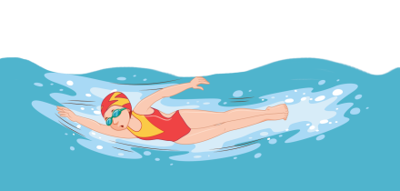
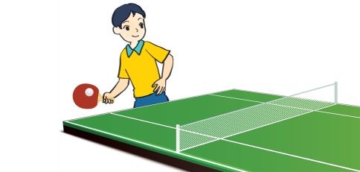
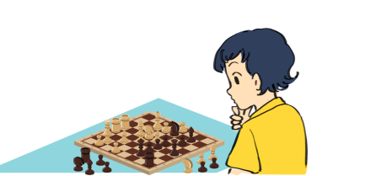

Pelmanism
1
2
3
4
chess
volleyball
5
6
7
8
aerobics
swimming
9
10
11
12
table tennis
cycling

Slide 18
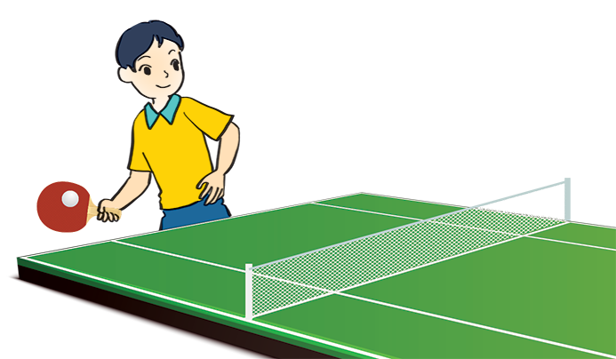
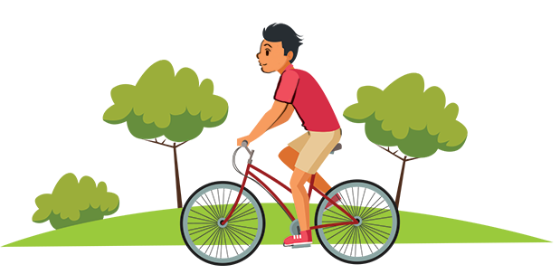
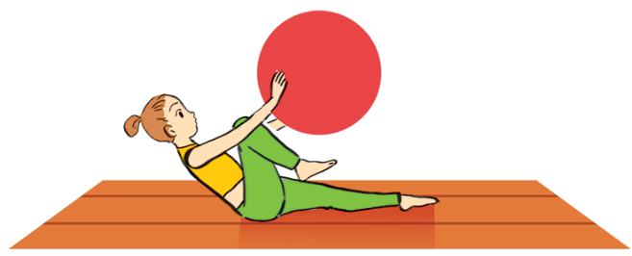
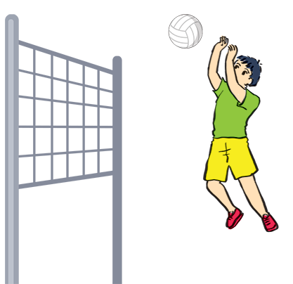
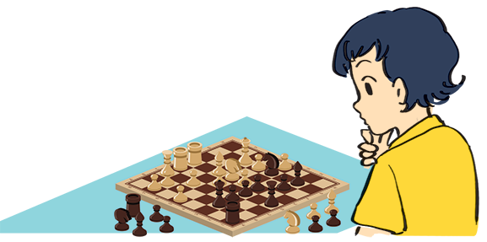
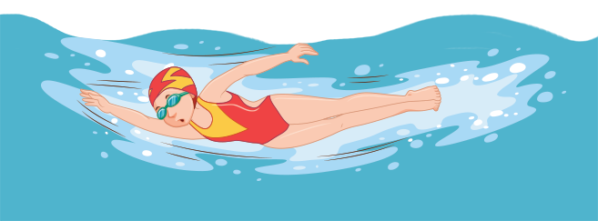
3
Name these sports and games, using the words from the box.
chess
cycling
aerobics
swimming
table tennis
volleyball
cycling
aerobics
3. table tennis
1.
2.
3.
swimming
5.
chess
6.
volleyball
4.

Slide 19

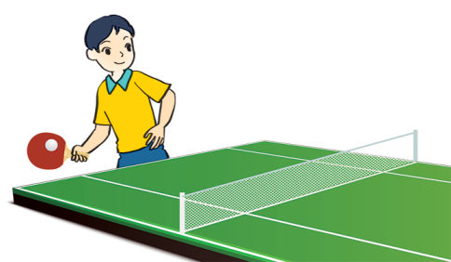
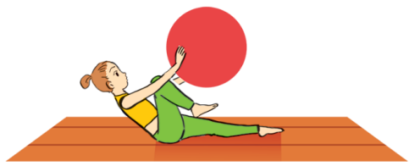
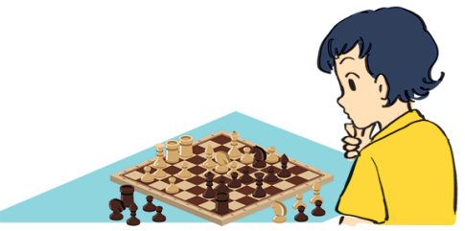
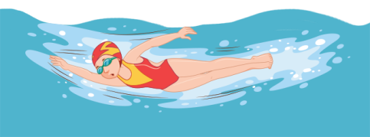
What is the diﬀerence between a sport and a game?
A sport: an activity that you do for pleasure and that needs physical exercise. Running, cycling, mountain climbing
A game: an activity or a sport with rules in which people or teams compete against each other. Chess, football, card games, computer games

Slide 20
4
Work in pairs. Ask your partner these questions to find out how sporty they are.
1.
Can you swim?
If your answers to the questions are mostly “A”, you are sporty. If they are mostly “B”, do more sport and try to be more
active.
A.
Yes.
B.
No.
2.
Do you play outdoors every day?
A.
Yes.
B.
No.
3.
Do you usually do morning excerise?
A.
Yes.
B.
No.
4.
What do you usually do at break time at school?
A.
Play in the school yard.
B.
Sit in the classroom.
5.
What do you think of sports and games?
A.
Very good.
B.
Not useful.

Slide 21

Homework
  Learn vocabulary and the structure by heart.
  Do exercise B in your work book
  Prepare the next lesson: A closer look 1

