Slide 1


TRƯỜNG THCS LONG BIÊN
BÀI GIẢNG ĐIỆN TỬ MÔN TIẾNG ANH 6
UNIT 7: TELEVISION
LESSON 1: GETTING STARTED
GV: Trần Thị Liên
Tổ NK-NN

Slide 2
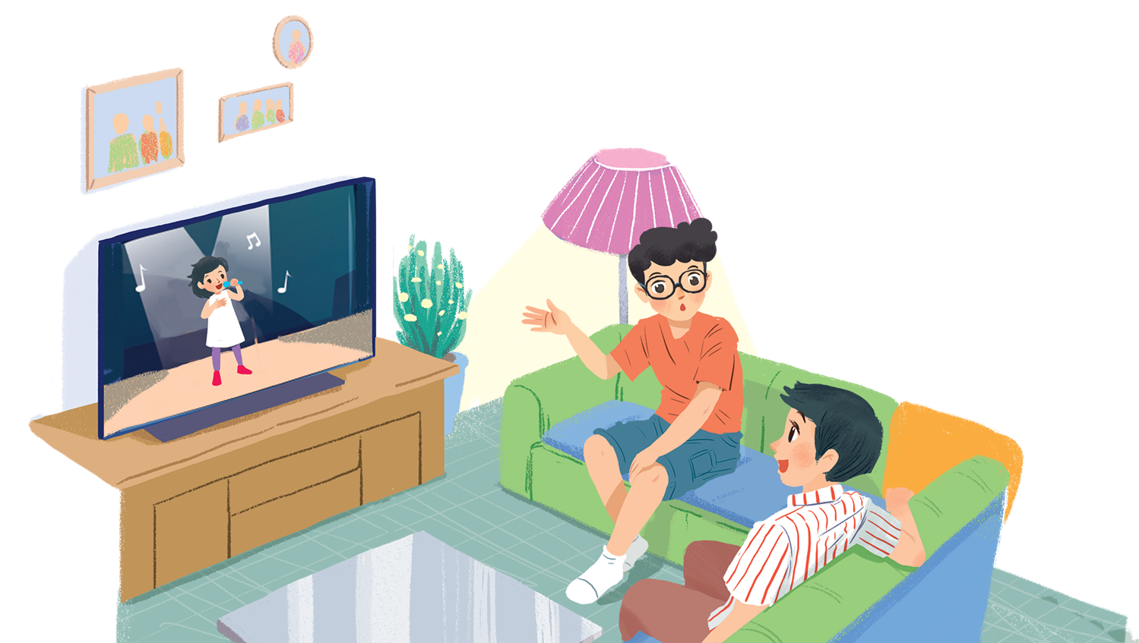
UNIT 7: TELEVISION
LESSON 1: GETTING STARTED
English 6

Slide 3


What’s on today?
1
Listen and read.
2
Choose the correct answer A, B, or C.
3
Read the conversation again and match 1-5 with a-e.
4
Find and write the adjectives in the conversation which describe the programmes and characters below.
Work in groups. Interview your partners about their favourite TV programmes and report to the class.
5

Slide 4



Slide 5

What’s your favourite
TV programme?

Slide 6
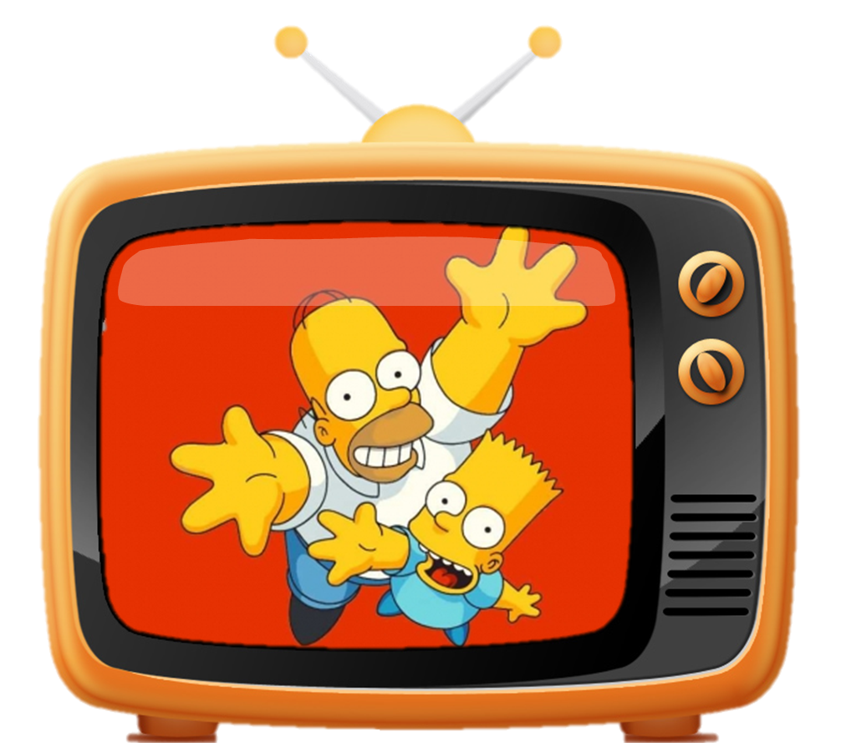
CARTOONS

Slide 7
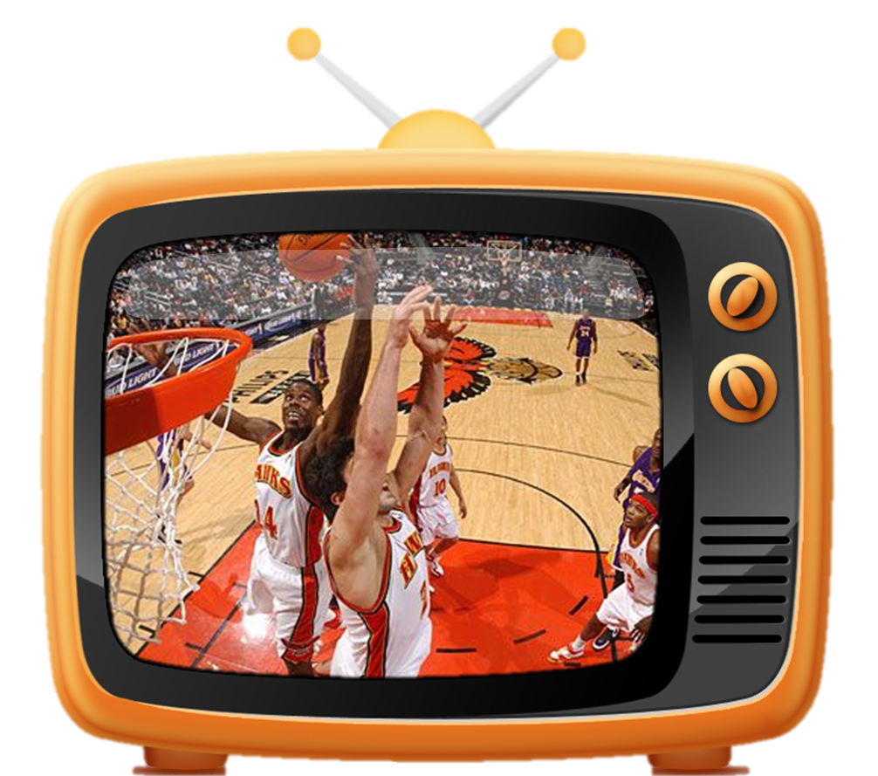
SPORTS PROGRAMME

Slide 8
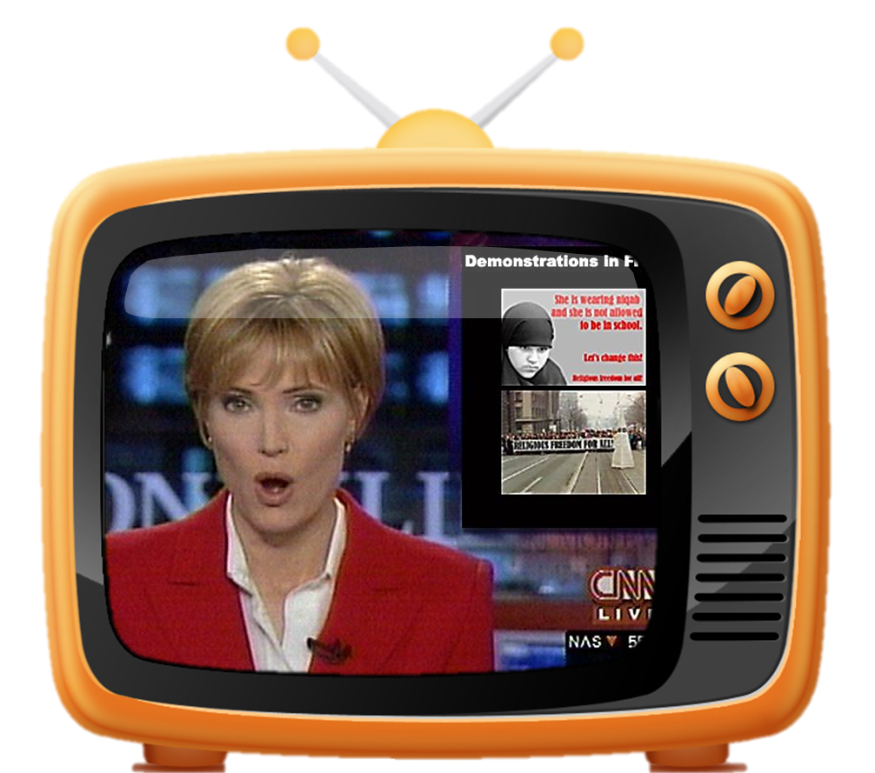
NEWS

Slide 9
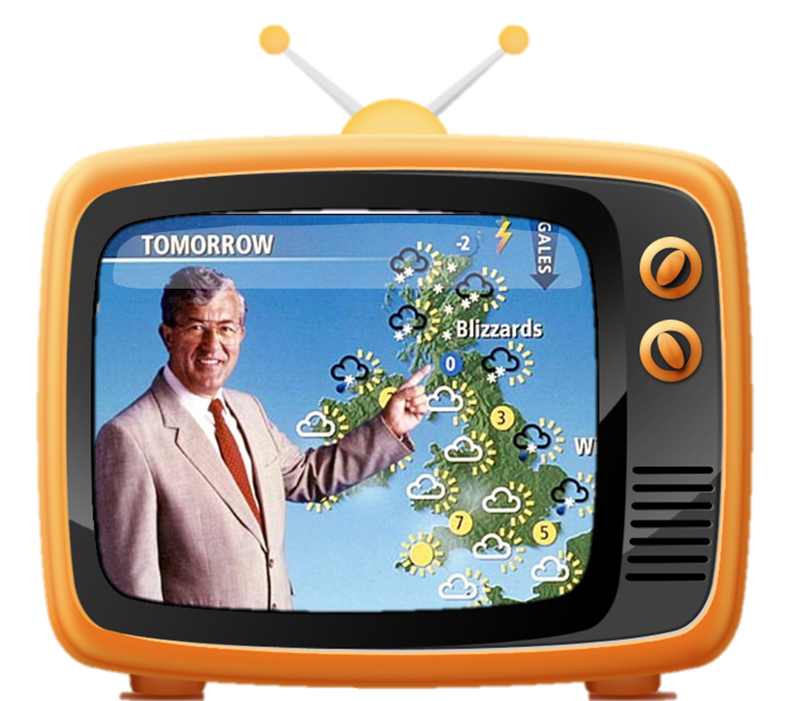
Weather forecast

Slide 10
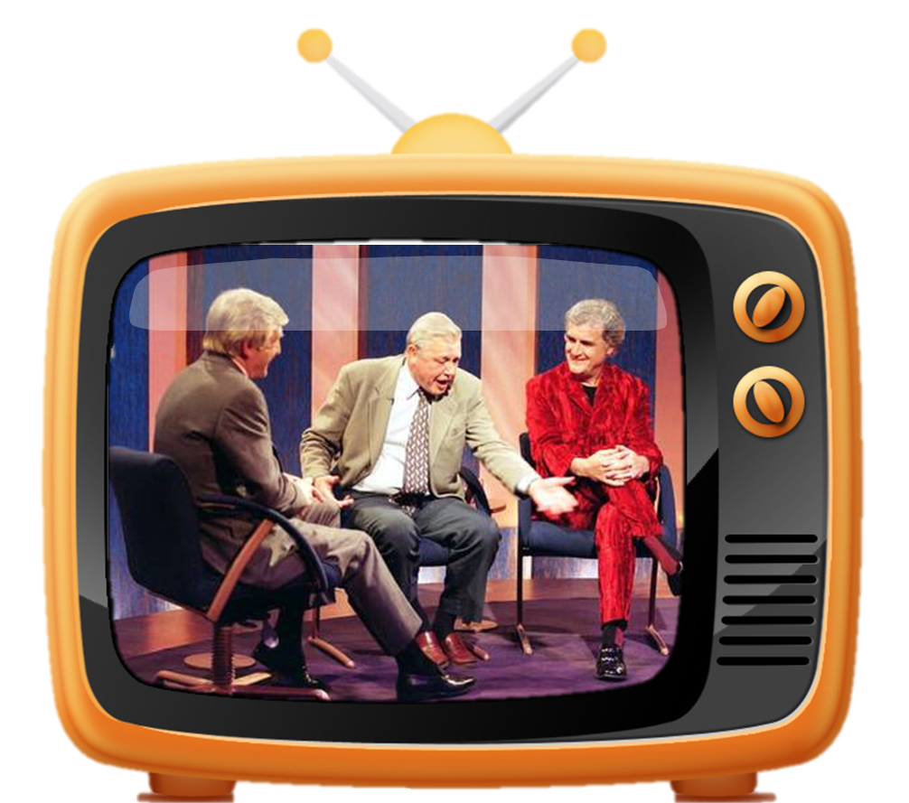
talk SHOW

Slide 11
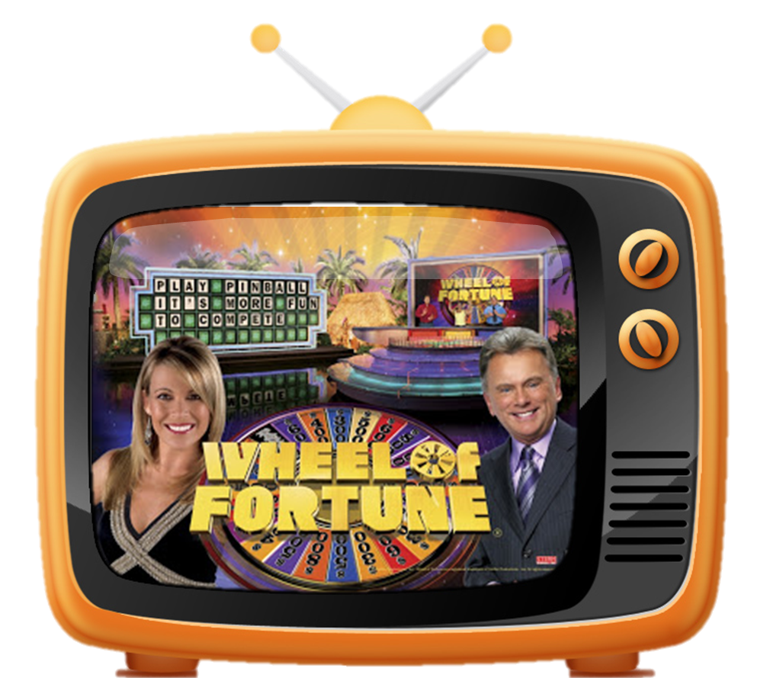
Quiz show

Slide 12
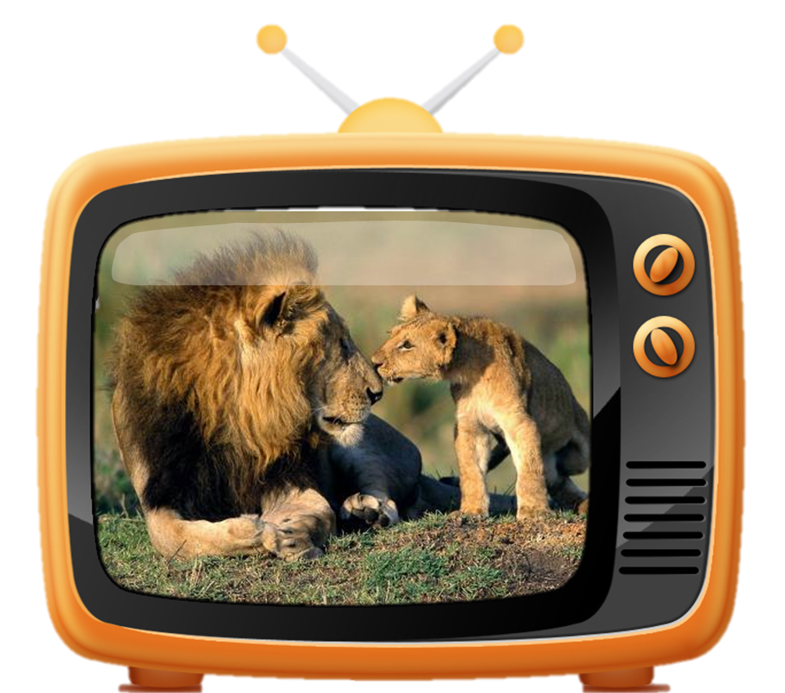
ANIMAL PROGRAMME

Slide 13
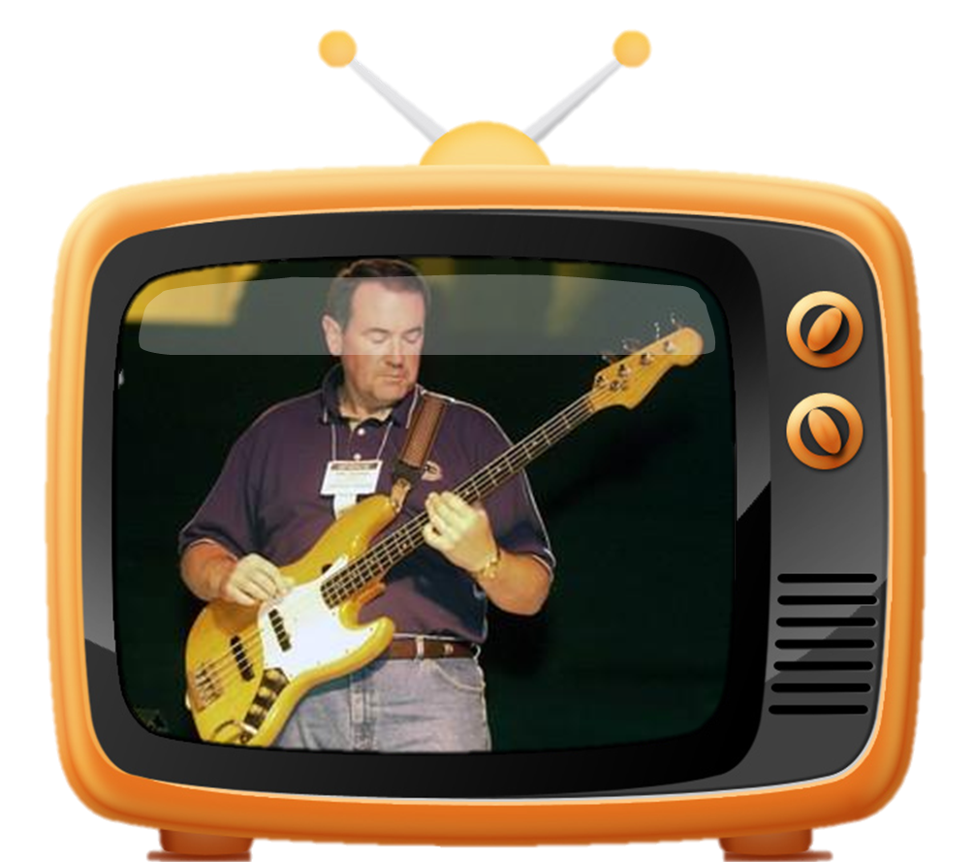
Music programme

Slide 14

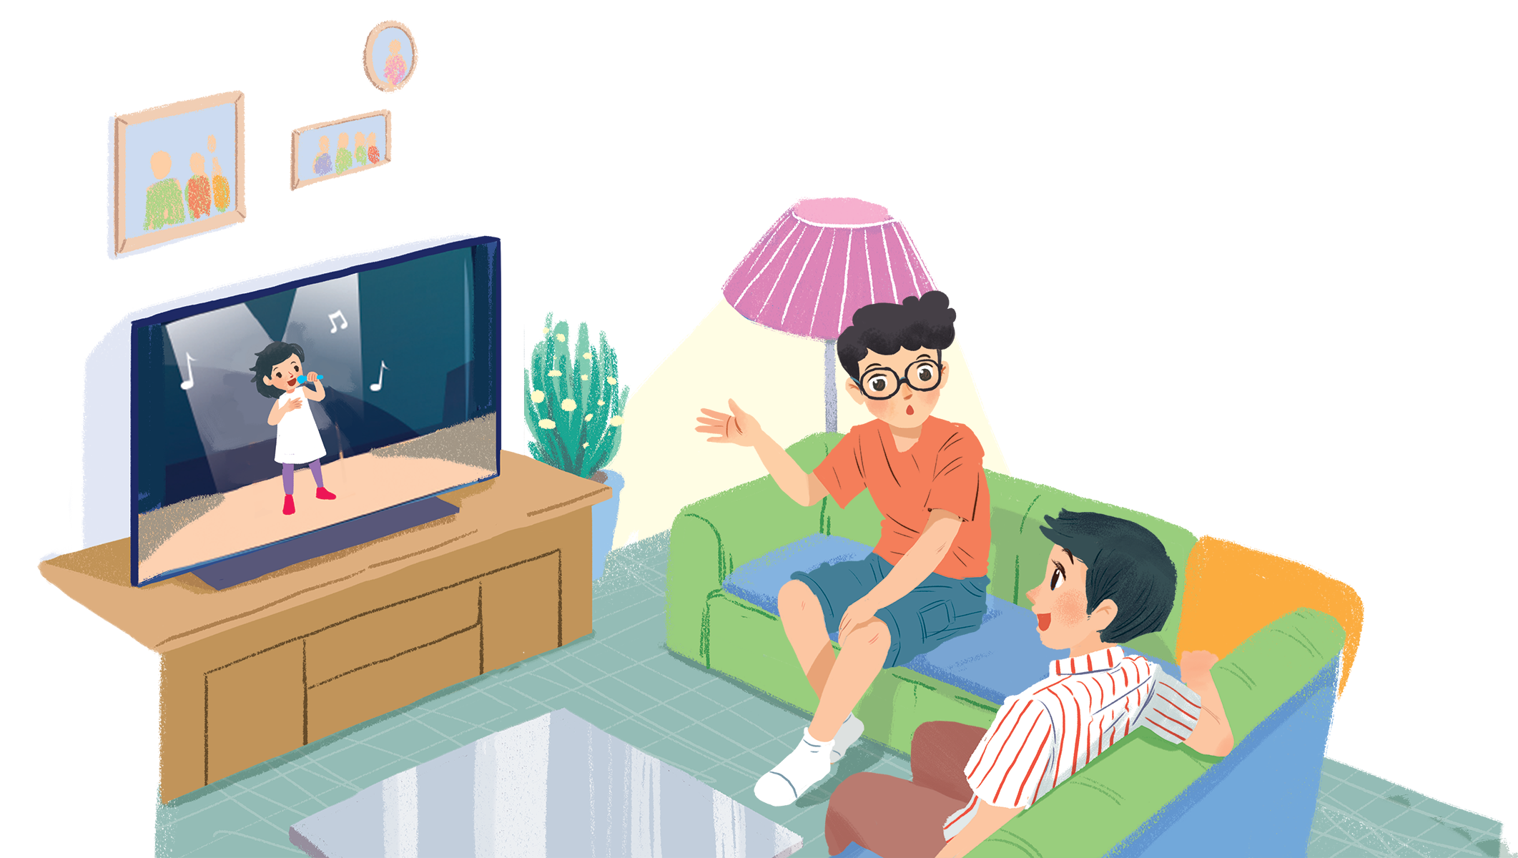
1
Listen and read.
What’s on today?
What do you think they are talking about?
Do you like watching TV? Why/Why not?
How many hours a day do you watch TV?
What channel do you like best?

Slide 15
What’s on today?
Phong: What are you watching, Hung?
Hung: The Voice Kids.
Phong: That music talent show is very interesting.
Hung: It is. What programme do you often watch, Phong?
Phong: Films. I like animated films like The Lion King.
Hung: I love them, too. They’re wonderful.
Phong: I often watch them with my little brother, but he prefers cartoons.
Hung: Tom and Jerry?
Phong: Ha ... ha ... Yes, he loves Jerry the mouse.
Hung: Jerry’s a clever character. Do you know any English programmes for children?
Phong: Yes. I watch English in a Minute on VTV7.
This channel has many educational programmes.
Hung: Great. I’ll watch it, too.

Slide 16


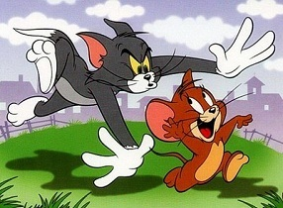
Vocabulary
‘talent (n)
tài năng
‘programme (n)
chương trình
‘animated (adj)
hoạt hình,
pre‘fer (v)
thích hơn
‘character (n)
tính cách, nhân vật
edu‘cational (adj)
tính giáo dục
animated film: for kids and adults
cartoon: for kids

Slide 17
Rub out and remember
talent (n
tài năng
programme (n)
chương trình
animated (adj)
hoạt hình
prefer (v)
thích hơn
character (n)
tính cách, nhân vật
educational (adj)
giáo dục

Slide 18
Structure
Phong: What are you watching, Hung?
Hung: The Voice Kids.
Phong: That music talent show is very interesting.
Hung: It is. What programme do you often watch, Phong?
Phong: Films. I like animated films like The Lion King.
Hung: I love them, too. They’re wonderful.
Phong: I often watch them with my little brother, but he prefers cartoons.
Hung: Tom and Jerry?
Phong: Ha ... ha ... Yes, he loves Jerry the mouse.
Hung: Jerry’s a clever character. Do you know any English programmes for children?
Phong: Yes. I watch English in a Minute on VTV7.
This channel has many educational programmes.
Hung: Great. I’ll watch it, too.

Slide 19
2
Choose the correct answer A, B, or C.
1.
Phong and Hung are talking about _______.
A.
The Voice Kids programme
B.
English in a Minute programme
C.
different TV programmes
2.
Phong likes _______.
A.
animated films
B.
cartoons
C.
talent shows
3.
When you’re viewing a TV programme, you say: “I’m _______ TV.”
B.
C.
looking
A.
watching
seeing
4.
When a programme teaches you something, it’s _______.
A.
educational
B.
funny
C.
clever

Slide 20
3
Read the conversation again and match 1-5 with a-e.
1. The Voice Kids
2. The Lion King
3. Tom and Jery
4. VTV7
5. English in a Minute
c. music talent show
a. animated film
a. animated film
b. channel
e. cartoon
c. music talent show
b. channel
d. educational programme
e. cartoon
d. educational programme

Slide 21
4
Find and write the adjectives in the conversation which describe the programmes and characters below.
1.
The Voice Kids
interesting
2.
animated films
wonderful
3.
Jerry the mouse
clever
4.
programmes on VTV7
educational

Slide 22
5
Work in groups. Interview your partners about their favourite TV programmes and report to the class.
Example:
In our group, Mai likes sports programmes on TV. Binh likes ...
I like films about animals in faraway countries like Kenya or India. They are on the Animal Planet.

Slide 23
Production
Find someone who…
 | Question | Yes | No
1 | … like sports programmes on TV.
2 | … like music talent shows.
3 | … like animated films.
4 | … like cartoons.
5 | … like English programmes.

Slide 24



Slide 25



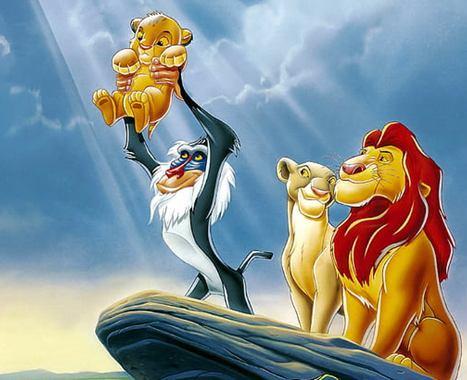
TIME’S UP
Like & Dislike
interesting
wonderful
clever
educational
animated films

Slide 26
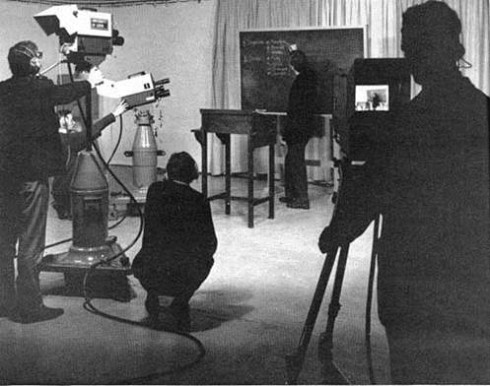
TIME’S UP
Like & Dislike
interesting
wonderful
clever
educational
English progrmammes

Slide 27
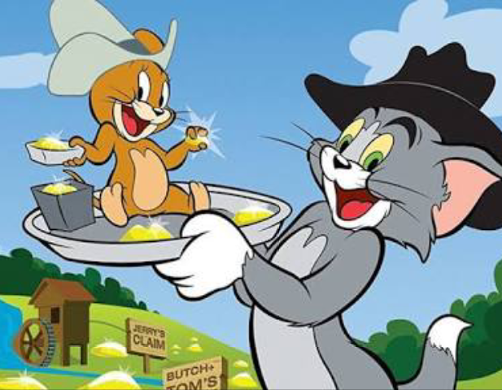
TIME’S UP
Like & Dislike
interesting
wonderful
clever
educational
Cartoons

Slide 28
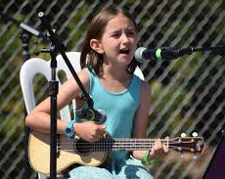
TIME’S UP
Like & Dislike
interesting
wonderful
clever
educational
Music talent shows

Slide 29
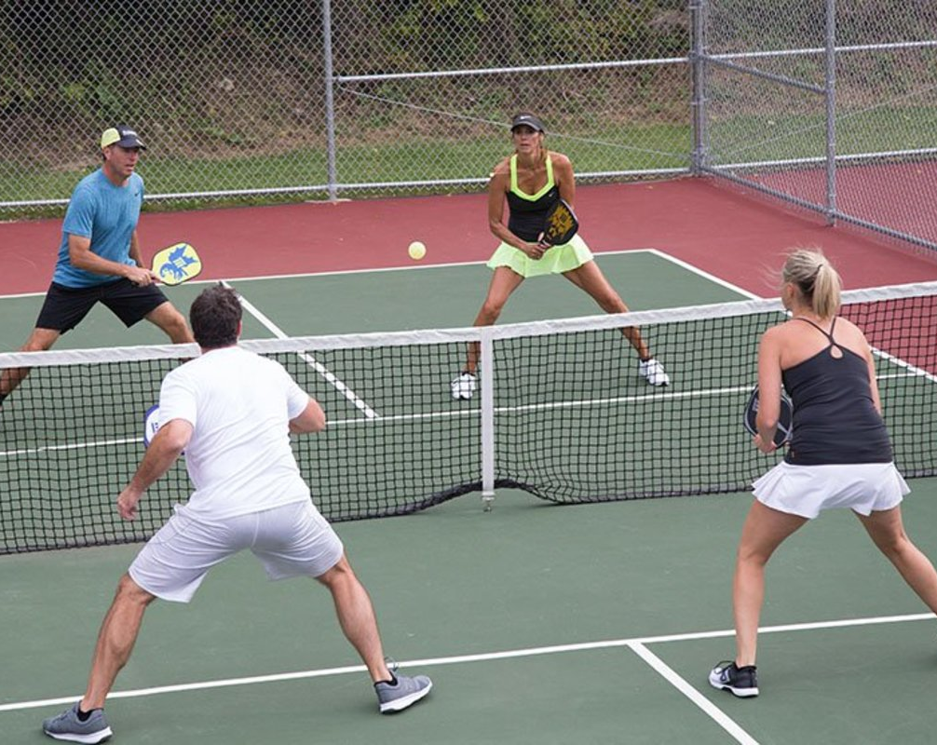
TIME’S UP
Like & Dislike
interesting
wonderful
sporty
educational
Sport programmes

Slide 30
Hung likes sports programmes on TV.
Lan likes music talent shows.
Binh likes animated films and Khoi likes cartoons.
Hoa likes English programmes

Slide 31

Homework
Learn vocabulary and the structure by heart.
Do exercise in your work book
Prepare the next lesson: A closer look 1
Write about 5 sentences to describe a TV programme you like (name, type, channel, character(s) and characteristics…)

