Slide 1


TRƯỜNG THCS LONG BIÊN
BÀI GIẢNG ĐIỆN TỬ MÔN TIẾNG ANH 6
UNIT 7: TELEVISION
LESSON 2: A closer look 1
GV: Trần Thị Liên
Tổ NK-NN

Slide 2


Vocabulary
1
Write the words / phrases in the box next to the definition.
2
Complete the sentences with the words / phrases in the box.
3
Complete the sentences with the adjectives in the box.
Pronunciation
/θ/and /ð/
4
Listen and repeat the words.
5
Tongue Twister Take turns to read the sentences quickly and correctly.

Slide 3
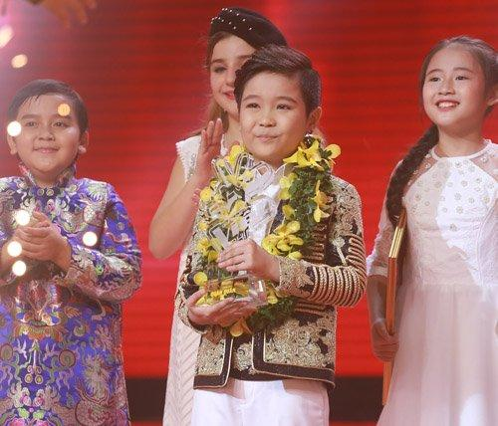
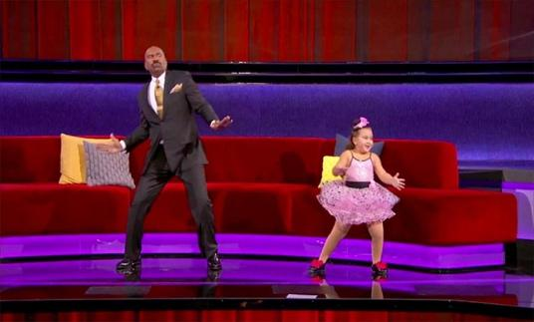
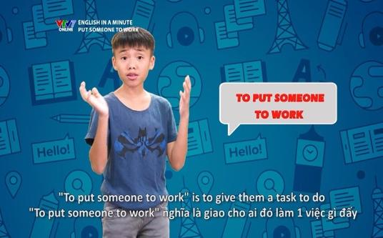

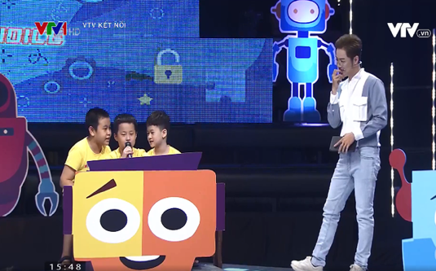
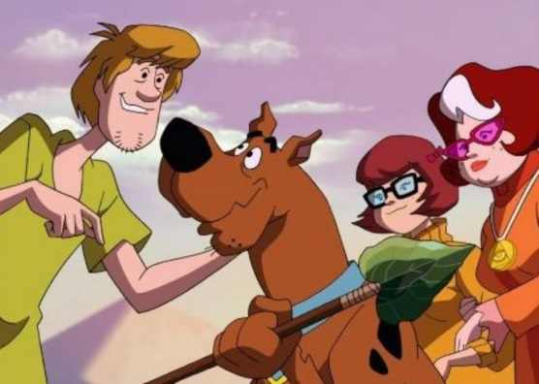
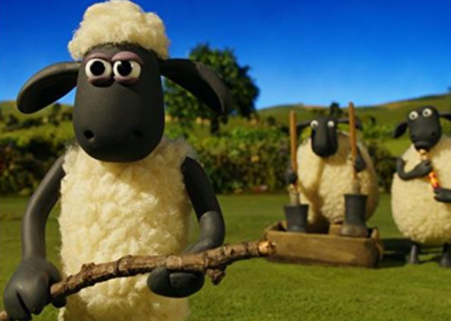
MATCHING
1
The Voice Kids
2
Little Big Shots
3
English in a Minute
English in a Minute
Scooby-Doo
Little Big Shots
Alo English
The Voice Kids
Shaun the Sheep
B
I
N
G
O
4
Alo English
5
Scooby-Doo
6
Shaun the Sheep

Slide 4
Vocabulary

Slide 5


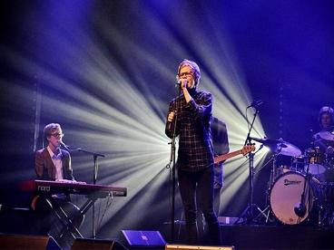
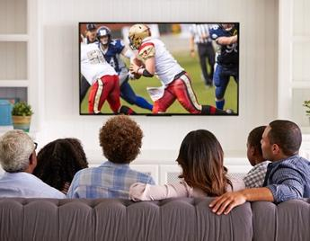
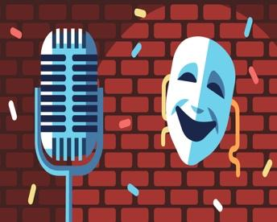
Vocabulary
‘comedy (n)
hài kịch
‘viewer (n)
người xem
per‘former (n)
người biểu diễn
‘popular (adj)
phổ biến
live (adj)
tại chỗ
‘boring (adj)
buồn tẻ

Slide 6
What and Where
viewer (n)
comedy (n)
popular (adj)
performer (n)
boring (adj)
live (adj)

Slide 7
1
Write the words / phrases in the box next to the definition.
talent show
comedy
educational programme
viewer
character
1.
an animal or person in a film
character
2.
a programme which teaches maths, English, etc.
educational programme
3.
a film / show which makes people laugh
comedy
4.
a competition to choose the best performer
talent show
5.
a person who watches TV
viewer

Slide 8
2
Complete the sentences with the words / phrases in the box.
character
viewers
game show
animated films
comedies
channel
Do you watch Bibi, the popular for children?
1.
channel
2.
Which do you prefer: Jerry the mouse or Tom the cat?
character
I love
animated films like Happy Feet and Coco.
3.
like Happy Feet and Coco.
for kids.
4.
I love Children are Always Right, a
game show for kids.
5.
My father often watches
comedies. They’re so funny.
. They’re so funny.
6.
A popular programme has a lot of .
viewers

Slide 9
3
Complete the sentences with the adjectives in the box.
popular
educational
cute
boring
live
funny
popular
1.
The most channel for children is the Cartoon Network.
2.
. I don’t want to watch it.
This film is very
boring. I don’t want to watch it.
Cat Kitty is a very
cute character. Children love her.
3.
character. Children love her.
4.
You can watch this programme at the same time it happens. It’s
live.
.
5.
Comedies are
funny. People laugh a lot when they watch them.
. People laugh a lot when they watch them.
6.
We learn a lot from Discovery Channel. This channel is
educational.
.

Slide 10
Pronunciation
/θ/and /ð/
/θ/: think, thank, throw, theatre, third.
/ð/: this, that, these, those, there, father.

Slide 11

4
Listen and repeat the words.
/θ/ | /ð/
theatre earth anything both through | there them neither weather than

Slide 12

5
Tongue Twister. Take turns to read the sentences quickly and correctly.
1.
They are thinking about the weather there.
2.
The new theatre opens on Thursday the third.

Slide 13

GAME

Slide 14

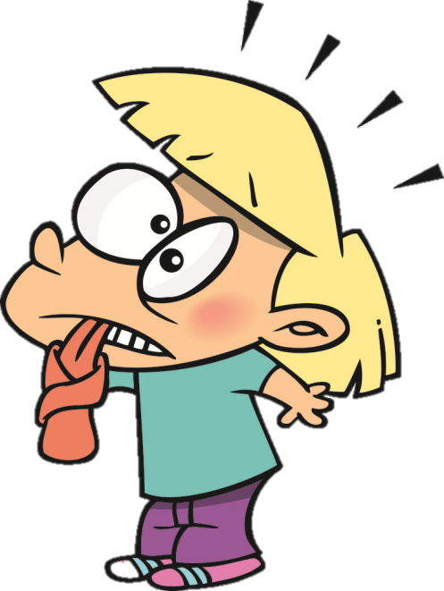
Tongue Twister.
The first thing that they think of is this.
ðə fɜːst θɪŋ ðət ðeɪ θɪŋk əv iz ðɪs.
These things finish sooner than you think.
ðiːz θɪŋz ˈfɪnɪʃ ˈsuːnə ðən jʊ θɪŋk.

Slide 15

Some more tongue twister sentences
The thirty-three thieves thought that they thrilled the throne throughout Thursday.
I thought, I thought of thinking of thanking you.
ðə ˈθɜːti-θriː θiːvz θɔːt ðət ðeɪ θrɪld ðə θrəʊn θru(ː)ˈaʊt ˈθɜːzdeɪ.
aɪ θɔːt, aɪ θɔːt əv ˈθɪŋkɪŋ əv ˈθæŋkɪŋ juː

Slide 16

Homework
  Learn vocabulary and the structure by heart.
  Do exercise … in your work book
  Prepare the next lesson: A closer look 2
  Revise the words in ocabulary and find 5 more words with /θ/ and 5 more words with /ð/.

