Slide 1
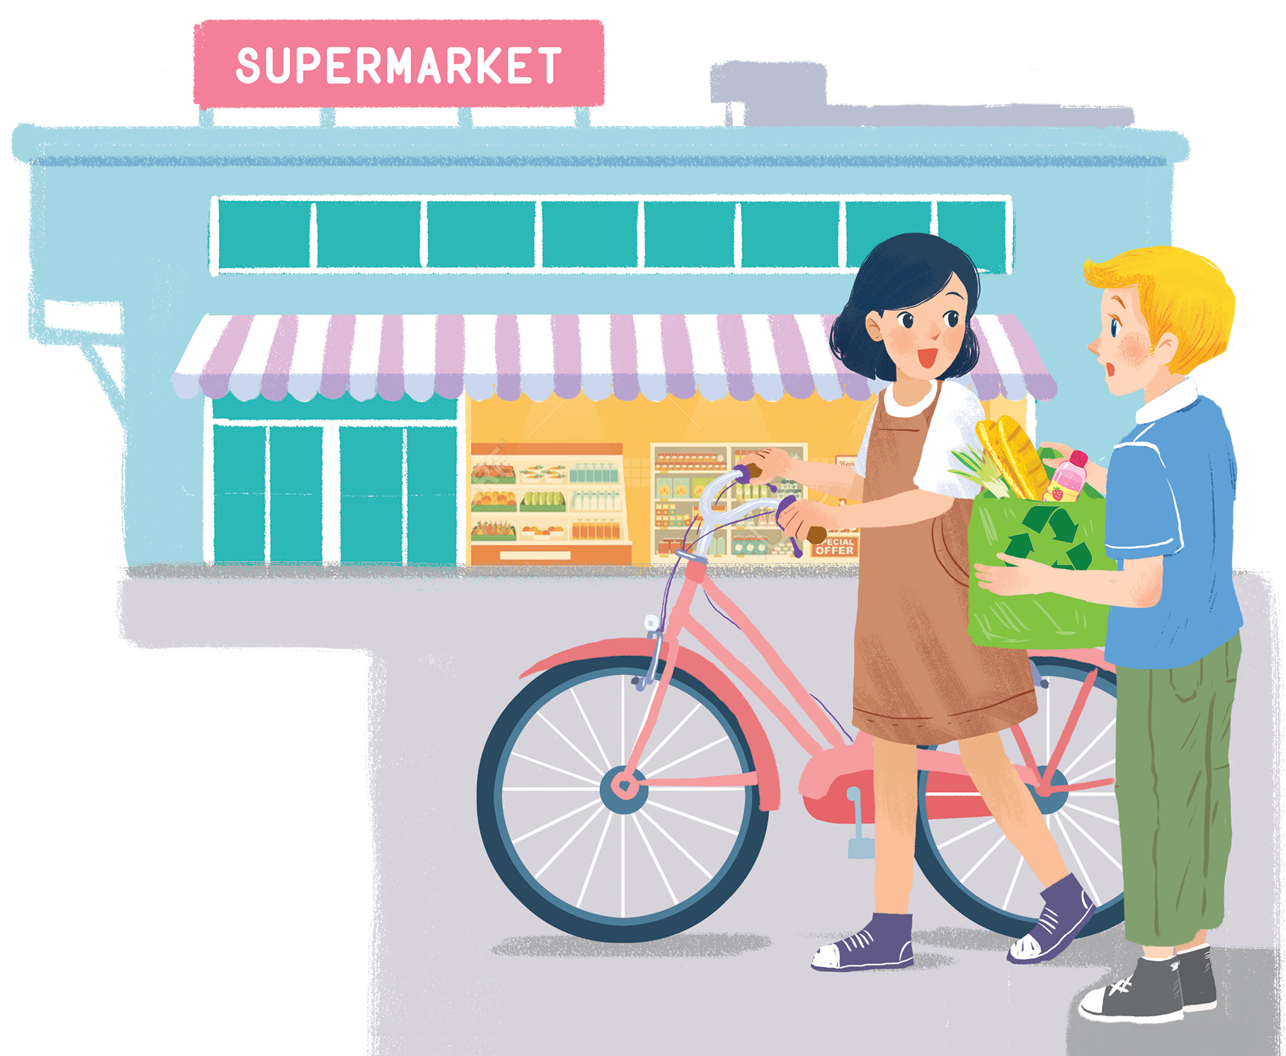
UNIT 11: OUR GREENER WORLD
LESSON 7: LOOKING BACK - PROJECT
English 6

Slide 2



Vocabulary
1
Add more words to the word webs below.
Grammar
2
Write a / an or the.
3
Write the correct form of each verb in brackets.
4
Combine each pair of sentences below to make a first conditional sentence.

Slide 3
Jumbled words
1. PSIERDNET
PRESIDENT
2. OGRANZEI
ORGANIZE
3. RAFI
FAIR
4. VESA
SAVE
5. COURENGERA
ENCOURAGE
6. PAWS
SWAP

Slide 4
Vocabulary

Slide 5
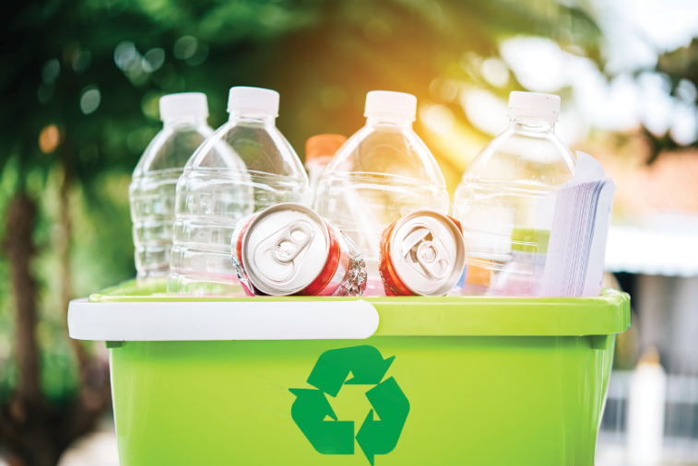
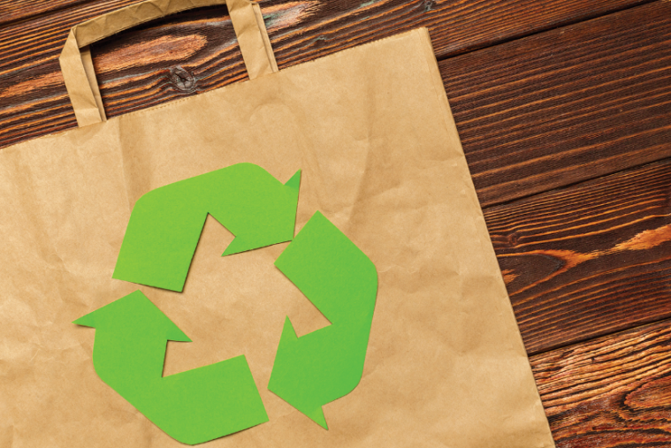
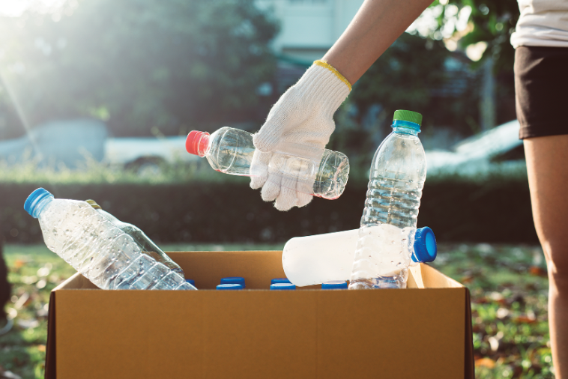
1
Add more words to the word webs below.

Slide 6
water
electricity
gas
Reduce
plastic bags
paper
rubbish

Slide 7
envelopes
bottles
cans
Reuse
plastic bottles
plastic bags
light bulbs

Slide 8
books
plastic boxes
plastic bags
Recycle
glass
cans
newspapers

Slide 9
Grammar

Slide 10
2
Write a / an or the.
1.
If I see
a dog, I will run away.
_______ dog, I will run away.
2.
Does your town have
an art gallery?
_______ art gallery?
The Moon is bright tonight.
3.
_______ Moon is bright tonight.
4.
There is a big temple in the town.
_______ temple is very old.
The temple is very old.
5.
- Is your mother
a teacher?
_______ teacher?
an artist.
- No, she isn’t. She’s
_______ artist.

Slide 11
3
Write the correct form of each verb in brackets.
If they (build) _______ an airport here, it (be) _______ very noisy.
1.
If they (build) build an airport here, it (be) will be very noisy.
People (save) will save the environment if they (reuse) reuse old items.
2.
People (save) _______ the environment if they (reuse) _______ old items.
If we (grow) grow trees, our school (be) will be greener.
3.
If we (grow) _______ trees, our school (be) _______ greener.
If we (not have) don’t have enough food, we (be) will be hungry.
4.
If we (not have) _______ enough food, we (be) _______ hungry.
5.
If we (be) are hungry, we (be) will be tired.
If we (be) _______ hungry, we (be) _______ tired.

Slide 12

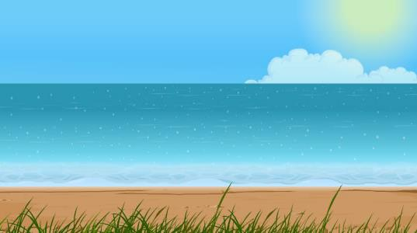

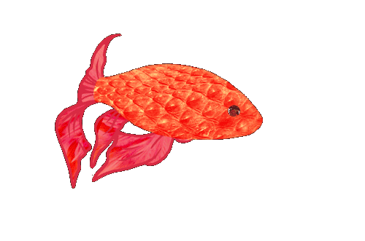
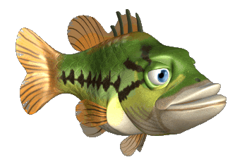

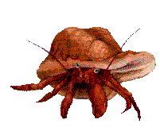


Slide 13
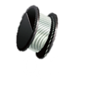
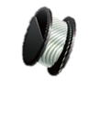
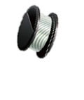
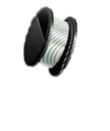
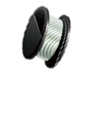
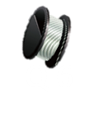


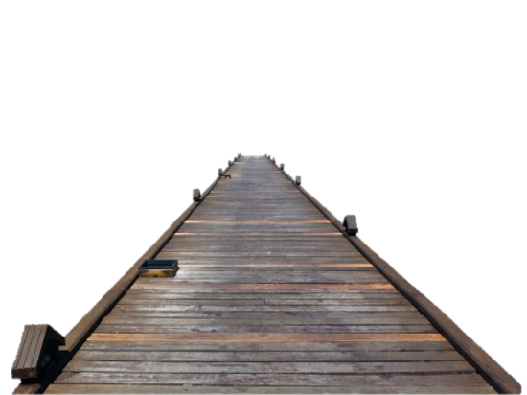


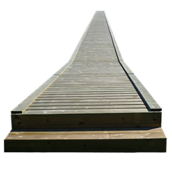


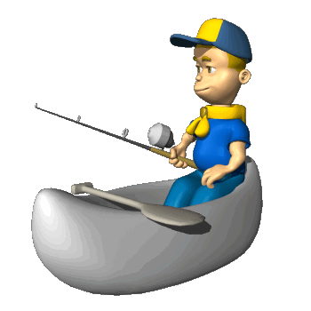



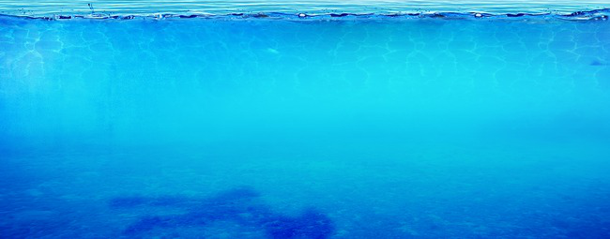

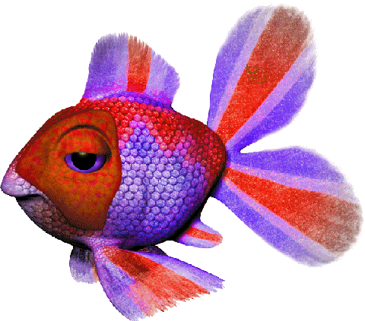


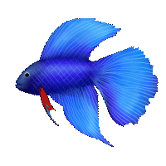

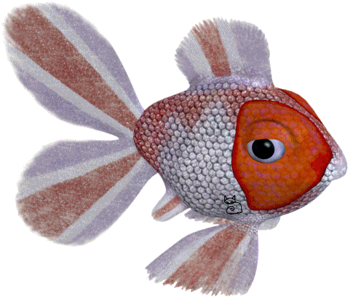
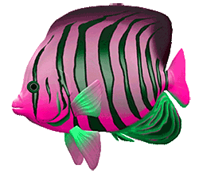







10
9
12
8
emperor fish
rainbow fish B
8
green fish
platy fish
9
10
betta fish
tiger fish
11
11
gold fish
12
12
tropical fish
rainbow fish A
angel fish
11
yellow fish
butterfly fish
Notes:
2 teams:
Correct answer: choose a fish to get points
Wrong answer: punishment (-1, or -2, or -3 points)
The winner: have a party of fried fish

Slide 14

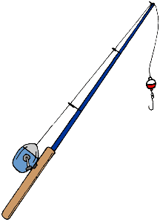

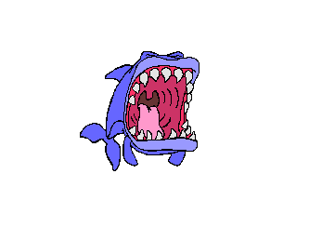

We walk or cycle. We are healthy.
If we walk or cycle, we will be healthy.

Slide 15
We use the car all the time. We make the air dirty.
If we use the car all the time, we will make the air dirty.

Slide 16
You reuse paper. You save trees.
If you reuse paper, you will save trees.

Slide 17
You make noise. Your sister doesn’t sleep.
If you make noise, your sister will not / won’t sleep.

Slide 18
I see a used bottle on the road. I put it in the bin.
If I see a used bottle on the road, I will put it in the bin.

Slide 19
I make something new from plastic bottles. I bring it to class
If I make something new from plastic bottles. I will bring it to class

Slide 20



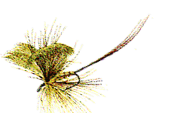
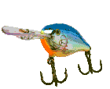

1
2
3
-1
-1
-3
4
5
6
-1
-2
-2

Slide 21
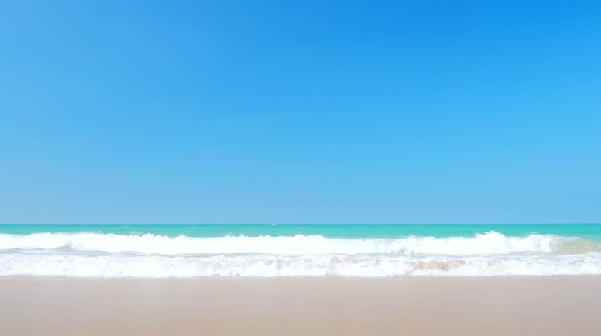

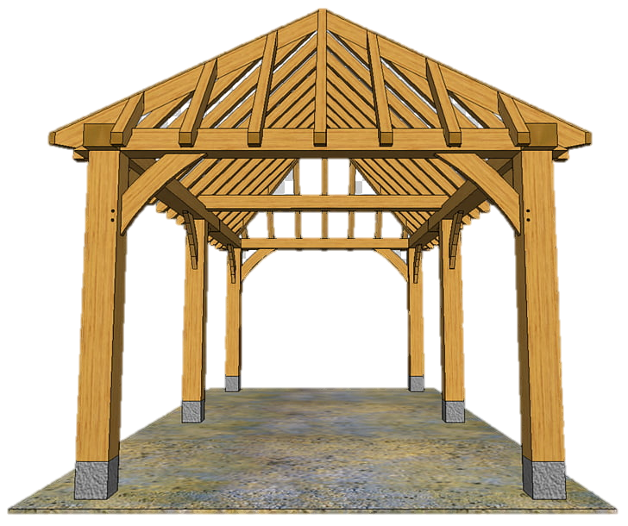


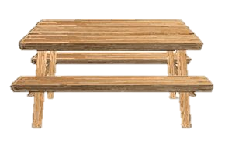






Slide 22
4
Combine each pair of sentences below to make a first conditional sentence.
1.
We walk or cycle. We are healthy.
If we walk or cycle, we will be healthy.
2.
We use the car all the time. We make the air dirty.
If we use the car all the time, we will make the air dirty.
3.
You reuse paper. You save trees.
If you reuse paper, you will save trees.
4.
You make noise. Your sister doesn’t sleep.
If you make noise, your sister will not / won’t sleep.
5.
I see a used bottle on the road. I put it in the bin.
If I see a used bottle on the road, I will put it in the bin.

Slide 23


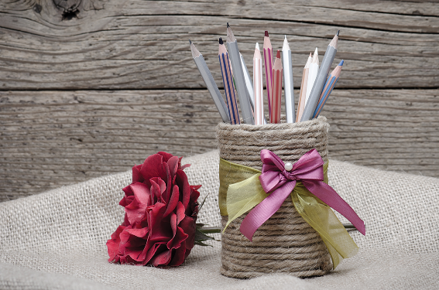
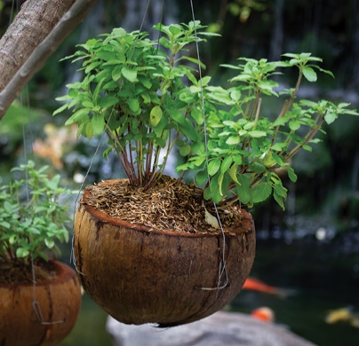


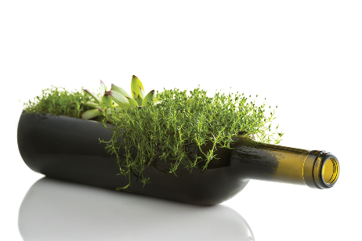
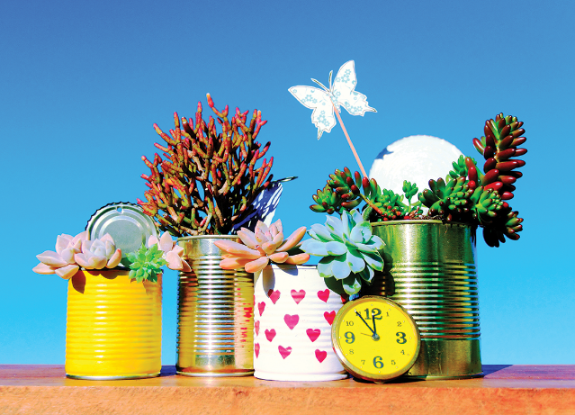

What can you see in each picture? What did people use to make the things in the pictures?
Now work in pairs or in groups to complete the project.
Choose a used object (a bottle, a sheet of paper, etc.).
Make something new from it and decorate it.
Bring it to class.
Do a “show and tell” about it.
Listen to other presentations and decide which is the best.

Slide 24
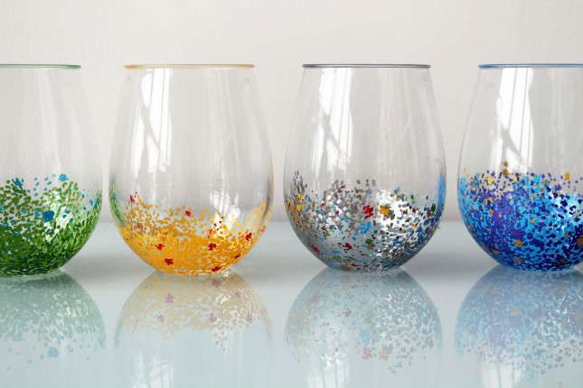
The cups

Slide 25
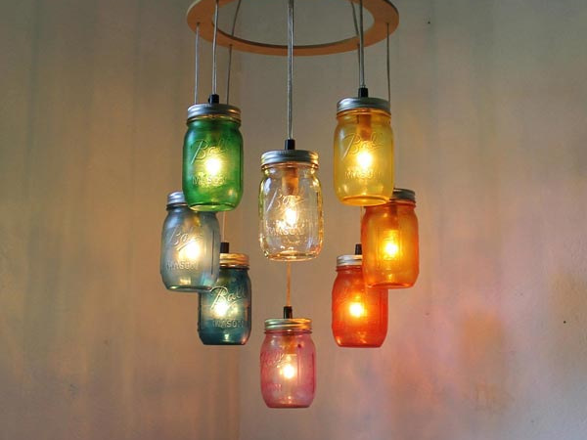
The light bulds

Slide 26
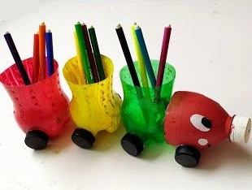
The pen cases

Slide 27
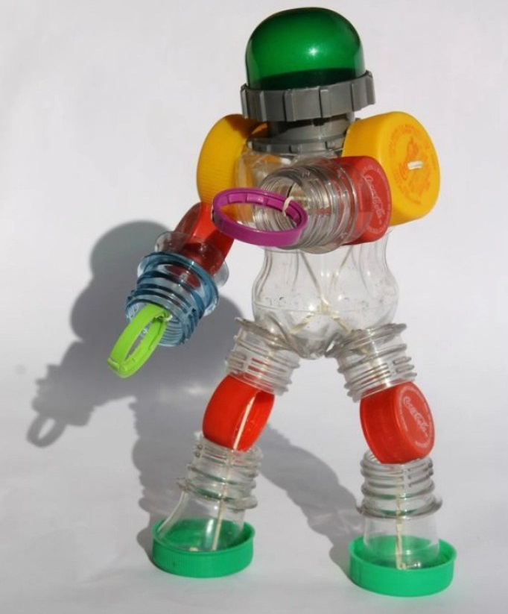
The toys

Slide 28
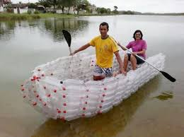
The boat

Slide 29
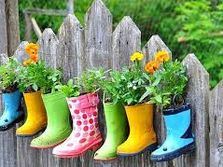
Flower pots

Slide 30


Answers:
Q1: A (0) B (2) C (2)
Q4: A (1) B (0) C (2)
9 - 12 points: You’re green!
Q2: A (1) B (0) C (2)
Q5: A (0) B (2) C (0)
5 – 8 points: Try to be greener!
Q3: A (0) B (2) C (0)
Q6: A (2) B (0) C (2)
1 – 4 points: You aren’t green at all!

Slide 31
Now I can … |  |  | 
use the words for things that can be reduced, reused and recycled.
say sentences with correct rhythm.
use the articles correctly.
use the first conditional to talk about possibilities.
give warnings.
read about ways to go green.
talk about tips for going green.
listen about ideas for a green club.
write a paragraph about ideas for a green club.
✓
✓
✓
✓
✓
✓
✓
✓
✓
✓
✓
✓
✓
✓
✓
✓
✓
✓
✓
✓
✓
✓
✓
✓
✓
✓
✓

Slide 32

Homework
Learn vocabulary and the structure by heart.
Do exercise in your work book
Prepare the next lesson

