Slide 1


TRƯỜNG THCS LONG BIÊN
BÀI GIẢNG ĐIỆN TỬ MÔN TIẾNG ANH 6
UNIT 10:OUR HOUSE IN THE FUTURE
LESSON 6: Skills 2
GV: Trần Thị Liên
Tổ NK-NN

Slide 2
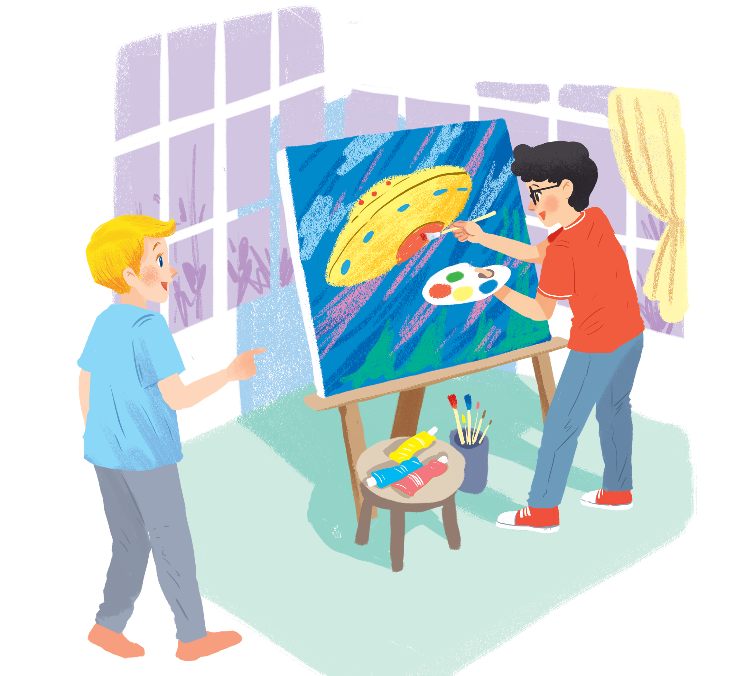
      UNIT 10: OUR HOUSES IN THE FUTURE
      LESSON 6: SKILLS 2
English 6

Slide 3


Listening
1
Listen to Nick and Linda talking about their dream houses. Which house would each prefer? Write their names under the correct pictures.
2
Listen to the conversation again. What is important to Linda? What is important to Nick? Tick () the columns.
3
Listen again and answer the questions about their dream houses.
Writing
4
Work in pairs. Discuss your dream house, and fill the table.
5
Use the information in 4 to write a paragraph of about 50 words about your dream house.

Slide 4



C
I
T
Y
V
I
E
W
I
Y
C
T
I
W
E
V

Slide 5
S
M
A
R
T
-
T
V
M
A
R
S
T
V
T
-

Slide 6
G
A
R
D
E
N
A
G
R
N
D
E

Slide 7
F
L
A
T
L
F
T
A

Slide 8
V
I
L
L
A
I
L
V
L
A

Slide 9
Listening

Slide 10

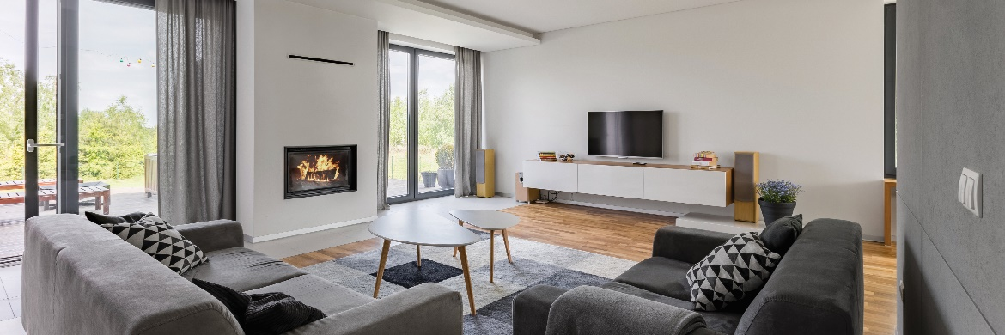
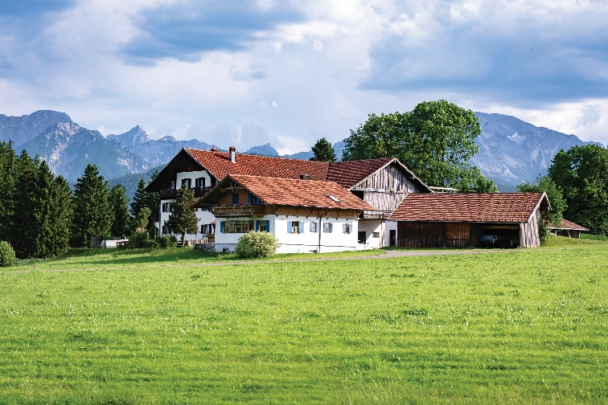
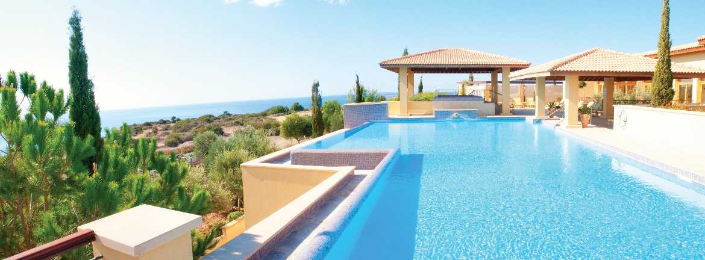
1
Listen to Nick and Linda talking about their dream houses. Which house would each prefer? Write their names under the correct pictures.
a
b
Nick: a flat in the city
c
Linda: a villa by the sea, with a swimming pool and a garden)
Audio script

Slide 11
AUDIO SCRIPT
Nick: Can you tell me about your dream house, Linda?
Linda: Well, it's a big villa by the sea. It has a view of the sea. It has a swimming pool and a garden.
Nick: My dream house is different.
Linda: Really? What's it like?
Nick: It's a beautiful flat in the city. It has a park view in front and a city view at the back.
Linda: Oh, sounds great!
Nick: It has a super smart TV. I can watch films from other planets.
Linda: That sounds great, too. But I think it'll be...

Slide 12
2
Listen to the conversation again. What is important to Linda? What is important to Nick? Tick () the columns.
 | Linda | Nick
1. park view
2. city view
3. sea view
4. swimming pool
5. garden





Audio script

Slide 13
AUDIO SCRIPT
Nick: Can you tell me about your dream house, Linda?
Linda: Well, it's a big villa by the sea. It has a view of the sea. It has a swimming pool and a garden.
Nick: My dream house is different.
Linda: Really? What's it like?
Nick: It's a beautiful flat in the city. It has a park view in front and a city view at the back.
Linda: Oh, sounds great!
Nick: It has a super smart TV. I can watch films from other planets.
Linda: That sounds great, too. But I think it'll be...

Slide 14
3
Listen again and answer the questions about their dream houses.
1.
What type of house does Linda have?
She has a big villa.
2.
Where is her house?
Her house / It is by the sea.
3.
What is around her house?
There’s a swimming pool and a garden around her house.
4.
What type of house does Nick have?
He has a flat.
5.
Where is it?
It’s in the city.
Audio script

Slide 15
AUDIO SCRIPT
Nick: Can you tell me about your dream house, Linda?
Linda: Well, it's a big villa by the sea. It has a view of the sea. It has a swimming pool and a garden.
Nick: My dream house is different.
Linda: Really? What's it like?
Nick: It's a beautiful flat in the city. It has a park view in front and a city view at the back.
Linda: Oh, sounds great!
Nick: It has a super smart TV. I can watch films from other planets.
Linda: That sounds great, too. But I think it'll be...

Slide 16
Writing

Slide 17
4
Work in pairs. Discuss your dream house, and fill the table.
Example:
A: What type of dream house is it?
B: It’s a palace.
A: Where is it?
B: It’s in the mountains
....
Types of house: | palace
Location: | in the mountains
Number of rooms: | _______________________
Appliances in the house: | _______________________
7
a robot: cook three meals, talk, sing
a smart TV: be controlled by voice, ask me for favourite channel

Slide 18
5
Use the information in 4 to write a paragraph of about 50 words about your dream house.
Example:
My dream house is a big palace. It is in the mountains. ___________________
________________________________
________________________________
________________________________

Slide 19
5
Use the information in 4 to write a paragraph of about 50 words about your dream house.
Sample paragraph
My dream house is a big palace. It is in the mountains. It is surrounded by lots of trees. It has seven rooms:
three bedrooms, two bathrooms, one kitchen and one living room. There is a large swimming pool in
front of it. I have some robots in the palace. They help me to clean the floor, cook meals, water flowers...
I am happy to live in my palace.

Slide 20

Homework
  Learn vocabulary and the structure by heart.
  Do exercise in your work book
  Prepare the next lesson: Looking back + Project

