Slide 1


TRƯỜNG THCS LONG BIÊN
BÀI GIẢNG ĐIỆN TỬ MÔN TIẾNG ANH 6
UNIT 10:OUR HOUSE IN THE FUTURE
LESSON 5: Skills 1
GV: Trần Thị Liên
Tổ NK-NN

Slide 2
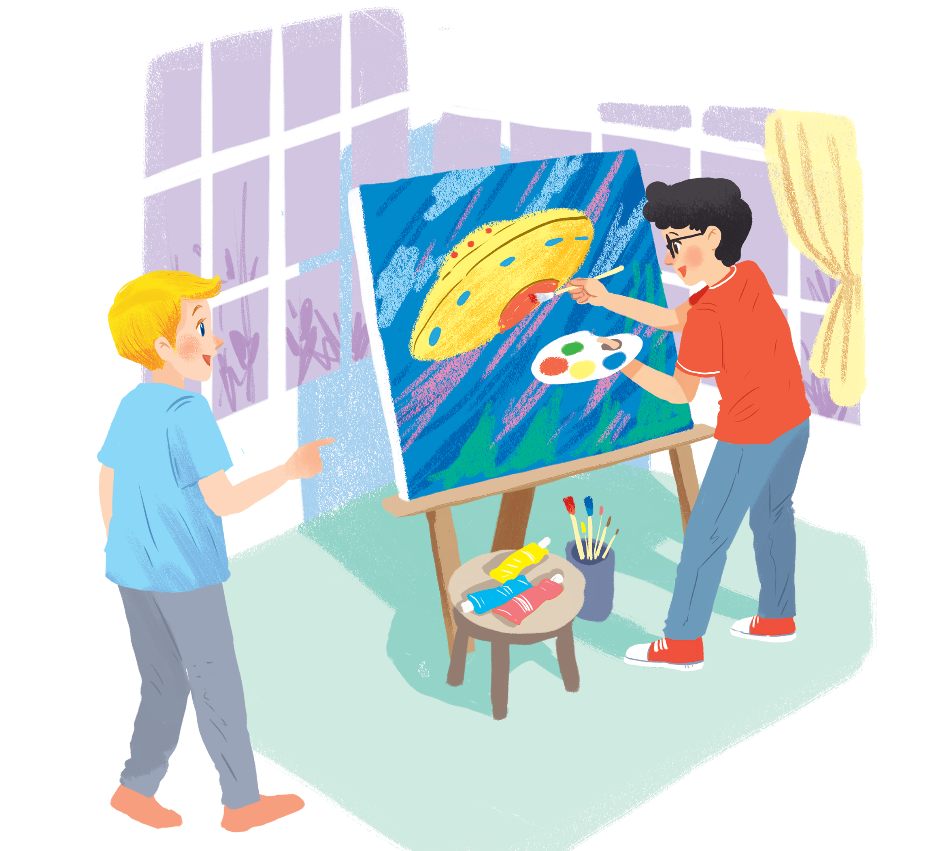
UNIT 10: OUR HOUSES IN THE FUTURE
LESSON 5: SKILLS 1
English 6

Slide 3


Reading
1
Look at the picture and discuss it with a partner.
2
Read the text and match the beginnings in A with the endings in B.
3
Read the text again and circle the option (A, B, or C) to complete the sentences.
Speaking
4
Work in pairs. Ask your partner about his / her future house. Use the suggested questions.
5
Work in groups. Tell your partners about your future house. You can use the information in 4.

Slide 4
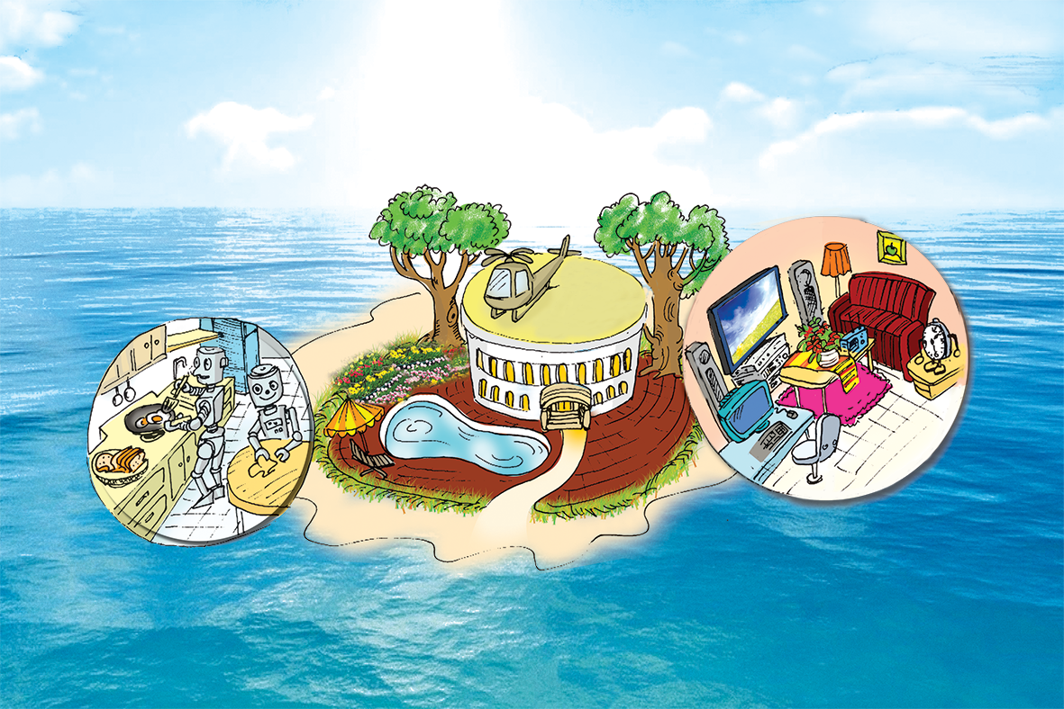
 | T | F
The house will be surrounded by a jungle.
Robots will help to do the housework.
There will be an UFO on the roof.
There will be a swimming pool in the house
True or False
✓
✓
✓
✓

Slide 5
Reading

Slide 6


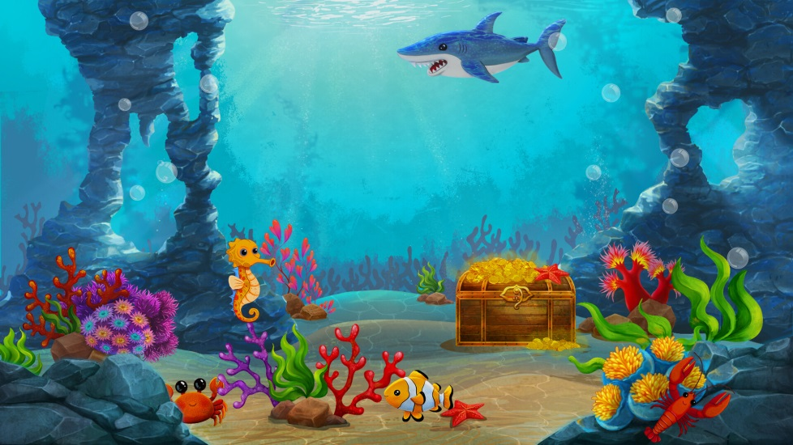
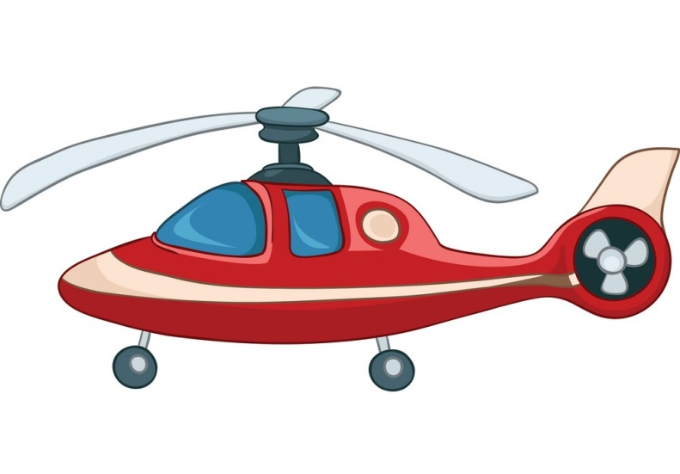


Vocabulary
surround (v)
bao quanh
helicopter (n)
máy bay
feed (v)
nuôi, cho ăn
ocean (n)
đại dương
super (adj)
siêu đẳng
type (n)
loại

Slide 7
What and Where
helicopter (n)
surround (v)
feed (v)
ocean (n)
super (adj)
type (n)

Slide 8
1
Look at the picture and discuss it with a partner.
1.
What type of house do you think it is?
2.
Where do you think the house is?
E.g.
A: What type of house do you think it is?
B: I think it’s a villa.
A: Where do you think it is?
B: I think it’s on an island.

Slide 9
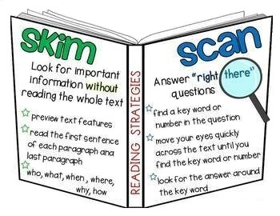

Slide 10
2
Read the dialogue quickly to check your ideas in 1.
My future house will be on an island. It will be surrounded by tall trees and the blue sea. There will be a swimming pool in front of the house. There will be a helicopter on the roof. I can ﬂy to school in it.
There will be some robots in the house. They will help me to clean the ﬂoors, cook meals, wash clothes and water the ﬂowers. They will also help me to feed the dogs and cats.
There will be a super smart TV. It will help me to send and receive emails, and contact my friends on other planets. It will also help me to buy food from the supermarket.

Slide 11
A
B
a. clean the floors.
c. wash clothes.
e. cook meals.
g. feed the dogs and cats
h. water the flowers.
b. contact my friends.
d. buy food from the supermarket.
f. send and receive emails.
B
a. clean the floors.
b. contact my friends.
1.
The house will have robots to
c. wash clothes.
d. buy food from the supermarket.
e. cook meals.
2.
The house will have a super smart TV to
f. send and receive emails.
g. feed the dogs and cats.
h. water the flowers.

Slide 12
3
Read the text again and circle the option (A, B, or C) to complete the sentences.
1.
The house will be _______.
A.
in the mountains
B.
on an island
C.
on the Moon
2.
There will be a _______ in front of the house.
A.
garden
B.
pond
C.
swimming pool
3.
The house will have _______ robots.
A.
B.
some
many
C.
a lot of
4.
The _______ will help me to feed the dogs and cats.
A.
helicopter
B.
robot
C.
super smart tv

Slide 13
Speaking

Slide 14
4
Work in pairs. Ask your partner about his / her future house. Use the suggested questions.
Example:
A: What type of future house do you think it will be?
B: It’ll be a palace.

Slide 15
1.
What type of future house do you think it will be?
It’s a villa.
2.
Where will it be?
On the ocean.
3.
What will it look like?
It will be surrounded by tall trees and green sea
4.
How many rooms will it have?
It will have 7 rooms
5.
What appliances will it have and what will they help you to do?
It will have robots in the kitchen; a TV, a computer, a hi-fi stereo, … in the living room.

Slide 16
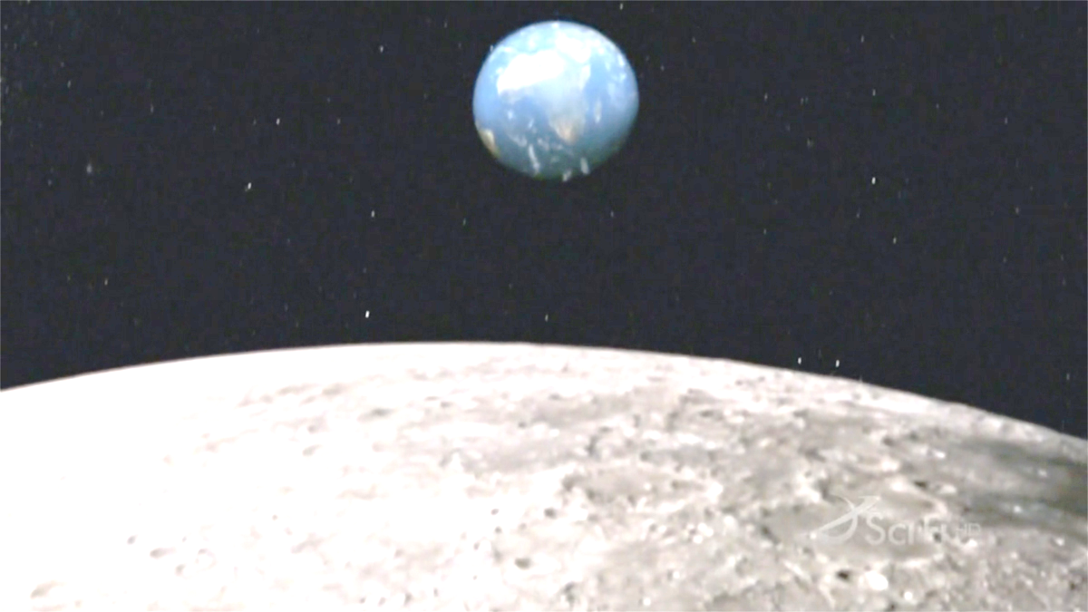

5
Choose one sportsperson in 4. Talk about him / her. Use the following cues.
Example:
My future house will be a palace. It’ll be on the Moon. There’ll be a super smart TV in the house. It’ll help me to talk to my friends on other planets.

Slide 17

Homework
Learn vocabulary and the structure by heart.
Do exercise in your work book
Prepare the next lesson: Skills 2

Slide 18


