Slide 1


TRƯỜNG THCS LONG BIÊN
BÀI GIẢNG ĐIỆN TỬ MÔN TIẾNG ANH 6
UNIT 9: CITIES OF THE WORLD
LESSON 1: GETTING STARTED
GV: Trần Thị Liên
Tổ NK-NN

Slide 2

      UNIT 9: CITIES OF THE WORLD
      LESSON 1: GETTING STARTED
English 6

Slide 3



1
Listen and read.
2
Write the names of the cities in the correct place.
3
Read the conversation again and match the cities with the adjectives describing them.
4
Match the cities with their landmarks.
5
What city is it?

Slide 4
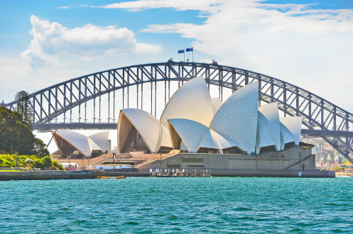
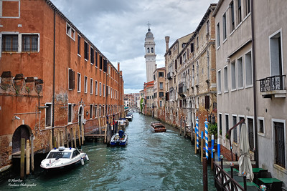
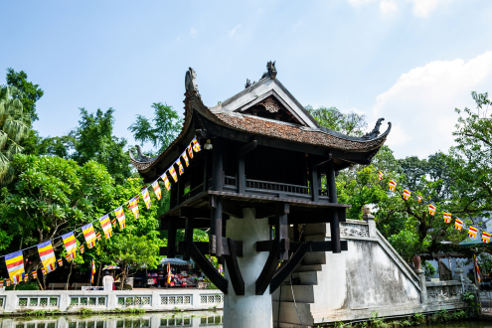
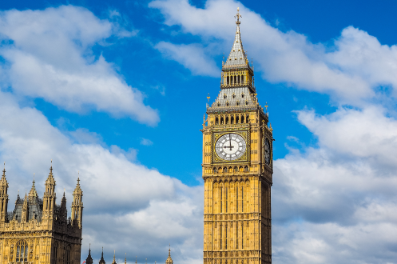
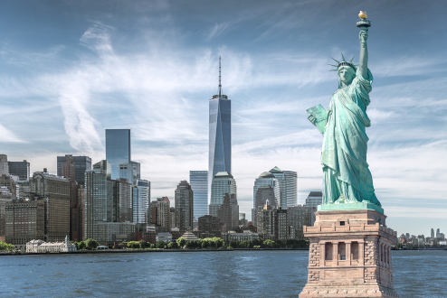
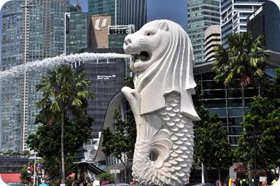
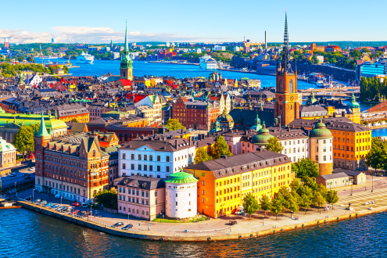
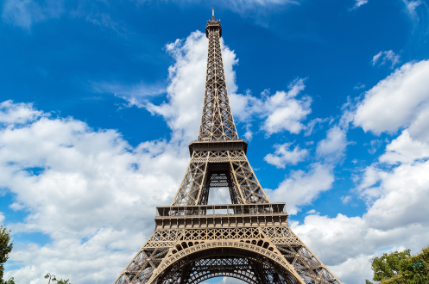
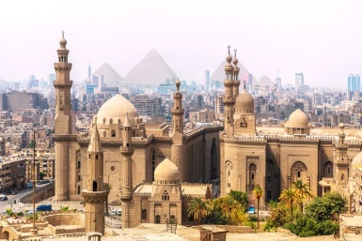
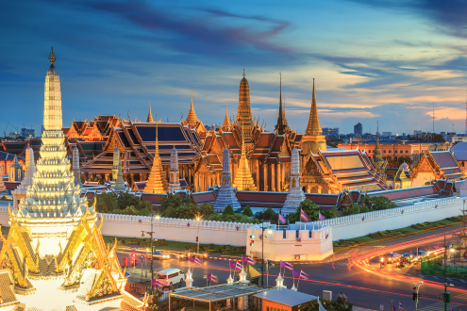
1
Sydney
9
Venice
5
Ha Noi
MATCHING GAME
Sydney
Venice
Ha Noi
Singapore
2
London
6
New York
London
New York
Sweden
Cairo
3
Singapore
7
Sweden
Paris
Bangkok
4
Paris
10
Cairo
8
Bangkok

Slide 5


1
Listen and read.
What nice photos!
What are Mai and Tom doing?
What are they looking at?
What is the name of the city?
What landmark is in the picture?
Notes:
Thiếu tên bài đọc.

Slide 6



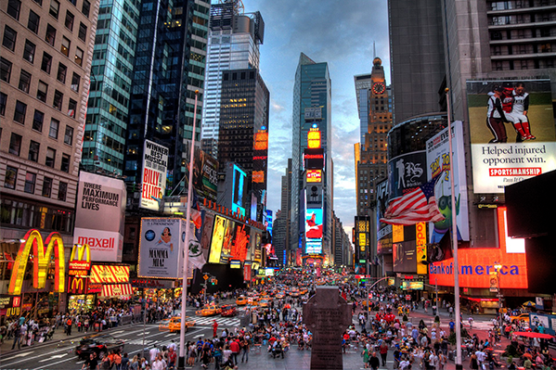
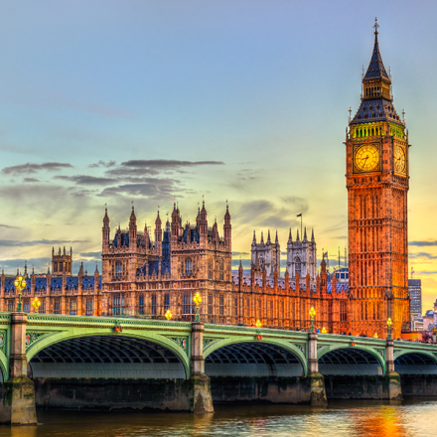

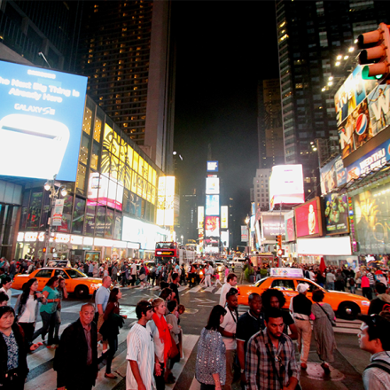

Vocabulary
‘rainy (adj)
có mưa
‘crowded (adj)
đông đúc
‘beautiful (adj)
đẹp
‘interesting (adj)
hấp dẫn
ex‘citing (adj)
náo nhiệt
time square
quảng trường thời đại
‘landmark
địa điểm thu hút khách

Slide 7
What and Where
rainy (adj)
exciting (adj)
crowded (adj)
time square
beautiful (adj)
landmark
interesting (adj)

Slide 8
What nice photos!
Mai: Tom, are these photos from your vacations?
Tom: Yes, they are. This is Sydney, a city in Australia.
Mai: What’s it like?
Tom: It’s exciting with a lot of beaches.
Mai: What a beautiful place!
Tom: Yes, its beaches are very clean.
Mai: Wonderful. Oh, this is London. Isn’t it raining?
What bad weather!
Tom: Yes, it rains all the time. Can you see Big Ben?
Mai: Yeah ... on the River Thames. It’s a landmark of London.
Tom: It is. And this is Times Square in New York, crowded but interesting.
Mai: You’re lucky to visit many places.
Tom: I am. What about your vacations?
Mai: Here are some photos of mine. This is ...
S
G

Slide 9
STRUCTURE
What nice photos!
Mai: Tom, are these photos from your vacations?
Tom: Yes, they are. This is Sydney, a city in Australia.
Mai: What’s it like?
Tom: It’s exciting with a lot of beaches.
Mai: What a beautiful place!
Tom: Yes, its beaches are very clean.
Mai: Wonderful. Oh, this is London. Isn’t it raining? What bad weather!
Tom: Yes, it rains all the time. Can you see Big Ben?
Mai: Yeah... on the River Thames. It’s a landmark of London.
Tom: It is. And this is Times Square in New York, crowded but interesting.
Mai: You’re lucky to visit many places.
Tom: I am. What about your vacations?
Mai: Here are some photos of mine. This is…

Slide 10
GRAMMAR
What nice photos!
Mai: Tom, are these photos from your vacations?
Tom: Yes, they are. This is Sydney, a city in Australia.
Mai: What’s it like?
Tom: It’s exciting with a lot of beaches.
Mai: What a beautiful place!
Tom: Yes, its beaches are very clean.
Mai: Wonderful. Oh, this is London. Isn’t it raining? What bad weather!
Tom: Yes, it rains all the time. Can you see Big Ben?
Mai: Yeah... on the River Thames. It’s a landmark of London.
Tom: It is. And this is Times Square in New York, crowded but interesting.
Mai: You’re lucky to visit many places.
Tom: I am. What about your vacations?
Mai: Here are some photos of mine. This is…

Slide 11

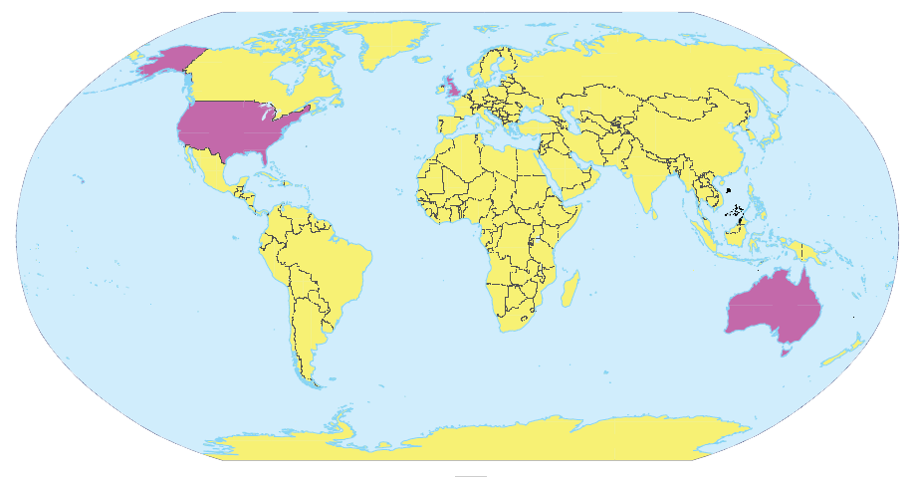
2
Write the names of the cities in the correct place.
1.
New York
2.
London
Sydney
London
New York
3.
Sydney

Slide 12
3
Read the conversation again and match the cities with the adjectives describing them.
a. rainy
1. Sydney
?
b. crowded
2. London
c. exciting
?
d. beautiful
3. New York
?
e. interesting

Slide 13
SUGGEST
What nice photos!
Mai: Tom, are these photos from your vacations?
Tom: Yes, they are. This is Sydney, a city in Australia.
Mai: What’s it like?
Tom: It’s exciting with a lot of beaches.
Mai: What a beautiful place!
Tom: Yes, its beaches are very clean.
Mai: Wonderful. Oh, this is London. Isn’t it raining? What bad weather!
Tom: Yes, it rains all the time. Can you see Big Ben?
Mai: Yeah... on the River Thames. It’s a landmark of London.
Tom: It is. And this is Times Square in New York, crowded but interesting.
Mai: You’re lucky to visit many places.
Tom: I am. What about your vacations?
Mai: Here are some photos of mine. This is…

Slide 14
SUGGEST
What nice photos!
Mai: Tom, are these photos from your vacations?
Tom: Yes, they are. This is Sydney, a city in Australia.
Mai: What’s it like?
Tom: It’s exciting with a lot of beaches.
Mai: What a beautiful place!
Tom: Yes, its beaches are very clean.
Mai: Wonderful. Oh, this is London. Isn’t it raining? What bad weather!
Tom: Yes, it rains all the time. Can you see Big Ben?
Mai: Yeah... on the River Thames. It’s a landmark of London.
Tom: It is. And this is Times Square in New York, crowded but interesting.
Mai: You’re lucky to visit many places.
Tom: I am. What about your vacations?
Mai: Here are some photos of mine. This is…

Slide 15
SUGGEST
What nice photos!
Mai: Tom, are these photos from your vacations?
Tom: Yes, they are. This is Sydney, a city in Australia.
Mai: What’s it like?
Tom: It’s exciting with a lot of beaches.
Mai: What a beautiful place!
Tom: Yes, its beaches are very clean.
Mai: Wonderful. Oh, this is London. Isn’t it raining? What bad weather!
Tom: Yes, it rains all the time. Can you see Big Ben?
Mai: Yeah... on the River Thames. It’s a landmark of London.
Tom: It is. And this is Times Square in New York, crowded but interesting.
Mai: You’re lucky to visit many places.
Tom: I am. What about your vacations?
Mai: Here are some photos of mine. This is…

Slide 16
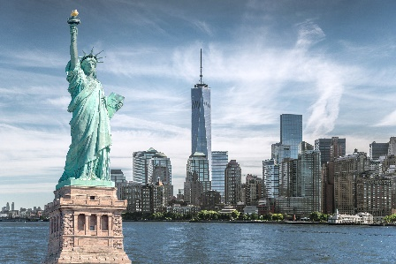
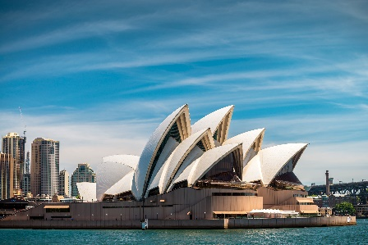

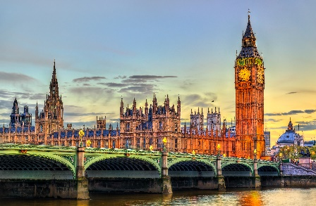
4
Match the cities with their landmarks.
a
1. Ha Noi
b
2. London
c
3. New York
d
4. Sydney

Slide 17
Ha Noi: One Pillar Pagoda, The Old Quarter, The Temple of Literature and Imperial Academy, Ho Chi Minh Mausoleum, Ha Noi Flag Tower, Ba Dinh Square, etc.
London: Houses of Parliament, Buckingham Palace, Trafalgar Square, Piccadilly Circus, The London Eye, Tower Bridge, The British Museum, St Paul’s Cathedral, The Thames, etc.
New York: Statue of Liberty, Central Park, Brooklyn Bridge, Broadway, Empire State Building, Times Square, etc.
Sydney: Sydney Opera House, Sydney Harbour Bridge, Sydney Observatory, Museum of Contemporary Art Australia, Art Gallery of New South Wales, Hyde Park Barracks, Sydney Tower Eye, Sydney Town Hall, Queen Victoria Building, St Mary's Cathedral, etc.

Slide 18
5
What city is it?
Example:
A: What’s it like?
B: It has beautiful beaches.
C: Is it in Australia?
B: Yes, it is.
A: It’s Sydney.
B: Right.

Slide 19
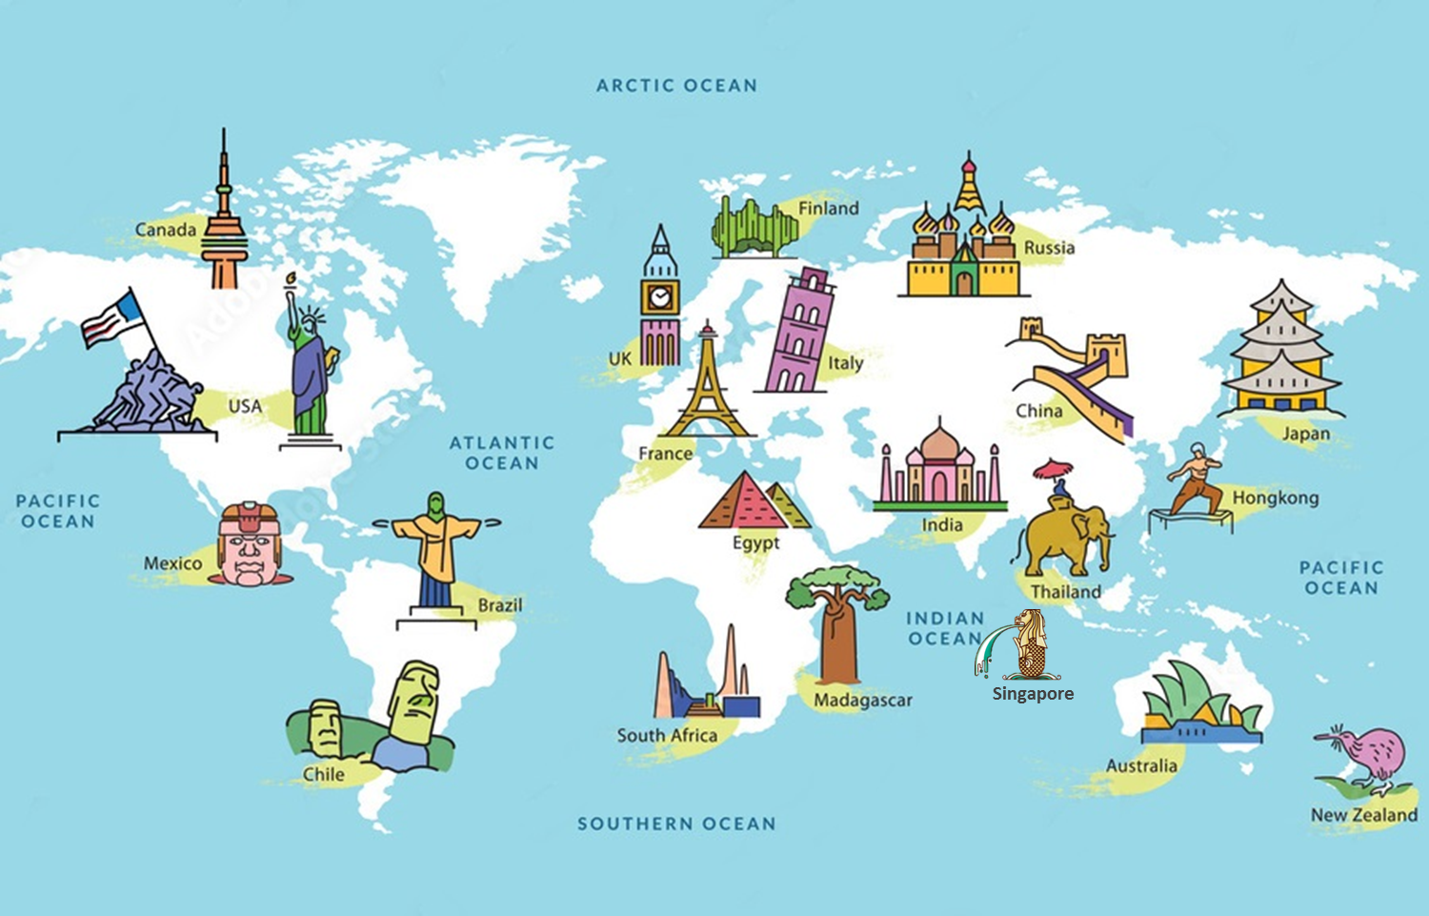

WHAT CITY IS IT?

Slide 20
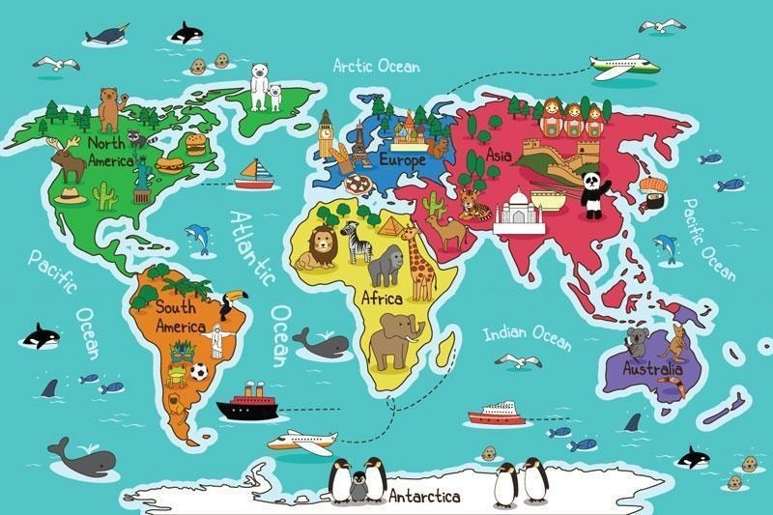
Question 1:
TIME’S UP
Big Ben, London
Eiffel Tower, Paris
Merlion, Singapore
Temple of Literature

Slide 21
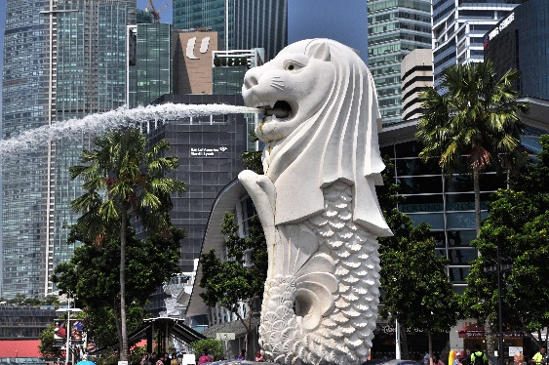
Question 2:
TIME’S UP
Big Ben, London
Sydney Opera House, Australia
Merlion, Singapore
Temple of Literature

Slide 22
Question 3:
TIME’S UP
Temple of Literature
Eiffel Tower, Paris
Big Ben, London
Sydney Opera House, Australia

Slide 23
Question 4:
TIME’S UP
Sydney Opera House, Australia
Big Ben, London
Merlion, Singapore
Eiffel Tower, Paris

Slide 24
Question 5:
TIME’S UP
Sydney Opera House, Australia
Merlion, Singapore
Stockholm, Sweden
Temple of Literature

Slide 25
Question 6:
TIME’S UP
Sydney Opera House, Australia
Stockholm, Sweden
Merlion, Singapore
Temple of Literature

Slide 26

Homework
  Learn vocabulary and the structure by heart.
  Do exercise in your work book
  Prepare the next lesson: A closer look 1
  Go to the Internet and search for the information on your favourite cities in the world (food, people, weather, etc.)

