Slide 1


TRƯỜNG THCS LONG BIÊN
BÀI GIẢNG ĐIỆN TỬ MÔN TIẾNG ANH 6
UNIT 8: SPORTS AND GAMES
LESSON 7: LOOKING BACK + PROJECT
GV: Trần Thị Liên
Tổ NK-NN

Slide 2
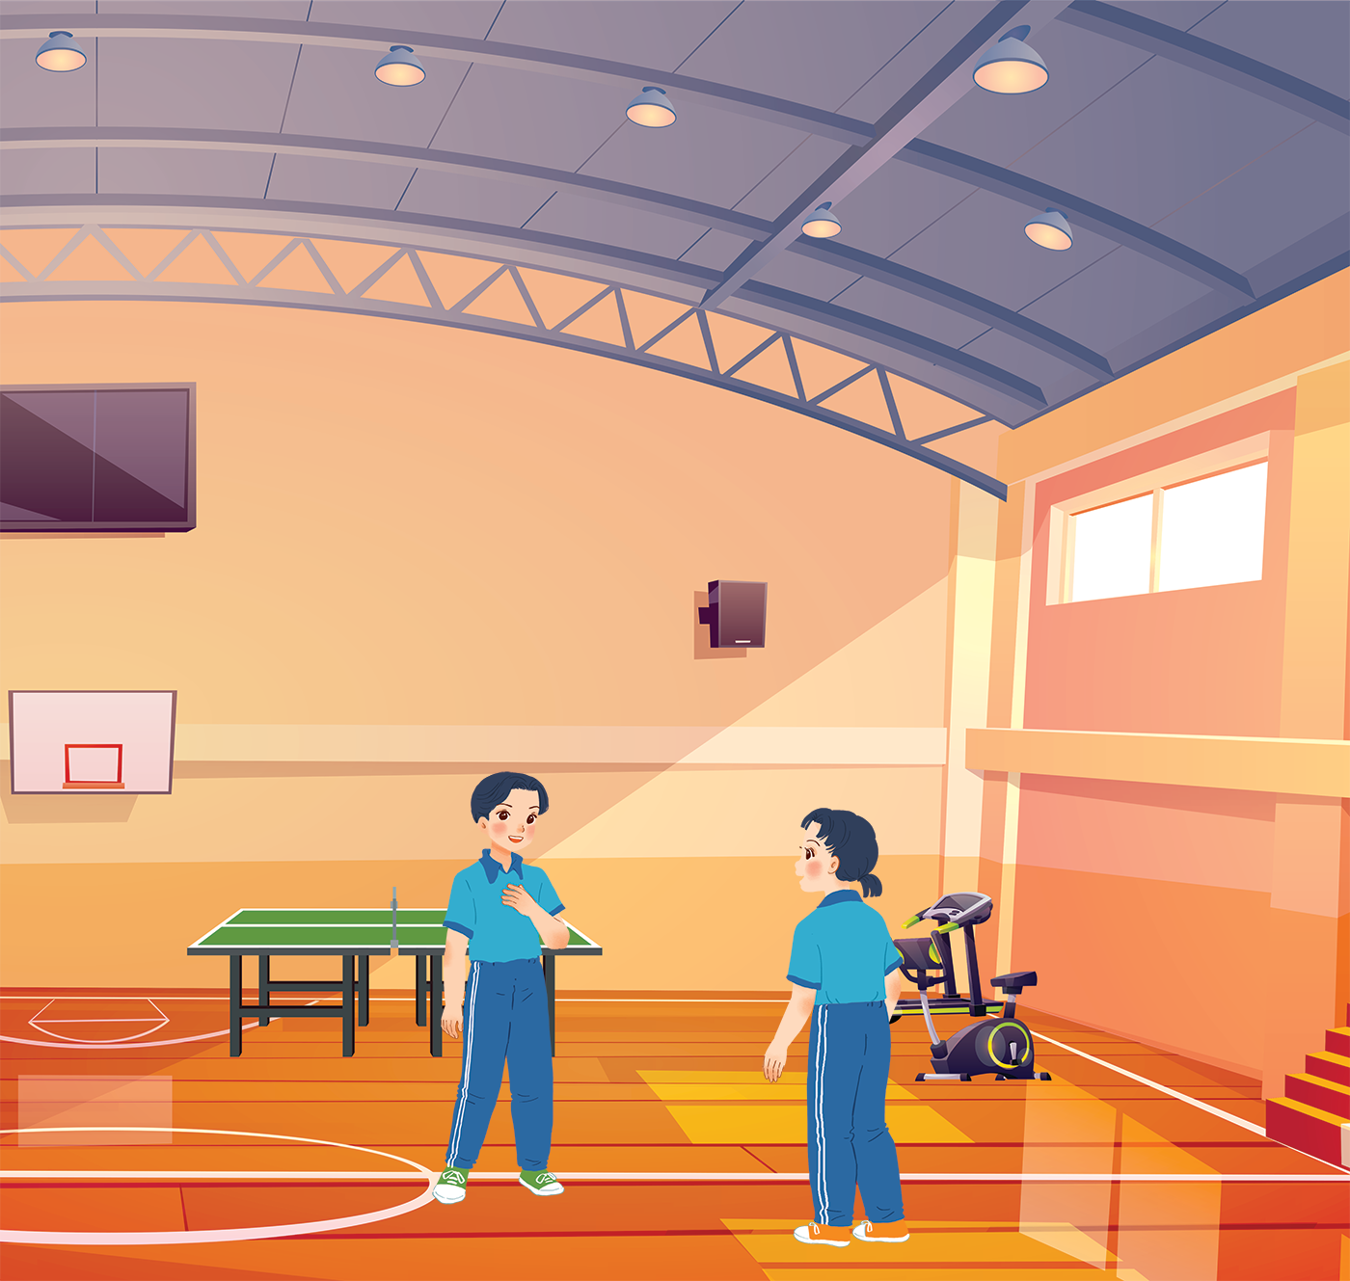
UNIT 8: SPORTS AND GAMES
LESSON 7: LOOKING BACK - PROJECT
English 6

Slide 3



Vocabulary
1
Find one odd word / phrase in each question.
2
Put the correct form of the verbs play, do or go in the blanks.
Grammar
3
Put the verbs in brackets in the correct form.
4
What do you say in these situations?
5
Fill each blank with ONE word to complete the passage.

Slide 4

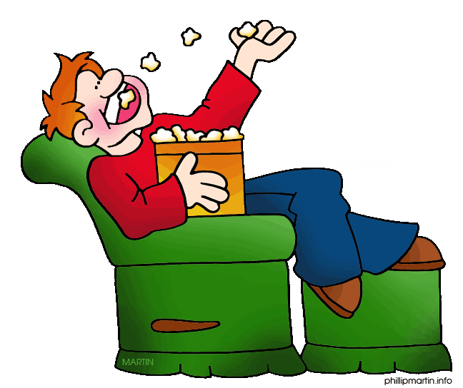
GO
PLAY
DO

Slide 5
There are 3 verbs in English that you can use to say what sport you do: play, go and do
So for any sport that is a game use the verb to play:
You can play tennis, football, badminton, basketball, squash, hockey, and so on.
If the name of the sport is an activity based on a verb and ends in -ing, then use the verb to go:
You can go running, swimming, cycling, climbing, and so on
Other sport, as for the word sport itself, use the verb to do:
You can do sport, karate, yoga, athletics, ballet, and so on
Notes:
A sport: an activity that you do for pleasure and that needs physical exercise. Running, cycling, mountain climbing
A game: an activity or a sport with rules in which people or teams compete against each other. Chess, football, card games, computer games

Slide 6
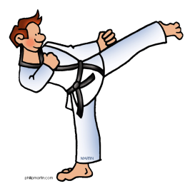
SPORTS VERBS: PLAY, GO, DO
TIME’S UP
GO
PLAY
DO
karate
do karate

Slide 7
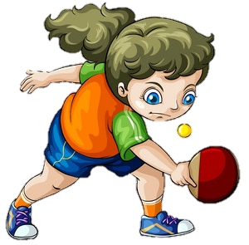
SPORTS VERBS: PLAY, GO, DO
TIME’S UP
GO
PLAY
DO
table tennis
play table tennis

Slide 8
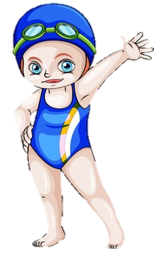
SPORTS VERBS: PLAY, GO, DO
TIME’S UP
GO
PLAY
DO
swimming
go swimming

Slide 9
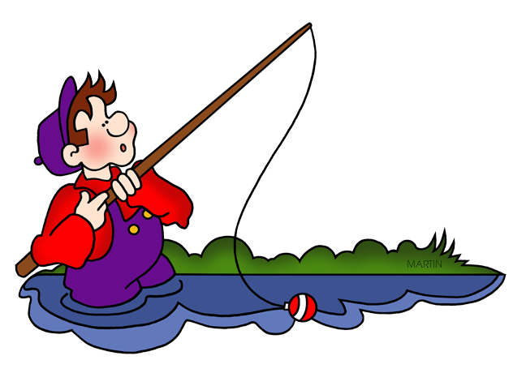
SPORTS VERBS: PLAY, GO, DO
TIME’S UP
GO
PLAY
DO
fishing
go fishing

Slide 10
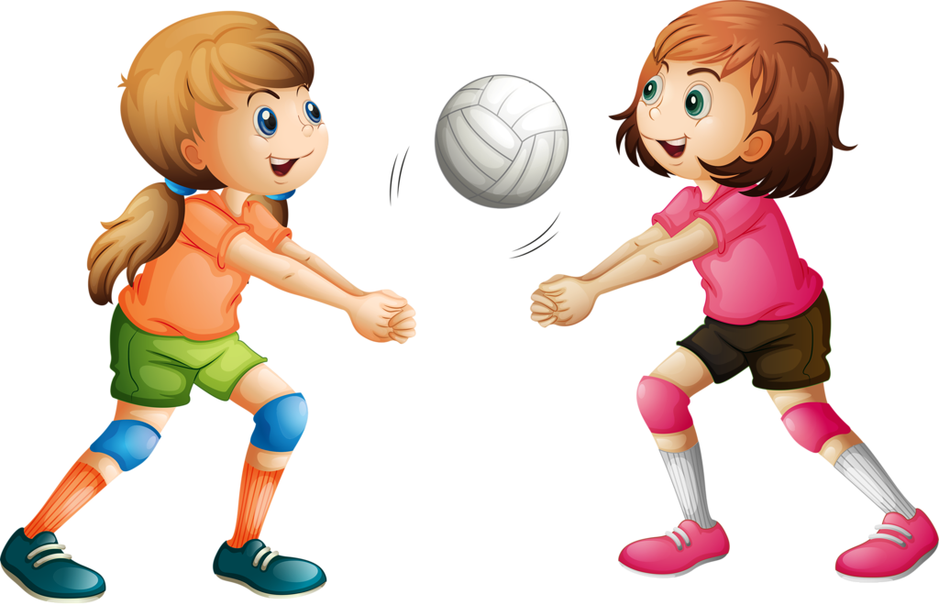
SPORTS VERBS: PLAY, GO, DO
TIME’S UP
GO
PLAY
DO
volleyball
play volleyball

Slide 11
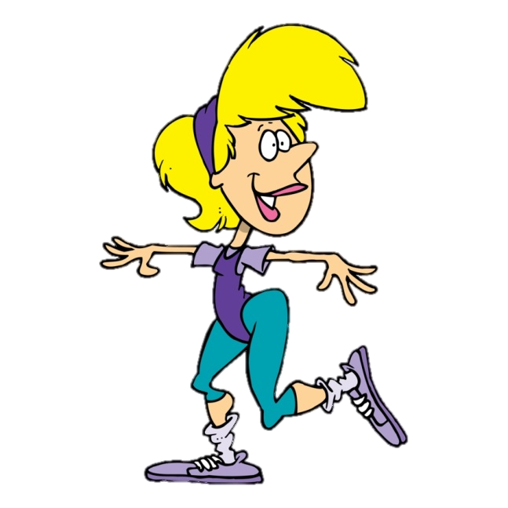
SPORTS VERBS: PLAY, GO, DO
TIME’S UP
GO
PLAY
DO
aerobics
do aerobics

Slide 12
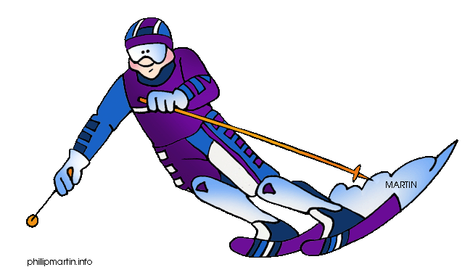
SPORTS VERBS: PLAY, GO, DO
TIME’S UP
GO
PLAY
DO
skiing
go skiing

Slide 13

SPORTS VERBS: PLAY, GO, DO
TIME’S UP
GO
PLAY
DO
homework
do homework

Slide 14

SPORTS VERBS: PLAY, GO, DO
TIME’S UP
GO
PLAY
DO
computer
playing computer

Slide 15
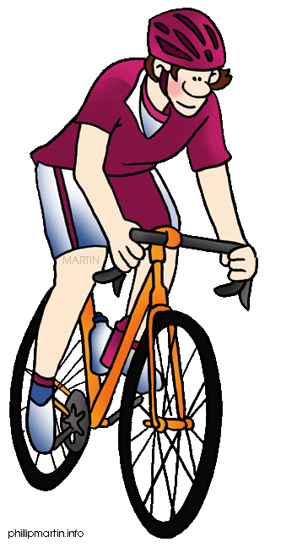
SPORTS VERBS: PLAY, GO, DO
TIME’S UP
GO
PLAY
DO
cycling
go cycling

Slide 16
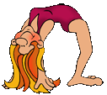
SPORTS VERBS: PLAY, GO, DO
TIME’S UP
GO
PLAY
DO
gymnastic
do gymnastics

Slide 17
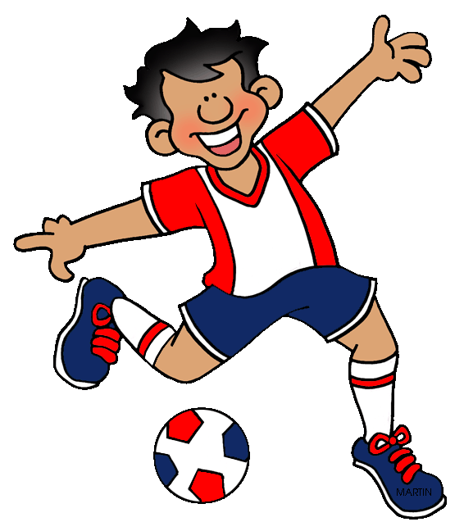
SPORTS VERBS: PLAY, GO, DO
TIME’S UP
GO
PLAY
DO
football
play football

Slide 18
Vocabulary

Slide 19
1
Find one odd word / phrase in each question.
1.
A.
volleyball
B.
badminton
C.
bicycle
2.
A.
playground
B.
ball
C.
racket
3.
A.
running
B.
cycling
C.
driving
4.
A.
sports shoes
B.
winter sports
C.
goggles
5.
A.
sporty
B.
intelligent
C.
fit

Slide 20
2
Put the correct form of the verbs play, do or go in the blanks.
Duong can
do karate.
1.
_______ karate.
2.
Duy isn’t reading now. He
_______ table tennis with his friend.
is playing table tennis with his friend.
Michael
goes swimming nearly every day.
3.
_______ swimming nearly every day.
went fishing.
4.
Phong didn’t play football yesterday. He
_______ fishing.
_______ volleyball last Saturday.
5.
Khang
played volleyball last Saturday.
6.
The girls
are doing aerobics in the playground now.
_______ aerobics in the playground now.

Slide 21
Grammar

Slide 22
3
Put the verbs in brackets in the correct form.
took place in Greece in 776 BC.
1.
The first Olympic Games (take)
_______ place in Greece in 776 BC.
2.
People (start)
started to use computers about 50 years ago.
_______ to use computers about 50 years ago.
didn’t like to play games when he was small.
3.
My brother (not like)
_______ to play games when he was small.
What _______ you (do) _______ last weekend?
I (cycle) _______ round the lake with my friends. Then I (watch) _______ TV in the afternoon.
4.
What did you (do) do last weekend?
I (cycle) cycled round the lake with my friends.
Then I (watch) watched TV in the afternoon.

Slide 23
4
What do you say in these situations?
1.
Your friends are making a lot of noise.
Please, stop
making noise.
_______.
2.
The boy is watching TV for too long.
_______ to play with your friends.
Go out to play with your friends.
3.
Some children are feeding the animals at the zoo, but it is not allowed.
_______ the animals.
Don’t feed the animals.
4.
The teacher wants the boys to stand in line.
Stand in line, boys.
_______.
5.
Your mother tells you not to touch the dog.
Don’t touch the dog.
_______.

Slide 24
5
Fill each blank with ONE word to complete the passage.
Sports and games are very important in our lives. We all can (1) _______ a sport, or a game, or watch sports events on TV or at the stadium. When you listen to the radio every day, you can always (2) _______ sports news. When you open a newspaper, you will always find an article about your (3) _______kind of game. Television programmes about (4) _______ are also very popular, and you can watch something interesting every day. Stories about (5) _______ sports stars are often very interesting.
play
hear
favorite
sports
famous

Slide 25


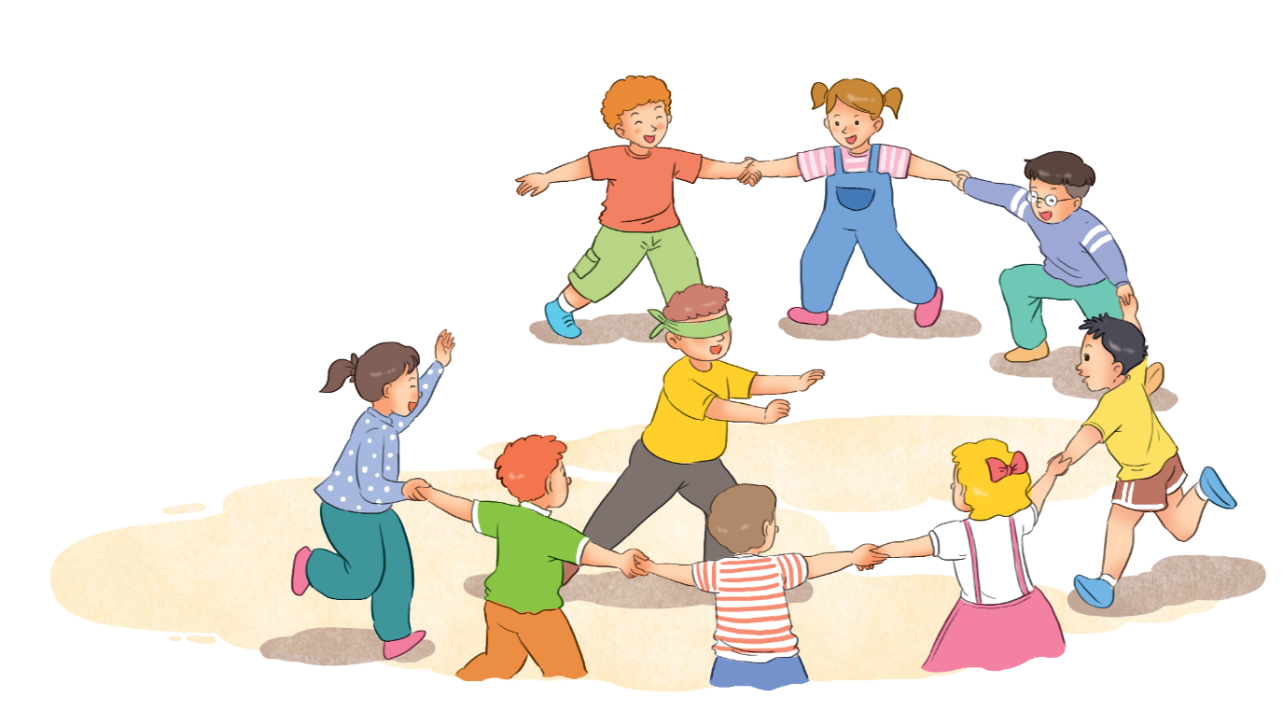
Read the information about a traditional game.
Name of the game: blind man’s buff
Number of players: five or more
Equipment: a blindfold, and open space
How to play:
1.
Players stand in a circle; one person blindfolded (the seeker) stands in the middle.
2.
The seeker tries to touch others without being caught.
3.
When the seeker catches a player, he / she tries to guess who it is by touching that player’s face and hair.
4.
When the seeker guesses that player’s name, he / she becomes the new seeker.

Slide 26

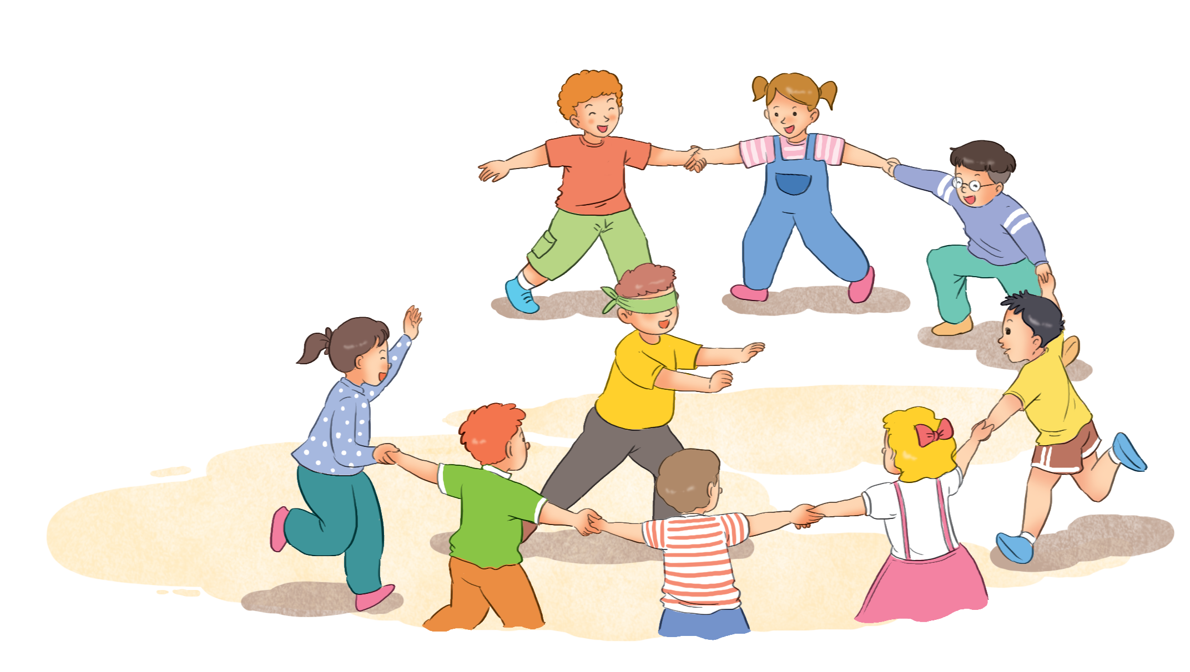
Choose one of the following games and write about it.
Tug of war (rope pulling)
Skipping
Wrestling
Cues:
Name of the game:
Number of players:
Equipment:
How to play:

Slide 27

Work in groups. Take turns to give presentation.

Slide 28
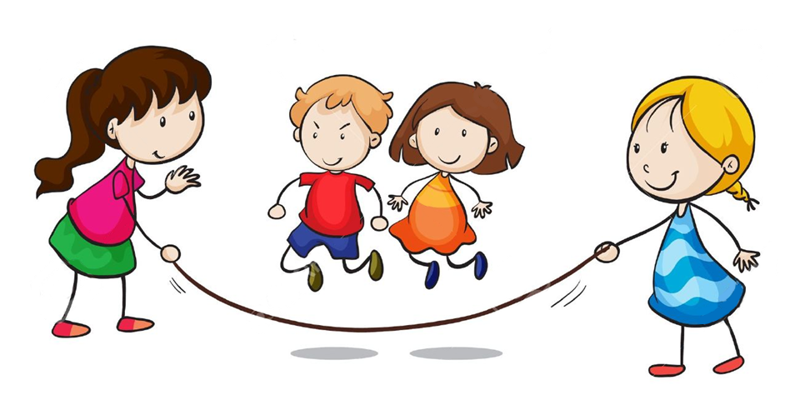
Vietnamese Jump Rope is a challenging game played by anyone anywhere. The simple rules test the skill and coordination of all players. The game is easily learned and always fun! Vietnamese Jump Rope is no ordinary "rope skipping" game. "Enders" hold an elastic rope while a "jumper" jumps the rope in special ways.

Slide 29
Now I can … |  |  | 
use the words related to the topic ‘Sports and Games’.
pronounce the sounds /e/ and /æ/ correctly.
use the past simple.
use imperatives to tell someone to do something.
express and respond to congratulations.
read about favourite sports stars.
talk about famous sportspeople.
listen about sport(s) / game(s).
write a paragraph about a sport / game.
✓
✓
✓
✓
✓
✓
✓
✓
✓
✓
✓
✓
✓
✓
✓
✓
✓
✓
✓
✓
✓
✓
✓
✓
✓
✓
✓

Slide 30

Homework
Learn vocabulary and the structure by heart.
Do exercise … in your work book
Prepare the next lesson: Getting started

