Slide 1


TRƯỜNG THCS LONG BIÊN
BÀI GIẢNG ĐIỆN TỬ MÔN TIẾNG ANH 6
UNIT 8: SPORTS AND GAMES
LESSON 6: SKILLS 2
GV: Trần Thị Liên
Tổ NK-NN

Slide 2
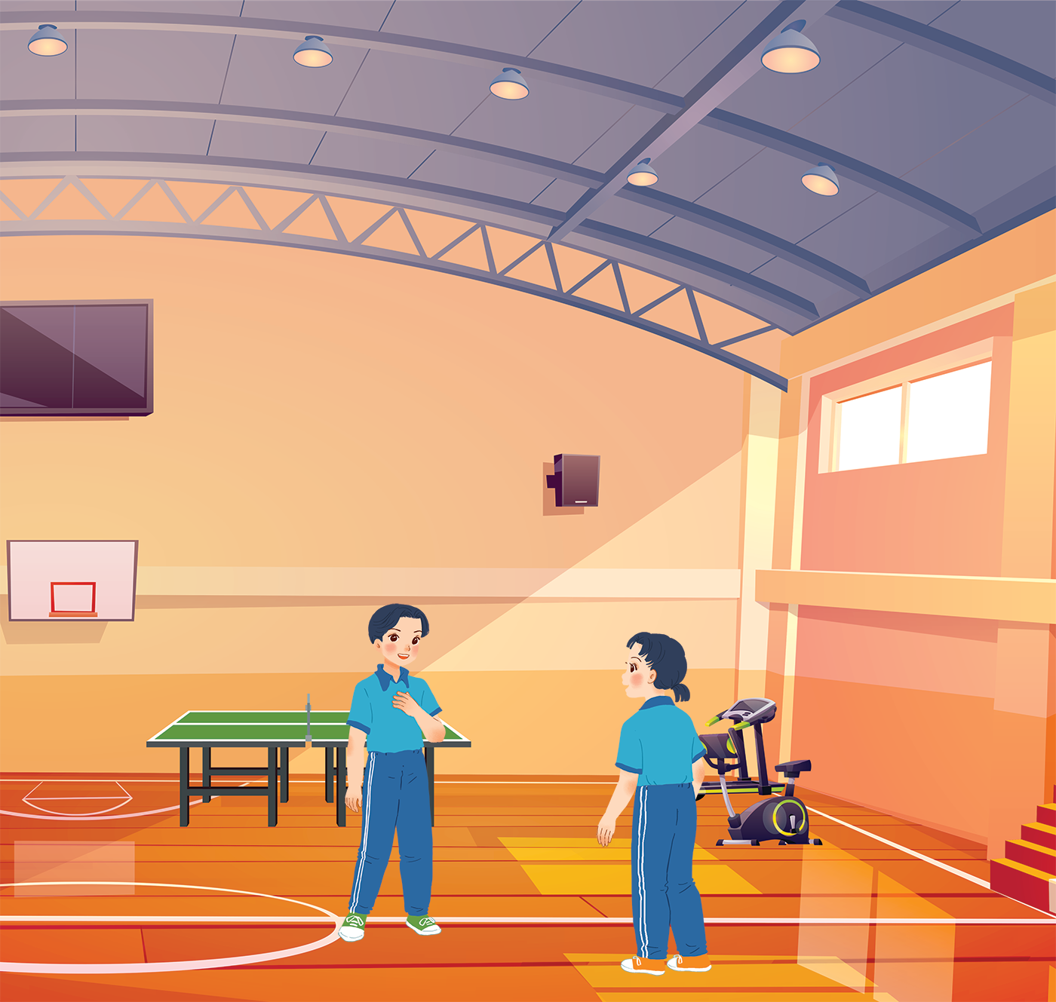
      UNIT 8: SPORTS AND GAMES
      LESSON 6: SKILLS 2
English 6

Slide 3


Listening
1
Listen to the passages. Who are they about?
2
Listen to the passages again. Then tick () T (True) or F (False) for each sentence.
3
Listen again and fill each blank with a word to complete each sentences.
Writing
4
Work in pairs. Talk about the sport / game you like. Use the following questions as cues.
5
Write a paragraph of 40-50 words about the sport / game you talked about in 4. You can also refer to the listening passages.

Slide 4
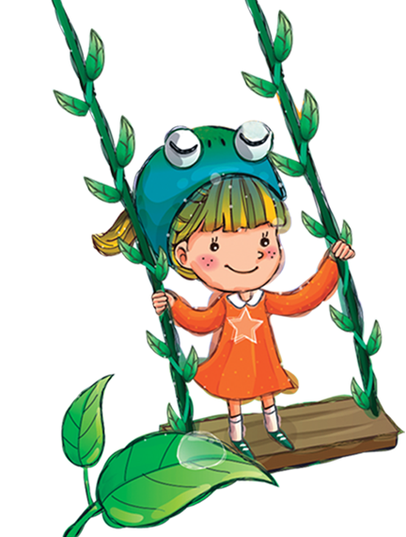
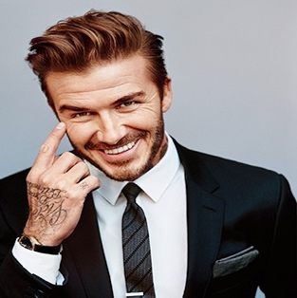
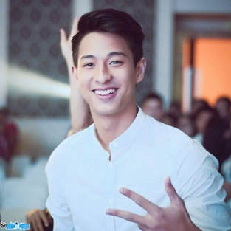
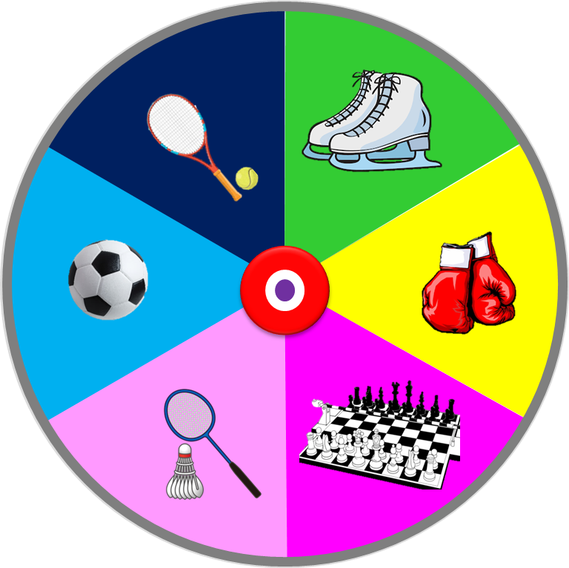
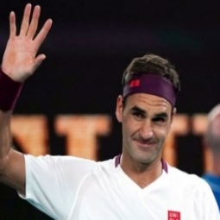
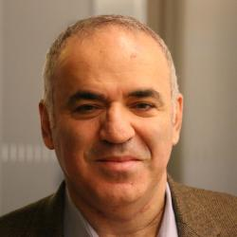

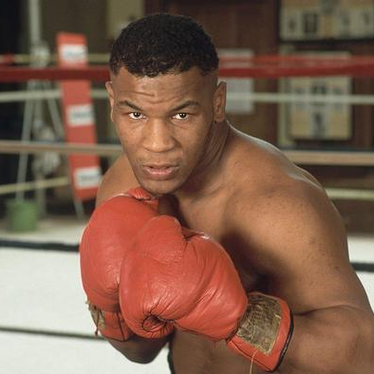
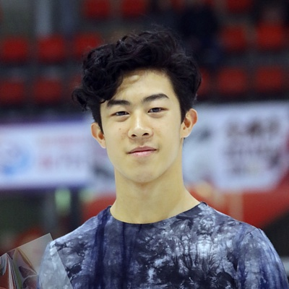

WHO IS THIS
Phạm Hồng Nam
David Beckham
ice skater
boxer
chess player
Garry Kasparov
Roger Federer
badminton player
footballer
tennis player
Spin
Nathan Chen
Mike Tyson

Slide 5
Listening

Slide 6

1
Listen to the passages. Who are they about?
The listening passages are about Hai and Alice.
Audio script

Slide 7
AUDIO SCRIPT
Hello. My name's Hai. I love sport. I play volleyball at school and I often go cycling with my dad at the weekend. But my favourite sport is karate. I practise it three times a week. It makes me strong and confident.
My name's Alice. I'm twelve years old. I don't like doing sport very much, but I like watching sport on TV. My hobby is playing chess. My friend and I play chess every Saturday. I sometimes play computer games, too. I hope to create a new computer game one day.

Slide 8
2
Listen to the passages again. Then tick () T (True) or F (False) for each sentence.
 | T | F
1. The passages are about two sportsmen.
2. Hai goes cycling at the weekend.
3. Hai’s favourite sport is karate.
4. Alice doesn’t like doing sport very much.
5. Alice plays computer games every day.





Audio script

Slide 9
AUDIO SCRIPT
Hello. My name's Hai. I love sport. I play volleyball at school and I often go cycling with my dad at the weekend. But my favourite sport is karate. I practise it three times a week. It makes me strong and confident.
My name's Alice. I'm twelve years old. I don't like doing sport very much, but I like watching sport on TV. My hobby is playing chess. My friend and I play chess every Saturday. I sometimes play computer games, too. I hope to create a new computer game one day.

Slide 10
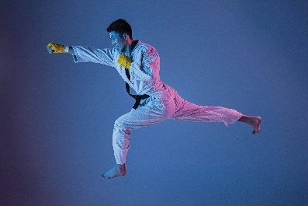

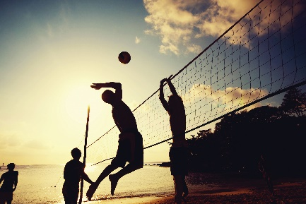
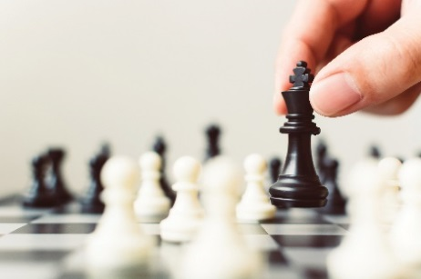
3
Listen again and fill each blank with a word to complete each sentences.
Hai plays
_______ at school.
1.
volleyball at school.
2.
_______ times a week.
Hai practises karate at the club
three times a week.
Alice likes watching sport on TV.
3.
_______ likes watching sport on TV.
Alice plays
_______ every Saturday.
4.
chess every Saturday.
Audio script

Slide 11
AUDIO SCRIPT
Hello. My name's Hai. I love sport. I play volleyball at school and I often go cycling with my dad at the weekend. But my favourite sport is karate. I practise it three times a week. It makes me strong and confident.
My name's Alice. I'm twelve years old. I don't like doing sport very much, but I like watching sport on TV. My hobby is playing chess. My friend and I play chess every Saturday. I sometimes play computer games, too. I hope to create a new computer game one day.

Slide 12
Writing

Slide 13
4
Work in pairs. Talk about the sport / game you like. Use the following questions as cues.
What is the name of the sport / game?
How many players are there?
How often do you play it?
What equipment does it need?
Why do you like it?

Slide 14

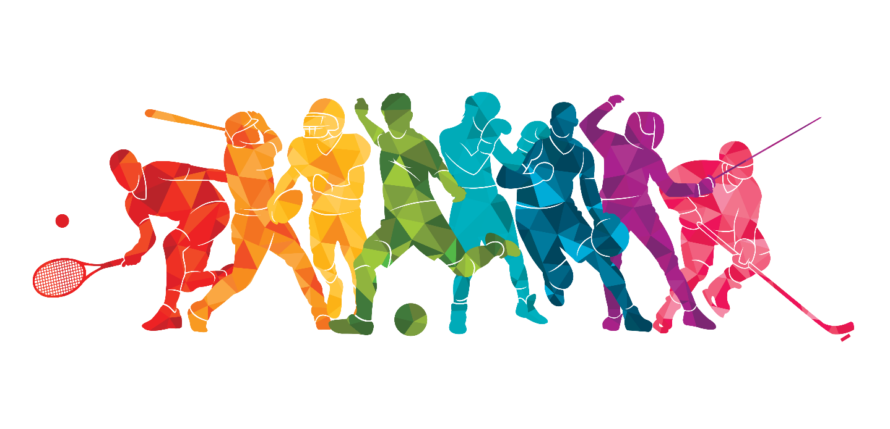
Write a paragraph of 40-50 words about the sport / game you talked about in 4. You can also refer to the listening passages.
5

Slide 15

Homework
  Learn vocabulary and the structure by heart.
  Do exercise … in your work book
  Prepare the next lesson: Looking back - Project

