Slide 1
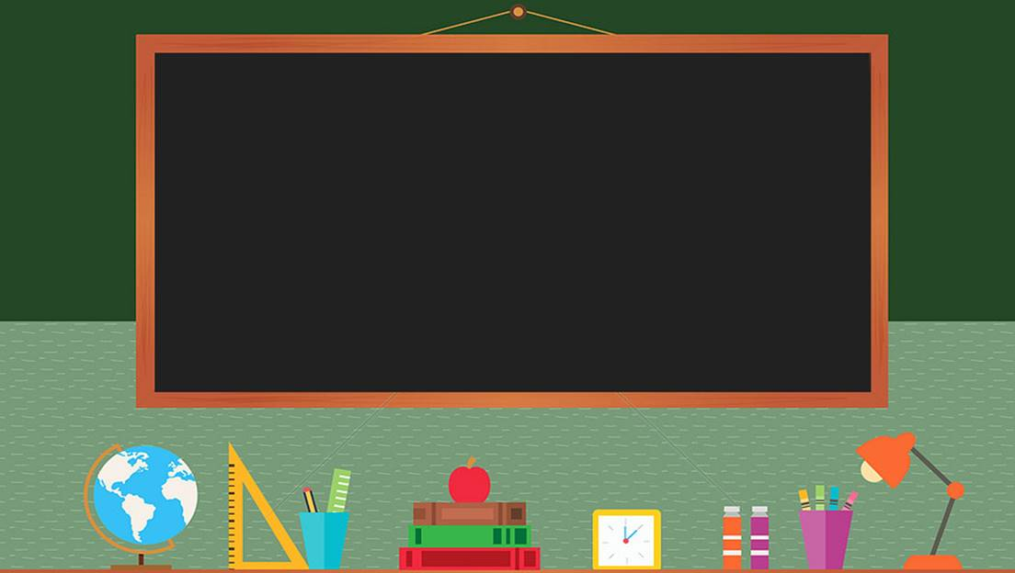

TRƯỜNG THCS LONG BIÊN
BÀI GIẢNG ĐIỆN TỬ MÔN TIẾNG ANH 7
UNIT 5: FOOD AND DRINK
LESSON 6 : SKILLS 2
GV: Trần Thị Liên
Tổ NK-NN

Slide 2
UNIT 5.
FOOD AND DRINK
Lesson 6. Skills 2

Slide 3

OBJECTIVES
By the end of this lesson, Ss will be able to:
Develop their listening skill for specific information about food and drink.
Write a paragraph about eating habits in their area.

Slide 4
GAME: OUR EATING HABITS
- 4 – 5 students in a group.
- Students answer 2 questions:
What did you eat and drink yesterday?
Who had healthiest diet?

Slide 5
LISTENING
Eating habits

Slide 6
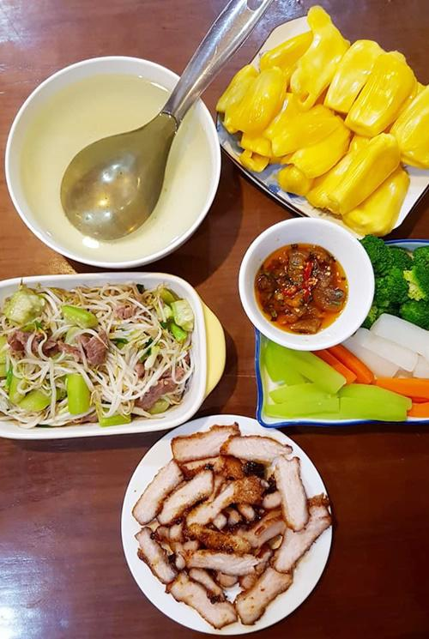
vocabulary
meal (n)
/mɪəl/
bữa ăn

Slide 7
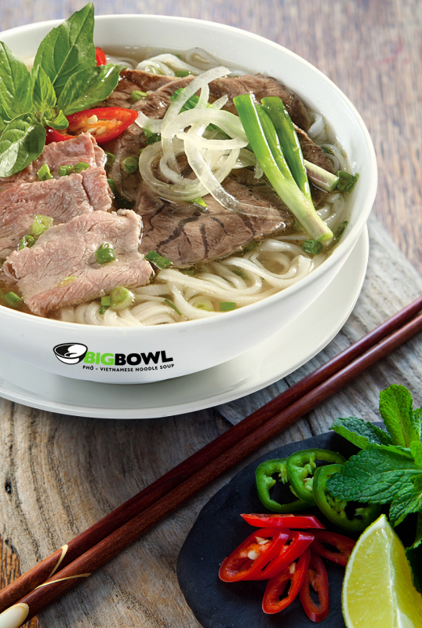
vocabulary
breakfast (n)
/ˈbrek.fəst/
bữa sáng

Slide 8
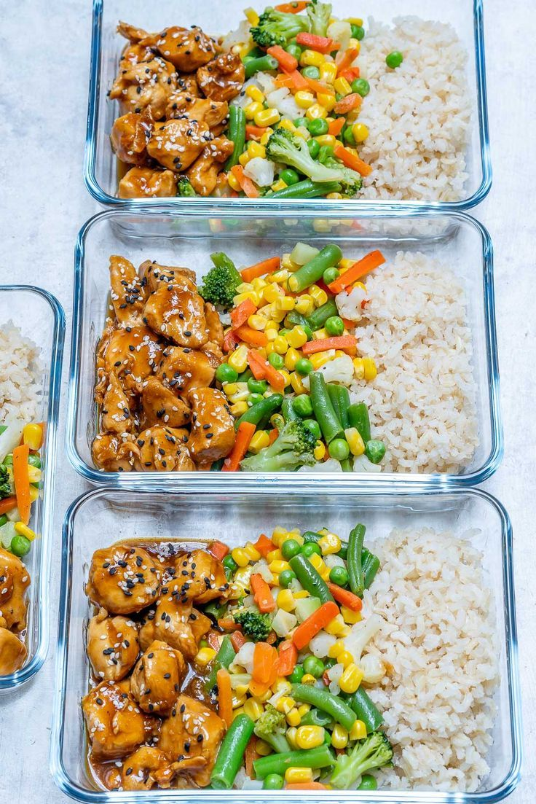
vocabulary
lunch (n)
/lʌntʃ/
bữa trưa

Slide 9
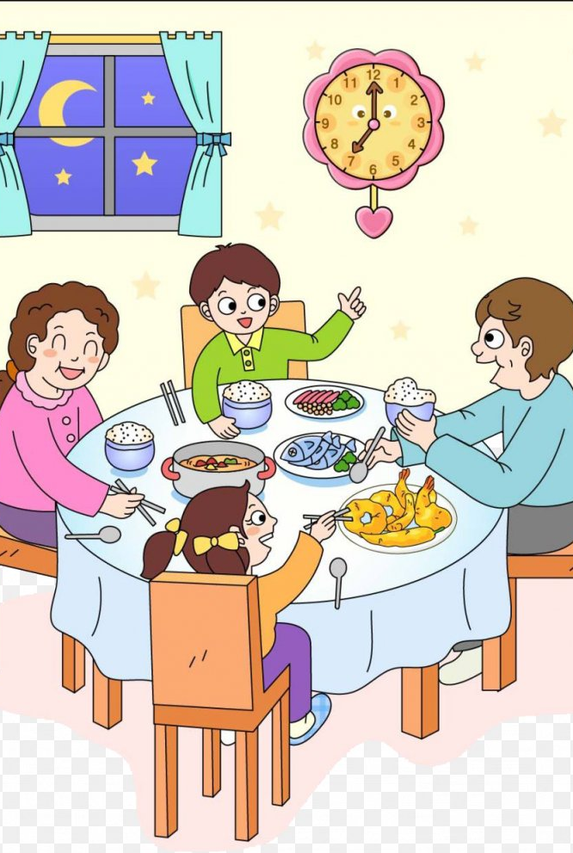
vocabulary
dinner (n)
/ˈdɪnər/
bữa tối

Slide 10

vocabulary
fabulous (adj)
/ˈfæbjələs/
rất tuyệt vời

Slide 11
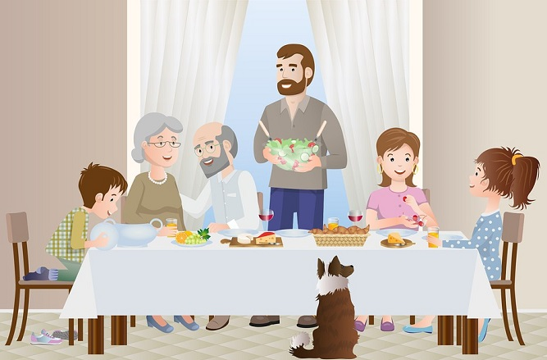
Ex 1. (p 57) Work in groups. Discuss the following questions.
1. What time do people in your area often have breakfast, lunch, and dinner?
→ They usually have breakfast at 6.30 a.m.
They usually have lunch at 11 p.m.
They usually have dinner at 7 p.m.
2. What do they often have for breakfast, lunch, and dinner?
→ They eat a light breakfast with many kind of foods like pho, bread and milk. At lunch, they eat rice with many dishes. And at dinner, they have a big dinner with fish, meat, or vegetables.

Slide 12


Ex 2. (p 57) Listen and circle the food and drink you hear.
eel soup | cakes | green tea
coffee | toast

Slide 13
Ex 3. (p 57) Underline the keywords.
Ex 3. (p 57) Listen and decide True or False.
 | T | F
1. People in Minh's area often have four meals a day.
2. Most of them have lunch at home.
3. Lunch is the main meal of the day in his area.
4. People in his neighbourhood often have rice, fresh vegetables, and seafood or meat for dinner.
5. After dinner, they often have some fruit and green tea.
1. People in Minh's area often have four meals a day.
2. Most of them have lunch at home.
3. Lunch is the main meal of the day in his area.
4. People in his neighbourhood often have rice, fresh vegetables, and seafood or meat for dinner.
5. After dinner, they often have some fruit and green tea.

Slide 14

01
People in Minh's area often have
four meals a day.
People in Minh's area often have
four meals a day.
→ People in my area often have three meals a day: breakfast, lunch and dinner.
False

Slide 15
02
Most of them have lunch at home.
Most of them have lunch at home.
→ Lunch often starts at 11:30 a.m. Most of us have lunch at home.
True

Slide 16
03
Lunch is the main meal of the day in his area.
Lunch is the main meal of the day in his area.
→ Dinner is the main meal of the day.
false

Slide 17
04
People in his neighbourhood often have rice, fresh vegetables, and seafood or meat for dinner.
People in his neighbourhood often have rice, fresh vegetables, and seafood or meat for dinner.
→ Dinner is the main meal of the day. It's also the time when family members gather at home, so it takes a bit longer than the other meals. It often starts at around 7:30 p.m. We usually have rice with a lot of fresh vegetables and seafood or meat.
true

Slide 18
05
After dinner, they often have some fruit and green tea.
→ We normally talk about everyday activities during the meal. Then we have some fruit and green tea.
True

Slide 19
Writing
What are your eating habits?

Slide 20
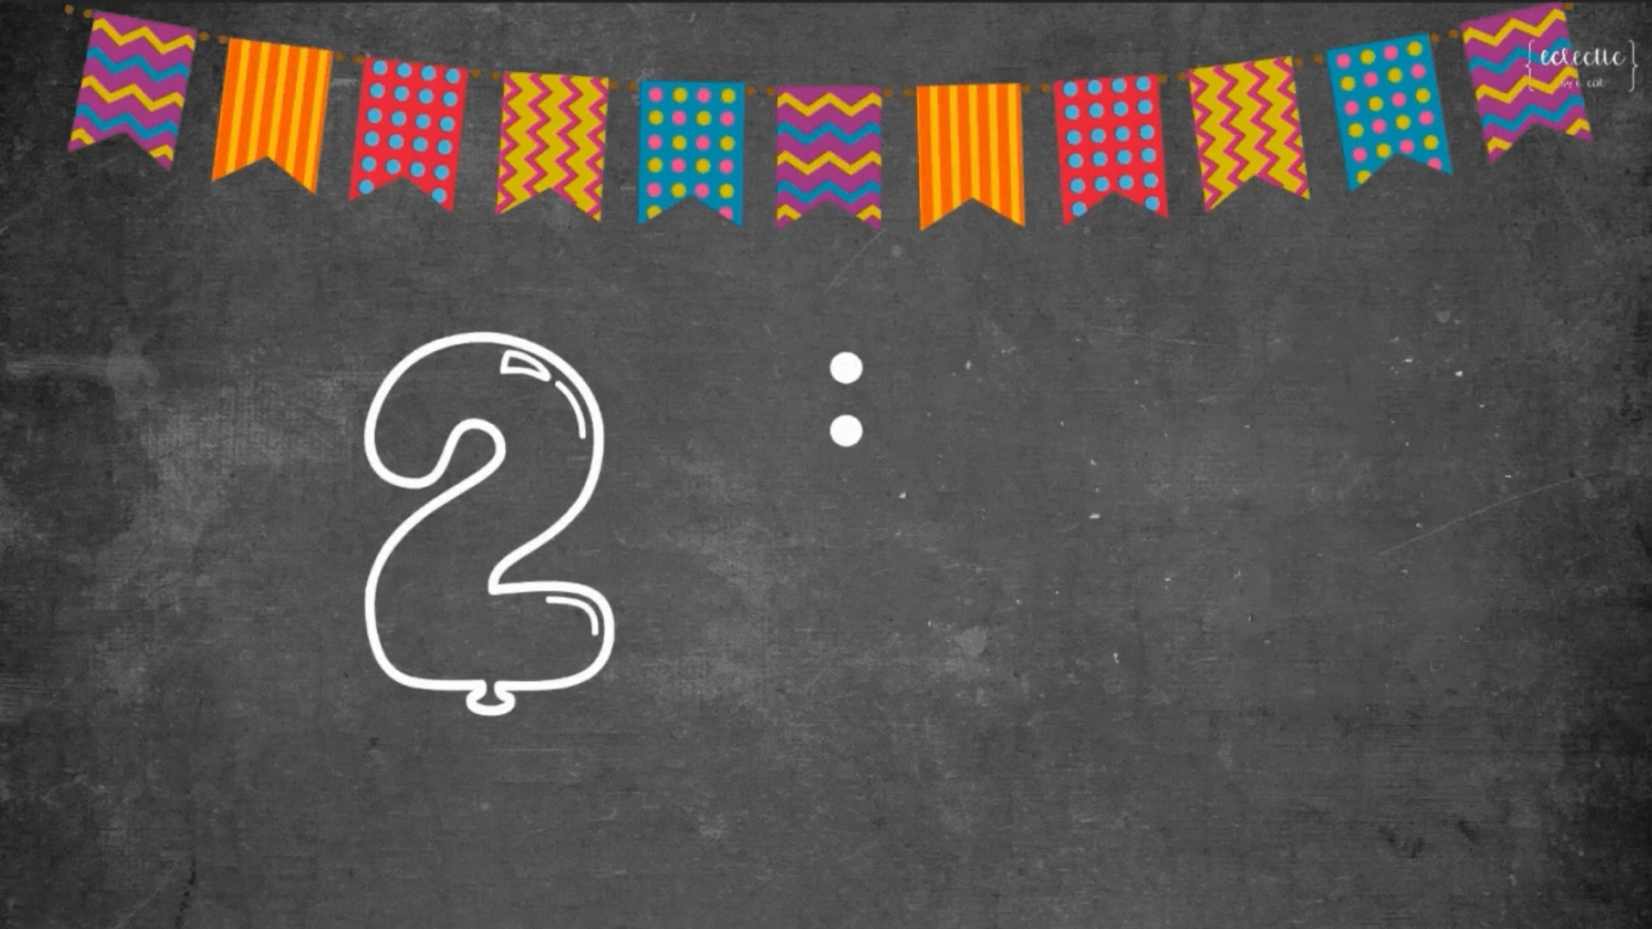
Ex 4. (p 57) Make notes about the eating habits in your area.
 | Time | Food and drink
Breakfast
Lunch
Dinner
Bread, noodle, milk, coffee, pho
6.30 am
Sticky rice, juice,
coffee
11.30 am
Rice, vegetables, fish, meat, tea
7 pm

Slide 21
Ex 5. (p 57) Answer these questions.
1. How many meals do you eat daily?
2. What do you have for breakfast, lunch and dinner?
3. What time do you have breakfast, lunch and dinner?
4. Do you eat anything before the main meals?
5. How many servings of fruits and vegetables do you have per day?
......

Slide 22
Ex 5. (p 57) Write a paragraph of about 70 words about the eating habits in your area. Use the information in 4 to help you.
Example:
People in my city love delicious food and they usually eat three meals a day including breakfast, lunch, and dinner. At around 6.30 a.m, they usually have a light breakfast with a bowl of pho or bread. Some people eat a bowl of instant noodles and drink a cup of coffee before going to work. Lunch usually starts around 11.30 a.m. They usually have a plate of fried rice and drink juice for lunch. Dinner usually starts at 18:00 with rice, lots of vegetables, some meat and fish. Then they usually have some fruit and some tea.

Slide 23
PEER CHECK
Criteria | Yes | No
1. Are the verbs in the correct form?
2. Are the nouns in the correct form?
3. Is the spelling correct?
4. Has the paragraph answered all questions?

Slide 24

recap
Circle the correct answer.
1. What skills have you leant today?
A. Speaking and Writing
B. Reading and Writing
C. Listening and Writing
2. What content have you leant today?
A. Eating habits
B. Dining table rules
C. Diet plans

Slide 25
Thank you!

