Slide 1


TRƯỜNG THCS LONG BIÊN
BÀI GIẢNG ĐIỆN TỬ MÔN TIẾNG ANH 7
UNIT 5: FOOD AND DRINK
LESSON 5: SKILLS 1
GV: Trần Thị Liên
Tổ NK-NN

Slide 2

Unit 5.
Food and
Drink
Lesson 5. Skills 1
DELICIOUS!

Slide 3

Objectives
By the end of this lesson, Ss will be able to:
Develop their reading skill for specific information about food and drink.
Talk about the popular food and drink.

Slide 4
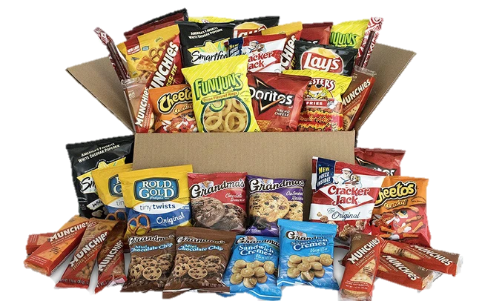
Vocabulary
snack (n)
/snæk/
đồ ăn vặt

Slide 5
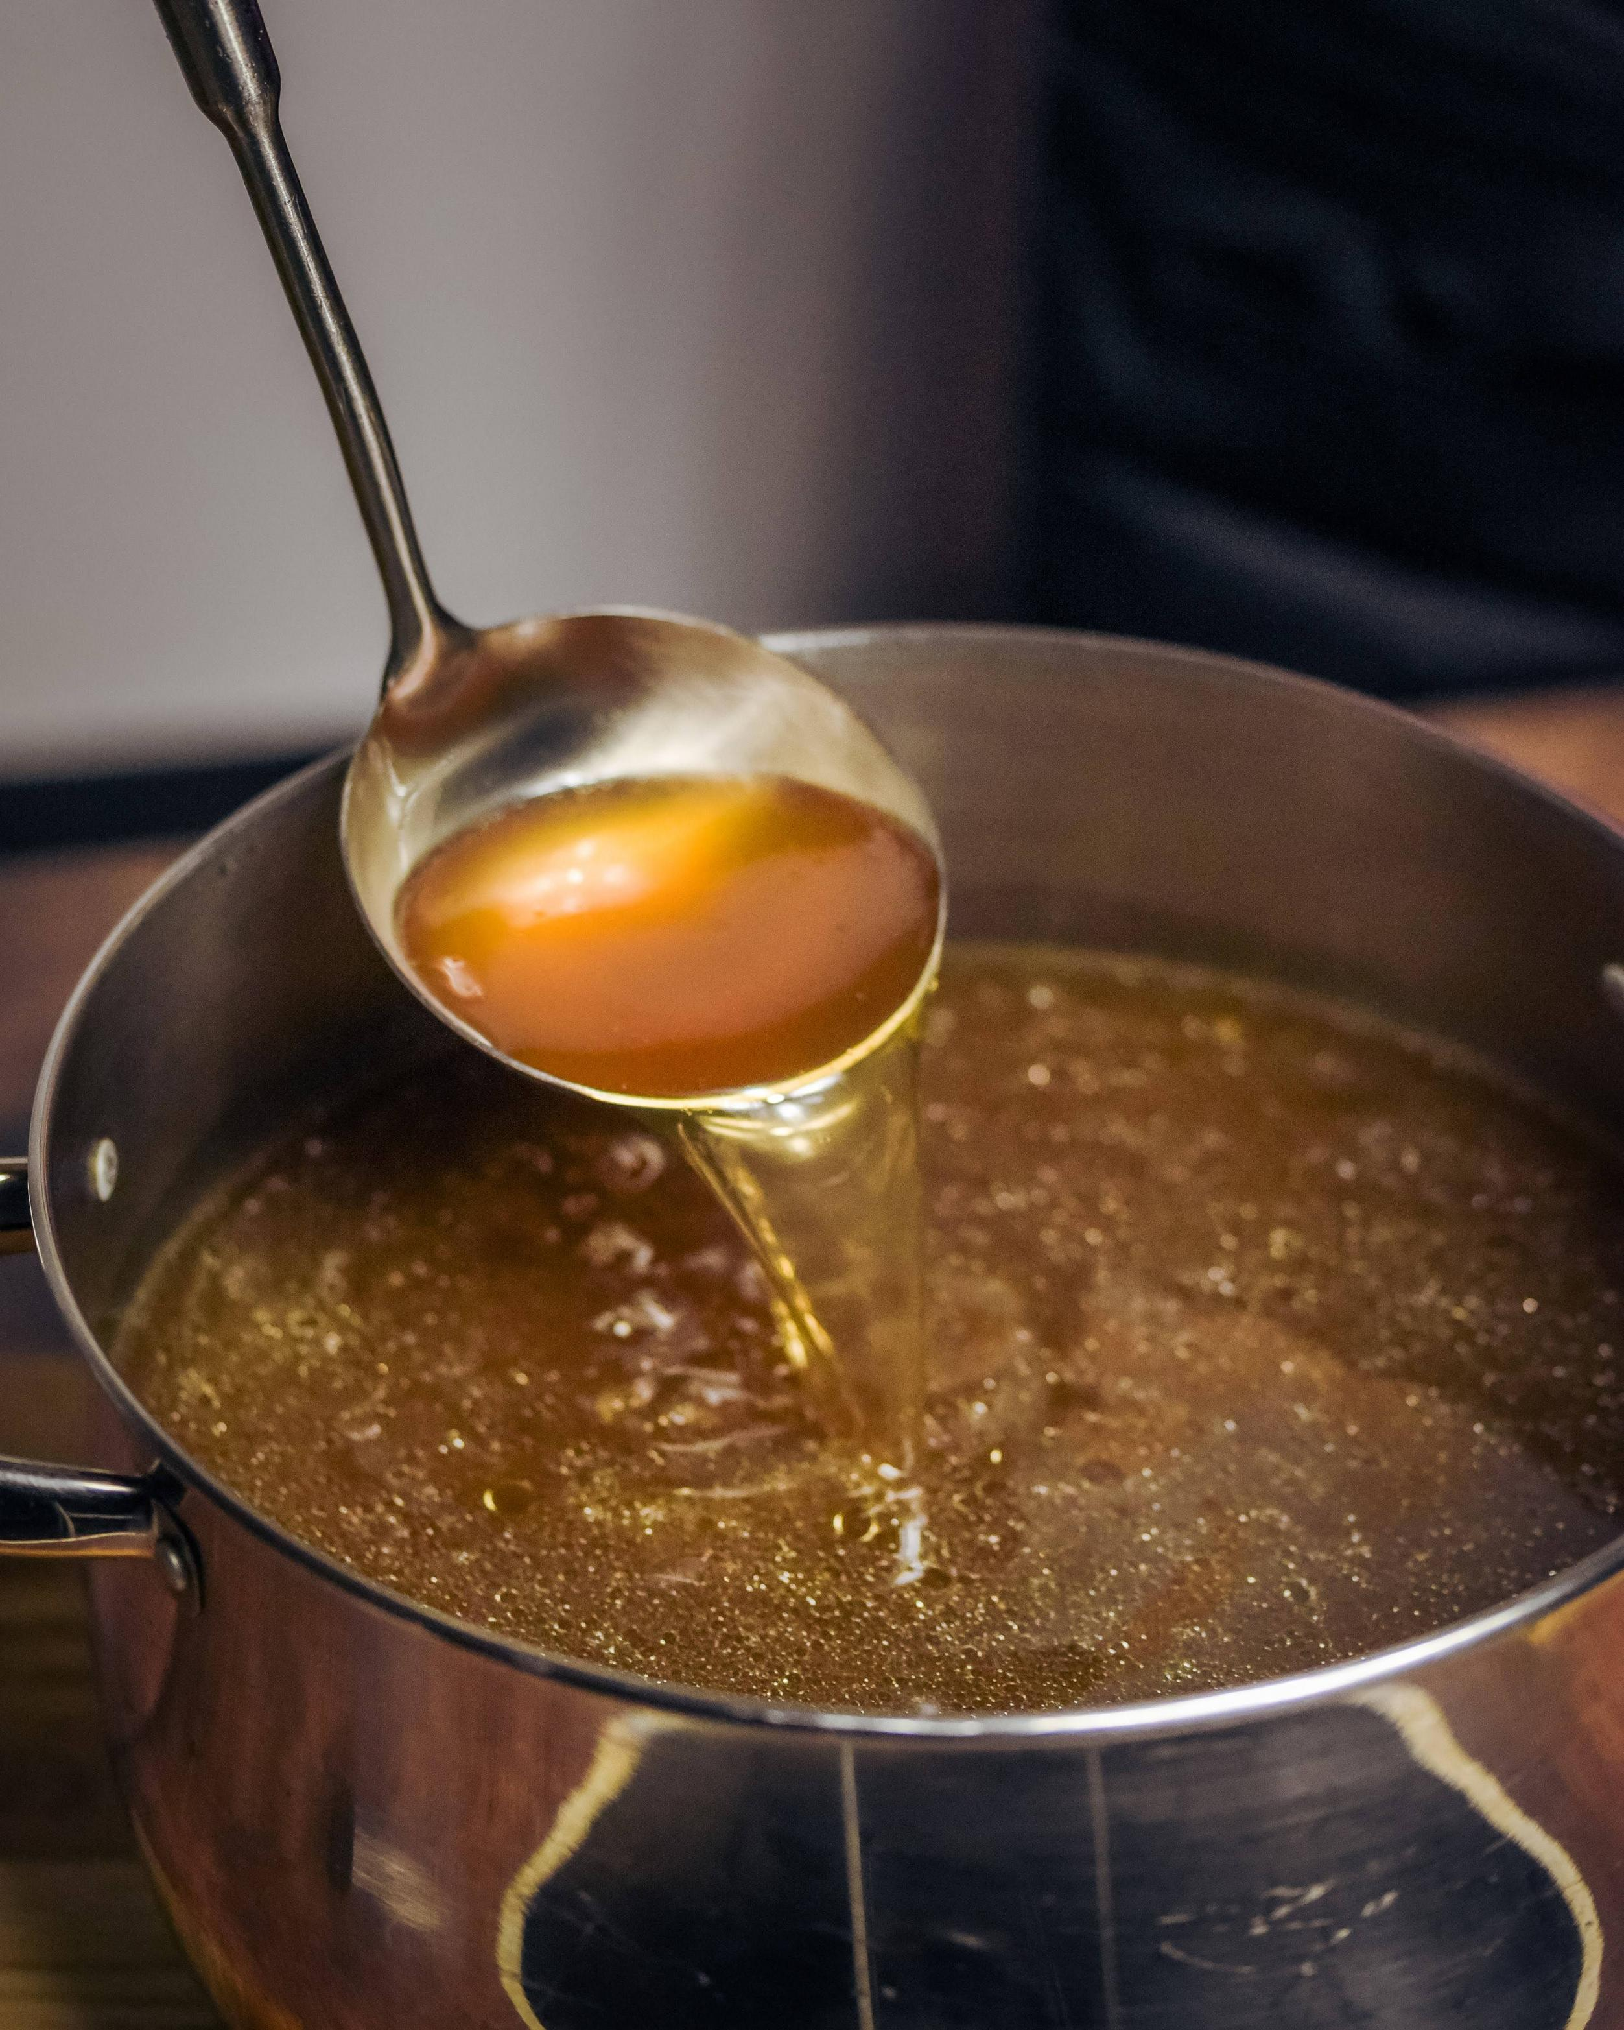
Vocabulary
broth (n)
/brɒθ/
nước lèo

Slide 6
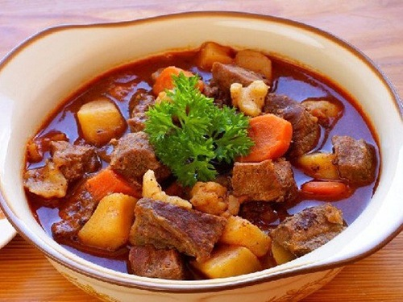
Vocabulary
stew (v,n)
/stjuː/
hầm

Slide 7
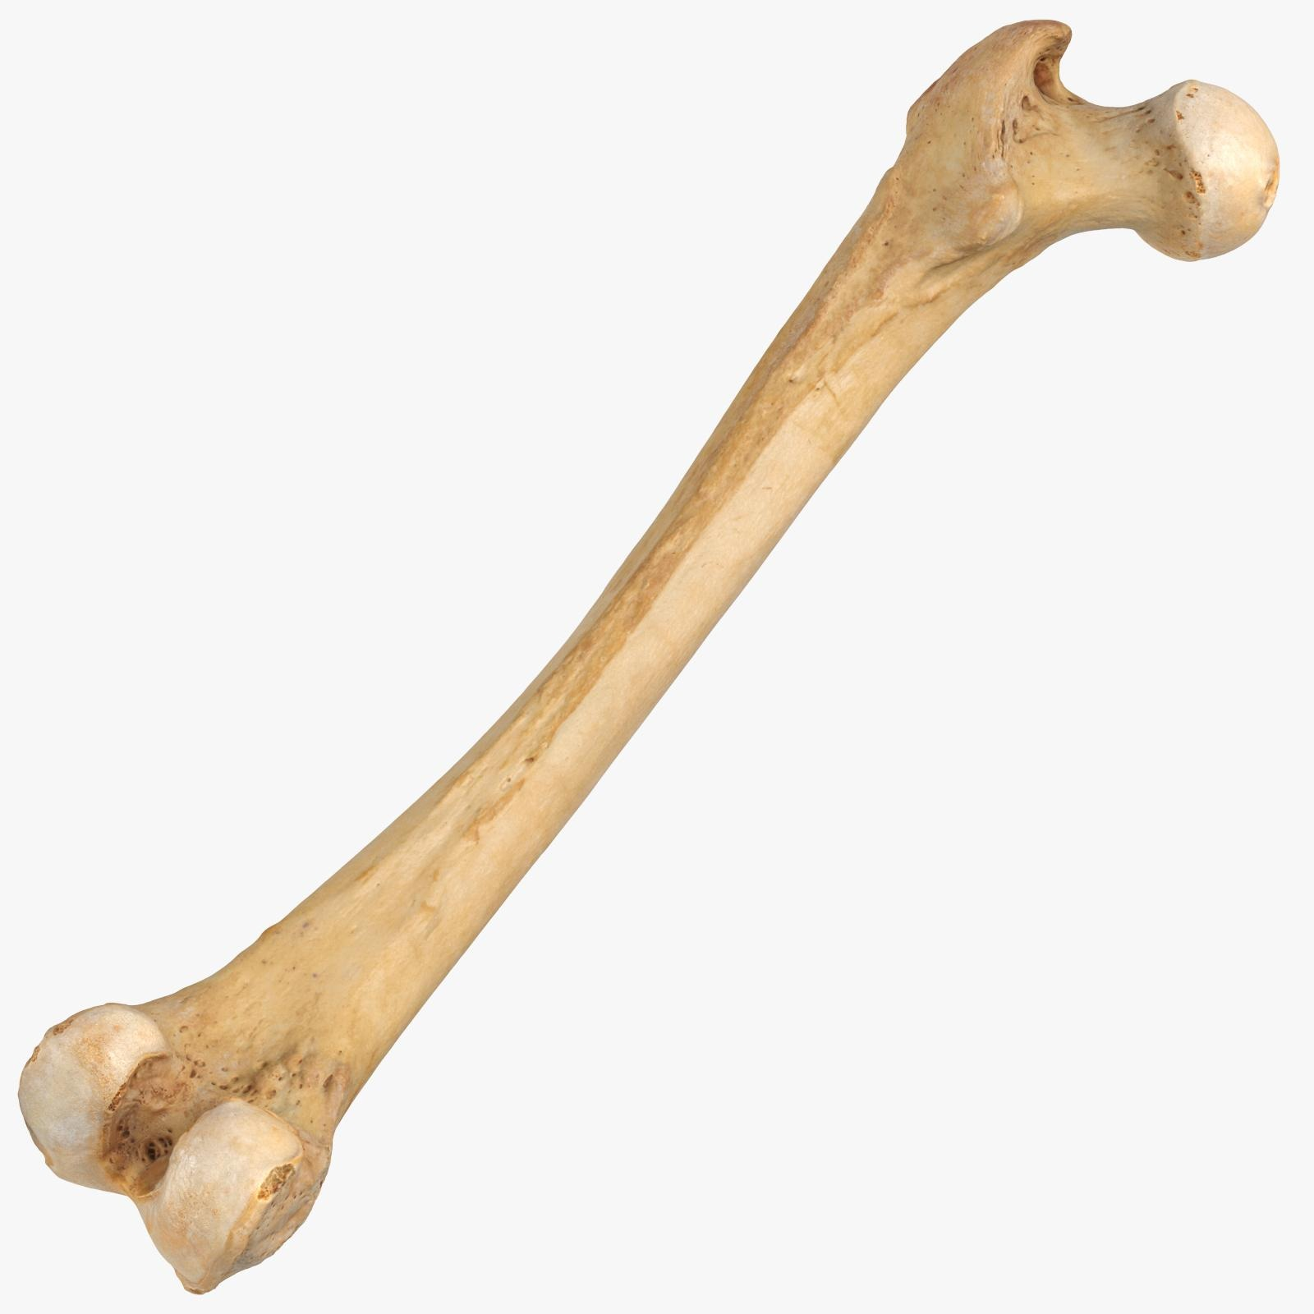

Vocabulary
boneless (n)
/ˈbəʊnləs/
không xương

Slide 8
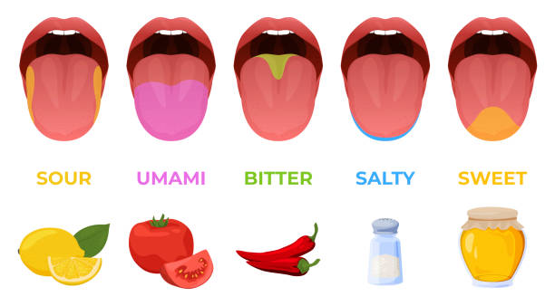
Vocabulary
taste (n)
/teɪst/
vị

Slide 9

Vocabulary
in a hurry
/ɪn ə ˈhʌri/
vội vàng

Slide 10

Vocabulary
slices (n)
/ ˈslaɪsɪz/
lát

Slide 11
Vocabulary
Example:
The meat served with pho is boneless and cut into thin slices.
served with (v.p)
/sɜːvd wɪð/
ăn kèm với

Slide 12

Vocabulary
delicious (adj)
/dɪˈlɪʃəs/
ngon

Slide 13
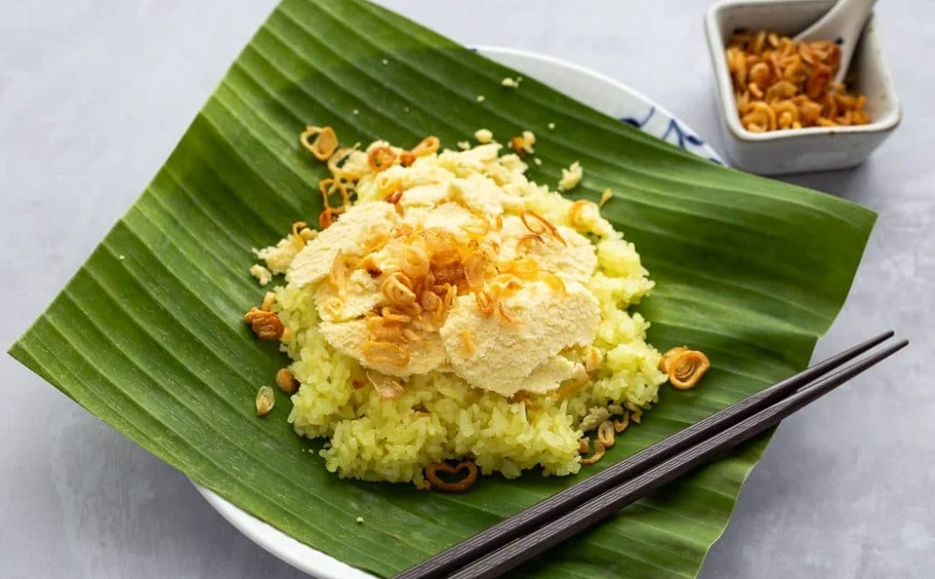
Vocabulary
sticky rice (n)
/ˈstɪki/ /raɪs/
xôi

Slide 14



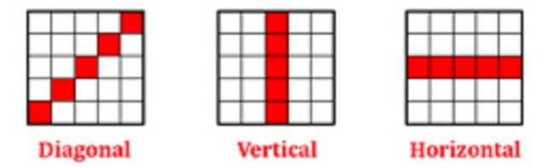
Materials:
A list of new words in Vocaburaly.
10 strips of paper for calling out words mixed in a box.
Winning partens.

Slide 15
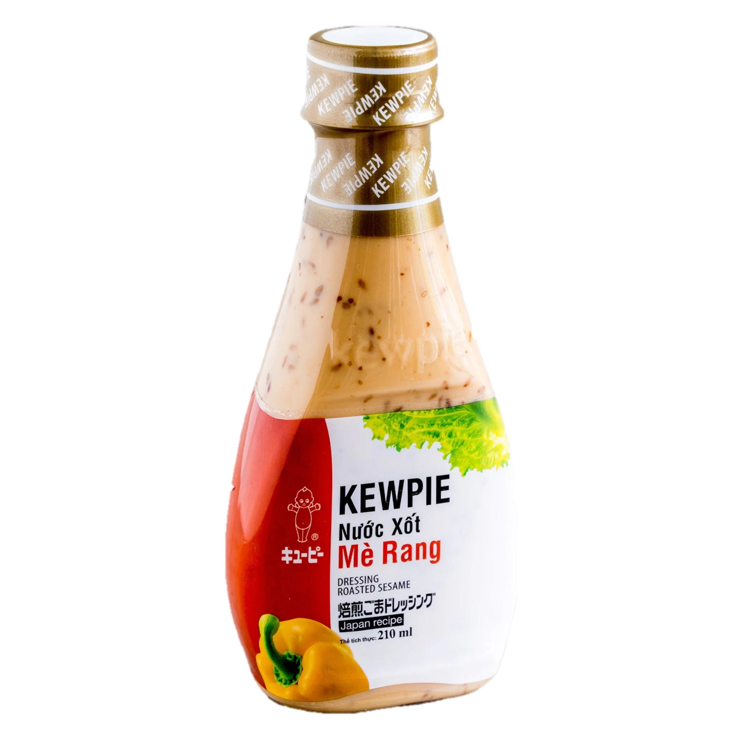
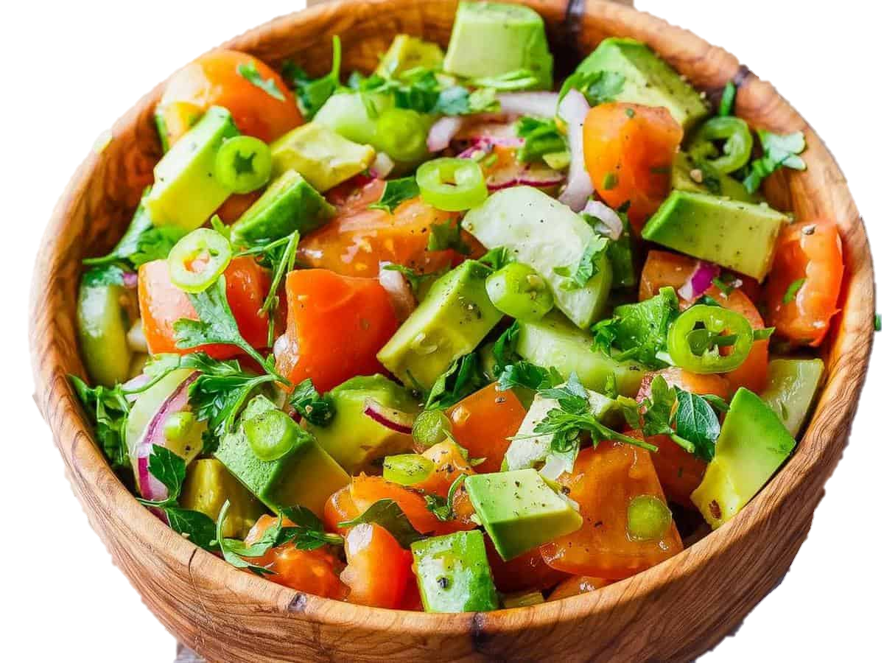
sticky rice | serve with | slices
snack | stew | in a hurry
boneless | taste | delicious

Slide 16
READING
“BEEF NOODLE SOUP”
DO YOU LIKE BEEF NOODLE SOUP?

Slide 17
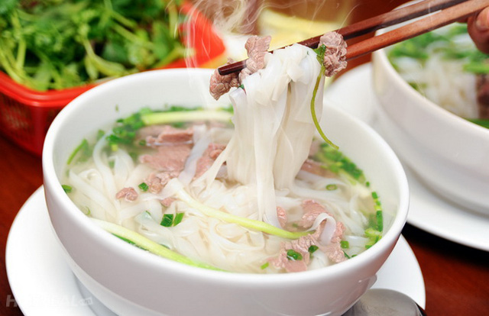
Ex 1. (p 56) Work in pairs. Discuss the following questions.
1. Is pho popular in your neighbourhood?
→ Yes, it is.
2. When can we have pho?
→ We have it in the morning.
3. What are the main ingredients of pho?
→ The main ingredients of pho are noodle beef or chicken.

Slide 18
Ex 2. (p 56) Read Phong’s blog.
Pho is a special kind of traditional Vietnamese dish. Its main ingredients are rice noodles and slices of beef or chicken. It is one of the most common dishes you will find in Viet Nam. People enjoy pho at all times of the day, even for a late-night snack. Pho has a very special taste. The rice noodles are made from the best kind of rice. There are two main kinds of pho: pho bo (beef noodle soup) and pho ga (chicken noodle soup). The broth for pho is made by stewing beef or chicken bones for a long time in a big pot. The meat (beef and chicken) served with pho is boneless and cut into thin slices ... It's really delicious! Tell me about a popular dish in your area!
Posted by Phong on Feb 22 at 5.30 p.m.

Slide 19

Ex 2. (p 56) Match the words with theirs meaning.
a. cooking something slowly, often in water
1. snack
2. taste
b. the flavour of something
c. soup made by boiling bones, meat, etc, and vegetables in water
3. broth
4. stewing
d. a small meal, usually eaten in a hurry
5. boneless
e. without bones

Slide 20
Ex 2. (p 56) Read Phong’s blog again.
Pho is a special kind of traditional Vietnamese dish. Its main ingredients are rice noodles and slices of beef or chicken. It is one of the most common dishes you will find in Viet Nam. People enjoy pho at all times of the day, even for a late-night snack. Pho has a very special taste. The rice noodles are made from the best kind of rice. There are two main kinds of pho: pho bo (beef noodle soup) and pho ga (chicken noodle soup). The broth for pho is made by stewing beef or chicken bones for a long time in a big pot. The meat (beef and chicken) served with pho is boneless and cut into thin slices ... It's really delicious! Tell me about a popular dish in your area!
Posted by Phong on Feb 22 at 5.30 p.m.
Pho is a special kind of traditional Vietnamese dish. Its main ingredients are rice noodles and slices of beef or chicken. It is one of the most common dishes you will find in Viet Nam. People enjoy pho at all times of the day, even for a late-night snack. Pho has a very special taste. The rice noodles are made from the best kind of rice. There are two main kinds of pho: pho bo (beef noodle soup) and pho ga (chicken noodle soup). The broth for pho is made by stewing beef or chicken bones for a long time in a big pot. The meat (beef and chicken) served with pho is boneless and cut into thin slices ... It's really delicious! Tell me about a popular dish in your area!
Posted by Phong on Feb 22 at 5.30 p.m.
Example:
The broth for pho is made by slowly cooking beef or chicken bones.
→ is made by (v.p):
/ɪz meɪd baɪ/
được nấu bằng cách

Slide 21
Ex 3. (p 56) Circle the correct answer.
1. The text is mainly about ____. A. pho, a popular dish in Viet Nam B. popular dishes in Viet Nam C. different ways to cook pho 2. Pho is made mainly with ____. A. rice noodles and beef or chicken B. rice, pork, and vegetables C. fish, shrimp, and noodles 3. We enjoy pho ____. A. only for breakfast B. for lunch and dinner C. at any time of the day | 4. To make noodles for pho, we use ____. A. a variety of sticky rice B. the best kind of rice C. eggs and rice flour 5. The broth for pho is made by ____. A. slowly cooking beef or chicken bones B. cooking beef or chicken with fish sauce C. boiling potatoes and chicken bones for a long time
1. The text is mainly about ____.
4. To make noodles for pho, we use ____.
2. Pho is made mainly with ____.
5. The broth for pho is made by ____.
3. We enjoy pho ____.

Slide 22

Ex 3. (p 56) Circle the correct answer.
1. The text is mainly about ____.
A. pho, a popular dish in Viet Nam
B. popular dishes in Viet Nam
C. different ways to cook pho
→ Pho is a special kind of traditional Vietnamese dish.

Slide 23
Ex 3. (p 56) Circle the correct answer.
2. Pho is made mainly with ____.
A. rice noodles and beef or chicken
B. rice, pork, and vegetables
C. fish, shrimp, and noodles
→ Its main ingredients are rice noodles and slices of beef or chicken.

Slide 24
Ex 3. (p 56) Circle the correct answer.
3. We enjoy pho ____.
A. only for breakfast
B. for lunch and dinner
C. at any time of the day
→ People enjoy pho at all times of the day, even for a late-night snack.

Slide 25
Ex 3. (p 56) Circle the correct answer.
4. To make noodles for pho, we use ____.
A. a variety of sticky rice
B. the best kind of rice
C. eggs and rice flour
→ The rice noodles are made from the best kind of rice.

Slide 26
Ex 3. (p 56) Circle the correct answer.
5. The broth for pho is made by ____.
A. slowly cooking beef or chicken bones
B. cooking beef or chicken with fish sauce
C. boiling potatoes and chicken bones for a long time
→ The broth for pho is made by stewing beef or chicken bones for a long time in a big pot.

Slide 27
SPEAKING
What is ‘pho’ for Vietnamese people?
typical food

Slide 28
Ex 4. (p 56) Make notes:
A popular food or drink in your area.
Its main ingredients.
How often and when you have it.
FOOD OR DRINK | INGREDIENTS | HOW OFTEN AND WHEN
Pho | Rice noodles Slices of beef or chicken Broth of stewing beef or chicken bones Chilies Lime Onion | For breakfast, lunch, and dinner.

Slide 29
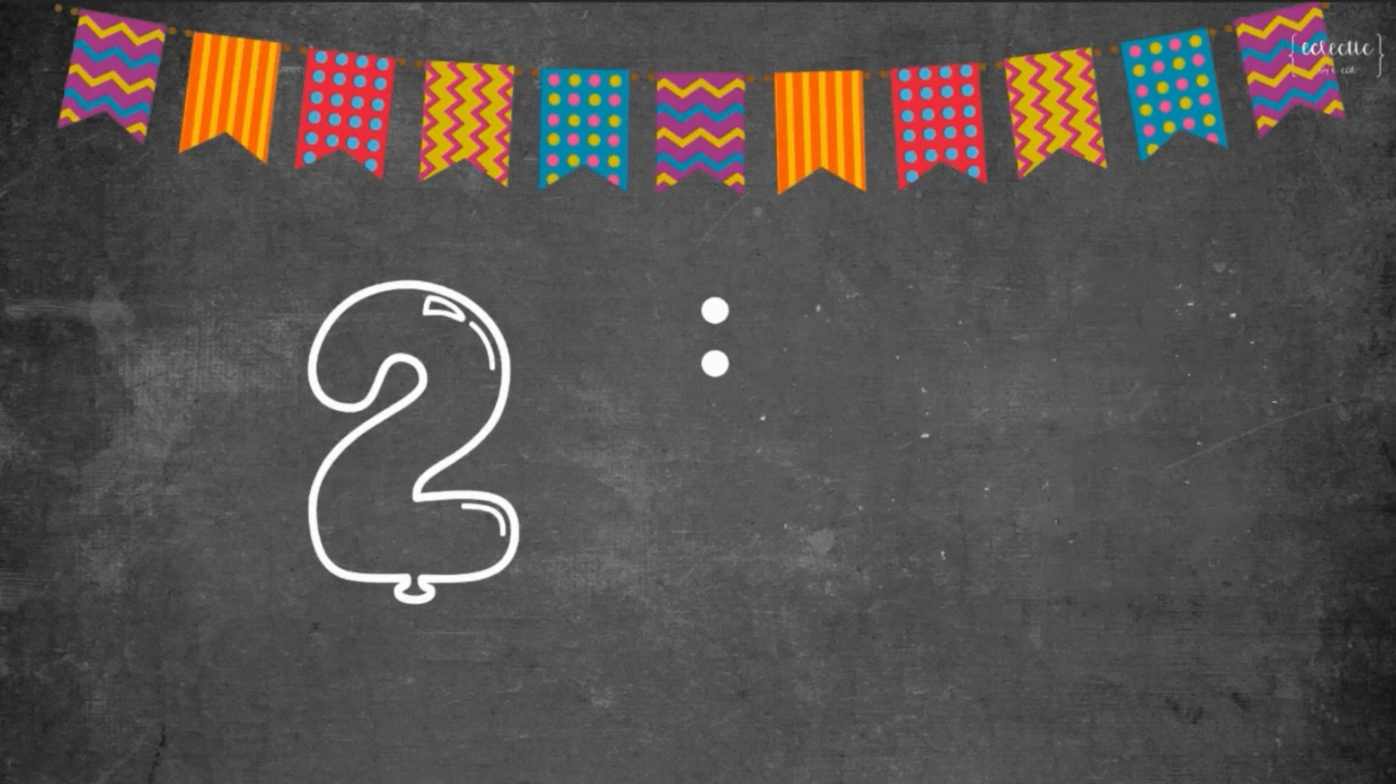
Ex 4. (p 56) Make notes:
A popular food or drink in your area.
Its main ingredients.
How often and when you have it.
FOOD OR DRINK | INGREDIENTS | HOW OFTEN AND WHEN

Slide 30

Ex 5. (p 56) Work in groups of 3 or 4. Take turns to talk about a popular food or drink in your area.
YUMMY!
Presentation
Did he/she talk enough ideas?
Did he/she use correct verb tenses?
Did he/she pronounce the words correctly?

Slide 31
RECAP
Answer these questions.
1. What foods drinks are popular in Vietnam?
→ Beef noodle soup, chicken noodle soup, banh mi, sticky rice, spring rolls, chung cake, bun cha, xeo cake, bun rieu,….
2. What ingredients does pho have?
- Rice noodle.
- Slices of boneless beef or chicken.
- The broth for pho is made by stewing beef or chicken bones.

Slide 32
THANK YOU!
YUMMY!

