Slide 1


TRƯỜNG THCS LONG BIÊN
BÀI GIẢNG ĐIỆN TỬ MÔN TIẾNG ANH 7
UNIT 4: MUSIC AND ARTS
LESSON 3: A CLOSER LOOK 2
GV: Trần Thị Liên
Tổ NK-NN

Slide 2
Unit 4
Music and Arts
Grade 7
Lesson 3: A closer look 2

Slide 3




Making comparisons
Robert
Mary
Bob
Robert’s pencil case
Mary’s
pencil case
Bob’s
pencil case

Slide 4

different from
Mary’s
pencil case
Bob’s
pencil case
Mary’s pencil case is different from Bob’s pencil case.
If two things are not similar, we use different from.
S
to be / verb
different from
N/ pronoun

Slide 5
like
Robert’s pencil case is like Mary’s pencil case.
Robert’s pencil case
Mary’s
pencil case
Robert’s pencil case is not like Bob’s pencil case.
Robert’s pencil case
Bob’s
pencil case
We can also use like to compare.
S
to be/ verb
like
N/ pronoun

Slide 6




(not) as … as
The red pencil is not as long as (shorter) the orange pencil.
The red pencil is as long as the green pencil.
The red pencil is not as long as (longer) the yellow pencil.
S
to be (not)
as adj as
N/ pronoun
as + adjective + as to show that two things are similar.
not as + adjective + as to show that sth is "more" or "less" than sth else.

Slide 7
Ex 1. Write like, as, or different in the gaps. (p.43)
1. This camera is not as expensive ______ I thought at first.
2. Her room is lovely. It is ______ a princess's room.
3. You like folk songs; I like pop music. Your taste is ______ from mine.
4. My dad is not always as busy ______ my mum.
5. Some of us think that Spiderman 2 is not too _________ from Spiderman 1.
1. This camera is not as expensive ______ I thought at first.
2. Her room is lovely. It is ______ a princess's room.
3. You like folk songs; I like pop music. Your taste is _________ from mine.
4. My dad is not always as busy ______ my mum.
5. Some of us think that Spiderman 2 is not too _________ from Spiderman 1.
as
like
different
as
different

Slide 8

Ex 2. Finish the second sentence in each pair, using like, as... as, or different from. (p.43)
1. Rock is very exciting. It is not like country music.
→ Rock is very ____________________ country music.
2. Composer Hoang Long wrote many good songs for children. Composer Pham Tuyen also wrote many good songs for children.
→ Composer Hoang Long, ____________________ Pham Tuyen, wrote many good songs for children.
3. The Vatican Museum has excellent works of art. The Louvre Museum has excellent works of art too.
→ The Vatican Museum's works of art are ______ excellent ______ the Louvre Museum's works of art.
4. A vacation on the beach is relaxing, while a vacation in a big city may not be.
→ A vacation on the beach is ____________________ a vacation in a big city.
5. City life is busy, but country life is peaceful.
→ City life is not _____ peaceful _____ country life.

Slide 9
Check your answers.
1. Rock is very exciting. It is not like country music.
→ Rock is very ____________________ country music.
1. Rock is very exciting. It is not like country music.
→ Rock is very ____________________ country music.
is not like = different from
different from
2. Composer Hoang Long wrote many good songs for children. Composer Pham Tuyen also wrote many good songs for children.
→ Composer Hoang Long, ____________________ Pham Tuyen, wrote many good songs for children.
2. Composer Hoang Long wrote many good songs for children. Composer Pham Tuyen also wrote many good songs for children.
→ Composer Hoang Long, ____________________ Pham Tuyen, wrote many good songs for children.
Hoàng Long & Phạm Tuyên are famous composers from Viet Nam. They have composed a lot of good songs for children.
like

Slide 10
Check your answers.
3. The Vatican Museum has excellent works of art. The Louvre Museum has excellent works of art too.
→ The Vatican Museum's works of art are excellent ____________________ the Louvre Museum's works of art.
• The Vatican Museum: art museum in the Vatican City.
• The Louvre Museum (or the Louvre): the world's largest art museum in Paris, France.
3. The Vatican Museum has excellent works of art. The Louvre Museum has excellent works of art too.
→ The Vatican Museum's works of art are _____ excellent _____the Louvre Museum's works of art.
as
as
4. A vacation on the beach is relaxing, while a vacation in a big city may not be.
→ A vacation on the beach is ________________ a vacation in a big city.
4. A vacation on the beach is relaxing, while a vacation in a big city may not be.
→ A vacation on the beach is ________________ a vacation in a big city.
different from
different from: khác biệt

Slide 11
Check your answers.
5. City life is busy, but country life is peaceful.
→ City life is not _____ peaceful _____ country life.
5. City life is busy, but country life is peaceful.
→ City life is not _____ peaceful _____ country life.
to be not as adj as:
không … bằng
as
as

Slide 12



Pick a box
Answer the question
Get a random prize below
The winning team has the most points
100
Blow friend’s point
Swap point
Your point

Slide 13

PICK A BOX
1
2
3
2
A
1
3
2
B

Slide 14
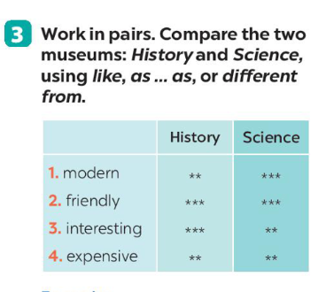

Making comparison
History museum Science museum
modern
History museum is
not as modern as Science museum.

Slide 15
Making comparison
History museum Science museum
friendly
History museum is as friendly as Science museum.

Slide 16
Making comparison
History museum Science museum
interesting
Science museum is not as interesting as History museum.

Slide 17
Making comparison
History museum Science museum
expensive
History museum is as expensive as Science museum.

Slide 18


Slide 20
Rewrite the sentences, using the words given at the beginning.
Example: A play is usually longer than a film.
→ A film is usually not as long as a play .
1. I think action films are more interesting than comedies.
→ I think comedies are not _____________________________
2. Our Maths homework is more difficult than our history homework.
→ Our history homework is not _____________________________
3. This year's music contest is different from last year’s.
→ This year's music contest is not _____________________________
4. The characters in the film are not the same as the ones in the play.
→ The characters in the film are _____________________________.
5. This picture is brighter than that picture.
→ That picture is not _____________________________.

Slide 21
Rewrite the sentences, using the words given at the beginning.
Example: A play is usually longer than a film.
→ A film is usually not as long as a play .
1. I think action films are more interesting than comedies.
→ I think comedies are not _____________________________
2. Our Maths homework is more difficult than our history homework.
→ Our history homework is not ____________________________________
3. This year's music contest is different from last year’s.
→ This year's music contest is not _____________________________
4. The characters in the film are not the same as the ones in the play.
→ The characters in the film are ___________________________________.
5. This picture is brighter than that picture.
→ That picture is not _____________________.
as interesting as action films.
as difficult as our maths homework.
like last year’s.
different from the ones in the play
as bright as this one

Slide 22
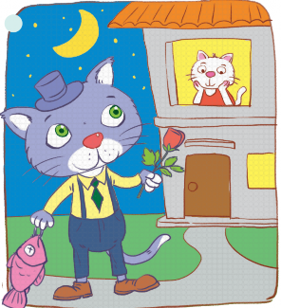
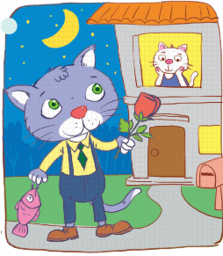
Ex 5. Work in groups. Look at the two pictures below.
Compare them, using like, as … as, or different from. (p.44)
A
SPEAKING
COMPETITION
B
Example:
- Picture A is not like / different from picture B.
- Picture A is not as big as picture B.

Slide 23
Recap
What structures did we learn today?
(not) as adj as
different from
the same as
is like

Slide 24
Recap
Tick the correct uses: like, (not) as…as and different from.
compare appearance or behaviour, we use ‘like’.
to show two things that are similar or different to each other.
‘like’ is followed by a noun or a pronoun.
‘(not) as…as’ is usually followed by from.
‘(not) so … as’ can be used instead of ‘(not) as … as’
in negative comparative form.

Slide 25
Homework
- Prepare for the next lesson
- Do Part B – Exercise 4,5,6,7 – pg 30

