Slide 1


TRƯỜNG THCS LONG BIÊN
BÀI GIẢNG ĐIỆN TỬ MÔN TIẾNG ANH 7
UNIT 4: MUSIC AND ARTS
LESSON 2: A CLOSER LOOK 1
GV: Trần Thị Liên
Tổ NK-NN

Slide 2
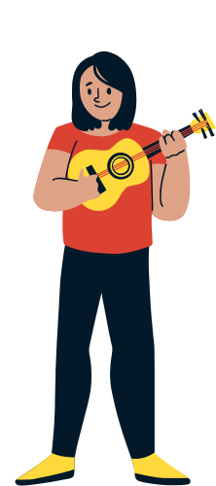



GUESSING GAME
Step 1
Listen to the sound
Step 2
Write the words
Notes:
To start with our lesson, let’s play a game together.
You’re going to hear the sounds of some instruments
Let see if you can name all of them.

Slide 3

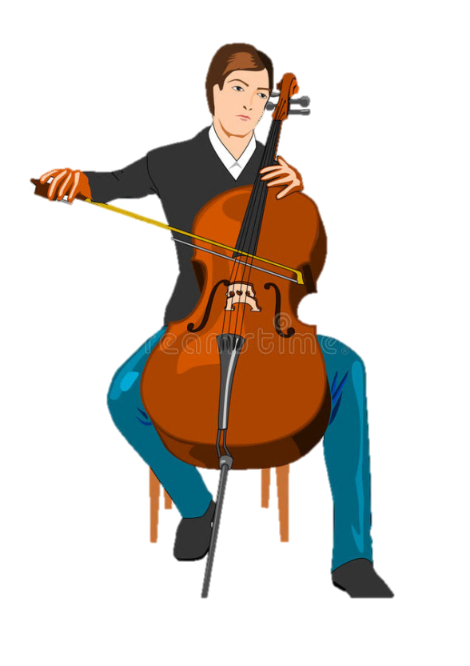



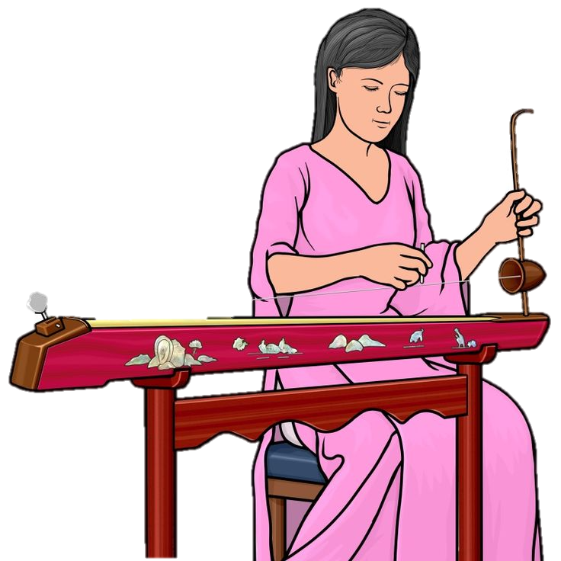


GUESSING GAME
r u m d
n o a i p
l l o e c
t r a u i g
l n i v i o
x o h o n e p a s
u a b n a d

Slide 4
CHECK YOUR ANSWERS
drum
piano
cello
guitar
violin
saxophone
Dan Bau

Slide 5




ENGLISH 7
UNIT 4
MUSIC AND ARTS
LESSON 2: A CLOSER LOOK 1
Notes:
Hello everyone, how are you doing?
I’m glad to see you in our English online course.
Today, we continue Unit 4, about Music and Arts, we’ll learn Lesson 2: A closer look 1.

Slide 6
TODAY’S LESSON
VOCABULARY
use lexical items related to the topic 'Music and Arts'
PRONUNCIATION
pronounce the sounds /ʃ/ and /ʒ/ correctly
in isolation and in context
Notes:
So, what does our lesson today include:
We have 2 main parts:
Vocab: We will lean how to use lexical items related to the topic 'Music and Arts’
And second part, we will learn how to pronoun the sounds /ʃ/ and /ʒ/ correctly in isolation and in context.

Slide 7
Activity 1 Listen and write the words.
1
2
3
4
5
6
7
8
Notes:
Matching acitivity – drag and drop – picture folder pictures

Slide 8
Activity 1 Check your answers.
art gallery
/ɑːt ’ɡæləri/
composer
/kəmˈpəʊzə/
concert hall
/ˈkɒnsət hɔːl/
musician
/mjuːˈzɪʃən/
actress
/ˈæktrɪs/
painter
/ˈpeɪntə/
artist
/ˈɑːtɪst/
puppet theater
/ˈpʌpɪt ˈθɪətə/
Notes:
Matching acitivity – drag and drop – picture folder pictures

Slide 9
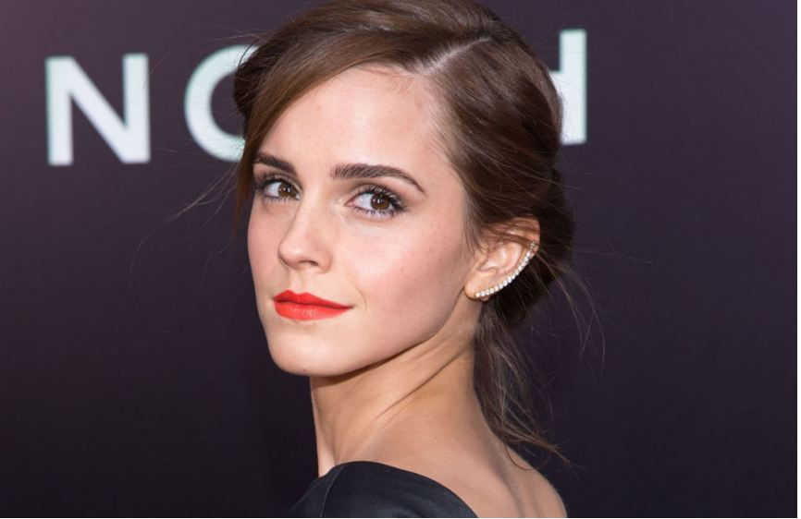
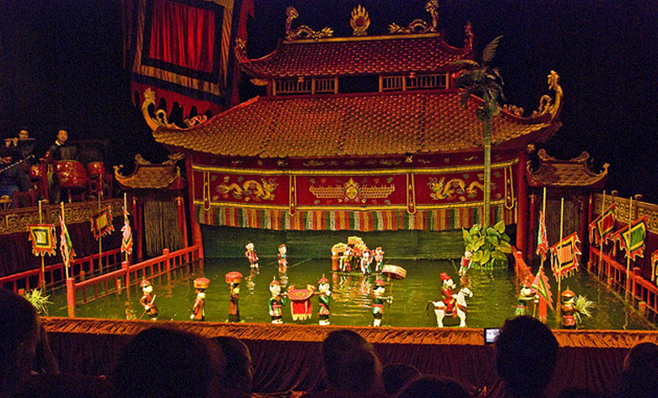
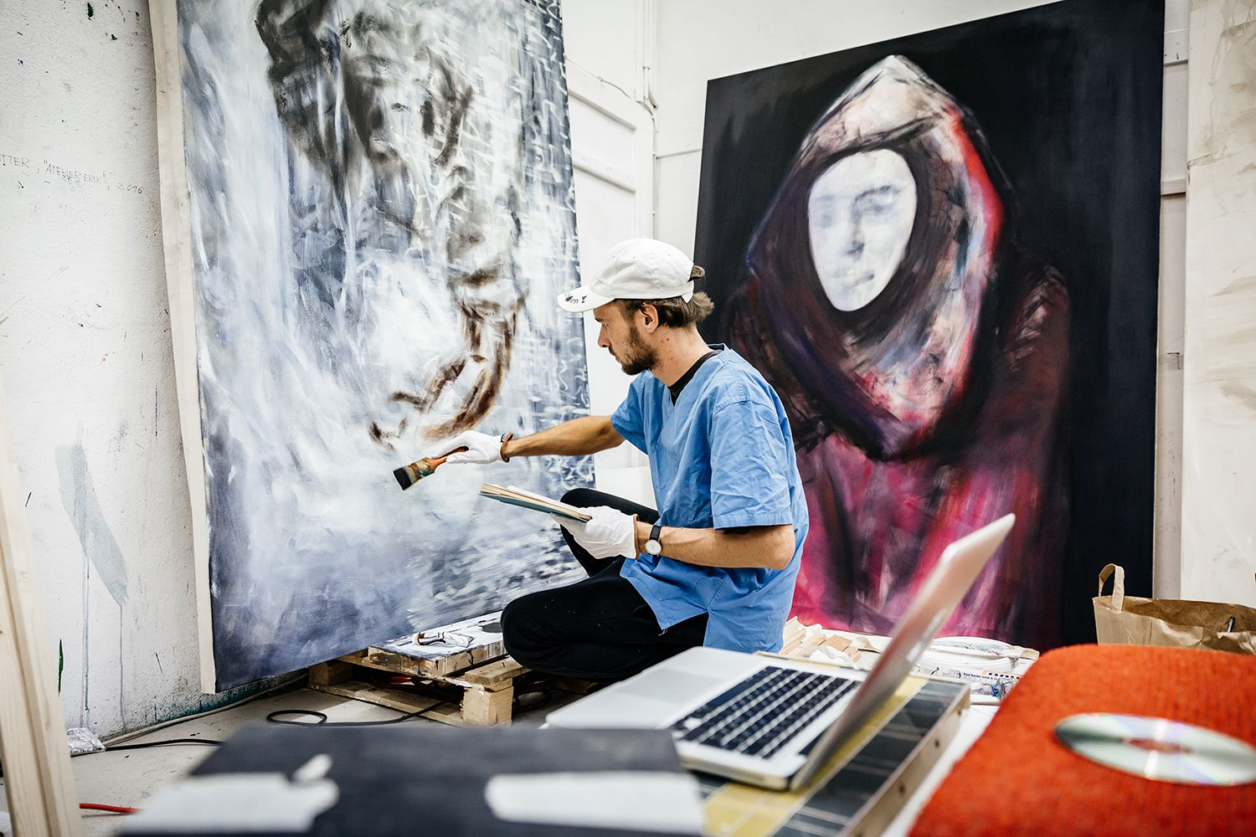
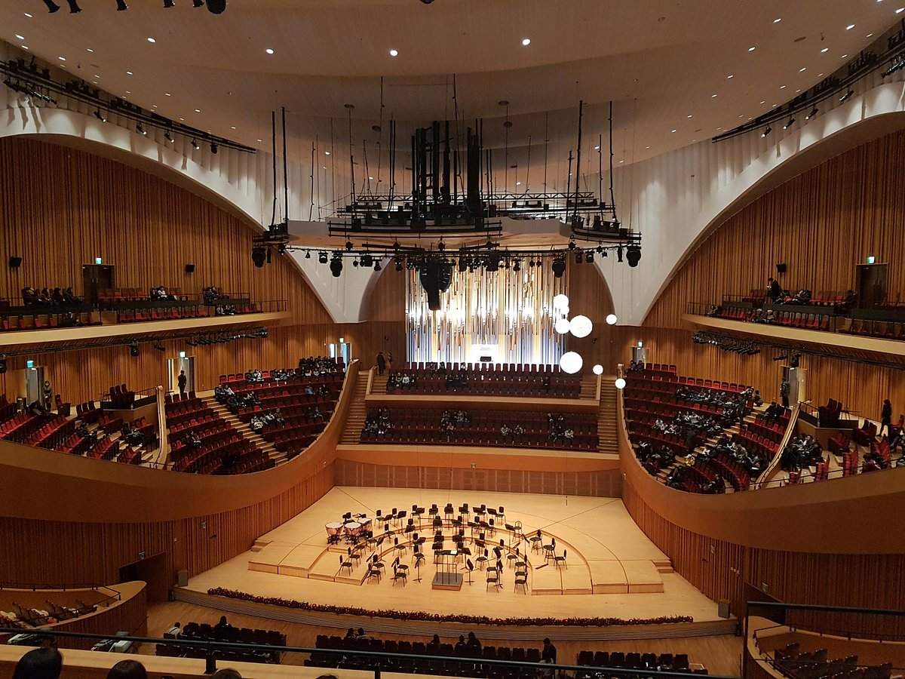
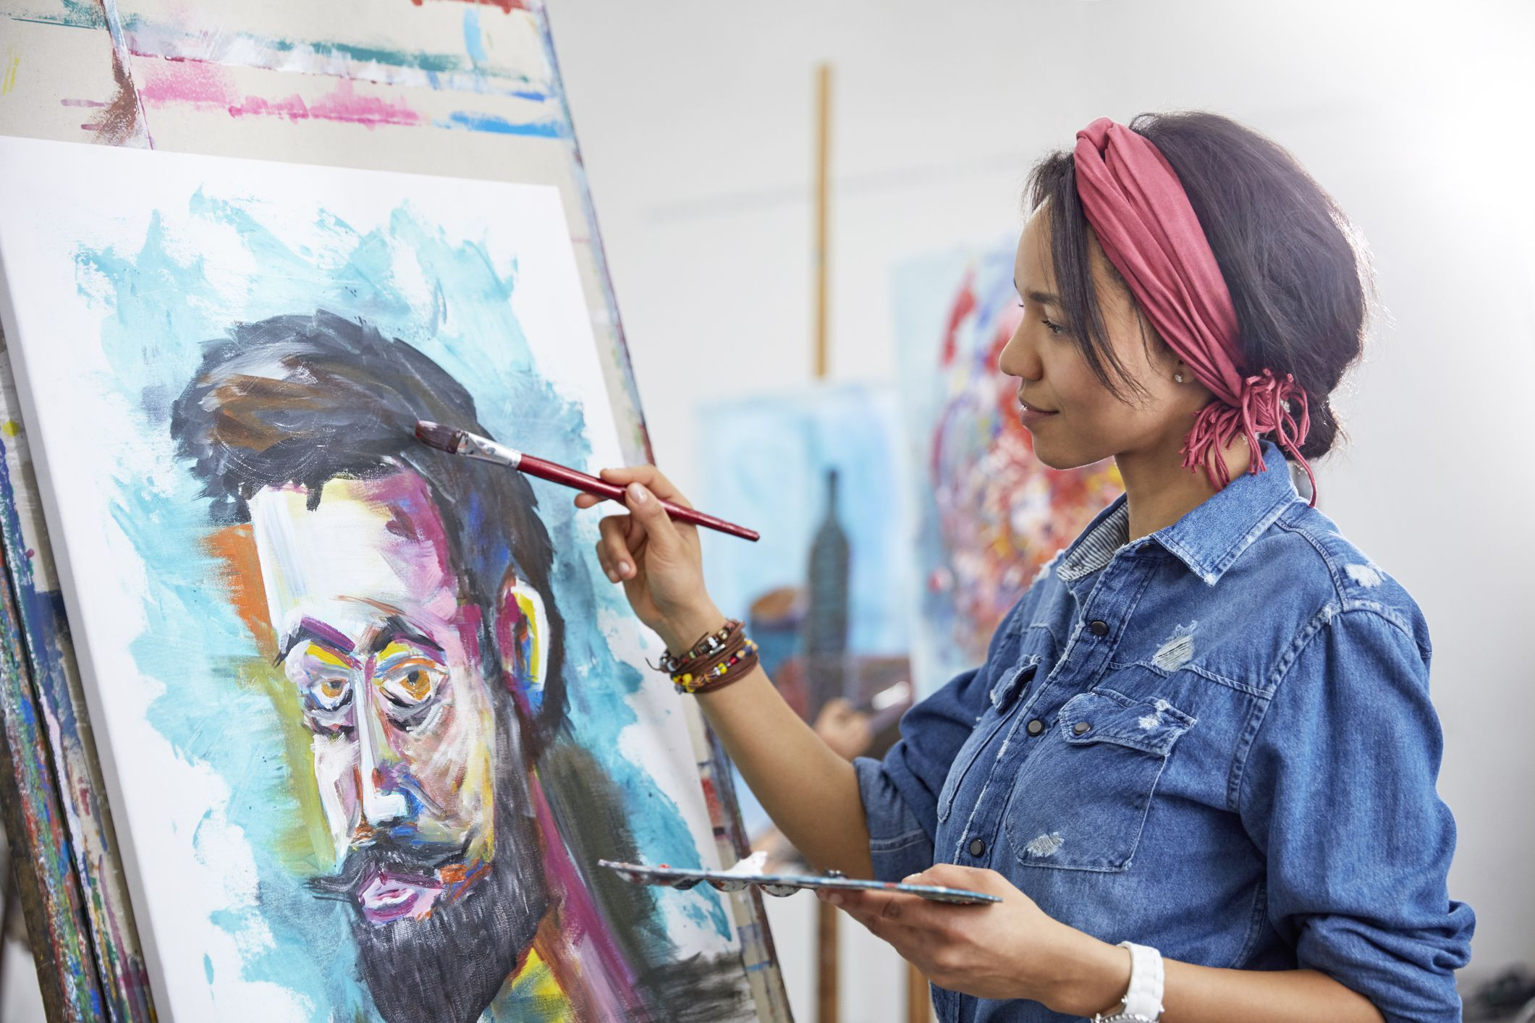
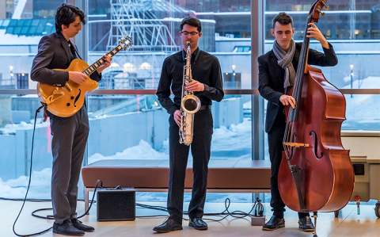
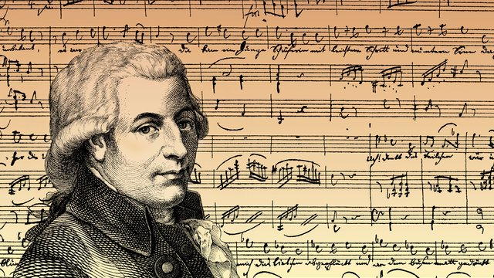
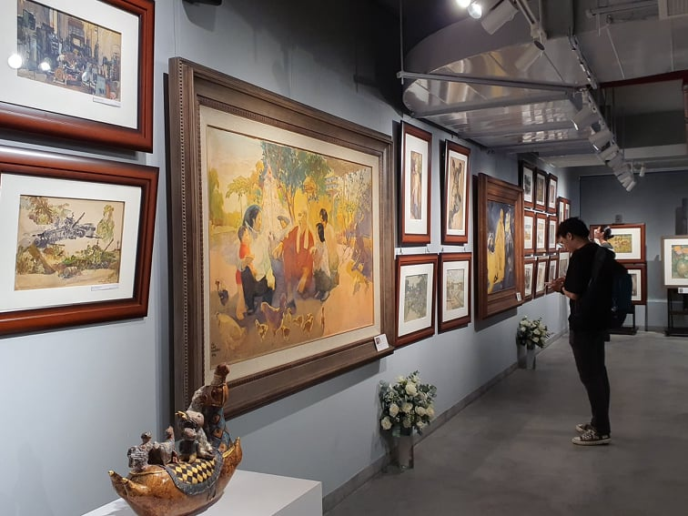
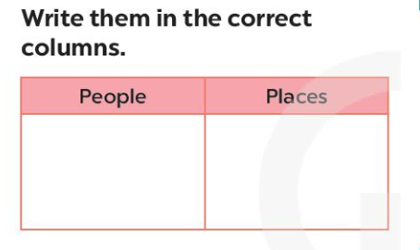
Activity 1 Work in pairs. Write them in the correct columns.
art gallery
composer
concert hall
musician
actress
painter
artist
puppet theater
People | Places
composer
art gallery
musician
concert hall
actress
puppet theater
painter
artist
Notes:
Matching acitivity – drag and drop – picture folder pictures

Slide 10
Activity 2 (p.42) Match a word in A with a word or phrase in B
1. compose
e. music
a. a show
2. paint
d. a portrait
b. a photo
3. perform
a. a show
c. the guitar
4. play
c. the guitar
d. a portrait
5. take
e. music
b. a photo
Notes:
Matching activity

Slide 11
Exercise 3 (p.42)
Underline the correct word or phrase to complete each sentence.
1. The little girl's drawing / photography of her kitten shows a lot of talent
2. Van Cao was a great Vietnamese scientist / composer. He was also a painter and poet.
3. The Louvre in Paris is the world's largest museum / puppet theater.
4. The orchestra will perform its final portrait / concert of the season tomorrow.
5. Did you see the film Amazon Jungle on TV last night? The photography / drawing was excellent.
Notes:
Write 1 word

Slide 12
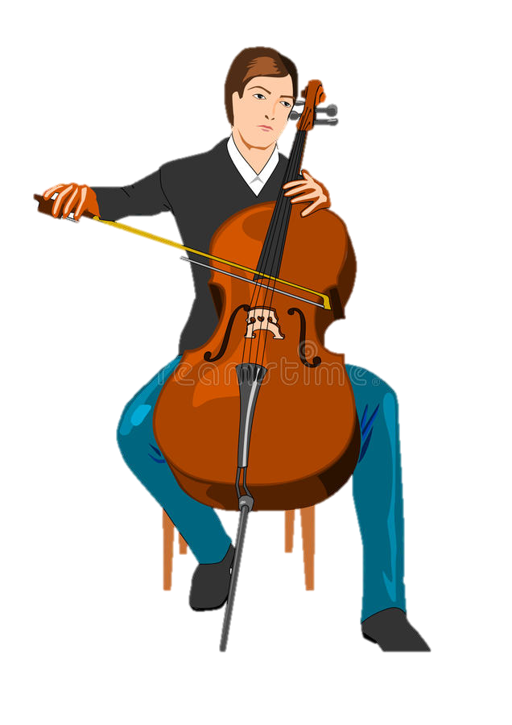
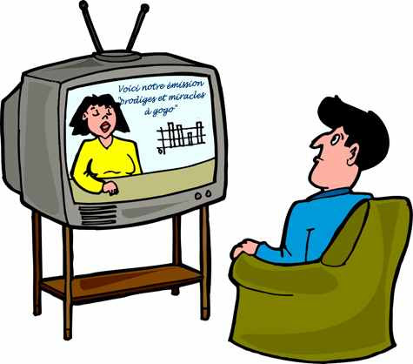
What are they doing?
c
The man is playing the cello.
The man is watching television.
s
/ʃ/
/ʒ/
Notes:
What are they doing? – Chỉnh lại thứ tự ra hình (theo cú click)

Slide 13
PRONUNCIATION
/ʃ/ and /ʒ/

Slide 14
musician | show | share | nation
television | visual | unusual | decision
Exercise 4 (p.42) Listen to the
words and put them in 2 groups
/ʃ/ | /ʒ/
Notes:
Listen and drop -

Slide 15
musician | show | share | nation
television | visual | unusual | decision
CHECK YOUR ANSWERS
/ʃ/ | /ʒ/
musician /mjuːˈzɪʃən/
television /ˈteləˌvɪʒən/
show /ʃəʊ/
visual /ˈvɪʒuəl/
share /ʃeə/
unusual /ʌnˈjuːʒuəl/
nation /ˈneɪʃən/
decision /dɪˈsɪʒən/
Notes:
Listen and drop -

Slide 16
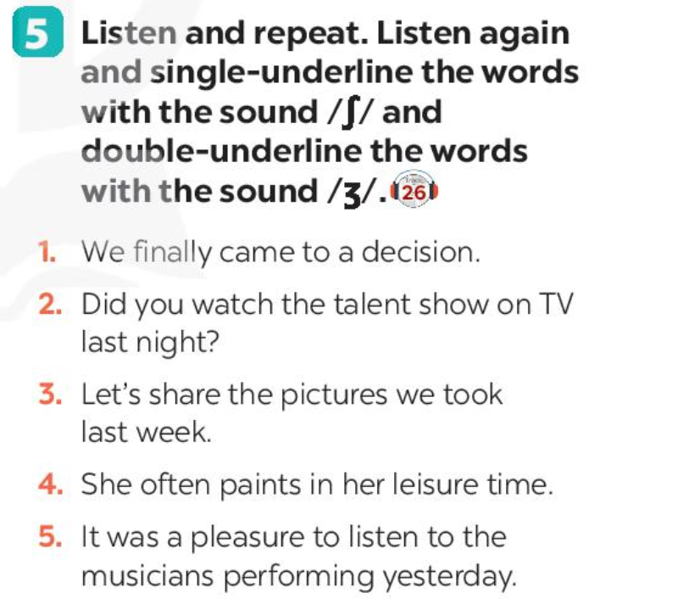
/ʃ/
Exercise 5 (p.42) Listen and underline
/ʒ/
1. We finally came to a decision.
2. Did you watch the talent show on TV last night?
3. Let's share the pictures we took last week.
4. She often paints in her leisure time.
5. It was a pleasure to listen to the musicians performing yesterday.
Notes:
Drag and drop

Slide 17
HOMEWORK
Learn all of the words by hear and make sentences using them
Practice saying the words and sentences in front of a mirror, record and then listen again
Do Part A – Exercise 1,2 in Workbook

