Slide 1


TRƯỜNG THCS LONG BIÊN
BÀI GIẢNG ĐIỆN TỬ MÔN TIẾNG ANH 7
UNIT 1: HOBBIES
LESSON 2: A CLOSER LOOK 1
GV: Trần Thị Liên
Tổ NK-NN

Slide 2
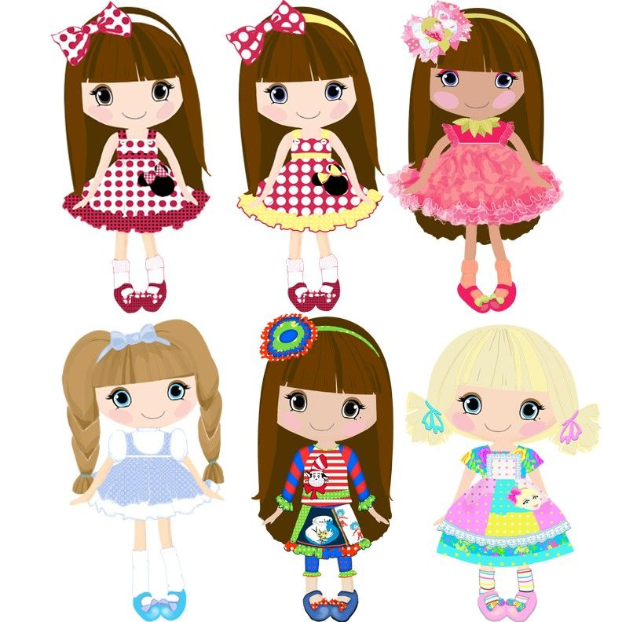
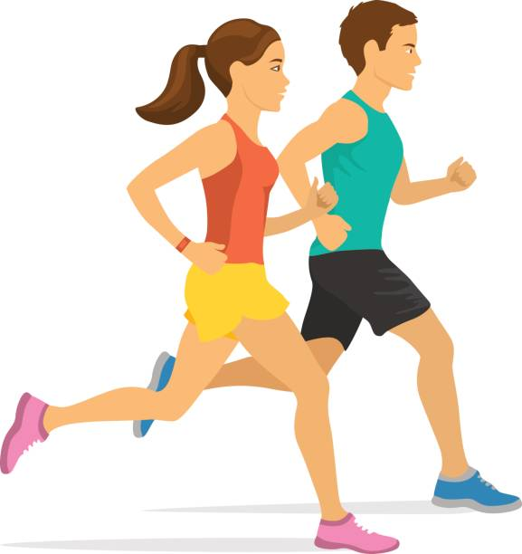
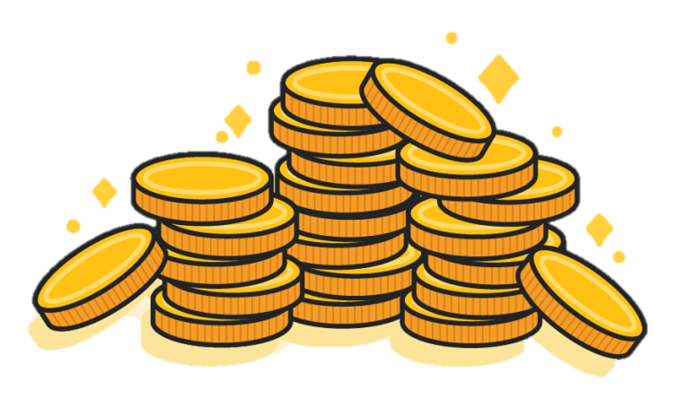
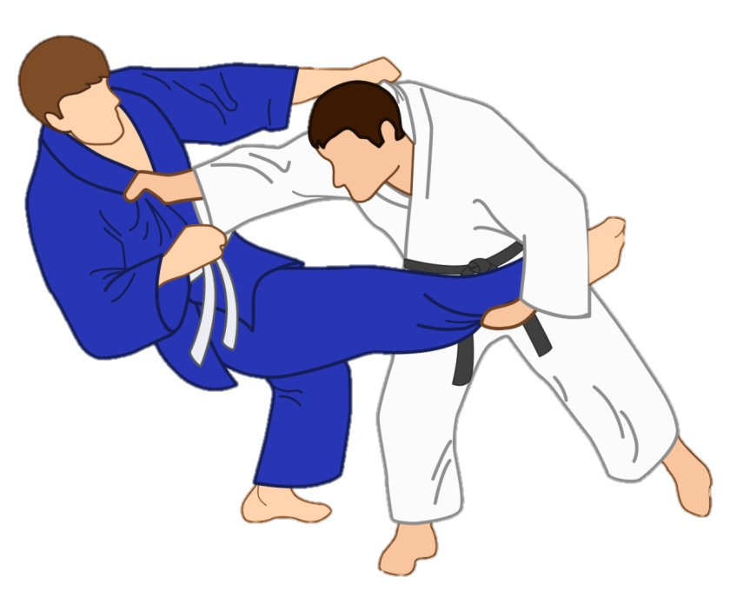
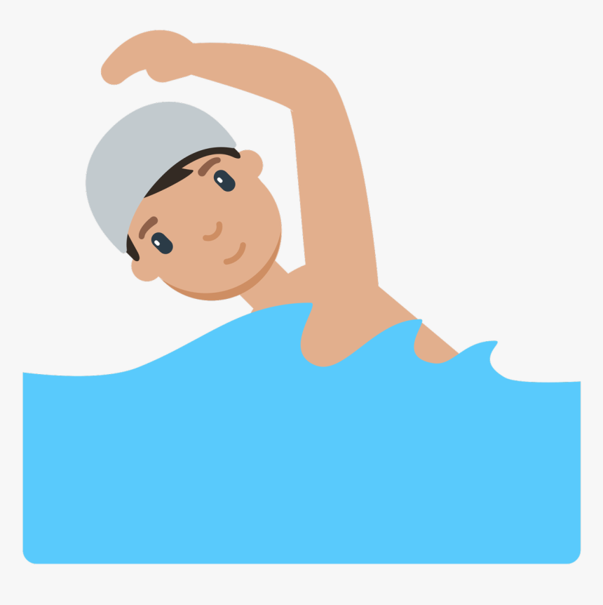
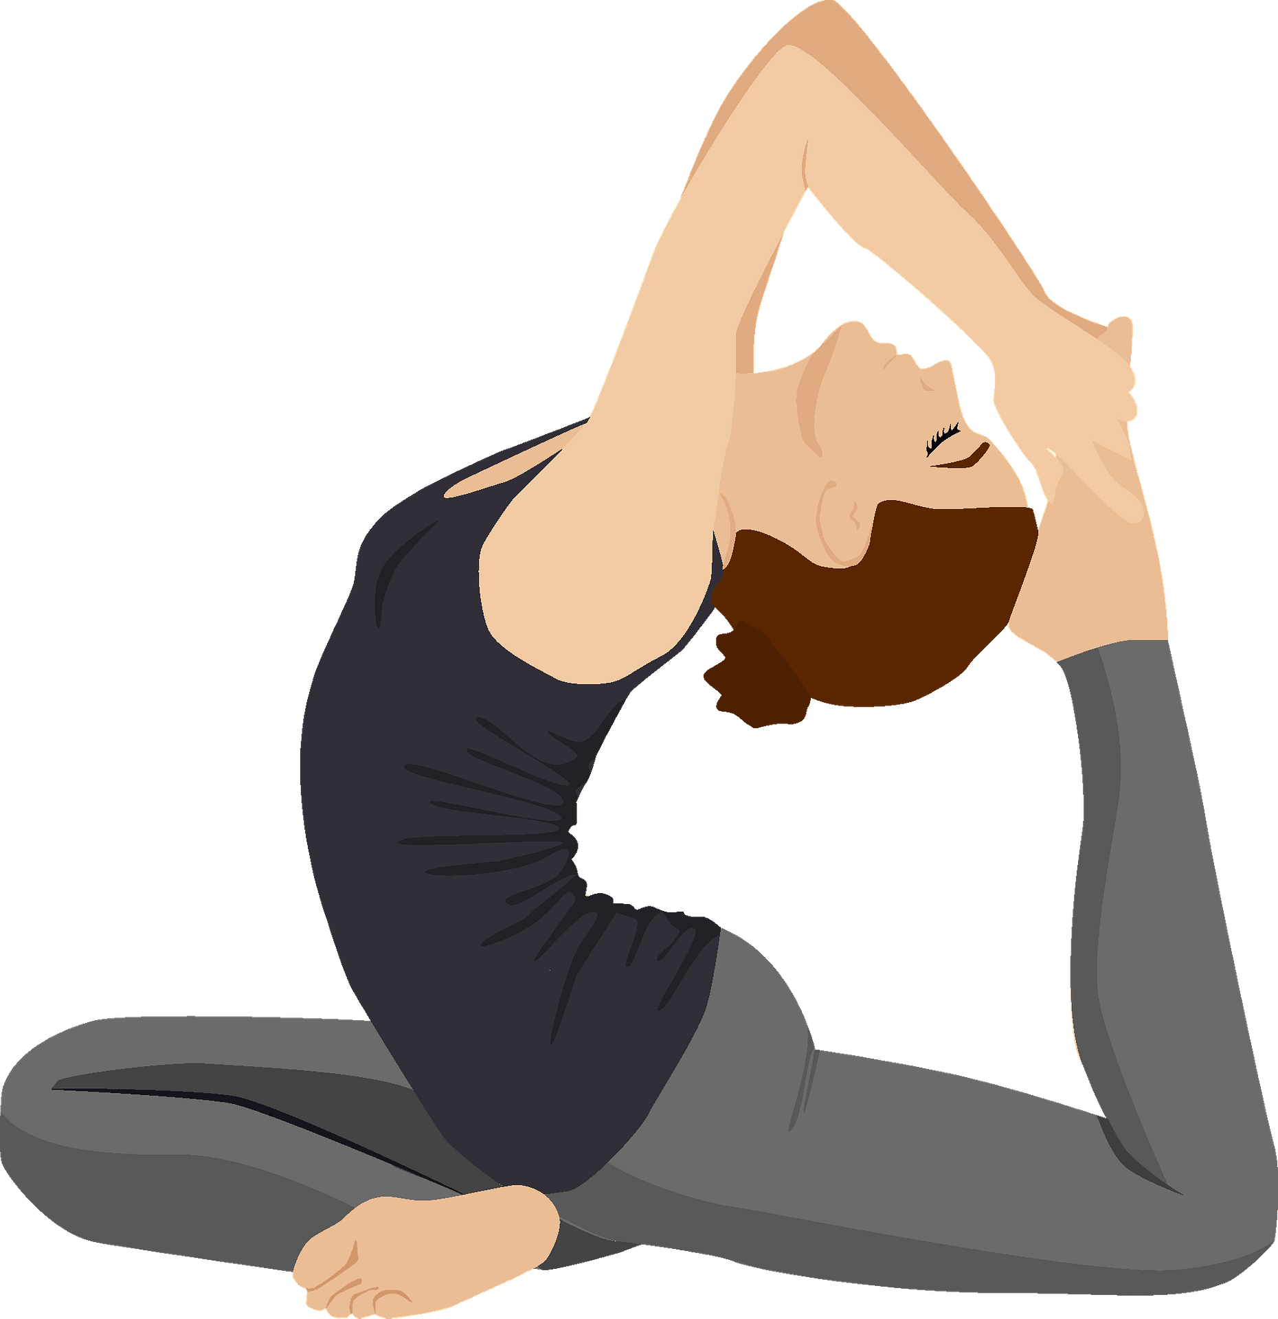
LOOK AND GUESS THE WORDS
dolls
jogging
coins
judo
swimming
yoga

Slide 3
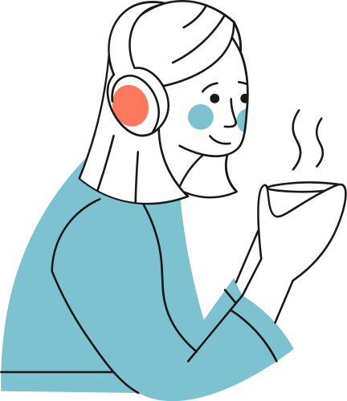
Unit 1: Hobbies
LESSON 2: A CLOSER LOOK 1

Slide 4
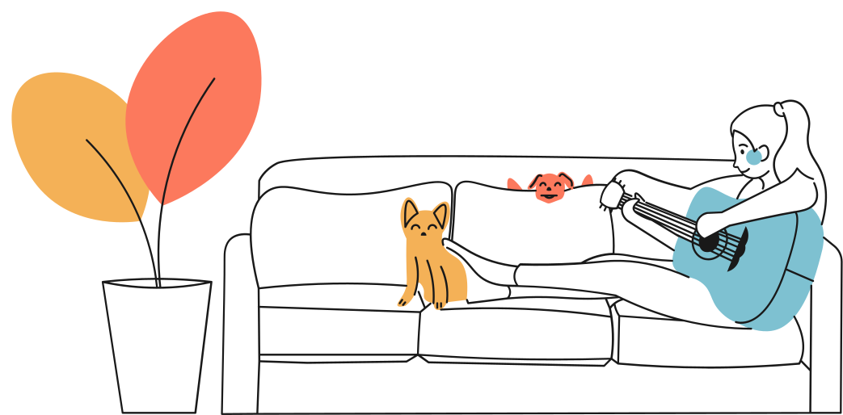
Objectives:
By the end of the lesson, students will be able to:
use lexical items related to the topic Hobbies
pronounce the sounds /ɜː/ and /ə/ correctly in isolation and in context

Slide 5
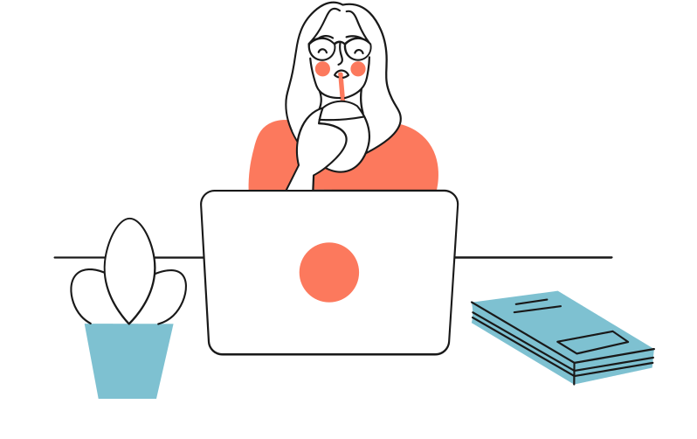
CHOOSE THE CORRECT ANSWER
collect
__________ dolls
A
go
B
do
C
collect
What’s about the others?

Slide 6
EX 1. Complete the word webs below. (P.10)
jogging
go
dolls
swimming
jogging
Can you add more words?
do
judo
coins
yoga
judo
swimming
collect
dolls
yoga
coins

Slide 7
HOW TO TALK ABOUT
HOBBY?

Slide 8
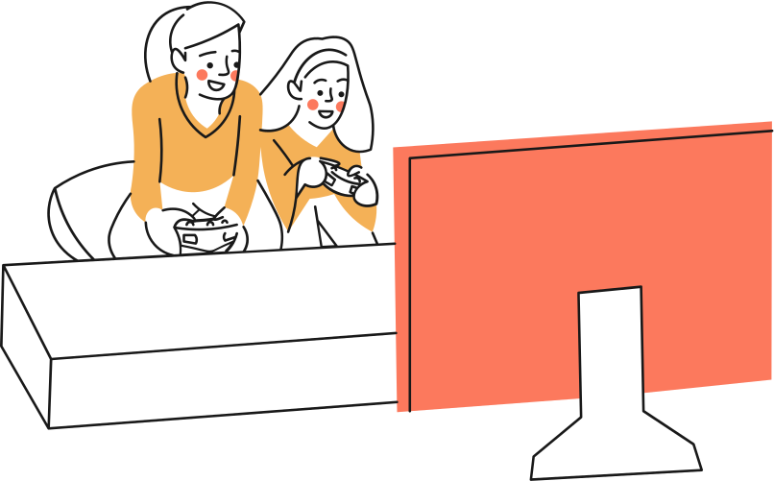
Underline the words after “like” and “hates”
I like gardening.
V-ING
She hates watching TV.
V-ING
S + like/ love/ enjoy/ hate + V-ING

Slide 9
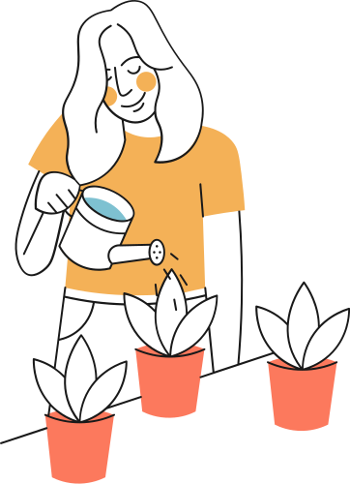
REMEMBER!
Common verbs of liking and disliking are like, love, enjoy and hate (not like). We often use –ing form after these verbs.
Example: I like gardening.
She hates watching TV.

Slide 10
EX 2. Complete the sentences, using the –ing form. (P.10)
go play collect do make
1. My dad has a big bookshelf because he loves ___________ old books.
2. My sister likes ___________ camping at the weekend.
3. My best friend hates ___________ computer games.
4. Does your brother like ___________ model?
5. My mum enjoys ___________ yoga every day to keep fit.
collect old books: Sưu tập sách cũ
collecting
go camping: đi cắm trại
going
play computer games: chơi điện tử
playing
making
make model: tạo mô hình
doing
do yoga: tập yoga

Slide 11

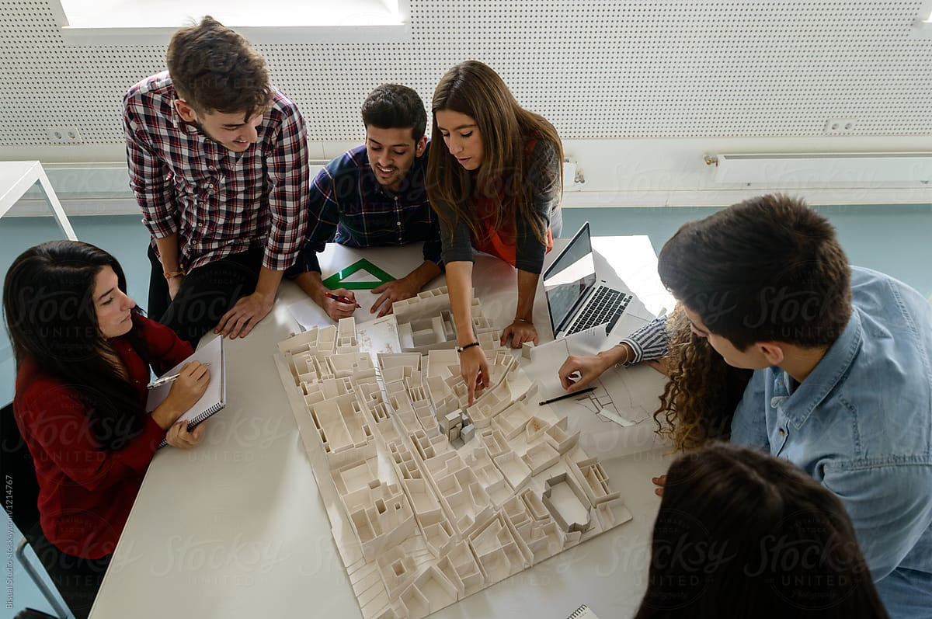
EX 3. Look at the pictures and make sentences.
Use suitable words of liking and disliking. (P.10)
Look and make sentences.
Raise hands to answer.
Example:
They like making models.

Slide 12

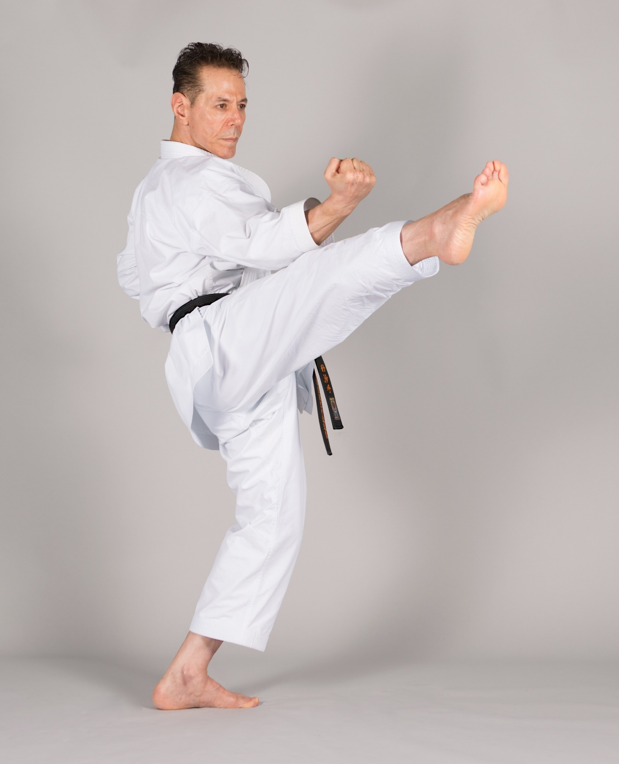
YOUR TURN!
He doesn’t like doing judo.
He hates doing judo.

Slide 13
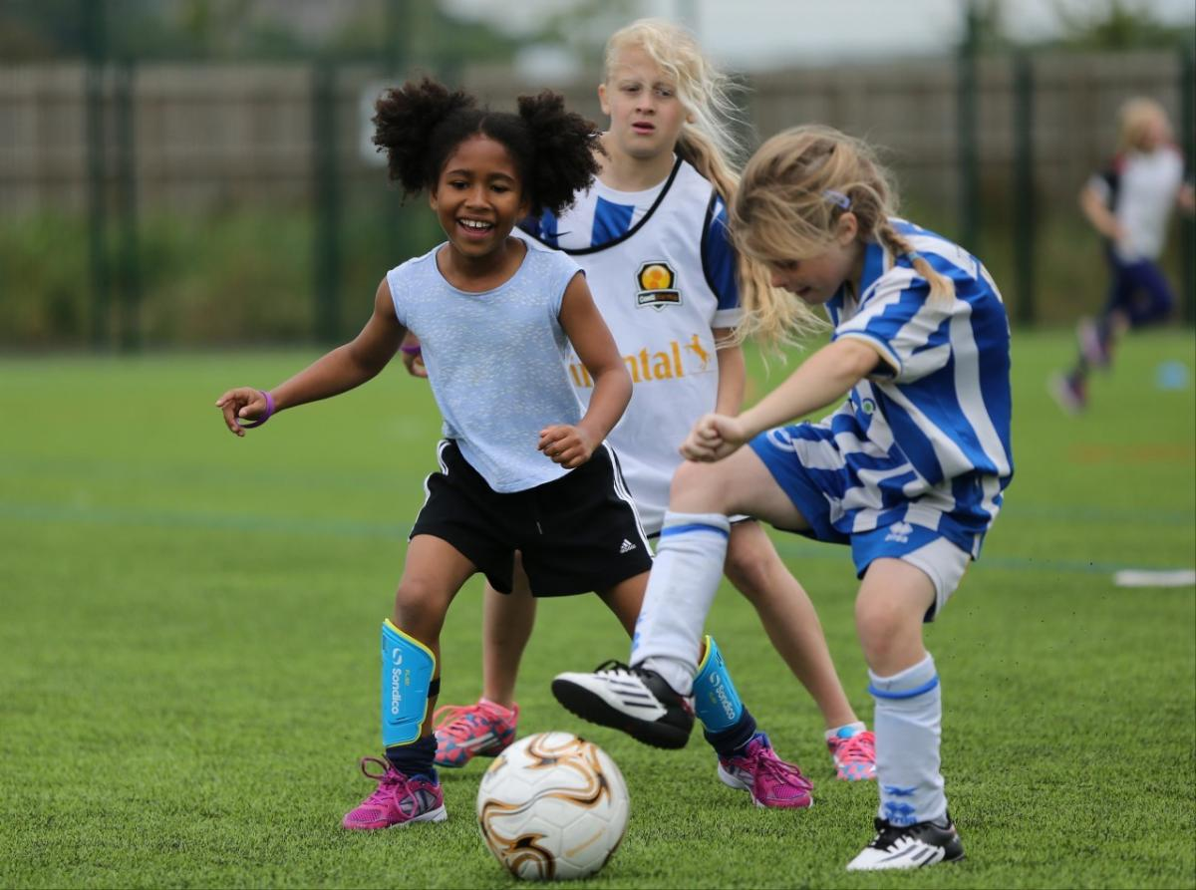
YOUR TURN!
They like/love/ enjoy playing football.

Slide 14
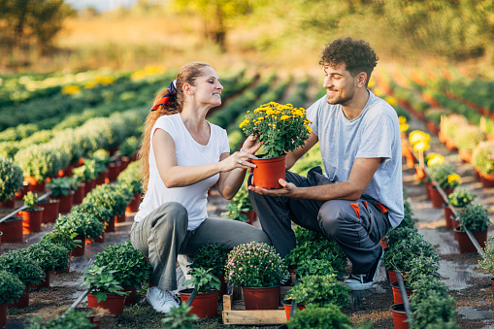
YOUR TURN!
They like/enjoy/love gardening.

Slide 15
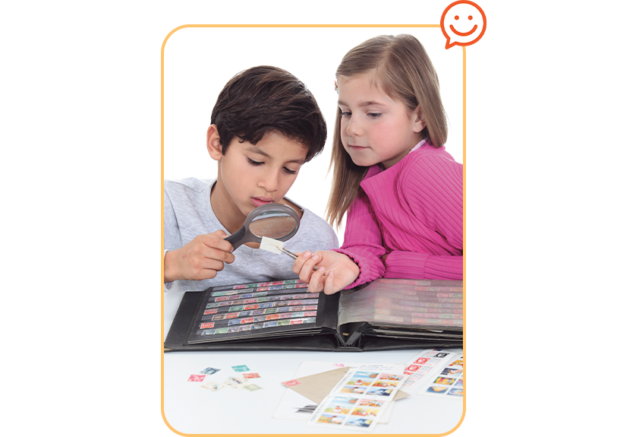
YOUR TURN!
They like/enjoy/love collecting.

Slide 16
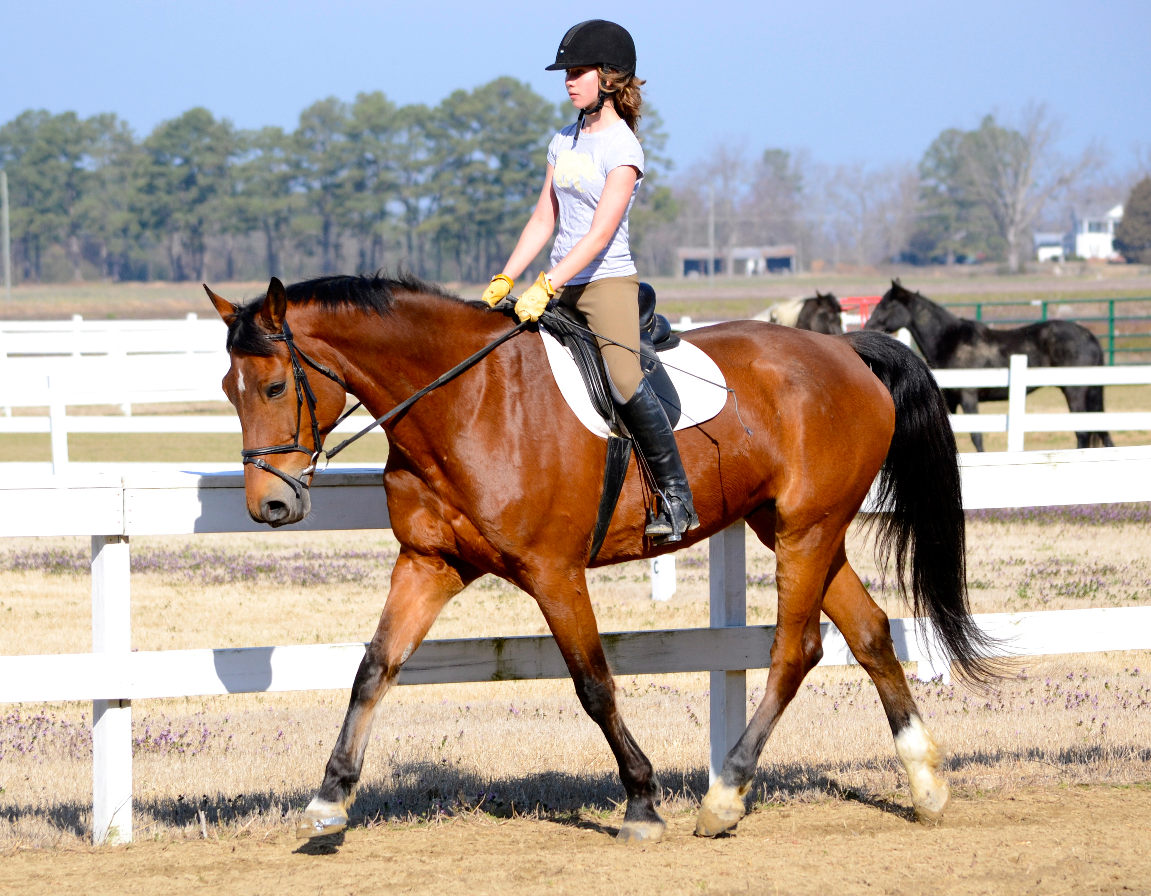
YOUR TURN!
She doesn’t like horse riding.
She hates horse riding.

Slide 17
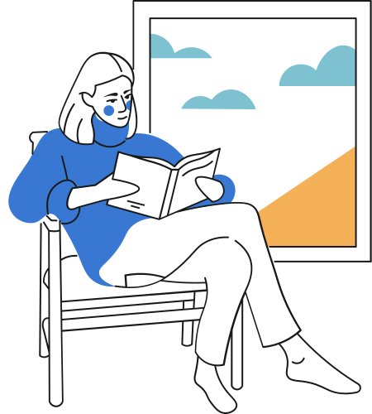
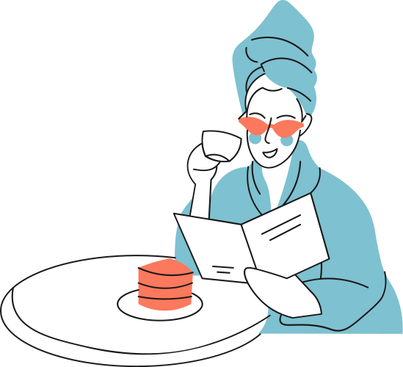
Share about you!
What do you like doing?

Slide 18
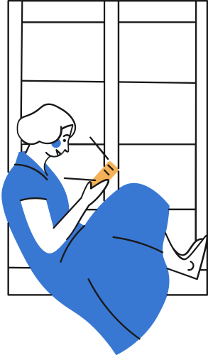
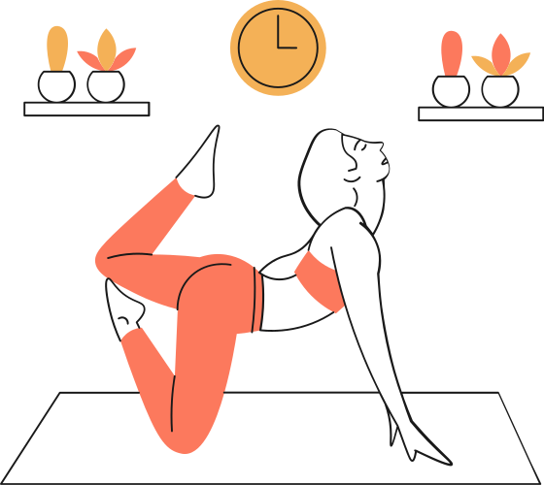
Can you guess the sound?
What are they doing?
do yoga
do yoga
surf the Internet
surf the Internet
/ə/
/ɜː/

Slide 19
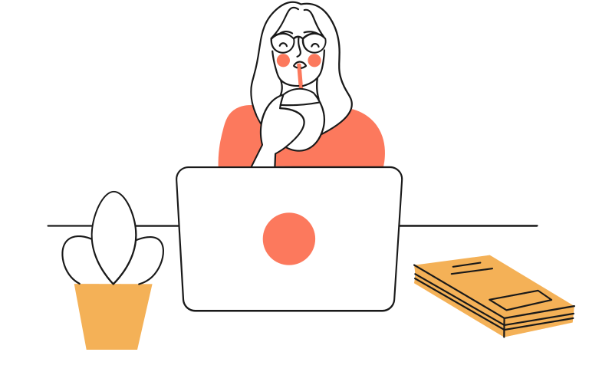
PRONUNCIATION
/ɜː/ and /ə/

Slide 20

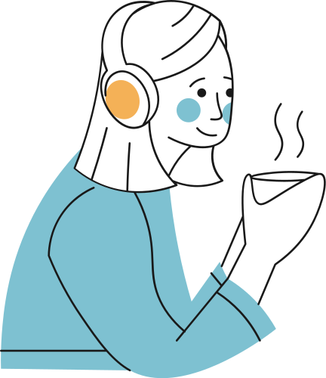
Ex 4. Listen and repeat. Pay attention to the sounds /ɜː/ and /ə/. (P.11)
/ə/
/ɜː/
amazing
learn
yoga
surf
collect
work
column
thirteen

Slide 21
Ex 5. Listen to sentences and pay attention to the underlined parts. Tick (). (P.11)
1. My hobby is collecting dolls.
2. I go jogging every Thursday.
3. My cousin likes getting up early.
4. My best friend has thirty pens.
5. Nam enjoys playing the violin.
/ə/
/ɜː/






Slide 22


* PRODUCTION
Game: Who is faster?
Work in groups of four
Write sentences including: hobbies and one of the sounds /ə/ and /ɜ:/
(e.g: Listening to music is a very common hobby.)
The group with the most correct sentences is the winner.

Slide 23
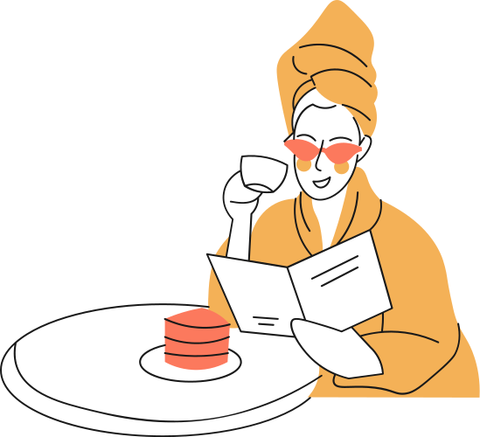
RECAP
1
My hobbies is _____ jogging.
A. doing B. going C. collecting
2
We like _____ football.
A. playing C. play C. to playing
3
Find the different sound.
A. hurt B. surf C. surprise
/ɜː/
/ɜː/
/ə/

Slide 24

* HOMEWORK
- Learn new words by heart.
Find 3 more words relating to hobbies that have the sound /ə/ or /ɜ:/.
Do exercises in the workbook.
Prepare Unit 1: A closer look 2

Slide 25
THANK YOU!

