Slide 1
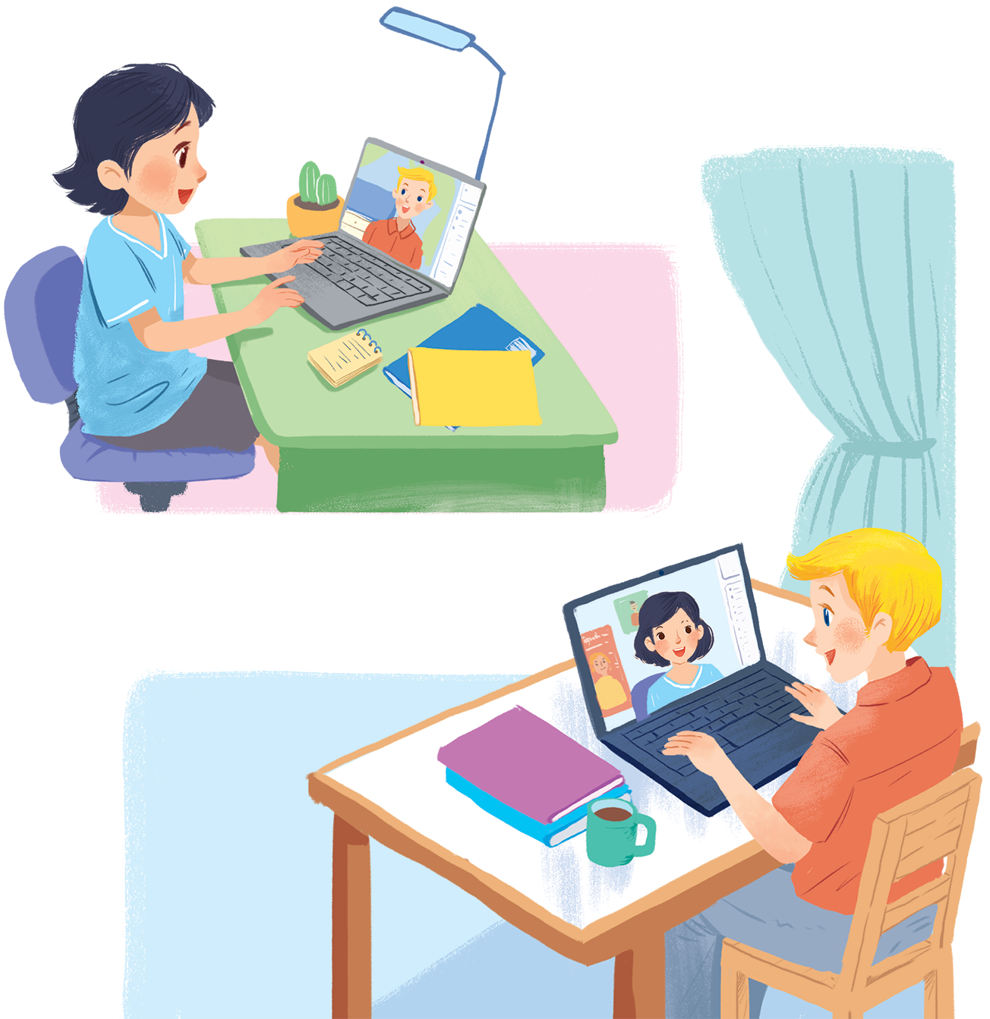
UNIT 2: MY HOUSE
LESSON 2: A CLOSER LOOK 1
English 6

Slide 2


Vocabulary
1
Look at the house. Name the rooms in it.
2
Name the things in each room in 1. Use the word list below. (You may use a word more than once.)
3
Think of a room in your house. In pairs, ask and answer questions to guess it.
Pronunciation
4
Final sounds: /s/ and /z/
5
Listen and repeat these words.
6
Listen to the conversation. Underline the final s in the words and put them into the

Slide 3


Warm up
You’re going to watch a video clip. Try to remember as much information from the clip as possible.

Slide 4
Vocabulary
Rooms and furniture

Slide 5


U2 L2
Vocabulary
chest of ‘drawers (n)
ngăn kéo tủ
‘poster (n)
áp phích
‘cupboard (n)
tủ đựng ly, chén
‘dishwasher (n)
máy rửa chén
‘cooker (n)
nồi cơm điện
light(n)
đèn
‘ceiling fan(n)
quạt trần
fridge(n)
tủ lạnh
sink(n)
bồn rửa tay

Slide 6
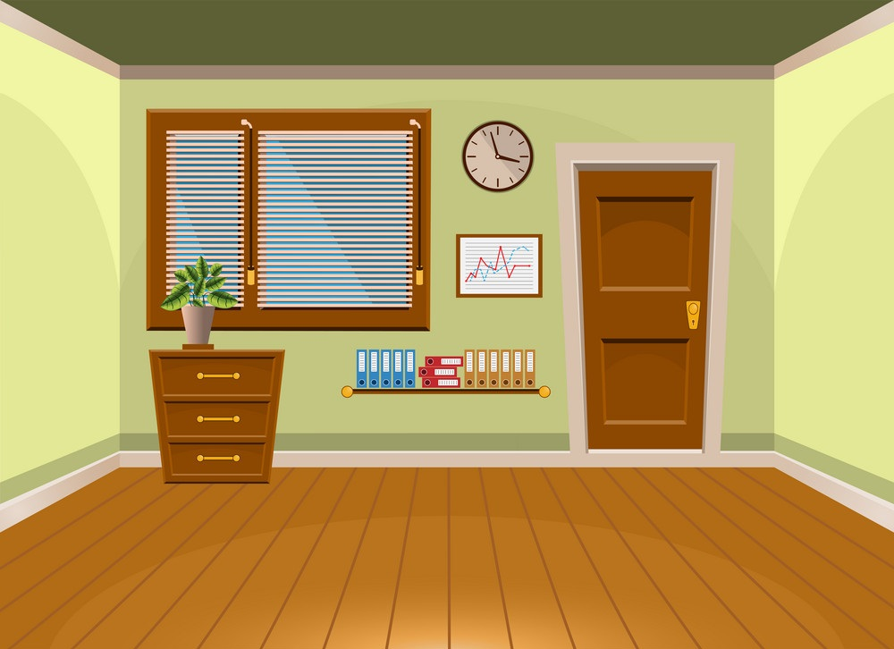
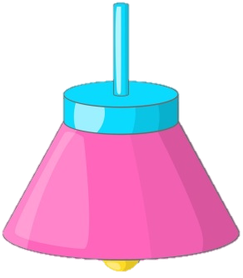
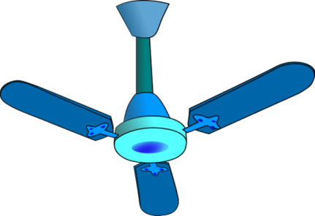

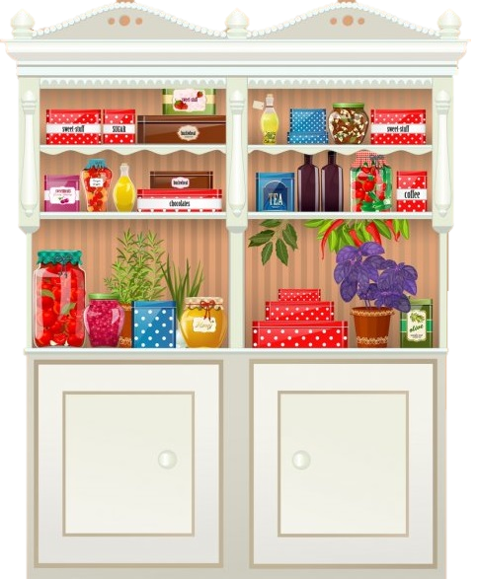
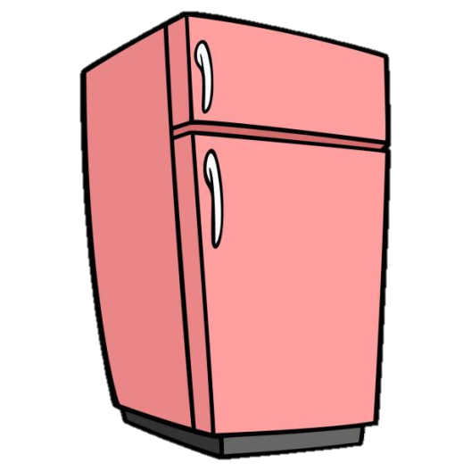


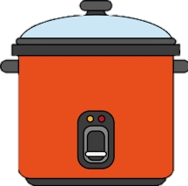
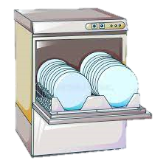
U2 L2
‘ceiling fan
‘poster
light
‘cupboard
fridge
chest of ‘drawers
sink
‘cooker
‘dishwasher
Vocabulary

Slide 7
quạt trần
áp phíc
đèn
tủ đựng chén
tủ lạnh
bồn rửa tay
ngăn kéo tủ
nồi cơm
máy rửa bát

Slide 8
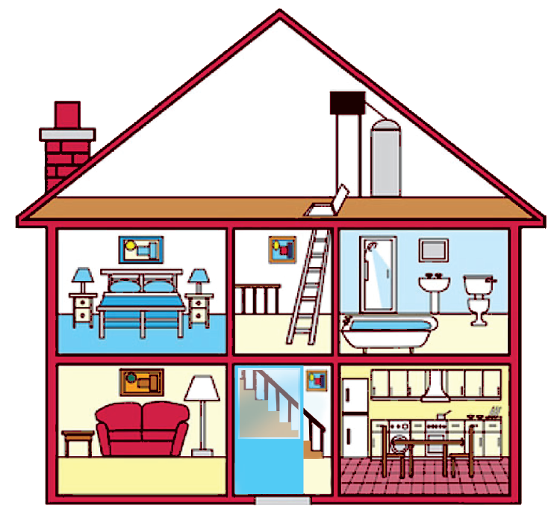
Look at the house. Name the rooms in it.
1
Hall: a space or passage inside the entrance or front door of a building/ house

Slide 9





hall
bathroom
hall
bathroom
kitchen
kitchen
living room
living room
bedroom
bedroom
c.
bedroom
d.
bathroom
b.
living room
e.
kitchen
a.
hall

Slide 10
Name the things in each room in 1. Use the word list below. (You may use a word more than once.)
2
lamp
toilet
picture
cupboard
dishwasher
sink
fridge
shower
sofa
chest of drawers
hall | kitchen | bedroom | bathroom | living room
picture
fridge
lamp
shower
lamp
cupboard
picture
sink
sofa
dishwasher
chest of drawers
toilet
picture
sink

Slide 11
Think of a room in your house. In pairs, ask and answer questions to guess it.
3
Example:
A: What’s in your room?
B: A sofa and a television.
A: Is it the living room?
B: Yes.

Slide 12
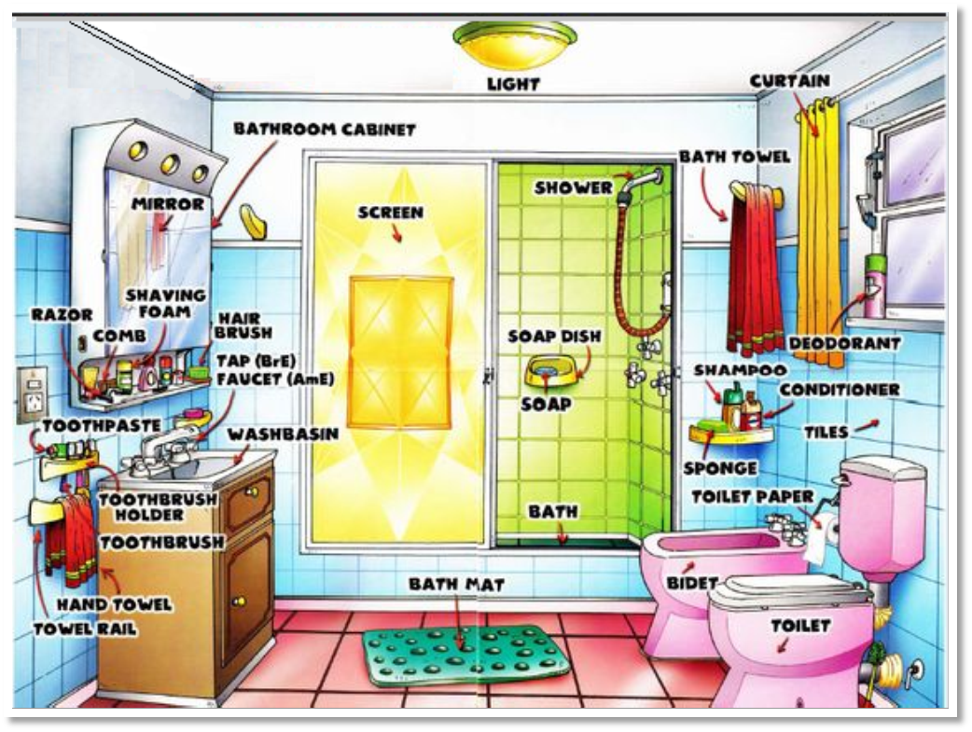
Example:
A: What’s in the room?
B: A bathtub and a toilet.
A: Is it the bath room?
B: Yes.
bathroom

Slide 13
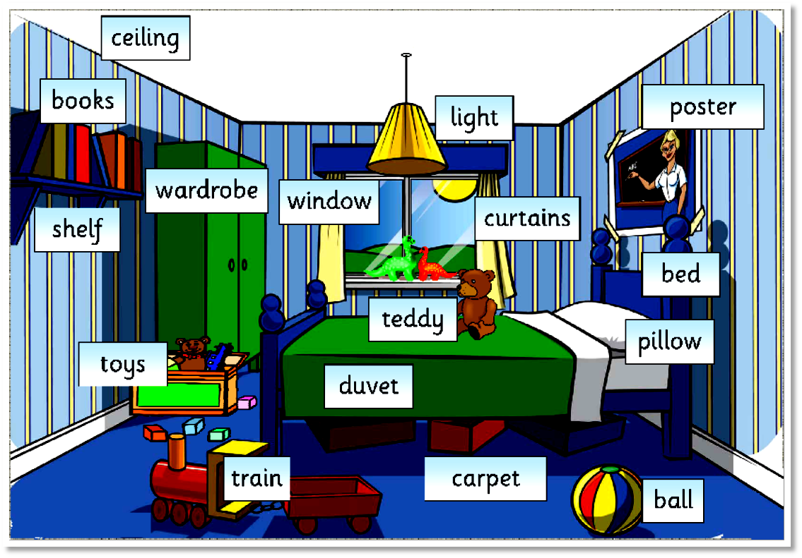
Example:
A: What’s in the room?
B: A bed and a wardrobe.
A: Is it the bed room?
B: Yes.
bed room

Slide 14
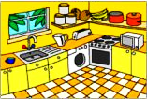
Example:
A: What’s in the room?
B: A sink and a stove.
A: Is it the kitchen?
B: Yes.
kitchen

Slide 15
Pronunciation
Final sounds: /s/ and /z/

Slide 16


Pronunciation
/z/, /s/ and /iz/

Slide 17
The ways to pronounce -s/-es at the end of the word
/z/
/s/
/ ɪz /
Final -s is pronounced /z/ after voiced sounds (/b/,/d/, /g/,/n/, /m/, l/…) and any vowel sounds
Final -s is pronounced /s/ after voiceless sounds (/t/, /p/, /k/, /f/, /θ/)
Final -es is pronounced /iz/ after /s/, /z/, /∫/, /t∫/, /d_{Ʒ}/
E.g. beds, dogs, cans, rooms, videos, cookers, bees
E.g. cats; lamps, books, months
E.g. buses, houses, toothbrushes, watches, pages

Slide 18

Listen and repeat these words.
4
lamps
cupboards
sink
sofas
flats
kitchen
toilets
rooms

Slide 19
Listen to the conversation. Underline the final s in the words and put them into the correct column.
5
Mi: Mum, are you home?
Mum: Yes, honey. I’m in the kitchen. I’ve bought these new bowls and chopsticks.
Mi: They’re beautiful, Mum. Where did you buy them?
Mum: In the department store near our house. They have a lot of things for homes.
Mi: Don’t forget we need two lamps for my bedroom, Mum.
Mum: Let’s go there this weekend.
bowls
chopsticks
things
homes
lamps
/s/ | /z/
Now practise the conversation with a partner.
bowls
chopsticks
lamps
things
homes
T

Slide 20
Matching
Word
Example: chairs
1. beds
2. caps
3. posters
4. clocks
5. villas
6. lights
Sound
/s/
/z/

Slide 21
AUDIO SCRIPT
Mi: Mum, are you home?
Mum: Yes, honey. I’m in the kitchen. I’ve bought these new bowls and chopsticks.
Mi: They’re beautiful, Mum. Where did you buy them?
Mum: In the department store near our house. They have a lot of things for homes.
Mi: Don’t forget we need two lamps for my bedroom, Mum.
Mum: Let’s go there this weekend.

Slide 22

Homework
Learn vocabulary by heart.
Do Exercise A1, 2 & B2, 3 (p. 10, 11) - Workbook.
Prepare the next lesson: A closer look 2

