Slide 1

UNIT 6: OUT TET HOLIDAY
LESSON 5: SKILLS 1
English 6

Slide 2


Reading
1
Read the passages and decide who says sentences 1 – 5.
2
Test your memory!
Tick () the things which appear in the passages, and cross (×) the ones which don’t.
Speaking
3
Work in groups. These are some activities from the reading passages in 1. Tell your group if you do them during Tet.
4
Work in groups. Read the list and discuss what you should or shouldn’t do at Tet.

Slide 3

Word cloud
How many words are there on the picture and what are these words?

Slide 4
Reading

Slide 5




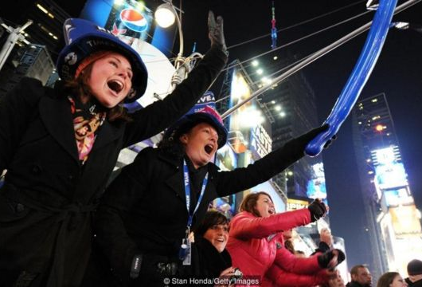
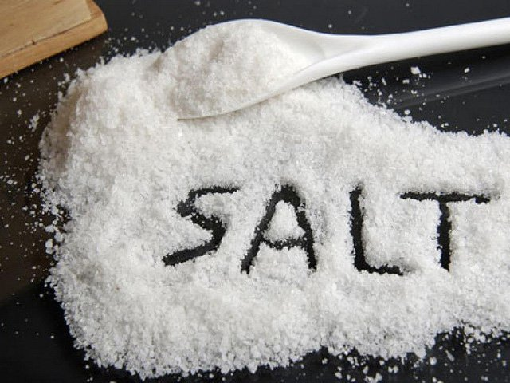
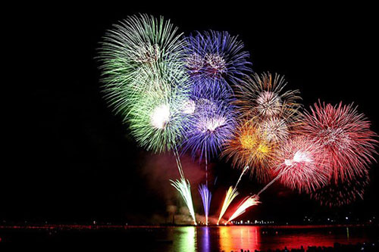
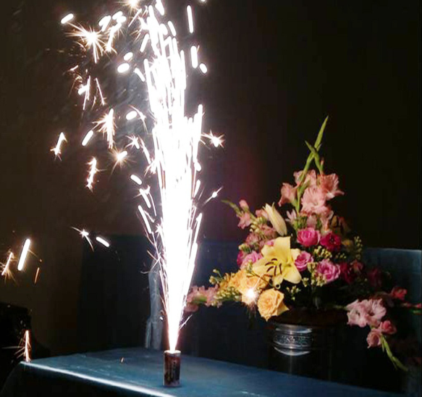
U6 L5
Vocabulary
strike ‘midnight
điểm nửa đêm
light up (v)
thắp sáng
cheer (v)
reo hò
‘custom (n)
phong tục
enough (deter)
đủ đầy
salt (n)
muối
cry sound (phrn)
tiếng khóc, tiếng kêu
poor (adj)
nghèo nàn

Slide 6
What and Where
light up
strike
midnight
custom
salt
cheer
enough
poor
cry sound

Slide 7
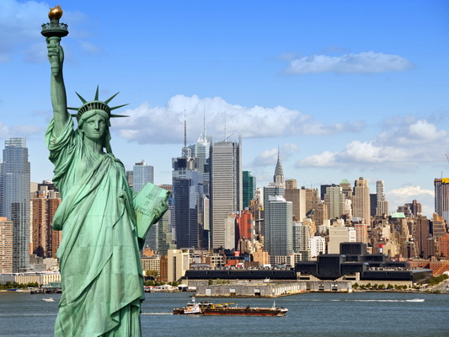
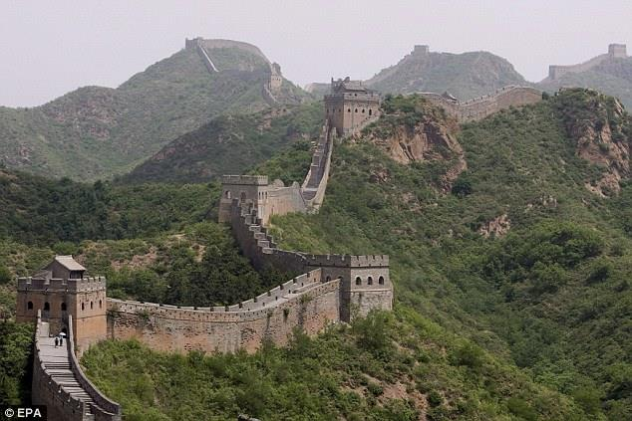
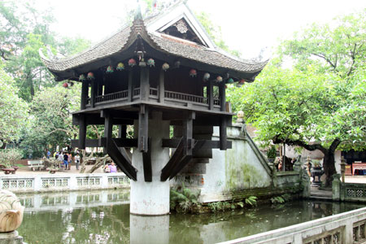
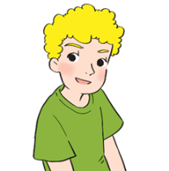
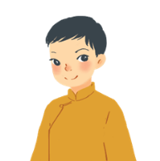
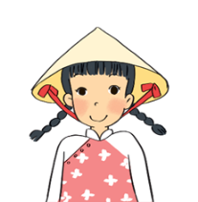
What is his/ her name?
Which country does he/ she come from?
Do you know anything about his/ her country?
Russ – the USA
Wu - China
Mai – Viet Nam

Slide 8
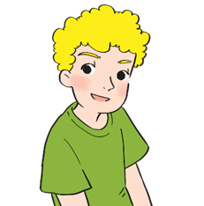
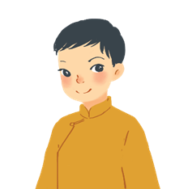
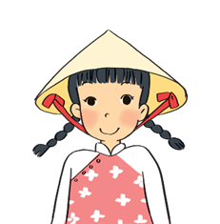
What are they talking about?
New Year Activities

Slide 9


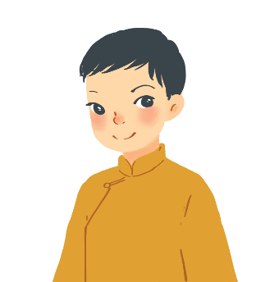

1
Read the passages and decide who says sentences 1 – 5.
A
I often go to Times Square with my parents to welcome the New Year. When the clock strikes midnight, colourful fireworks light up the sky. Everybody cheers and sings.
Russ – the USA
B
On New Year’s Day, we dress beautifully and go to our grandparents’ houses. We wish them Happy New Year and they give us lucky money. Then we go out and have a day full of fun.
Wu - China
c
I learn some customs about Tet from my parents. People give rice to wish for enough food and buy salt to wish for good luck. Dogs are lucky animals but cats are not. A cat’s cry sounds like "poor" in Vietnamese.
Mai – Viet Nam

Slide 10
A. Russ
B. Wu
C. Mai
Statements | Who
1. Dogs are lucky animals. | C
2. We welcome the New Year at Times Square.
3. Children get lucky money.
4. We give rice to wish for enough food.
5. Children fress beautifully.
A
B
C
B

Slide 11
Game: lucky number
1. Who does Russ often go to Times Square to welcome the New Year?
2. What do everybody do when the clock strikes midnight
in the USA?
3. What does Wu do On New Year’s Day?
4. Does Wu go out and have a day full of fun ?
5. Where does Mai learn some customs about Tet from?
6. Are cats lucky animals in Viet Nam?
with his parents .
Everybody cheers and sings.
dress beautifully and go to his grandparents’ houses.
Yes, he does..
Her parents.
No. they aren’t . (Dogs are lucky animals.)

Slide 12


Test your memory! Tick () the things which appear in the passages, and cross (×) the ones which don’t.
2
a. Lucky money
e. A day full of fun


b. A cat’s cry
f. Decorating the
house


c. fireworks
g. Saying wishes


d. Cheering and
singing
h. Visiting relatives



Slide 13
Speaking

Slide 14
Work in groups. These are some activities from the reading passages in 1. Tell your group if you do them during Tet.
3
Example:
go to Times Square to welcome the New Year
I don’t go to Time Square to welcome the New Year.

Slide 15
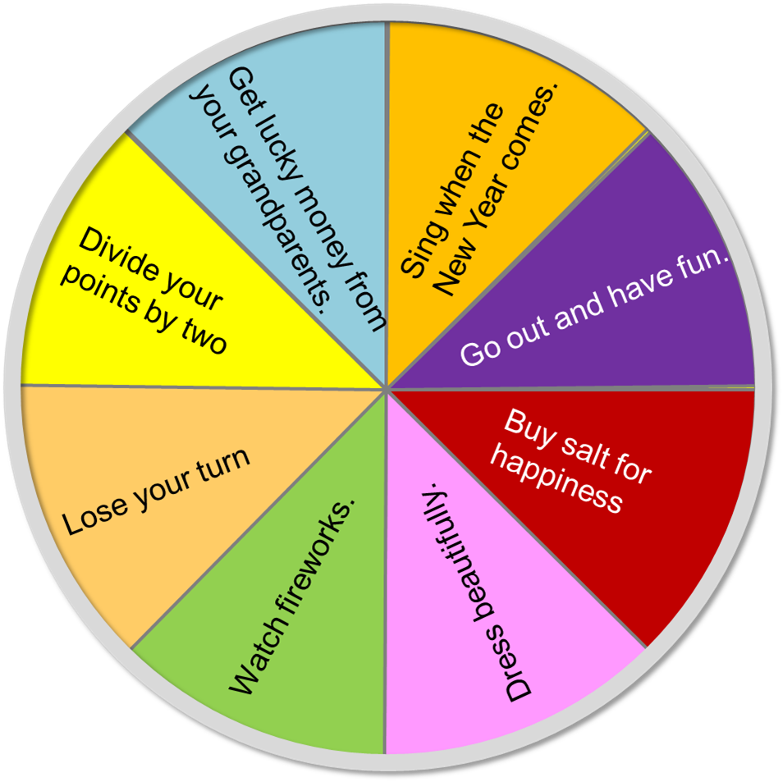



Wheel of English
50
200
100
250
200
150
0
divide
Finish
Spin
Your activities on Tet

Slide 16
1.
watch fireworks on New Year’s Eve
I don’t watch fireworks on New Year’s Eve.
2.
Sing when the New Year comes
3.
get lucky money
4.
go out and have fun
I often go out and have fun with my friends at Tet.
5.
dress beautifully
I dress beautifully On New Year’s Day .
6.
buy salt for happiness

Slide 17
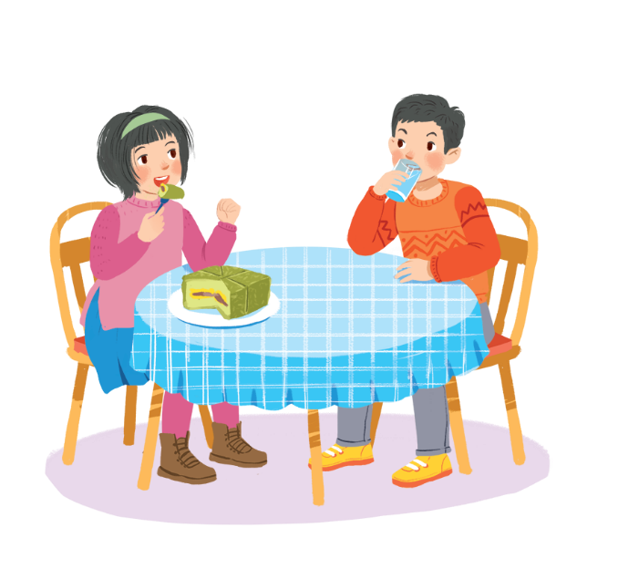
4
Work in groups. Read the list and discuss what you should or shouldn’t do at Tet.
break things
make a wish
dress beautifully
say “have fun!” to friends
help decorate our houses
play games all night
invite friends home
ask for lucky money
play loud music
Example:
Hey, you shouldn’t eat all that banh chung!
A: We should dress beautifully at Tet.
B: I agree. Should we ask for lucky money?
C: No, we shouldn’t.

Slide 18

Post speaking
Give visit stay be have
Complete the conversations with the provided words / sentences. Then practise speaking them.
Phong: When shall we (1)……………. our grandparents, Dad?
Dad: On the second day of Tet.
Phong: Hurrah! Will we (2)……………. long?
Dad: For two days. Do you (3)………………………. any plans?
Phong: Yeah … I’ll (4)………….my cousins a surprise.
Dad: Good. We will (5)……………….. busy but happy.

Slide 19

Homework
Learn vocabulary and the structure by heart.
Do exercise in your work book
Prepare the next lesson: Skills 2

