Slide 1
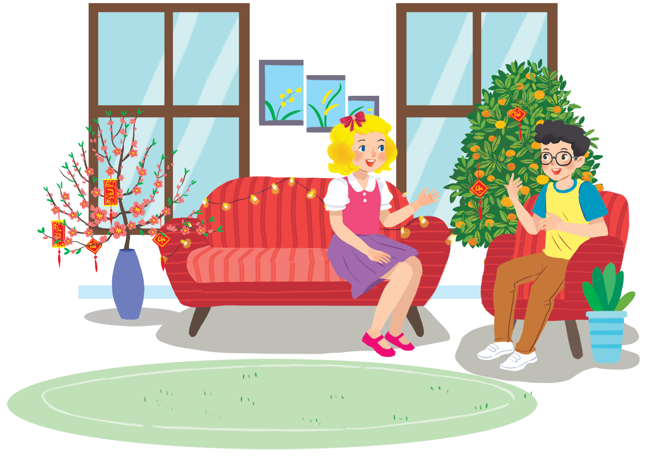
UNIT 6: OUT TET HOLIDAY
LESSON 3: A CLOSER LOOK 2
English 6

Slide 2

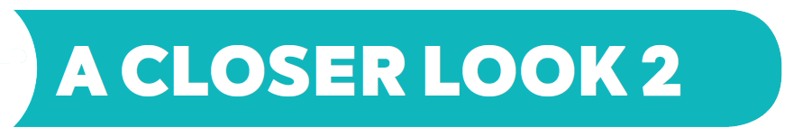
Should / shouldn’t for advice
1
Look at the signs at the library and complete the sentences with should or shouldn’t.
2
Tick () the activities children should do at Tet and cross (×) the ones they shouldn’t.
3
Work in pairs. Look at the activities in 2. Take turns to say what you think children should / shouldn’t do.
Grammar
Some / any for amount
4
Complete the sentences with some or any.
5
Work in pairs. Look at the fridge. Make sentences with the words / phrases provided, using some or any.

Slide 3
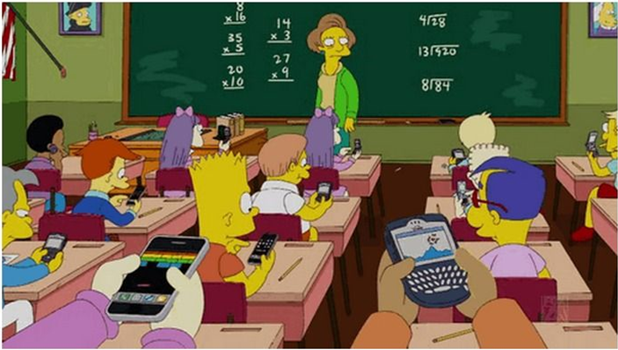
Good things to do in class | Bad things to do in class
………………….……… ………………….……… ………………….……… | ………………….……… ………………….……… ………………….………
Listen to the teacher
Talk loudly
Be quiet
Play game
Do exercises
Make a call
1. Imagine you want your friend to listen to the teacher. What do you say?
2. What do you say if you want your friend not to talk loudly?

Slide 4
Elicit the model sentences
What is Nam wearing? (a raincoat)
Why? (because it’s raining)
What does his mother say to him? (Nam, you shouldn’t wet the ﬂoor. You should take your raincoat off first)
What do ‘should’ and ‘shouldn’t’ mean?
Does his mother say ‘should take oﬀ’ or ‘should to take off?
When do you use ‘should’ and ‘shouldn’t’? (to give advice)
What is the diﬀerence between ‘should’ and ‘shouldn’t’?

Slide 5


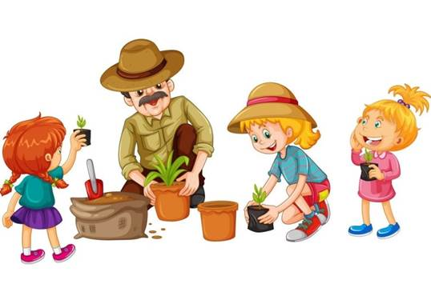
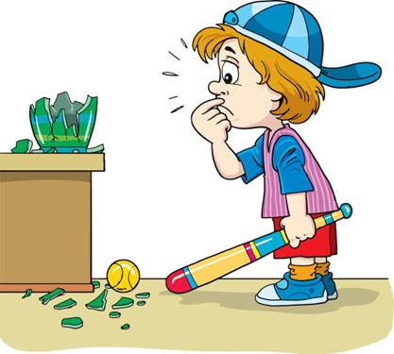
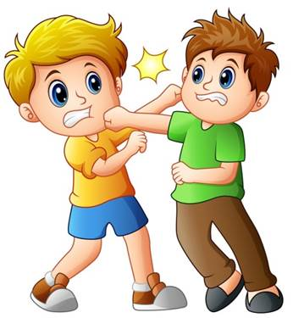
U6 L3
Vocabulary
be‘have (v)
cư xử, đối xử
plant (v)
trồng ( cây)
fight (v)
đánh nhau
break (v)
làm bể, vỡ

Slide 6
Rub out and remember
behave (v)
cư xử, đối xử
plant (v)
trồng ( cây)
fight (v)
đánh nhau
break (v)
làm bể, vỡ

Slide 7
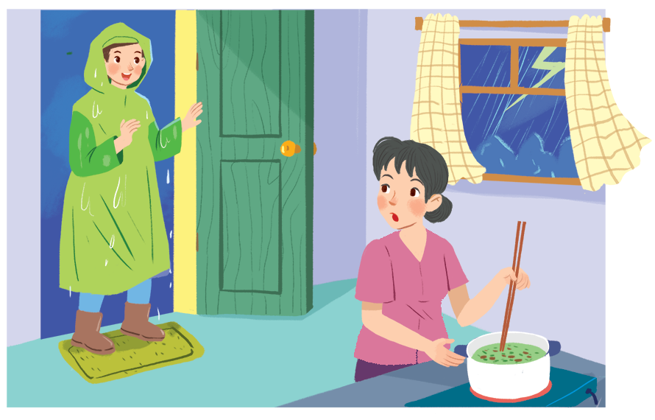
Grammar
Should / shouldn’t for advice
Nam, you shouldn't come in with your raincoat on.

Slide 8
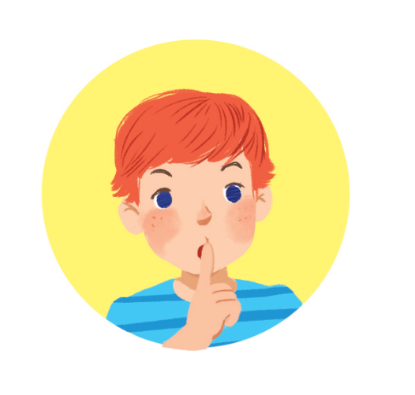

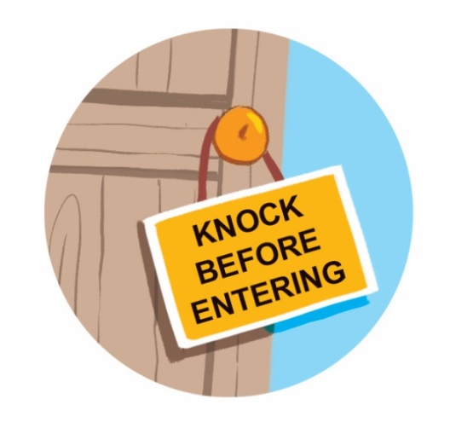
1
Look at the signs at the library and complete the sentences with should or shouldn’t.
You
shouldn’t eat or drink.
should
eat or drink.
1.
You keep quiet.
2.
shouldn’t run.
should
4.
You
run.
3.
You knock before you enter.

Slide 9

Grammar
Should / shouldn’t for advice
We use should for things that are good to do.
We use shouldn’t for things that are not good to do.

Slide 10
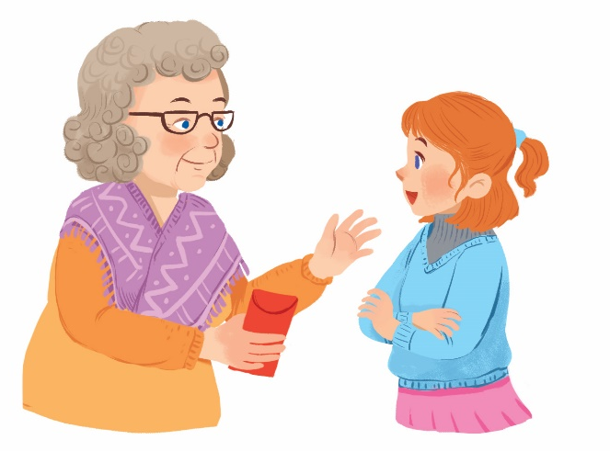
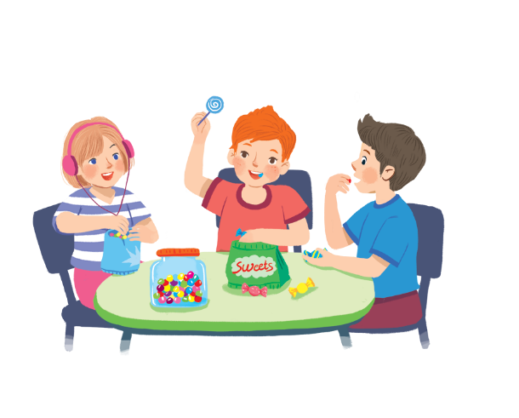
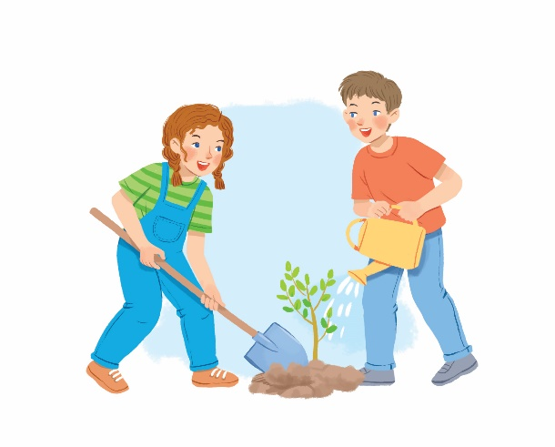
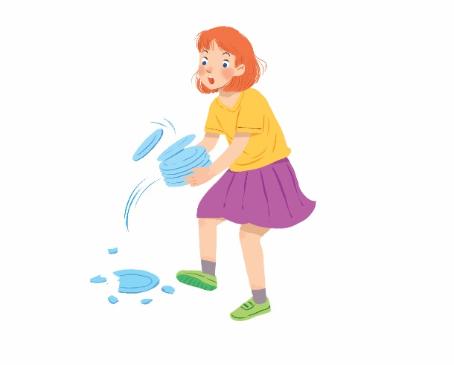
2
Tick () the activities children should do at Tet and cross (×) the ones they shouldn’t.
Thank you.


1.
behave well
2.
eat lots of sweets


3.
plant trees
4.
break things

Slide 11
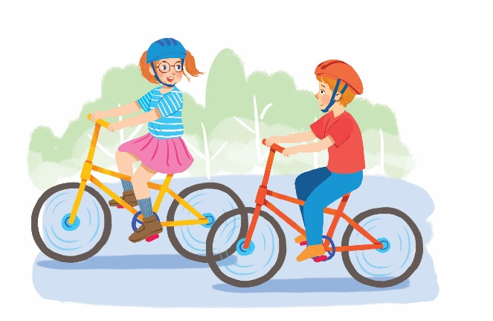
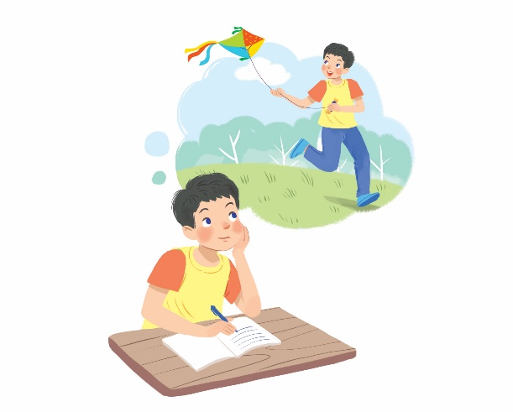
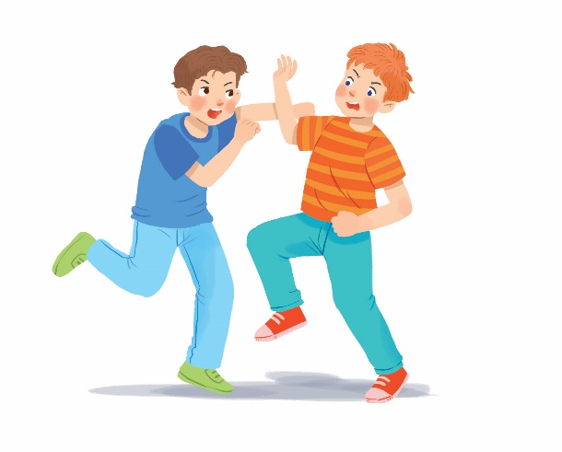
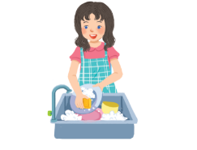
2
Tick () the activities children should do at Tet and cross (×) the ones they shouldn’t.


5.
go out with friends
6.
make a wish


7.
fight
8.
help with housework

Slide 12


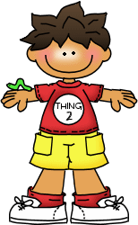
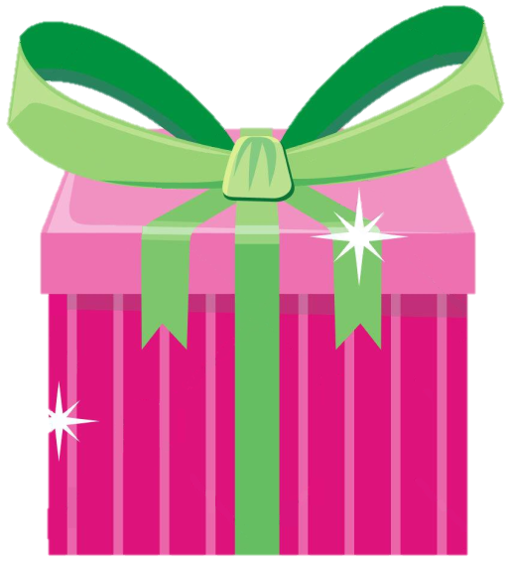
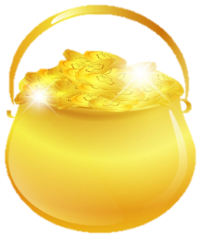

should / shouldn’t
= 10
= 15
= 5
By: Nguyelinarose

Slide 13
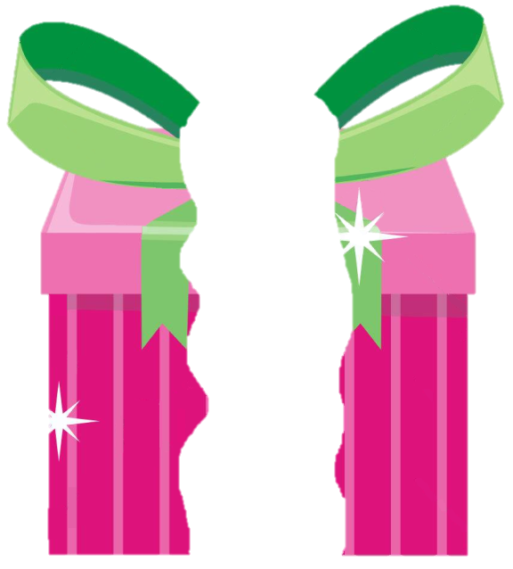
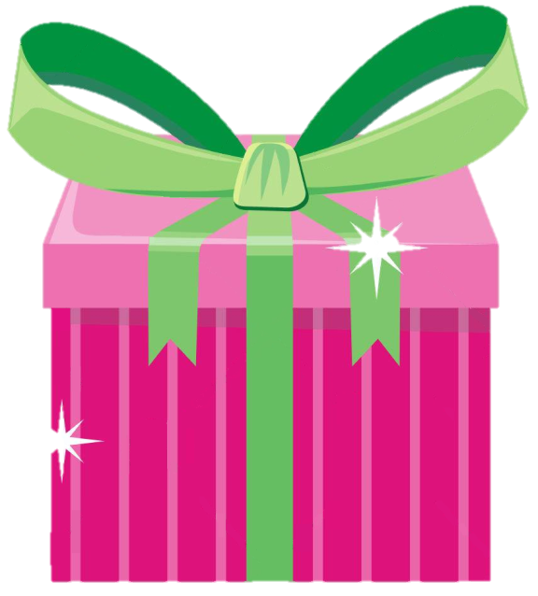
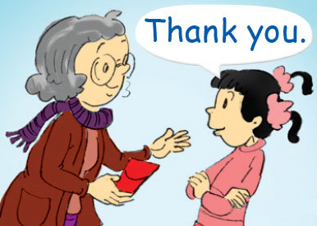
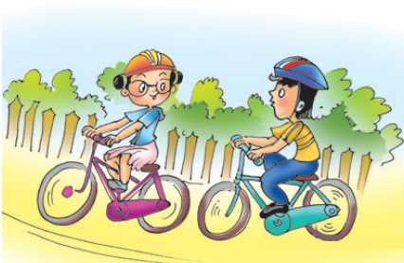
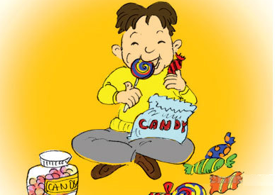
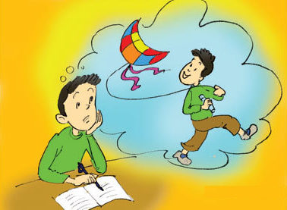
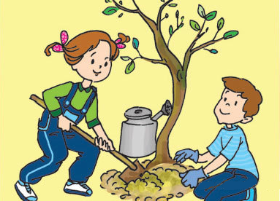
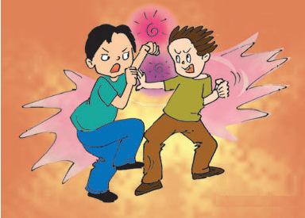
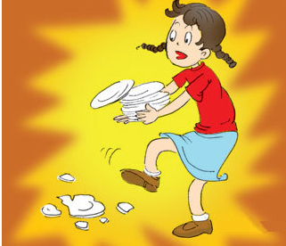
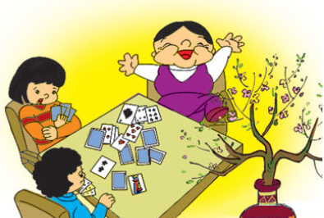
1
2
3
4
5
6
7
8

Slide 14
Activity 4. Use the activities in 3, write down the sentences.
Example :
We should make a wish.
We shouldn’t fight.
Picture 1: We should behave well.
Picture 2: We shouldn’t eat lots of sweets.
Picture 3: We should plant trees.
Picture 4: We shouldn’t break things.
Picture 5: We should go out with friends.
Picture 8: We should help with housework.

Slide 15
3
Work in pairs. Look at the activities in 2. Take turns to say what you think children should / shouldn’t do.
Example:
Children should behave well.
Children shouldn’t eat lots of sweets.

Slide 16
Grammar
Some / any for amount
Some
any
(+) My mother bought some fruits.
(+) I need some milk for the cake.
(-) I can’t answer any questions.
(?) Do you have any sugar?
Note:
- Some: Dùng trong câu khẳng định.
- Any: Dùng trong câu phủ định và câu hỏi.
* Ngoại lệ câu mời : Would you like some tea?

Slide 17
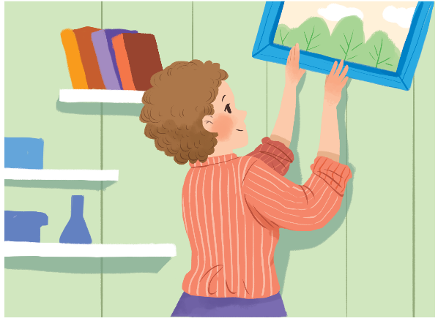
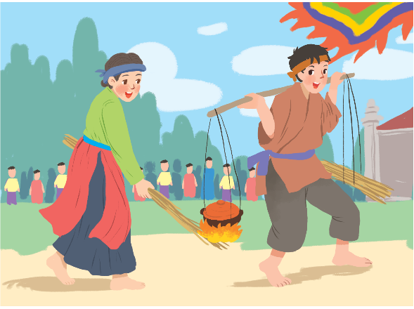
4
Complete the sentences with some or any.
1.
What do you need to decorate your room?
I need colour paper and pictures.
some
some
any
2.
Do you have free time for spotrs?
Yes, I do.
Are there interesting activities here during Tet?
Yes, there are traditional games like human chess, running and cooking.
3.
any
some

Slide 18
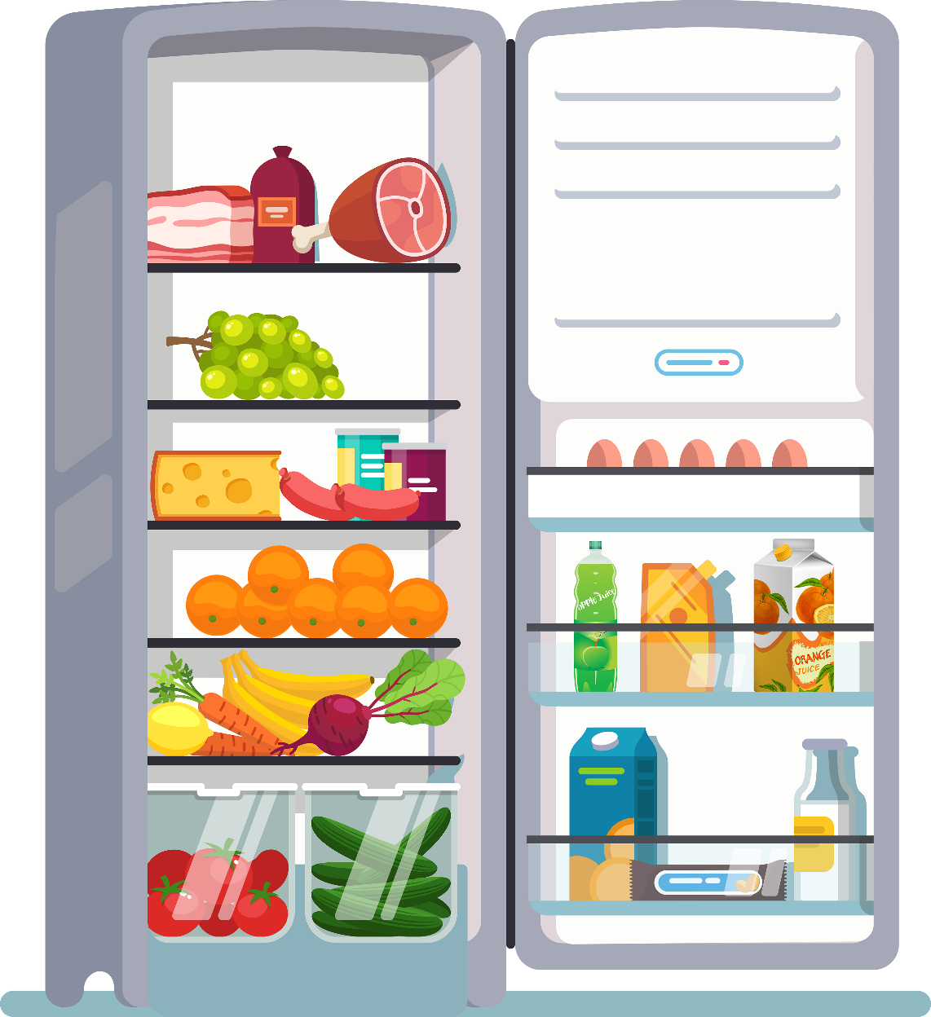
5
Work in pairs. Look at the fridge. Make sentences with the words / phrases provided, using some or any.
Example:
ice cream
There is not any ice cream.
cucumbers
There are some cucumbers.

Slide 19
1.
eggs
There are some eggs (in the fridge).
2.
fruit juice
There is some fruit juice.
3.
apples
There aren’t any apples.
4.
bread
There isn’t any bread.
5.
bananas
There are some bananas.
6.
cheese
There is some cheese.

Slide 20

Rewrite the following sentences without changing their original meanings.
1. It’s good if children go to bed early.
→ Children should……………………………………………………. .
2. It’s not a good idea when students copy other students’ work.
→ Students shouldn’t ………………………………………………………...
3. I’m not happy when children lie to their parents.
→ Children shouldn’t………………………………………………………..
4. It’s good if you say “Thank you” to a person who has helped you.
→ You should ………………………………………………………………
5. There is no water in the bottle.
→ There is not …………………………………………………………...
6. We have no peach flowers for the New Year here. any water in the bottle
→ We don’t…………………………………….
go to bed early.
copy other students’ work.
lie to their parents.
say “Thank you” to a person who has helped you
any water in the bottle.
have any peach flowers for the New Year here.

Slide 21

Homework
Learn vocabulary and the structure by heart.
Do exercise in your work book
Prepare the next lesson: Communication

