Slide 1

      UNIT 6: OUT TET HOLIDAY
      LESSON 2: A CLOSER LOOK 1
English 6

Slide 2


Vocabulary
1
Write the words / phrases in the box under the pictures.
2
Match the verbs with the nouns.
3
Complete the sentences with the words in the box.
Pronunciation
/s/ and /ʃ/
4
Listen and repeat the words.
5
Listen and repeat the poem. Pay attention to the sounds /s/ and /ʃ/ in the underlined words.

Slide 3
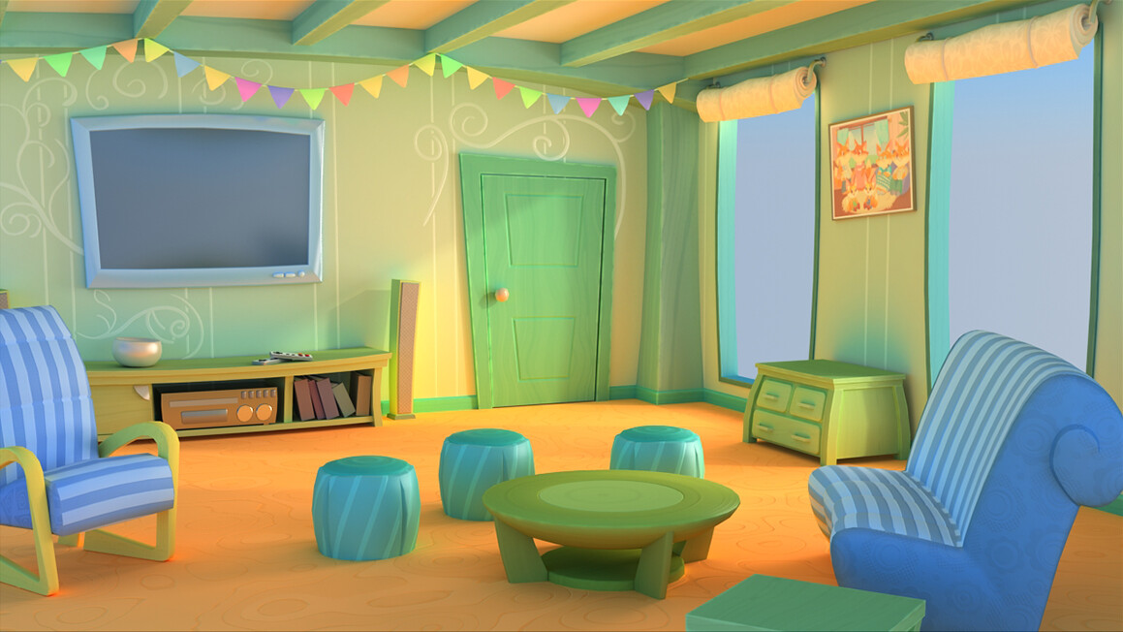
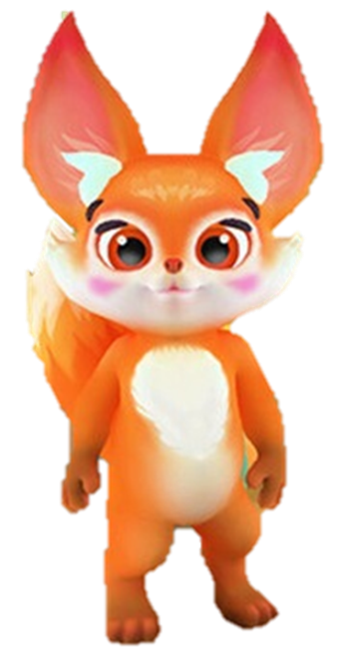
Things for Tet
Hello! Tet is coming. Please help me to choose things for Tet. Thanks

Slide 4

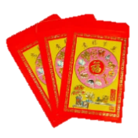






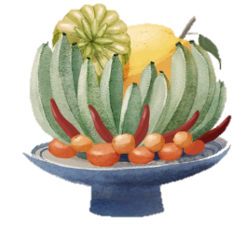
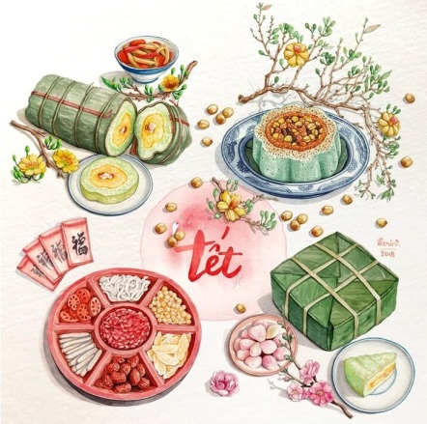

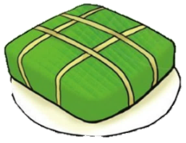

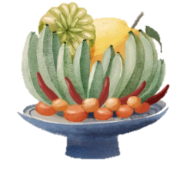
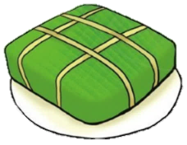
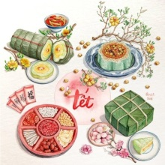
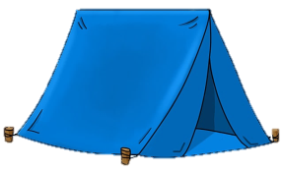
Well done!
Thank you
End

Slide 5


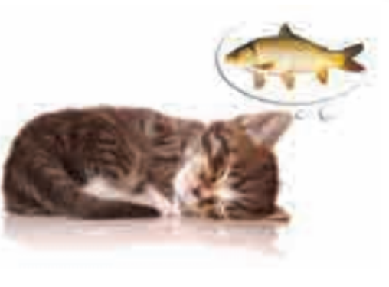

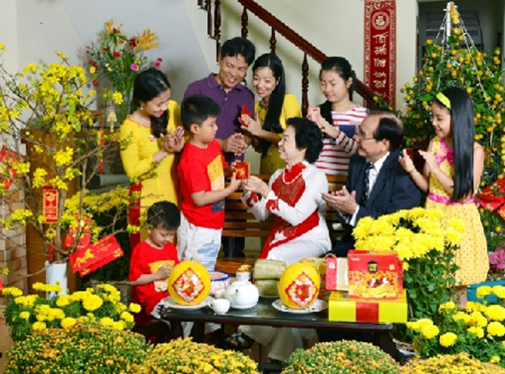
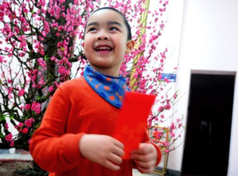
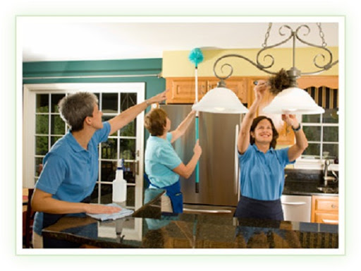
U6 L2
Vocabulary
have fun
có sự vui vẻ
‘visit ‘relatives
thăm họ hàng
watch ‘fireworks
xem pháo hoa
make a wish
làm điều ước
give lucky money
nhận tiền lì xì
clean the ‘furniture
lau chùi đồ đạc

Slide 6
What and Where
make
a wish
watch
fireworks
give
lucky money
have fun
visit relatives:
clean
the furniture

Slide 7
Vocabulary

Slide 8
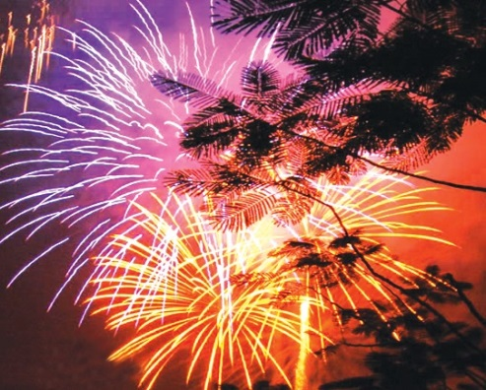
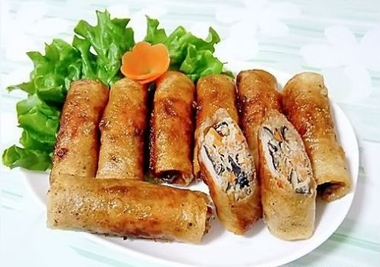
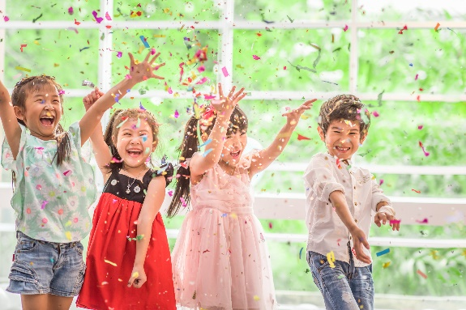
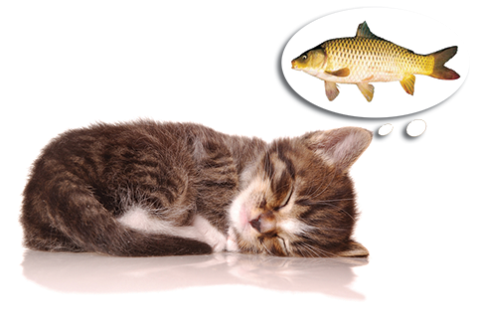
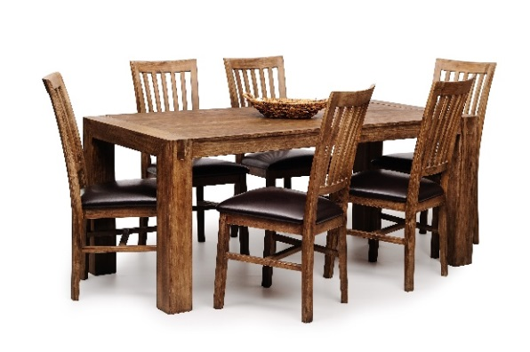
1
Write the words / phrases in the box under the pictures.
wish
fun
fireworks
special food
furniture
1. fireworks
2. special food
3. fun
1.
2.
3.
4. wish
5. furniture
4.
5.

Slide 9
2
Match the verbs with the nouns.
Verbs
Nouns
a. a wish
1. have
f. fun
e. relatives
2. visit
b. fireworks
d. lucky money
3. give
c. the furniture
4. make
d. lucky money
a. a wish
5. clean
e. relatives
c. the furniture
f. fun
6. watch
b. fireworks

Slide 10
3
Complete the sentences with the words in the box.
shopping
celebrate
clean
food
peach
1.
In Viet Nam, we
celebrate Tet in January or February.
Tet in January or February.
At Tet, we decorate our houses with
peach flowers.
2.
flowers.
3.
Children should help their parents to
clean their houses.
their houses.
before Tet.
4.
People do a lot of
shopping before Tet.
5.
My mother usually cooks special
during Tet.
food during Tet.

Slide 11
Pronunciation
/s/ and /ʃ/

Slide 12
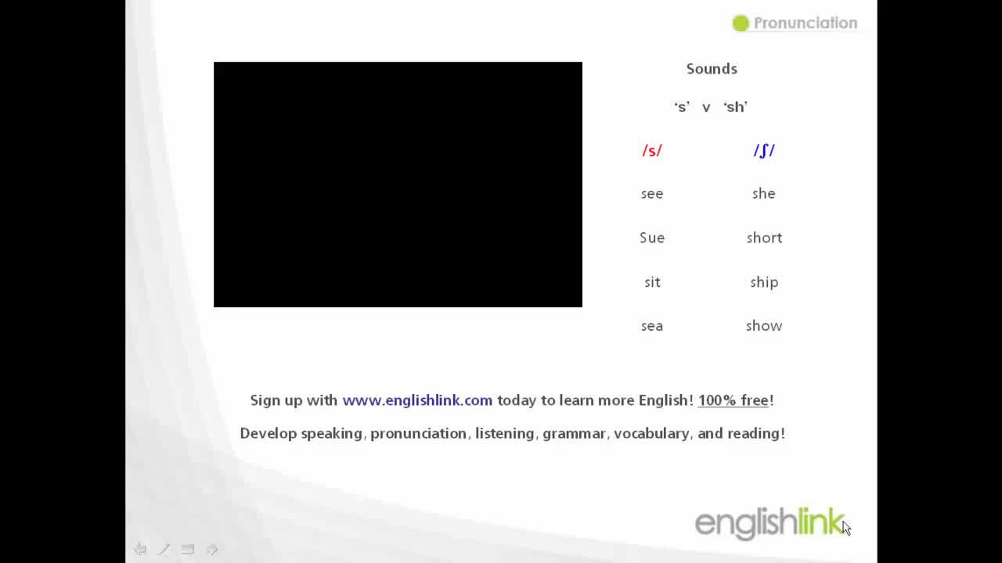

Slide 13

4
Listen and repeat the words.
shopping
special
rice
spring
wish
celebrate

Slide 14
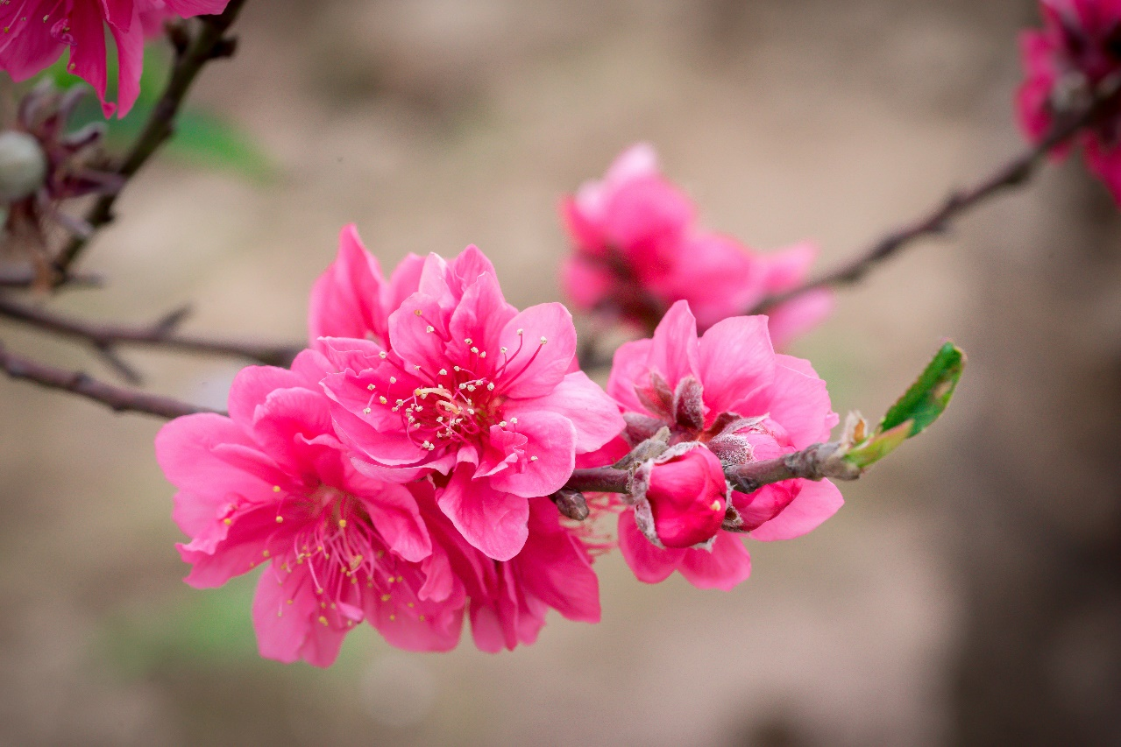
5
Listen and repeat the poem. Pay attention to the sounds /s/ and /ʃ/ in the underlined words.
Spring is coming!
Tet is coming!
She sells peach flowers.
Her cheeks shine.
Her eyes smile.
Her smile is shy.
She sells peach flowers.

Slide 15

Practise saying the following sentences with a focus on the underlined words
1. The policeman showed me the way to the centre.
2. Do you have peach flowers during summer?
3. Children shouldn’t eat too much ice cream.
4. Most countries celebrate the New Year.
5. When Tet comes, everybody makes a wish.

Slide 16

Game: Sentence race
The tongue twister: Seashells
She sells sea shells by the sea shore.
The shells she sells are surely seashells.
So if she sells shells on the seashore.
I'm sure she sells seashore shells.

Slide 17

Homework
  Learn vocabulary by heart.
  Do exercise in your work book
  Prepare the next lesson: A closer look 2

